Slide 1
Teaching on Shift in Emergency Medicine
Module 1: General Principles
Notes:
In this presentation, we hope to provide a brief overview of Medical Education concepts that are applicable to bedside teaching on shift in Emergency Medicine. This is first part of a 5 part series designed to help you be the best clinical teacher on shift possible.

Slide 2
Objectives
Understand the principles of adult learning theory
Create a learning objective utilizing Bloom’s Taxonomy
Describe an example of a learner at each level of the RIME Framework
Notes:
Today, we will briefly be covering several topics that form the foundation for what you need to know about medical education and teaching on shift in Emergency Medicine. Obviously, each of these topics could be a doctorate level training. We are not going to bore you with all of the details. Instead, we are going to provide a high-level overview of the concepts you need to know to be a better teacher on shift.
The learning objective for this presentation are:
Understand the principles of adult learning theory
Create a learning objective utilizing Bloom’s Taxonomy
Describe an example of a learner at each level of the RIME paradigm

Slide 3

Notes:
So why are we even talking about bedside education in the first place? Well, we wanted to highlight the importance of being a good bedside educator.
William Osler once said “To study the phenomena of disease without books is to sail an uncharted sea whilst to study books without patients is not to go to sea at all”
Bedside teaching is viewed by nearly all students as the best way to learn clinical skills; yet, less than half of students feel they have gotten enough in medical education. Unfortunately, training for faculty in how best to incorporate bedside teaching effectively into a busy workflow to maximize learning outcomes is lacking
Thus, bedside teaching has decreased from 75% of the clinical curriculum in the 1960s to less than 10% today
And yet, bedside teaching has still been shown to improve clinical skills and diagnosis.
The goal of this series is to help you improve and hone your bedside teaching skills and provide ways to work bedside teaching into the complex and fast paced emergency medicine practice.
Bandiera G, Lee S, Tiberius R. Creating effective learning in today’s emergency departments: How accomplished teachers get it done. Ann Emerg Med. 2005;45(3):253-261. doi:10.1016/j.annemergmed.2004.08.007
Nair BR, Coughlan JL, Hensley MJ. Student and patient perspectives on bedside teaching. Med Educ. 1997;31(5):341-346. doi:10.1046/J.1365-2923.1997.00673.X
Natesan S, Bailitz J, King A, et al. Clinical Teaching: An Evidence-based Guide to Best Practices from the Council of Emergency Medicine Residency Directors. West J Emerg Med. 2020;21(4):985. doi:10.5811/WESTJEM.2020.4.46060
Peters M, ten Cate O. Bedside teaching in medical education: a literature review. Perspect Med Educ. 2014;3(2):76-88. doi:10.1007/S40037-013-0083-Y
Thurgur L, Bandiera G, Lee S, Tiberius R. What do emergency medicine learners want from their teachers? A multicenter focus group analysis. Acad Emerg Med. 2005;12(9):856-861. doi:10.1197/J.AEM.2005.04.022

Slide 4
Adult Learning Theory
Self-Directed
Self-Motivated
Experienced
Adult Learner Assumptions
Practical
Goal Oriented
Notes:
In order to effectively teach medical student or resident learners at the department, we need some level of understanding of who we are teaching. Adult learning theory provides key assumptions of our learners that can help shape your approach to bedside teaching.
First, adult learners are self directed. They are independent in that they want to make their own decisions and determine their own learning pathway. They need to understand why they are learning something in order to take ownership of it. Creating an environment of cooperation, respect and collaboration will help learners take charge of their own studies. This involves respecting time constraints of the learner and the teaching environment, setting expectations, and allowing learners to define their own goals for each learning experience.
Second, our adult learners come with multiple prior experiences which shape how they learn and the lens they view your teaching from. Learners also expect what they learn to build on their prior experiences. Understanding these experiences will help educators determine the learners specific needs and interests. As educators, maintaining a flexible approach to teaching and being able to employ multiple styles of teaching is beneficial. Teaching to a learners experiences will allow them to be able to more easily engage with the content.
Third, adult learners are goal oriented. Their interest in a topic extends only so far as it will help them in their professional or social roles. In the same breath, learners will disengage from topics they do not feel is relevant. Creating learning objectives based on the learners interest and skills will help keep them on task and involved.
Fourth, adult learners expect teachings to be Practical. There is a need for teachings to have an immediate impact that they can bring to their roles. Utilizing concrete, hands-on experiences will help learners translate teachings into their professional activities.
And fifth, adult learners are self-motivated. Their desire to learn is born from internal stimuli, such as job satisfaction, self-esteem, and personal growth. Additionally, adult learners will respond poorly to ridicule or negative reinforcement. Proper assessment will help to ensure learners stay committed, allowing for continued adjustment and refinement of the teaching methods.
Das K, Malick S, Khan KS. Tips for teaching evidence-based medicine in a clinical setting: lessons from adult learning theory. Part one. J R Soc Med. 2008;101(10):493. doi:10.1258/JRSM.2008.080712
Knowles M. The Adult Learner: A Neglected Species. 3rd ed. Houston: Gulf Publishing; 1984.
Pappas C. The Adult Learning Theory - Andragogy - of Malcolm Knowles. elearning industry. https://elearningindustry.com/the-adult-learning-theory-andragogy-of-malcolm-Knowles. Accessed March 2, 2024.

Slide 5
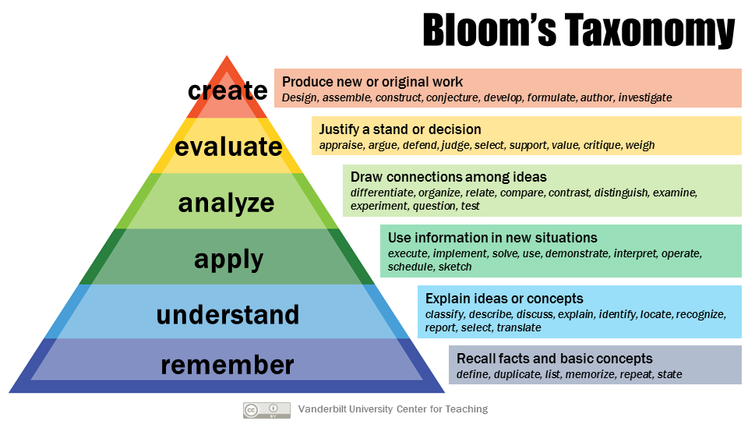
Understanding the Learner
Image by Vanderbilt University Center for Teaching, retrieved from: https://cft.vanderbilt.edu/guides-sub-pages/blooms-taxonomy/ on 1 Dec 2023. Creative Commons License Associated.
Notes:
Adult learning theory helps us to understand the attitudes of our adult learners. Next, we need to be able to identify the skill, knowledge and experience of level of our learners. Our teaching needs to be targeted to each learners abilities while also ensuring that learners are developing on an expected trajectory.
Bloom’s taxonomy is an educational framework that describes the educational goals and outcomes learners must pass through to master a concept. Each subsequent level contains tasks of increasing levels of complexity. The framework utilizes key verbs to describe the increasingly complex knowledge and skills learners should be able to demonstrate with mastery of a level. These verbs can be used both to determine the current understanding level of a learner and help to create learning objectives for your educational interventions
For example, a learner at the level of “understanding” would be able to describe lab tests which should be ordered for the work up of chest pain. A learning objective to advance the learner to the level of “application” could be, “Learner will be able to interpret labs ordered for a chest pain evaluation.”
This is just one way to identify who your learners are. Another commonly utilized taxonomy in emergency medicine education is the RIME framework.
Armstrong P. Bloom’s Taxonomy | Center for Teaching | Vanderbilt University. https://cft.vanderbilt.edu/guides-sub-pages/blooms-taxonomy/. Accessed March 2, 2024.
Bloom B, Engelhart M, Furst E, Hill W, Krathwohl D. Taxonomy of Education Objectives: The Classification of Educational Goals. Handbook I: Cognitive Domain. David McKay Company; 1956.

Slide 6
RIME framework
  REPORTER gathers and report data
R
  INTERPRETER assimilates information from history, exam, diagnostic tests to generate a differential using medical knowledge
I
  MANAGER organizes information and resources to prioritize differential diagnoses and diagnostic and treatment plan using available evidence
M
  EDUCATOR articulates what is known, determines what needs to be known, and conveys medical knowledge and its limitations to the patient and colleagues
E
Notes:
The RIME framework provides terminology for describing the professional growth of trainees. It is one of the most well studied and commonly used framework across the country. Trainees can use it to monitor their own progress and faculty can use it to monitor trainee progress and to provide appropriate feedback. It also provides a universal communication tool that can be used so faculty and evaluators are “speaking the same language”, so to say.
RIME has been shown to be reliable across evaluators and to correlate with clinical performance in several studies in many specialties, including Emergency Medicine.
The progression of student development during the clinical years is probably best conceptualized by the RIME framework. As students grow in knowledge, skills and attitudes, they generally progress through four stages: Reporter, Interpreter, Manager and Educator. Attributes of each level include:
Reporter
Reporters can accurately and reliably gather clinical information on each of their patients. Reporters can communicate clearly (both verbally and in writing) the clinical information they have obtained. Reporters are able to distinguish important information from unimportant information and are able to focus data collection and presentation on central issues. It is expected that all students will function as master Reporters (and be transitioning into beginning Interpreters) by the end of the clerkship.
Interpreter
Interpreters are able to identify problems independently and to prioritize problems, including new problems, as they arise. Interpreters are able to develop a differential diagnosis independently and to make a case for and against each of the important diagnoses under consideration for a patient’s central problem(s). Helping students make the transition from Reporter to Interpreter is one of the focal efforts of the clerkship. All students are expected to show significant progress in this area; students should continue making progress in this stage during the rest of their 3rd year clerkships.
Manager
Managers are able to develop and defend a diagnostic and a therapeutic plan for each of their patients’ central problem(s). Managers are able to utilize their growing clinical judgment to decide when action needs to be taken. Managers can analyze the risk/benefit balance of specific diagnostic and therapeutic measures based on an individual patient’s circumstances. While some students will acquire sufficient knowledge, skills, and confidence to function as Managers for some of their patients in the latter part of the clerkship, not all will make this transition. The transition from Interpreter to Manager is one of the goals of the fourth year Acting Internship.
Educator
Educators have mastered the fundamental skills described above. Educators have the insight to define important questions to research in more depth, the drive to seek out the evidence behind clinical practice, and the skills to scrutinize the quality of this evidence. Educators take a share in educating the rest of the team. The transition from Manager to Educator is usually completed during Internship and Residency.
It is important to stress that the RIME framework is task specific. A learner may function at an interpreter level in one task and as a reporter in another. Use these four levels to describe performance, not people.
RIME Framework | Medicine Clerkship (Inpatient). https://www.med.unc.edu/medclerk/education/grading/rime-framework/. Accessed March 3, 2024.

Slide 7
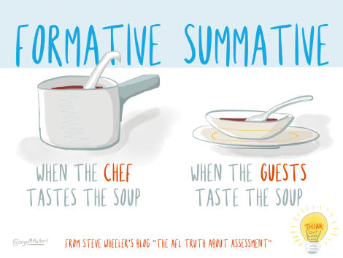
Assessment Basics
This Photo by Unknown Author is licensed under CC BY-SA
Notes:
Once you understand these frameworks the next step is to place your student within them. While assessment is a tool that can be used for grading, it can also be used for the purposes on teaching. In this situation, assessment helps instructors and students define their level of understanding and can help monitor progress towards achieving learning objectives.
Formative assessment is used throughout an instructional period to treat misconceptions, struggles, and learning gaps.
Summative assessments evaluate learning, knowledge, proficiency, or success at the conclusion of an instructional period.
Directors and medical education leaders will develop summative assessment. On shift, we will most often use formative assessment for students.
Formative and Summative Assessment – Center for Excellence in Learning and Teaching. https://www.celt.iastate.edu/instructional-strategies/evaluating-teaching/assessment-overview/. Accessed March 3, 2024.
Pangaro L, Ten Cate O. Frameworks for learner assessment in medicine: AMEE Guide No. 78. Med Teach. 2013;35(6). doi:10.3109/0142159X.2013.788789

Slide 8
Bedside Education Method
Understand the Learner
Feedback
Bedside Instruction
Assessment
Notes:
The final component of bedside teaching is learner feedback. Feedback is what allows students to improve on actionable items.
It should be clear, specific, and timely.
Bloom’s taxonomy and the RIME framework give learners specific direction for growth. Feedback should also follow adult learning theory, focused on learner specific goals and ensuring learner ownership of the feedback.
There are numerous feedback methods and tools available in emergency medicine literature which may be used to guide learner feedback.
Natesan S, Jordan J, Sheng A, et al. Feedback in Medical Education: An Evidence-based Guide to Best Practices from the Council of Residency Directors in Emergency Medicine. West J Emerg Med Integr Emerg Care with Popul Heal. 2023;24(3):479-494. doi:10.5811/WESTJEM.56544

Slide 9
Take Home Points
Remember the five key assumptions made in adult learning theory to better understand your learners
Bloom’s Taxonomy describes six levels of actions or tasks that learners must go through to master a concept
Use the RIME Framework to identify what level your learner is at in the clinical setting
Notes:
Hopefully today you walked away with a better understanding of your learners using adult learning theory, how to create impactful learning objectives using Bloom’s taxonomy, and better understand your learners abilities based on the RIME paradigm

Slide 10

Notes:
The next series of modules will present bedside education techniques that you can add to your teaching repertoire for your upcoming shifts. These are organized by the type of learner you will be educating.
The Novice Learner module will cover students within the Reporter and Interpreter stages.
The Experienced Learner module will cover students within the Manager and Educator Stages.
The General Techniques module can be applied to all learner types
And the Procedures module provides bedside education technique of common emergency medicine procedures
Each module contains a Learning Resource Handout with information that can be quickly referenced on your next shift.
Each module also contains an Activity Handout which will give you examples of how to apply the bedside techniques and ensure your understanding.

Slide 11

Notes:
It is time for our post-curriculum activity. Use the Activity Printout accompaniment for this module to assist with the exercise questions

Slide 12
Question 1
Q1. A learner on shift has shown the ability to take lessons they learned in a previous lecture on unstable arrhythmias by placing a patient with atrial fibrillation with rapid ventricular response on a cardiac monitor and placing defibrillator pads on the patient. What level of Bloom’s Taxonomy is the learner demonstrating?
(Remember, understand, apply, analyze, evaluate, create)
Notes:
I would make sure the presenter notes convey the fact that there is seldom a single simple answer to cses like this. Medical tasks and knowledge are too complex and interconnected for any given situation to be purely an “application” or a “analysis” activity.

Slide 13
Question 1
Q1. A learner on shift has shown the ability to take lessons they learned in a previous lecture on unstable arrhythmias by placing a patient with atrial fibrillation with rapid ventricular response on a cardiac monitor and placing defibrillator pads on the patient. What level of Bloom’s Taxonomy is the learner demonstrating?
(Remember, understand, apply, analyze, evaluate, create)
A1. Apply- Use information in new situations (execute, implement, solve)

Slide 14
Question 2
Q2. A medical student is presenting a 65 year-old male patient with chest pain they interviewed. They tell you the patient has a history of coronary artery disease and is presenting with crushing chest pain, shortness of breath, cough, and nausea. They tell you they are most suspicious for acute coronary syndrome, but are still concerned for pulmonary embolism and aortic dissection. When asked for a diagnostic and treatment plan the student recommends getting an electrocardiogram, complete blood count, and chest X-ray. What level of the RIME pathway is this student demonstrating?
(Reporter, interpreter, manager, educator)

Slide 15
Question 2
Q2. A medical student is presenting a 65-year-old male patient with chest pain they interviewed. They tell you the patient has a history of coronary artery disease and is presenting with crushing chest pain, shortness of breath, cough, and nausea. They tell you they are most suspicious for acute coronary syndrome, but are still concerned for pulmonary embolism and aortic dissection. When asked for a diagnostic and treatment plan the student recommends getting an electrocardiogram, complete blood count, and chest X-ray. What level of the RIME pathway is this student demonstrating?
(Reporter, interpreter, manager, educator)
A2. Interpreter- the student can decipher the patient's clinical history and exam into a coherent, well-organized differential diagnosis. The student still struggles with developing a comprehensive therapeutic plan, thus they have not reached the level of a manager.
Notes:
Again, not a simple correct answeer but the RIME framework gives you a way to analyszee and plan the students learning - and how YOU are going to behave as a teacher.

Slide 16
Question 3
Q3. You are looking to determine if a senior resident has attained the level of an evaluator based on Bloom’s Taxonomy. What verbs could be used to identify if the resident has achieved this level in the hierarchy?
Notes:
Nice question to get people to integrate Bloom and RIME.
Beware the Fundamental Attribution Error, though!

Slide 17
Question 3
Q3. You are looking to determine if a senior resident has attained the level of an evaluator based on Bloom’s Taxonomy. What verbs could be used to identify if the resident has achieved this level in the hierarchy?
A3. Verbs used to justify a stand or decision- appraise, argue, defend, judge, select, support, value, critique, weight

Slide 18
Question 4
Q4. A resident presents a patient with a GI bleed to you. They note the patient has had three days of melanotic stools and lightheadedness. They also mention the patient has been taking NSAIDs for back pain. Their exam is remarkable for tachycardia and epigastric pain and tenderness. They are concerned about a GI bleed due to peptic ulcer disease. They do not believe this is acute coronary syndrome given the lack of chest pain. They want to order a type and screen, a complete blood count, and Tylenol for pain. When asked if they would like to start a proton pump inhibitor and why, the resident said they were not sure. What is the next level of the RIME pathway that you should focus on as the learning objective for this resident?
(Reporter, interpreter, manager, educator)
Notes:
I like the focus on the teacher in this case

Slide 19
Question 4
A4. Educator. The prompt describes a learner at the manager level who can defend a differential and propose a therapeutic plan for the patient’s central problems. The resident is not yet able to define important questions and must still conduct in-depth research and evidence behind best practices.

Slide 20
Question 5
Q5. When preparing for educating adult learners, learning objectives should be aimed towards learners who are experienced, goal-oriented, practical, and what else?

Slide 21
Question 5
Q5. When preparing for educating adult learners, learning objectives should be aimed towards learners who are experienced, goal-oriented, practical, and what else?
A5. Self-motivated and self-directed. Adult learners' desire to learn comes from internal stimuli, such as personal growth and job satisfaction. They are also independent in deciding their learning pathway and prefer ownership of learning objectives.

Slide 22
Questions?
Comments?
Concerns?
Opinions?
Anecdotes?
Monologues?
Diatribes?
Riddles?

