Slide 1

Academy of Administrators in Academic Emergency Medicine
Hot Topics
Wes and Steve
On behalf of the
AAAEM Benchmark Committee
March 18, 2025

Slide 2
CMS’s Age-Friendly Hospital measure
Eliciting Patient Goals
Medication Safety
Frailty & Delirium Prevention
  < 8 hours LOS
  < 3 hours after admission decision
Social Needs Screening
Leadership & Accountability

Slide 3
Geriatric demographics (> 65 years old)
Volume
 | % of ED volume > 65
Min | 11%
25th percentile | 20%
Median | 25%
75th percentile | 30%
Max | 39%
Mean | 25%
Throughput
 | Discharged | Admitted
Average LOS (Academic) | 9.1 (SD 5.7) hours | 14.9 (SD 6.9) hours
Average LOS (Community) | 5.4 (SD 3.1) hours | 8.9 (SD 4.2) hours
Notes:
50 Academic centers and 28 community

Slide 4
Geriatric Accreditation
 | Level 1 | Level 2 | Level 3 | Response rate
Academic | 10 (22%) | 1 (2%) | 2 (4%) | 47 (62%)
Community | 1 (6%) | 1 (6%) | 0 | 17 (57%)

Slide 5
University Medical Education (UME)

Slide 6
University Medical Education (UME)
How academic departments engage with their College/School of Medicine
  EM has multiple unique opportunities
  Medical students are our next EM physicians
  UME offers career path development

Slide 7

Survey Overview
51
Academic Centers
Responded
Program Length Distribution
71%
3-Year
Programs
29%
4-Year
Programs
36 programs
15 programs

Slide 8




UME Demographics
Med School / College Graduates
EM Residency Pursuit Rate
152.5 Median
5.6% Mean Rate
Mean: 142.7 (SD 53.6)
IQR: 120.0 – 176.5
Range: 0 – 253
Mean (SD): 5.6% (2.8%)
Median: 4.3% | Range: 0.8–12.5%
IQR: 2.8% – 9.2%
Home Students in EM Clerkship
Visiting Students in EM Clerkship
51.0 Median
18.5 Median
Mean: 78.5 (SD 69.5)
IQR: 20.0 – 120.0
Range: 1 – 254
Mean: 22.3 (SD 14.8)
IQR: 10.5 – 32.0
Range: 5 – 63

Slide 9
Course Offerings from Dept / Division of EM
3-Year (N=36)
4-Year (N=15)
EM Clerkship Required
65.7%
64.3%
Preclinical Required Course
90.9%
75.0%
Preclinical Elective/Selective
50.0%
66.7%
Required Core Non-EM Clerkship
21.7%
25.0%
Selective/Elective Core Non-EM
39.1%
57.1%
Required Adv. Non-EM Clerkship
18.2%
14.3%
Selective/Elective Adv. Non-EM
34.8%
71.4%
Residency Prep Course/Bootcamp
68.2%
100.0%
Notes:
COURSE OFFERINGS FROM DEPT / DIVISION OF EM – No specific definitions were given for each option
None found to be statistically significant

Slide 10
EM SUBSPECIALTY ELECTIVES OFFERED
3-Year (N=36)
4-Year (N=15)
Ultrasound
88.5%
90.9%
Toxicology
62.5%
50.0%
Research
65.2%
50.0%
Wilderness Medicine
30.4%
63.6%
Pediatric EM
56.5%
55.6%
EMS
52.0%
40.0%
Global Health
34.8%
40.0%
Disaster Medicine
14.3%
18.2%
Hyperbarics
17.4%
0%
Med Ed
13.6%
20.0%
Geriatrics
4.5%
0%
Notes:
EM SUBSPECIALTY ELECTIVES OFFERED

Slide 11
FACULTY W/ FORMAL LEADERSHIP OUTSIDE COURSE CURRICULUM
No
Yes, at least one
Yes, multiple
Dean’s Office
3-Year (N=36)
30.4%
43.5%
26.1%
4-Year (N=15)
36.4%
63.6%
Special Program Leadership
3-Year (N=36)
19.0%
38.1%
42.9%
4-Year (N=15)
36.4%
54.5%
9.1%
Notes:
Dean’s office (Assistant/Associate/Vice-Dean/Dean, etc)
Special program leadership (Assistant/Associate/Director of Simulation, Advising Program, Assessment and Evaluation Office, Innovation, etc.)
Other

Slide 12
FACULTY SUPPORT
College/School of Med
Combination
Health Sys/Hospital
No Funding
Pre-Clinical Course Teaching p = 0.545
3-Year (N=36)
76.2%
19.0%
4-Year (N=15)
62.5%
37.5%
Clinical Teaching / Rotations p = 0.036
3-Year (N=36)
73.9%
21.7%
4-Year (N=15)
33.3%
22.2%
44.4%
Leadership / Curriculum Development p = 0.337
3-Year (N=36)
91.3%
4-Year (N=15)
88.9%
11.1%

Slide 13
FACULTY
# Professors p = 0.002
# Associate Professors p < .001
3-Year
4-Year
3-Year
4-Year
6.0
13.5
11.0
21.5
Median
Median
Median
Median
Mean: 6.4 (4.0)
Range: 1–16
IQR: 3.0–8.5
Mean: 12.8 (7.5)
Range: 4–33
IQR: 7.0–16.0
Mean: 10.9 (5.3)
Range: 3–26
IQR: 7.0–14.0
Mean: 22.6 (7.6)
Range: 11–35
IQR: 19.0–28.0
# Assistant Professors p = 0.347
# Instructors p = 0.275
3-Year
4-Year
3-Year
4-Year
28.0
34.5
1.0
3.0
Median
Median
Median
Median
Mean: 33.2 (19.6)
Range: 9–76
IQR: 17.0–47.0
Mean: 39.0 (22.4)
Range: 14–104
IQR: 26.0–44.0
Mean: 3.6 (6.3)
Range: 0–30
IQR: 0–6.0
Mean: 8.1 (12.7)
Range: 0–45
IQR: 0–16.0

Slide 14
FACULTY (% of Total)
% Professors p = 0.370
% Associate Professors p = 0.036
3-Year
4-Year
3-Year
4-Year
12%
13%
18%
23%
Median
Median
Median
Median
Mean: 14% (SD 16%)
Range: 1–100%
IQR: 6–17%
Mean: 14% (SD 6%)
Range: 6–26%
IQR: 10–16%
Mean: 20% (SD 10%)
Range: 6–41%
IQR: 13–26%
Mean: 26% (SD 6%)
Range: 17–38%
IQR: 21–31%
% Assistant Professors p = 0.021
% Instructors p = 0.426
3-Year
4-Year
3-Year
4-Year
55%
41%
2%
3%
Median
Median
Median
Median
Mean: 54% (SD 15%)
Range: 26–89%
IQR: 43–62%
Mean: 42% (SD 12%)
Range: 19–63%
IQR: 32–49%
Mean: 6% (SD 10%)
Range: 0–45%
IQR: 0–9%
Mean: 8% (SD 12%)
Range: 0–41%
IQR: 0–17%

Slide 15



TRAINING
3-Year
4-Year
ACGME Fellows
N: 31 (3-yr) | 14 (4-yr)
2.00
2.50
3-Yr Median
4-Yr Median
Non-ACGME Fellows
N: 33 (3-yr) | 13 (4-yr)
2.00
5.00
3-Yr Median
4-Yr Median
Residents Per Year
N: 36 (3-yr) | 14 (4-yr)
12.00
15.00
3-Yr Median
4-Yr Median

Slide 16
RESIDENT EXPERIENCES

Slide 17
Post-residency job activities
3-Year
4-Year
Internal Fellowship
2.5 (1.00, 3.00)
2.0 (1.00, 2.00)
External Fellowship
1.0 (1.00, 3.00)
4.0 (2.00, 4.00)
Internal Academic
Non-Fellowship
0.0 (0.00, 0.00)
1.0 (0.00, 3.00)
External Academic
Non-Fellowship
0.0 (0.00, 2.00)
1.0 (0.00, 2.00)
Internal Community
0.0 (0.00, 1.00)
0.0 (0.00, 1.00)
External Community
6.0 (3.00, 8.00)
5.5 (2.50, 6.50)
Values shown: Median (IQR)

Slide 18
Academic Emergency Medicine
Tripartite Mission
Research
Teaching
Patient Care

Slide 19


Research – Where have we been
Emergency Medicine Grant Activity FY 25
  Institutions reporting Active Grants: 37
  Institutions reporting Active NIH Grants: 34
Notes:
Number of institutions have trend in decline over five years from 55 to 49 to 42 to 48 to 45 to 40 to 39 to 38 to 37
NIH decline follows similar 44 to 43 to 37 to 41 to 37 then reduced to the 34 for the past two years

Slide 20
Submissions and Awards
Reported Grant Submissions and Awards
 | FY16 | FY17 | FY18 | FY19 | FY20 | FY21 | FY22 | FY23 | FY24 | FY25
Number Submitted | 1,026 | 915 | 782 | 938 | 1,158 | 892 | 758 | 861 | 1,015 | 1,113
Awarded from Submissions | 507 | 373 | 334 | 350 | 356 | 283 | 296 | 248 | 259 | 363
Conversion Rate | 49.4% | 40.7% | 47.6% | 37.4% | 44.3% | 38.4% | 39.1% | 37.9% | 39.1% | 39.58
Awarded from submissions is a calculation based upon a subset of institutions that reported conversion rate and
number of the grants submitted.
Notes:
Awarded from submissions is calculation based on submitted grants and the conversion rate for those that reported conversions

Slide 21
Grant Spending
Notes:
NIH of $119M is about 73% of the blue ridge total of $159M in awards for 2025

Slide 22
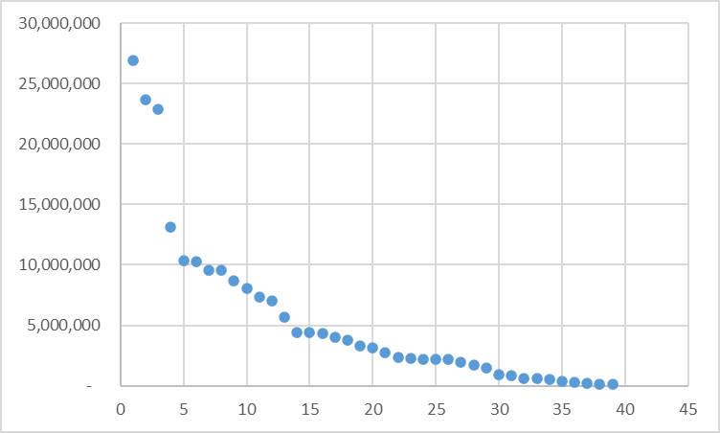
Total spending by institution 2025
Total Grant Spending
Reporting Institutions
Notes:
Continued trend upwards of spending

Slide 23
What are our trends on NIH funding?
Notes:
Correlation between the number of grants submitted and the total spending. Could be more spending leads to submitting more grants or submitting more grants leads to more research spending.
Number of submissions going up – increase from 4 to 6 to 7 instutitutions with >40 grants submitted.

Slide 24
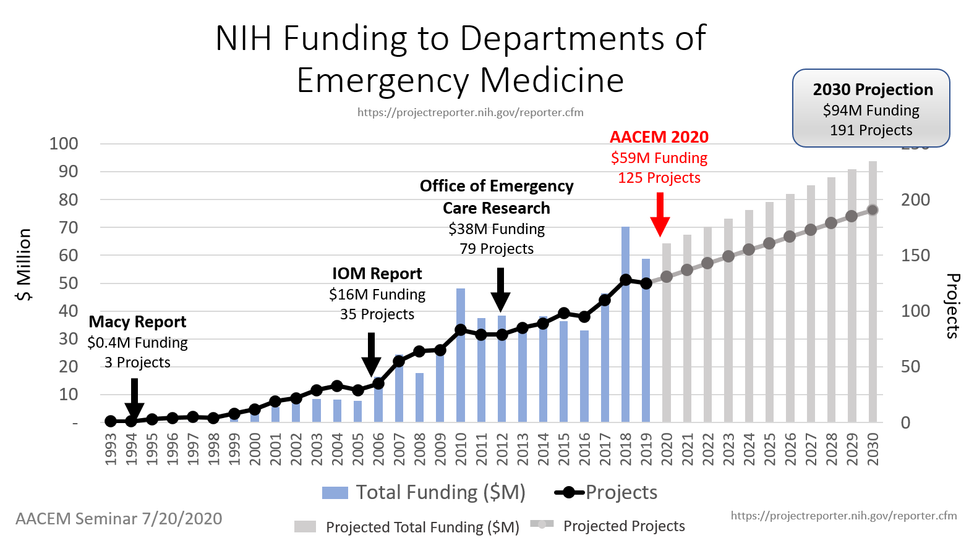
What is going well? Growth in dept, PI and $’s
2030 goal = $100M in NIH funding
2030 goal = 200 NIH Grants
2030 goal = 150 NIH Funded PI’s
2030 goal = 50 departments with NIH funded PI’s

Slide 25
Establishing an Emergency Medicine Investigator Pipeline
AACEM Virtual Seminar
July 20, 2020
Robert W. Neumar, MD, PhD
Professor and Chair,
Dept. of Emerg. Med.
University of Michigan
Roger J. Lewis, MD, PhD
Professor
Dept of Emerg. Med.
Harbor-UCLA Medical Center

Slide 26
NIH Funded Departments by Specialty
http://www.brimr.org/NIH_Awards/NIH_Awards.htm
Achieving 2030 target of 46 departments with a NIH-funded PI
Departments with NIH-Funded PI
Annual Department Funding (Median)
AACEM Seminar 7/20/2020
Note: We are now at 42 departments and were at 47 last year

Slide 27
Percentage of Full Time Medical School Faculty that are NIH PIs
http://www.brimr.org/NIH_Awards/NIH_Awards.htm
https://www.aamc.org
Achieving 2030 target of 156 PIs would increase percentage from 1.9% to 3.0%
AACEM Seminar 7/20/2020
Note: We are now at 2.2% and 168 investigators

Slide 28
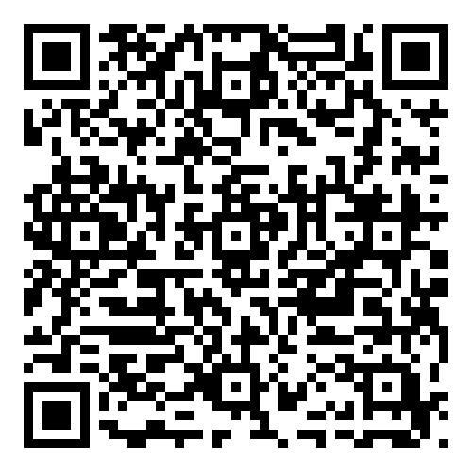
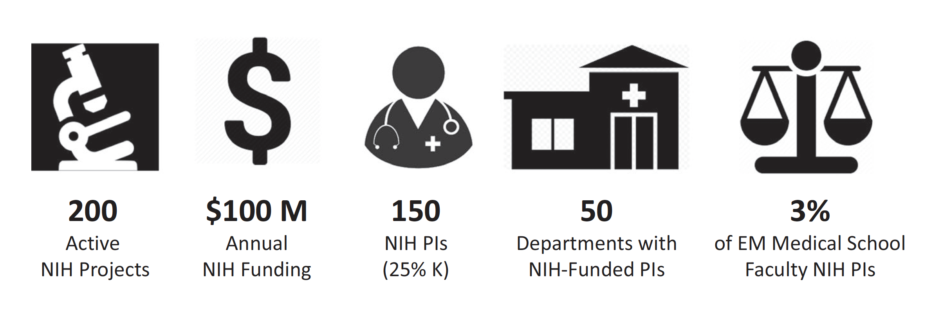
2030 Strategic Goals
2020 149 $92M 99 36 1.7%
2025 219 $163M 168 42 2.2%
Neumar et al, Academic Emerg Med, 2021

Slide 29
Shall we celebrate?
Submissions are increasing
Five year trend of increasing:
Awards, Sites and PI’s
There has been a flattening this year
We have a strong infrastructure
To support continued growth in EM

Slide 30
Thank You!
Questions?

