Slide 1

Academy of Administrators in Academic Emergency Medicine
Salary and Productivity Survey
Fiscal Year 2025
Deb Diercks, MD, Alyssa Starcher, MTDA
On behalf of the
AAAEM Benchmark Committee
March 17, 2025

Slide 2
No APP Survey this Year

Slide 3
Fellowships

Slide 4
Stats
256 Fellows
66% come from 3 Year Programs
64% Non-ACGME Programs
Popular Fellowships:
  Ultrasound – 15%
  Education/Education Scholarship – 12%
  EMS – 12%

Slide 5
Types of Fellowships and Trends
Global EM fellows increased from 2023
Administration fellows decreased from 2023
Other Fellowships: PEM, Critical Care and EM, Disaster Medicine, Medical Toxicology, Sports Medicine, Undersea and Hyperbaric Medicine, Faculty Development, Geriatric EM, Research, Simulation, Transport Medicine, Wilderness Medicine

Slide 6
Department Investment
Of the whole cohort 65% utilize the PGY scale
 | Average Base Compensation | Average Total Compensation
ACGME Fellows | $ 82,850.61 | $ 122,199.93
Non-ACGME Fellows | $ 95,757.90 | $ 118,776.86
 | Average Base Hours | Average Extra Hours Worked
ACGME Fellows | 718.48 | 266.79
Non-ACGME Fellows | 790.32 | 159.75
Notes:
PGY scale varies across the country. A PGY1 in NYC will make more than a PGY3/4 in a lower cost of living state which is why the pay band is so big
Do regional comparison
5.29 RVUs/Hour

Slide 7
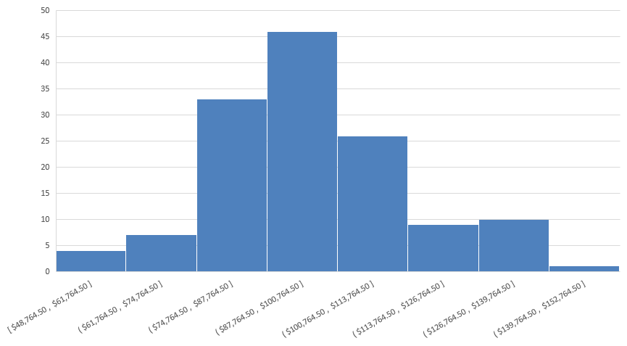
Non-ACGME Fellowship Pay

Slide 8
Base Compensation by Region

Slide 9
Degree Investment from Department
17% of fellowships require a degree
  Average $31,305.42 investment for degree
  For required degrees, 73% of departments pay for the whole thing
17% of fellowships have optional degrees
  Average $19,351.73 investment
Required fellowships include admin, education, global EM, research, and simulation

Slide 10

Faculty Salary

Slide 11
Faculty Demographics
2025 Salary Survey Demographics
 | FY 21 | FY 22 | FY 23 | FY 24 | FY 25
# Faculty | 2560 | 2454 | 2677 | 2383 | 2501
Experience
Years at Current EM | 8.5 | 8.9 | 8.9 | 9.3 | 9.3
Years post Residency | 10.8 | 11.0 | 10.9 | 11.2 | 11.1
Degree
MD/Master/PhD | 95% | 95% | 94% | 93% | 93%
DO | 5% | 5% | 6% | 7% | 7%

Slide 12
Faculty Demographics
Years as EM Faculty
53.37% < 10 years
31.22% = 10 to 20 years
15.41% > 20 years

Slide 13
Faculty Demographics
Faculty Rank
In EM: 6.45
In EM: 7.3
In EM: 22.8
In EM: 14.0

Slide 14
Faculty Demographics

Slide 15
Faculty Demographics

Slide 16
Faculty Demographics

Slide 17
Clinical Hours: Rank & Site
What is the hours worked for a pure 1.0 FTE, no buydown, accounting for vacation?
1435
Do you require a minimum number
of clinical hours?
81% = Yes
Median = 384
Do shifts recognize sign in & out?
42% = Yes
Assumed work week hours for 1.0?
40 hours

Slide 18
Salary Trends: No Chair & Chief
Mean Total Salary = $347,854.31
Mean Total Salary All Faculty = $352,443
Chairs and Chiefs and Pure Pediatrics excluded from graph

Slide 19
Salary Trends
Mean Total Salary = $347,854
Mean Base Salary = $285,708
2025 Base = 84% of total
Chairs and Chiefs and Pure Pediatrics excluded

Slide 20
Total Salary by Rank
Chairs, Chiefs, pure Peds EM excluded

Slide 21
Salary Trends
First Year Faculty
Mean Total Salary = $319,449 (+3.0%)

Slide 22
FTE Breakdown by Rank
 | FY24 | FY25 | Delta | Percent < 1.0
Instructor | 0.93 | 0.93 | 0.00 | 28%
Assistant Professor | 0.95 | 0.95 | 0.00 | 18%
Associate Professor | 0.95 | 0.95 | 0.00 | 19%
Professor | 0.96 | 0.95 | (0.01) | 15%
20% of faculty have an FTE < 1.0 in FY25

Slide 23
Salary Trends: Regions
Notes:
12.5% difference between northeast and west

Slide 24
Buydown/Protected Time Buckets
Hours
Dollars
Percent of Time
Shifts

Slide 25
Benchmark Data and Buydown
Can think of benchmark data in two ways:
  Hours worked by position
  Hours bought down by position
  Which one you use depends on what you want to get out of the data

Slide 26
Averages for Conversation
Average Hours for a 1.0 FTE with no buydown is 1435
Average Base: $285,708
Average Fringe Rate: 24.8%
Average Department Investment: $356,563.58
Average Hourly Expense: $248.48 ($356,563.58/1435)
Notes:
Maybe try to show visualization of ranges

Slide 27
Medical Director Buydown
Average Base Hours Worked for Year: 878 Hours (~73 hours per month)
Average Buydown: 535 hours
  Converting to Dollars: $132,936.80
  Converting to Percent Buydown: 37%

Slide 28
Gender Differences
 | Female | Male
FTE | 0.93 | 0.96
Base Salary | $276,748 | $291,744
Total Salary | $331,462 | $358,729
Adjusted 1.0 Base Salary | $296,772 | $302,715
Adjusted 1.0 Total Salary | $356,529 | $375,621
Adjusted 1.0 Bonus | $35,832 | $37,667
RVUs/Hour | 5.25 | 5.35
Base Hours | 954 | 975
Adjusted 1.0 Base Hours | 1046 | 1026
cFTE (1435 hours) | 0.68 | 0.70
Bold indicates significance

Slide 29
Gender and Leadership
38% of females in some form of leadership position
62% of males in some form of leadership position

Slide 30
Leadership Roles N > 25 & Grouped
Role | N | Percent Female | Percent Male
Clinical Operations Director | 94 | 34% | 66%
Clinical Operations Director – Associate | 25 | 40% | 60%
Clinical Operations Director – Assistant | 36 | 44% | 54%
Residency Director | 41 | 41% | 59%
Residency Director – Associate | 53 | 49% | 51%
Residency Director – Assistant | 61 | 48% | 52%
EMS Director | 37 | 27% | 73%
EMS Director – Assistant | 26 | 46% | 54%
Division Director | 35 | 40% | 60%
Other Medical Center Leadership Outside of Dept | 33 | 33% | 67%
Non-ACGME Fellowship Director | 29 | 45% | 55%
Quality/Patient Safety/Risk Director | 29 | 41% | 59%
Vice Chair of Education | 27 | 41% | 59%

Slide 31
Vice Chair Roles
Role | N | Percent Female | Percent Male
Vice Chair of Clinical Operations | 24 | 21% | 79%
Vice Chair/Director of Diversity | 8 | 63% | 37%
Vice Chair of Education | 27 | 41% | 59%
Vice Chair of Faculty Affairs | 14 | 64% | 36%
Vice Chair of Quality | 6 | 50% | 50%
Vice Chair of Research | 23 | 17% | 83%
Vice Chair – Other | 17 | 35% | 65%

Slide 32
Compensation Plans

Slide 33

How do we pay our faculty?
Faculty Compensation Plans
Single component: 4.5%
Salary only
Three component: 15.9%
Base + Extra + Stipend
Base + Extra + Bonus
Base + Stipend + Bonus
Two component: 6.8%
Base + Extra hours
Base + Stipend
Base + Bonus
Four component: 72.7%
Base + Extra+ Stipend + Bonus
Notes:
Part of this is self selection. We are only basing this off the information they provide for us.
Four component plans doesn’t mean that everyone achieved four components but that they can potentially achieve four components

Slide 34
Salary Components
100%
Base
87%
Base
83%
Base
74%
Base
Chairs, Chiefs, pure Peds EM faculty excluded

Slide 35
Salary Components
Notes:
Benefit rate is now 25.43%, and the 88k is calculated on total salary

Slide 36
Faculty Productivity

Slide 37
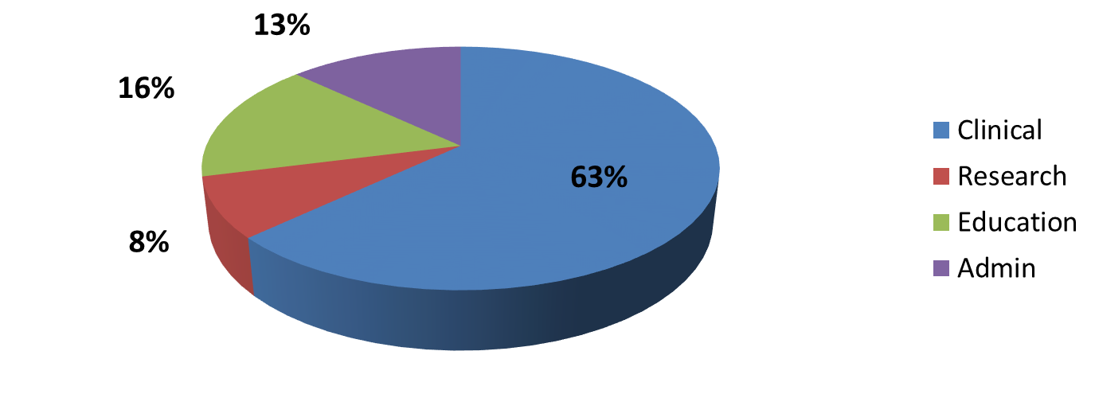
Faculty Effort
Percent Faculty Effort: Multiple Missions
Increasing clinical effort
FY 2015
FY 2025
Academic Centers

Slide 38


Faculty Benchmarks
RVU Productivity
  Per hour
  Total
Publications
  First vs any author
External Funding
  What percentage of your effort is externally funded research grants and research contracts including all sponsors (federal, non-federal, foundations and industry) and subcontracts from other institutions?
Notes:
2016 =160356 total median COLLECTION $44.44, PER MD HOUR 6.54; PER PATIENT BILLED 2.88; RVU PER CLINICAL fte 10613
2017= 173902 total median; Collection $45.76; PER MD HOUR 6.73; PER PATIENT BILL 2.86, PER FTE 10127
Work RVU per MD hour up slightly from last yeas as is collection per RVU.
RVU collection range 93.63-9.92
25th percentile = 39.08
75th percentile 51.77

Slide 39
Faculty Benchmarks NEED
Clinical Productivity
 | Mean | Median
Annual Physician Hrs | 34,098 | 29,555
Patients per Hour Staffed | 2.3 | 2.2
Patients per Hour Billed | 2.2 | 2.1
WRVU/CFTE | 9,304 | 9,318
WRVU per MD Hour | 6.3 | 6.1
Note: CFTE based upon the FTE reported as clinically based FTE
Notes:
Annual physician hours went up – add in non-calculated, actual number
wRVU/cFTE went down
RVUs/hour went down

Slide 40
Mean and Median RVUs/Hour

Slide 41


Faculty Benchmarks Primary Academic
Authorship
  545 faculty reported having a publication this year (32%)
    17% First Author
    23% Senior Author
    66% Other Authorship position
External Funding
  13% of faculty reported having “external funding”
  Of those reporting:
    24% of effort is supported
    Range: 1 to 90%
Notes:
Support effort went up from 22% to 24%, authorship went up (26 to 32%) positions stayed a little flat/senior decreased while other increased

Slide 42
Thanks
Let’s talk…

