Slide 1
The Power Pivot:
Thriving Amid Leadership Changes
AAAEM/AACEM Retreat | March 2026
Greg Archual, Katy Oksuita & Cali Myers
Notes:
Welcome, everyone. Today’s session, The Power Pivot: Thriving Amid Leadership Changes, focuses on how experienced department administrators successfully navigate—and even thrive—during transitions in senior leadership such as Chairs, Deans, and CEOs.

Slide 2

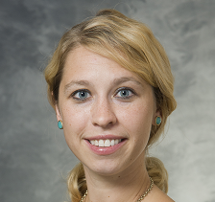
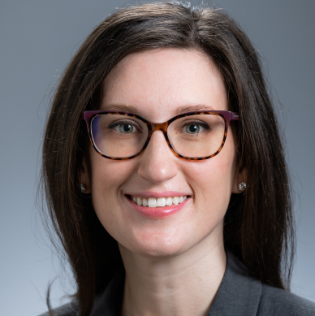
Meet the Panel
Greg Archual, MBA
The Ohio State University
Katy Oksuita, MBA, MS
University of Wisconsin-Madison
Cali Myers, MHA
University of Alabama at Birmingham
Notes:
The three of us are administrators who have each been through significant organizational pivots and are here to share practical examples and lessons learned. Would each of you mind introducing yourself and giving a brief overview of your background?

Slide 3
When a new leader arrives, administrators often have to quickly understand their priorities. How did you assess your new leader’s goals early on, and what strategies helped you align your department with their vision?

Slide 4
Leadership changes can create anxiety among faculty and staff. What communication approaches helped you maintain stability and morale within your department during the change?

Slide 5
Administrators often find themselves honoring the legacy of an outgoing leader while adapting to the expectations of an incoming one. How have you balanced continuity with necessary change?

Slide 6
Relationships matter more than ever during transitions. How has relationship building—within your department and across the institution—helped you navigate leadership changes?

Slide 7
What tools, resources, or practices—such as dashboards, meeting structures, documentation strategies, or cultural assessments—helped your team create continuity during these changes?

Slide 8
If you could offer one piece of advice to an administrator preparing for an upcoming senior leadership transition, what would it be—and why?

Slide 9
Thank you!
Notes:
Thank you all for sharing your insights and experiences. Leadership transitions can be challenging, but as we’ve heard today, they can also open doors for growth, innovation, and stronger departmental culture.
We hope today’s discussion gives everyone here new strategies, perspectives, and confidence to navigate their next pivot.

Slide 10
Sometimes new leaders are unfamiliar with the structure, culture, or demands of academic emergency medicine. What steps have you taken to effectively educate and influence senior leaders who were new to the environment?

Slide 11
Think back to the first major leadership transition you experienced—whether it was a Chair, Dean, CEO, or other significant leader. What was the most unexpected challenge that arose during that transition?

Slide 12
Transitions can bring surprises, but sometimes we see early warning signs. What signals have told you a leadership change might disrupt operations, and how do you prepare for that proactively?

Slide 13
Many of us have experienced initiatives that suddenly shift when leadership changes. Can you share an example of a process or workflow that had to pivot quickly—and how you steered that shift successfully?

