Slide 1
Career Development in the era of a Transactional Generation
AACEM Leadership Development Working Group
Facilitated by Chris Fox & Stephen Wolf

Slide 2
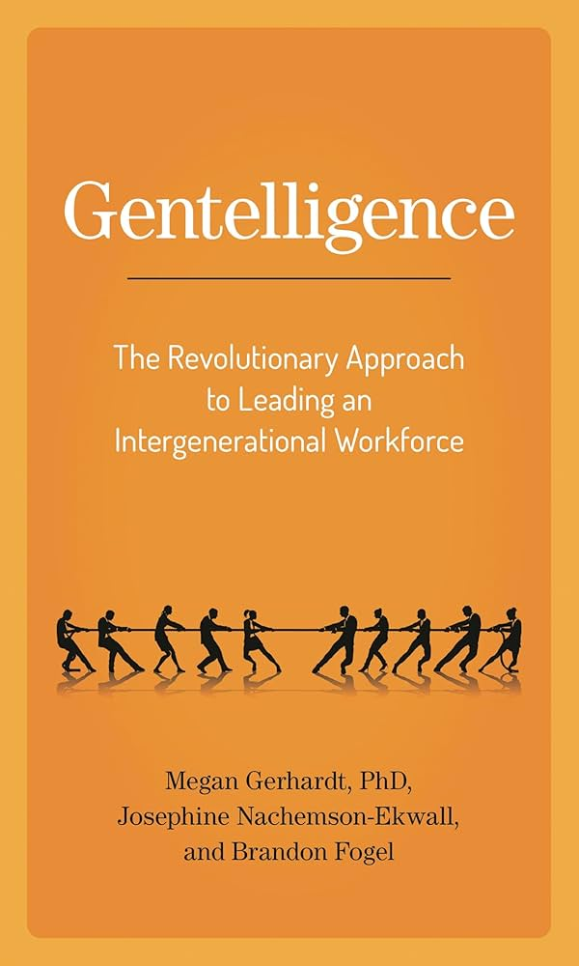
Gentelligence Review
Key Principles
Avoid stereotypes
Focus on context
Practice reciprocal learning
Build culture based on shared purpose
Think about how you can adapt, not just expect adaptation
Notes:
Key principles of Gentelligence
1. Avoid stereotypes about generations
Labels like Boomers, Gen X, Millennials, Gen Z can oversimplify behavior and create bias.
2. Focus on context, not age alone
Differences often come from career stage, economic conditions, training environment, or institutional culture — not just generation.
3. Practice reciprocal mentoring
Learning should go both directions:
Senior → experience, judgment, institutional knowledge
Junior → technology, new norms, new expectations
4. Build cultures based on shared purpose, not shared age
Strong organizations define:
what is non-negotiable
what is flexible
what must be earned
what must be supported
5. Leadership must adapt, not just expect adaptation
Modern faculty often expect:
transparency
explicit expectations
negotiated roles
clear return on effort
Ignoring this creates disengagement.

Slide 3
Tabletop Cases - Guidelines
One facilitator per table (LDWG member)
Read the case aloud at your table
Choose one person to report out (preferably not the facilitator)
Discuss the dilemma and potential responses
Focus on practical, solution-oriented approaches
Consider the discussion questions (if helpful)
Be prepared to share key insights with the group

Slide 4
Case Debriefs
Case 1 – I Need Buy Down
  A junior faculty member requests protected time before demonstrating initiative, raising questions about expectations, support, and accountability.
Case 2 – The Portfolio Career
  A successful faculty member prioritizes personal career opportunities over departmental roles, challenging norms around loyalty, flexibility, and fairness.
Case 3 – Beyond the Individual
  A faculty member declines committee work without compensation, testing expectations for academic citizenship and shared responsibility.
Case 4 – High Potential, Low Alignment
  A high-performing faculty member pursues individual opportunities outside departmental priorities, forcing leadership to balance retention with strategic alignment.

Slide 5
Take Aways
Create pathways for engagement before allocating scarce protected time
Support career flexibility while preserving departmental mission
Build a sense of shared vision, mission and purpose beyond clinical work.
Clarify expectations such that individual opportunity align with departmental priorities

Slide 6
Thank You

