Slide 1
Committing to Research as Foundational in Academic Emergency Medicine
AACEM Retreat
March 17, 2026

Slide 2
Outline
Pipeline Programs
  SAEM Foundation Research Scholars Program
    Medical students only
  National Foundation of Emergency Medicine early career faculty development program
    Faculty within five years of faculty position
  K12 NeuroEM Scholars Program
    Faculty in first two years of faculty position
The Virtuous Cycle of Academic Medicine
  Investing in research

Slide 3
SAEM Foundation Research Scholars Program
A great new opportunity for medical students to dedicate a year to emergency medicine research
Students work with established EM researchers
Comprehensive support structure:
• SAEM Foundation: Administrative support and oversight
• AACEM Research Committee: Program sponsorship
• Advisory Council: Mentorship and guidance
Building the research leaders of tomorrow

Slide 4
SAEM Research Scholars Launch Timeline
March 2026
• Program announcement to AACEM
• Advisory Council formation begins
April 2026
• SAEM Foundation Board approval of Advisory Council
• Marketing materials development
May 2026 – SAEM Annual Meeting
• Major program launch at SAEM Conference
• Special focus at RAMS (Residents and Medical Students)
• Applications open
Goal: Create significant visibility and excitement among medical students and residents
Your Role: Help us identify exceptional students and promote this opportunity

Slide 5
NFEM Scholar Program
2026–2028 Cohort
Award Summary
Scholar Eligibility
• $50,000/year for 2 years
(total $100,000)
• 20% protected research time
(clinical reduction)
• Up to 3 awards per cohort
• July 1, 2026 – June 30, 2028
• Junior faculty within 5 years of
appointment/terminal training
• Preference for EM physicians
• No current K award or NIH grant
as PI
• Demonstrated likelihood of
securing non-institutional funding
Application Due: April 10, 2026 | Decisions: May 18-21, 2026 (SAEM)

Slide 6
NFEM Scholar Program Requirements
Institutional Commitments
Program Expectations
• Chair-signed commitment to 20%
protected time
• Signed Mentor/Mentor Team
commitment
• Strong research infrastructure
• Individualized development plan
• Periodic webinars and meetings
• 2 abstracts + 1 manuscript/year
• Attend NFEM Annual Meetings
• Present capstone at conclusion
Application Components
• Narrative (3-5 pages): Alignment with NFEM, research infrastructure, benefit to institution/Scholar, match commitment
• Mentor information (up to 2 pages): Track record, mentorship plan, milestones
• Scholar information (up to 2 pages): Goals, EM relevance, aims/approach, training plan
• Evidence of program strength: EM faculty grants and publications (past 5 years)
Submit to: Gentry Wilkerson, MD | GWilkerson@som.umaryland.edu

Slide 8
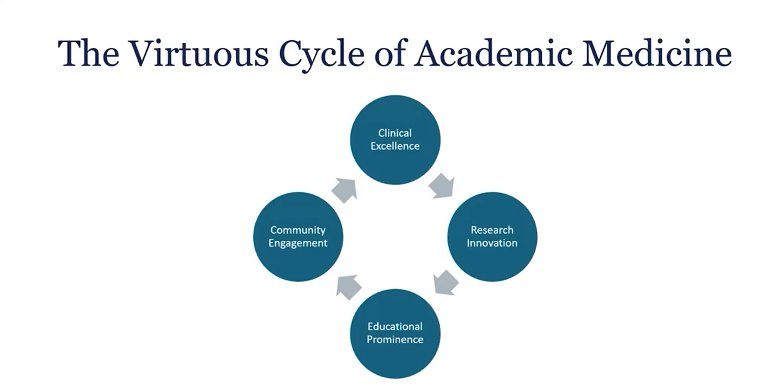
“…challenges have catalyzed a remolding of the academic health center (AHC) from an ivory tower to a complex business enterprise that captures the power of a virtuous cycle, whereby clinical revenue and academic performance support each other by being strategically and tactically aligned. The “virtue” is that each makes the other better.”
https://www.youtube.com/watch?v=YagvamSJrYk
Wartman, SA. Academic Medicine. 2008

Slide 9
Charge of AACEM Research Committee
Objective: Facilitate implementation of proposed action items assigned to department chairs from the 2024 Consensus Conference on creating a Sustainable Emergency Medicine Investigator Pathway.
Key Components:
  Mentorship Programs: Develop structured mentorship initiatives for emerging investigators
  Funding & Resource Allocation: Secure and allocate resources for research activities
  Collaborative Research Initiatives: Promote multi-institutional, multi-departmental collaborative research efforts
  Career Development: Provide comprehensive training and career development opportunities
  Institutional Support: Enhance institutional support and infrastructure to sustain investigator pathways

Slide 10
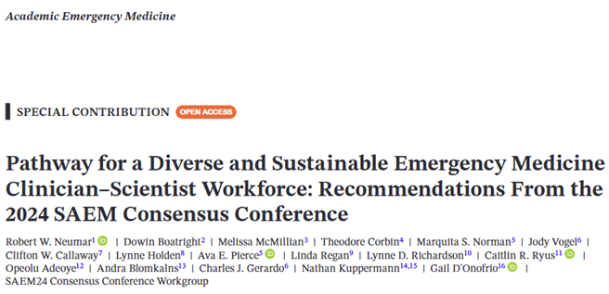
Academic Emergency Medicine, 2025; 32:1122–1137

Slide 11
AACEM Overview
163 total institutions
About 90 complete annual benchmark surveys
  Only ~40 of complete the research questions
18 responses to our research survey

Slide 12
Annual Survey

Slide 13
Annual Survey

Slide 14
Research Committee Survey (N=18)
Question | Median & Interquartile Range | Minimum - Maximum
What were the total expenses for your academic sites during the most recent fiscal year? | Median: $47,796,500 IQR: $27,885,838 - $64,875,992 | $16,000,000 - $90,512,784
What were the total research expenses for your academic sites during the most recent fiscal year? | Median: $4,626,384 IQR: $1,913,430 - $5,894,941 | $745,000 - $29,725,730
What were the total extramurally funded research expenses for your academic sites during the most recent fiscal year? | Median: $3,128,500 IQR: $1,565,575 - $6,819,857 | $0 - $25,248,096
Investment in Research | Median: $1,497,844 ~3% of median total expenses ~32% of median research expenses
Research Expenses as % of Total Expenses – Median: 9.1%, IQR: 6.8% - 15.3%

Slide 15
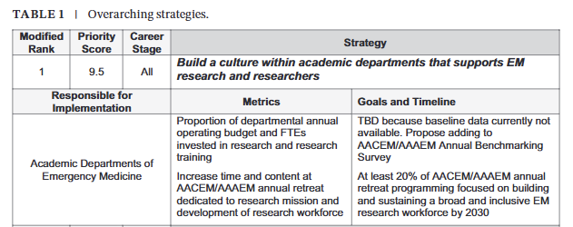
Discussion
How do you decide how much/what percentage of operating budget to spend on research infrastructure?
What does success/ROI look like for your investment in research? (e.g. successful funding (list categories), publications, presentations)
What is the minimum an academic department should invest in research?

