Slide 1
Benchmark Analytics:
Introducing the Administrative Staff Survey
Staff Survey Committee Members
March 17, 2026

Slide 2

Staff Survey Committee
Committee leads:
Sara Engel, MBA, CAEMA
Alyssa (Tyransky) Starcher, MTDA
Committee members presenting today:
Benton Baker, MBA
Bonnie Lemelin, MBA
Becky McGown, MBA
Jennifer Muir, EdD, MBA
John R. Rottenborn, MBA
Tanner Vincent, MHSA
Other Contributors and Committee members:
David Christensen, MBA
Frank Jurkiewicz, MBA
Adrian Lopez Rangel, M.B.A., C.SA.F.
Sahana Pathanjeli

Slide 3
Disclosures
Alyssa Starcher is the AAAEM Benchmark Survey Data Manager, a paid position
No financial or other disclosures

Slide 4
Agenda
Introduction and background of Survey
High-level findings
Centralization across domains
5 learnings across domains
Administrative Assistants
Clinical Operations
Education
Research
Finance

Slide 5
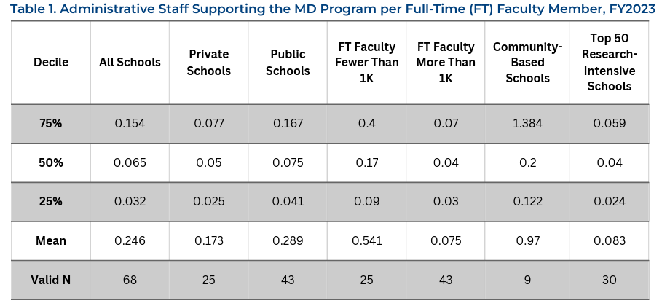
Why This Survey?
According to the AAMC, mean Admin staff to MD ratio is 0.246 across all schools
Business/Administrative Staff important part of department structure
Little to no data on staff ratios or expectations for support
Difficult to advocate for additional staffing
Aim to create an understanding and inform future staffing decisions
Source: Association of American Medical Colleges (AAMC). [Infrastructure Review: Administrative Staff Head Count Per Full-Time Faculty at U.S. Medical School]. https://www.aamc.org/media/84581/download

Slide 6
Presented by Jennifer Muir & Alyssa Starcher
High Level Findings

Slide 7
High level findings
30 institutions
1,115 employees
35 employees per department
73% of all employees employed by department
Ratio for Emergency Medicine as compared to the AAMC: ~0.5
Notes:
We think this is representative of the larger survey because of who answered and where across the country people answered – diverse institutions

Slide 8
High Level Findings
How is additional staffing determined?
  43% uses financial considerations
  54% use multiple methodology
  3% use staffing ratios
Pediatrics support
  60% support a peds mission in some way

Slide 9
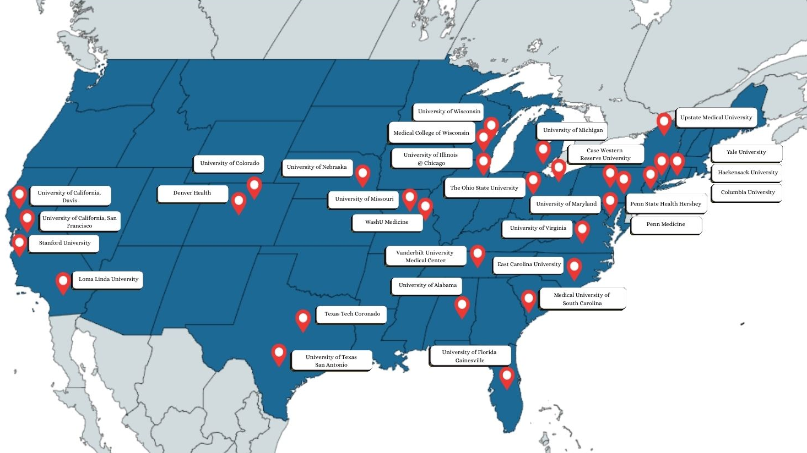
Participating Institutions
Notes:
Inaugural survey!
30 institutions participated in this survey – thank you!!

Slide 10
Interesting findings
Research staffing heavily influences size of teams
Unique roles
  A lot of quality and clinical research related positions
    Quality Abstractor Analyst
  Analytics, Programming, and Bioinformatics – how we use them and what we call them
    Web and app developers
    Health analysts, Data Analysts, Data Architects
  Hybrid teams more prevalent
  Greater use of project managers

Slide 11
Centralization Across Unique Domains

Slide 12
Presented by Benton Baker
Centralization Findings

Slide 13
Centralization Index
Caveats
  Self Reporting
  Definition mismatch
Centralized = 1
Hybrid* = 0.5
Decentralized = 0

Slide 14
Centralization Across Domains

Slide 15
Data overview
Denver Health
TT EP
Penn Medicine
University of Colorado
Columbia University
Wash U

Slide 16
Admin Staff Headcount vs Size
Wash U
Michigan
Colorado

Slide 17
Admin Staff (Excluding Research) vs Size
Wash U
Stanford

Slide 18
Learnings Across Domains

Slide 19
Presented by John Rottenborn
Administrative Assistant Support

Slide 20
General Administrative Support
Administrative Assistant
Decentralized 12.0% Centralized 84.0% Hybrid 4.0%

Slide 21
General Administrative Support
Administrative Assistant
Average Staffing: 1 Admin : 19.1 Faculty (14.5 Residents)
Standard faculty ratio to determine support? No (96%)
1 Admin Asst : 5 leaders
1 Admin Asst : 12 (includes all faculty FTE)
1 Admin Asst : 16 (clinical faculty)
Offer clinical leaders in the department support? Yes (56%)
Large variance in support scope

Slide 22
Presented by Frank Jurkiewicz
Clinical Operations Support

Slide 23
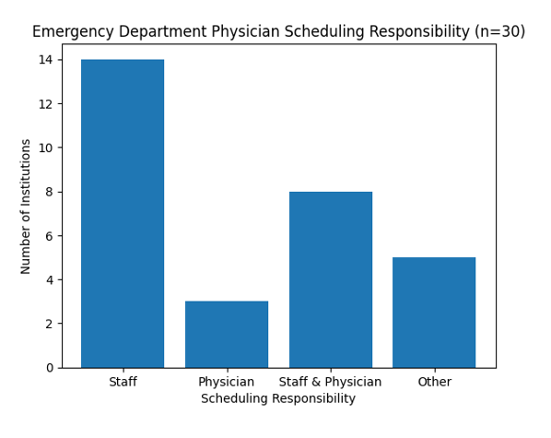
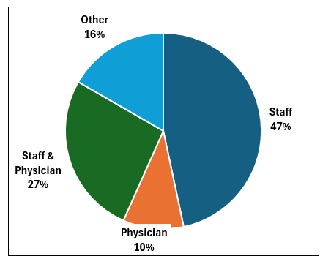
Clinical Operations
Clinical scheduling responsibility
Response categories: Staff, Physician, Staff & Physician, or Other
Distribution of Scheduling Responsibility

Slide 24
Clinical Operations
Nearly half of institutions (47%) rely on administrative staff to build clinical schedules
27% use a collaborative model between staff and physicians
Only 10% rely exclusively on physicians for scheduling
Findings suggest a strong operational role for administrative staff in schedule management

Slide 25
Presented by Bonnie Lemelin
Education Support

Slide 26
Education & Centralization

Slide 27
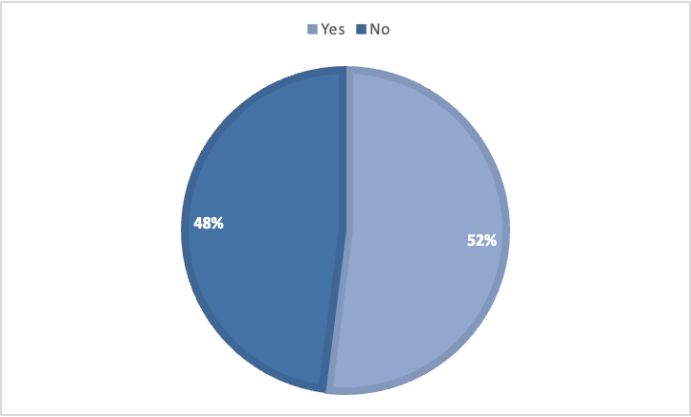
Do you provide additional administrative staffing over ACGME requirements?

Slide 28
Approaches to Non-ACGME Fellowship Administrative Effort
No standardized methodology across institutions
Staffing driven by ACGME guidance, workload, and funding
Heavy reliance on shared or flexible administrative support

Slide 29
Presented by Becky McGown & Tanner Vincent
Research Support

Slide 30
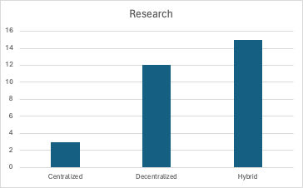
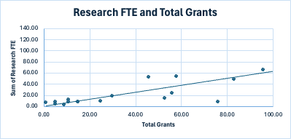
Research
50% - Hybrid
40% - Decentralized
10% - Centralized
Linear relationship between total research FTE and total grants

Slide 31
Research
 | # of Research Faculty | Total Grants | # of Research FTE | # of Finance FTE | Total $ in Annual Spend (Direct + Indirect)
Min | 2.00 | 1.00 | 3.10 | 0.25 | $ 165,528
Max | 57.00 | 149.00 | 116.58 | 8.40 | $ 26,927,517
Average | 19.07 | 45.11 | 26.56 | 3.10 | $ 7,061,942
Median | 14.50 | 30.00 | 9.05 | 3.07 | $ 2,196,344

Slide 32
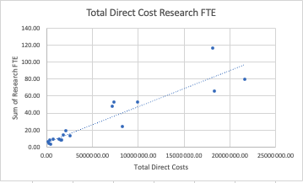
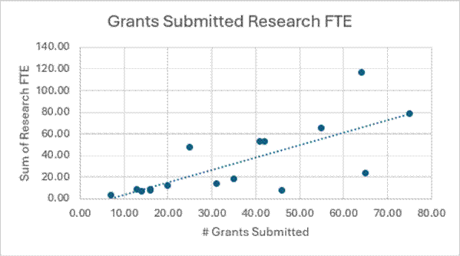
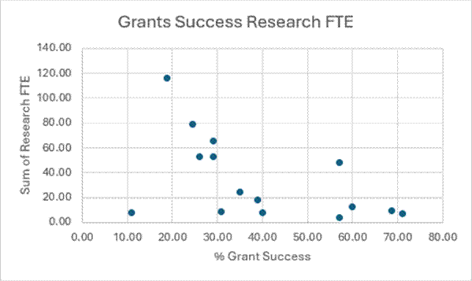
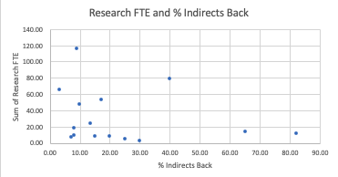
Research

Slide 33
Presented by Adrian Lopez Rangel
Finance Support

Slide 34
Finance position summary
Survey represents 1,115 total individuals
113 individuals (85.2 FTE) reported a % effort dedicated to finance
55 individuals reported 100% of their effort is finance

Slide 35
Finance Position Breakdown
Level 1
Strategic Leadership
Most Common titles:
Administrative Director
Department Administrator
Director of Operations
VC of Administration
Typical responsibilities:
Budget management
Faculty comp. Modeling
Strategic planning
Institutional negotiation
Level 2
Middle Management
Most Common titles:
Finance Manager
Business Manager
Operations Manager
Research Manager
Typical responsibilities:
Budget tracking
Monthly reporting
Productivity Metrics
Faculty Incentive
Management of day-to-day
Level 3
Finance Support Roles
Most Common titles:​
Finance Coordinator
Budget Analyst
Financial Specialist
Grant/Contract Coordinator
​
Typical responsibilities: ​
Expense Reconciliation
Grant accounting
Purchase Management
Financial tracking
Financial Reporting Preparation

Slide 36
Finance Data Findings
More than 90% of Tier 1 staff members reported effort distributions across several areas.
Data shows additional staff is allocated to finance more in a decentralized model and hybrid than a centralized model.

Slide 37

Future direction & Questions
Annual or bi-annual survey
Further breakdown areas for: research, billing/coding, admin assistant roles
Other foundational questions
  Turnover and connection to centralization
  How hybrid is defined
Future opportunities for publications
Possible future lunch & learn topic

Slide 38
Definitions
Term | Definition Description/Rule
Centralized resources | Work done in a central unit outside the department, whether in the college, practice plan, or health system
Clinical Operations/Scheduling | Supports patient care, including clinical mission support, project management of clinical operations, physician scheduling in system, provider gone time, etc.
Decentralized resources | Departments largely responsible for all or majority of daily operations with minimally centralized resources
Education FTE | Effort dedicated to coordination of UME, GME, or CME activities and management of all educational programs that rotate/impact clinical departments: clinical rotations, course development & coordination, accreditation, partner agreements, etc.
External to the institution resources | Work is outsourced to a unit that is external to the institution
Finance | Effort dedicated to all financial matters including budget, funds flow, compensation, reimbursement, and Research post award if applicable
FTE | Full Time Equivalent
General Administrative Support | Administrative Assistants, secretaries - calendar management, meeting setup, event coordination, expense management, travel coordination, CV/resume management
Human Resources & Faculty Affairs | Talent Acquisition/Faculty Recruitment, Employee Relations, Compensation, Onboarding and Professional Development, Policy & Procedure Compliance, Promotions, appointments, Tenure process, Terminations
Hybrid Centralization of resources | Resources are a mix of centralized in a unit outside the department or in the department
Marketing/ Communications | Staff responsible for communications, website management, marketing, social media, possibly development, philanthropy, etc.
Performance Reporting / Analytics | Effort dedicated to pulling data, generating and analyzing reports, etc.
Project Management / Process Improvement / Change Management | Project Management, Process Improvement, Change Management, communications; other department administration
Reimbursement/Rev Cycle | Staff responsible for billing, coding, or reimbursement management
Research FTE/Type of Research | Effort dedicated to coordination of Research operations, projects, funding, or management. This also includes preaward and clinical trials support. Lab staff should be identified in Column I
Other / Not Sure (please enter) | Enter any information that has been missed above

Slide 39

Thank you!
Benton Baker, MBA
Sara Engel, MBA, CEAMA
Bonnie Lemelin, MBA
Becky McGown, MBA
Jennifer Muir, EdD, MBA
John R. Rottenborn, MBA
Alyssa Starcher, MTDA
Tanner Vincent, MHSA

