Slide 1

Academy of Administrators in Academic Emergency Medicine
Operations
Fiscal Year 2025
Greg Archual
Kain Robbins
On behalf of the
AAAEM Benchmark Committee
March, 2026

Slide 2
Benchmark Committee Members
Gregory M. Archual, MBA (Co-Chair) Kain Robbins (Co-Chair)
Benton Baker, MBA Chad Cannon, MD
David Christiansen, MBA Kevin Crawford, MS
Greg Davis. MHA Deborah Dierks, MD, MBS
Sara Engle, MBA Frank Jurkiewicz, MBA
Bonnie Lemelin, MBA Kenny Lopiano, PhD (Huron/Roundtable)
Steve Maxwell, MSM Becky McGowan, MBA
Ashlee Melendez, MSPH, BSN Jennifer Patton Muir, EdD, MBA
Adrian Lopez Ranger John Rottenborn, MBA
James Scheulen, PA, MBA (Emeriti) Ken Taylor, MBA
Alyssa Tyransky, MTDA Arjun Venkatesh, MD, MBA, MHS
Gregory Volturo, MD Wes Zeger, DO

Slide 3
Data Set: Demographics
Fiscal Year | 2020 | 2021 | 2022 | 2023 | 2024 | 2025
Academic Hospital | 72 | 70 | 73 | 76 | 69 | 67
Academic Affiliated | 18 | 18 | 20 | 20 | 14 | 18
Academic/Affiliated | 90 | 88 | 93 | 96 | 83 | 85
Community | 28 | 34 | 40 | 42 | 34 | 30
Freestanding ED | 7 | 6 | 8 | 8 | 8 | 10
Adult Department | 125 | 127 | 141 | 142 | 125 | 125
Pediatric ED | 18 | 20 | 20 | 19 | 21 | 23
Total ED Report | 143 | 127 | 161 | 165 | 145 | 148
Urgent Care | - | - | - | - | 14 | 7

Slide 4
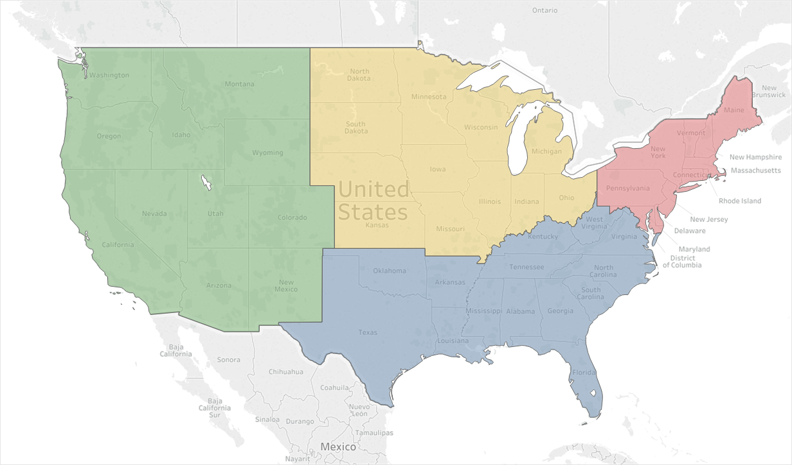
Data Set
Adult Academic and Affiliate Responses: 85
17
13
31
24
5,119,747 Emergency Visits
1,409,722 Hospitalizations
$768,324,705 Collected Revenue
Notes:
FY23
5,814,990 Emergency Visits
1,523,165 Hospitalizations
$757,032,693 Collected Revenue
37, 20, 18, 17

Slide 5
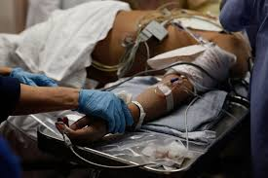



Updates
Complexity and Throughput
How does the composition or complexity of
the patient population impact operations

Slide 6
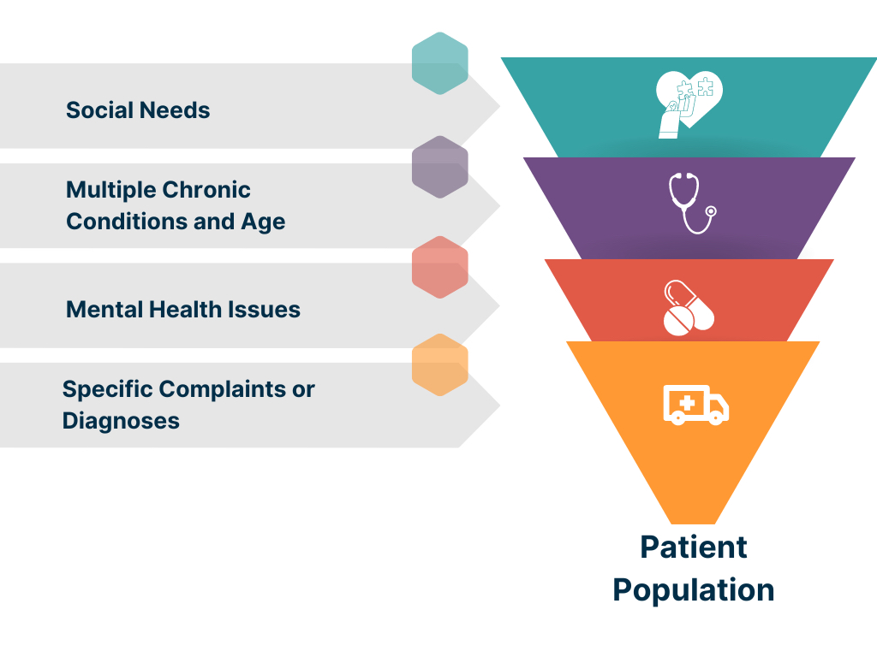
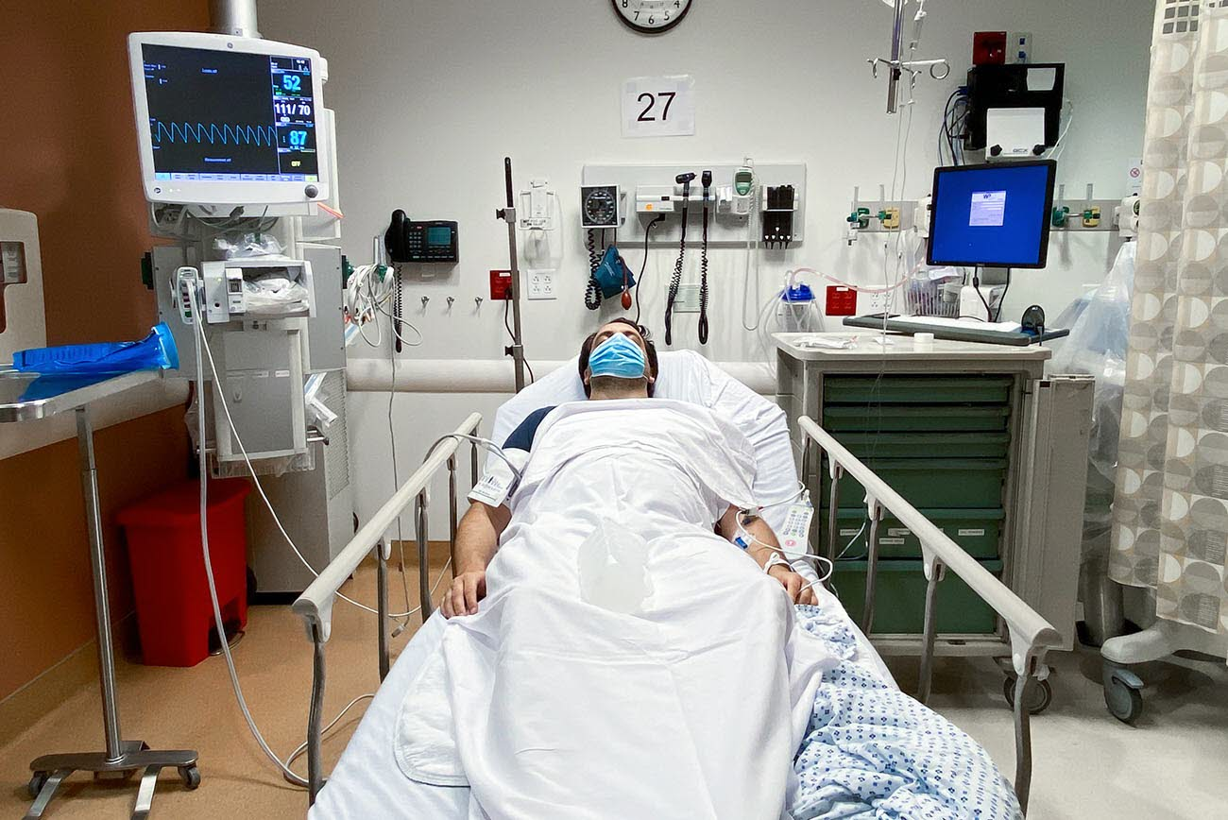

Patient Based Complexity
Defining the Patient Population
Encounter level data: Hospital Coding
    Demographics (Age)
    Presentations
    Diagnoses
    Co-morbidities
    Social needs
280 Patient level variables
Notes:
There are 2 options we can pursue.
Looking at acuity as a stand-alone concept for our patient population where we seek to quantify and contrast how sick our patients are. High acuity patients are more likely than low acuity patients to die, require surgery, or be medically admitted. Question: is your average behavioral health patient high or low acuity?
The other option is to expand this concept and incorporate additional factors that serve as indicators of how complex it is to clinically and operationally manage these patients. This option isn’t just about how sick the patients are but how resource intensive they are and how much pressure the place on the internal system of the ED.

Slide 7
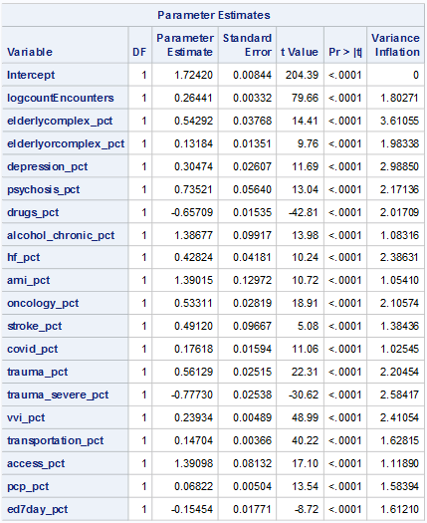
Patient Based Complexity Model
Variables provide a good fit
(r² = 0.71)
More patients
More patients with chronic ETOH
More patients with psychosis
More elderly and/or with comorbidities
More patients with oncology Dx
Patients from neighborhoods with high social needs/PCP desert
Reduced time = more patients with:
  Current drug or alcohol overdose
  History of 7-day returns to the ED
  Severe trauma
Predicting LOS in the ED
Notes:
Jim Scheulen and Dr. Kelen continue to work with Vizient on the publication
Discussions ongoing regarding the acuity formula being made available to AAAEM for future use

Slide 8
Updates
The Emergency Care Access & Timeliness (ECAT) is a CMS measure tracking four key ED access gaps to improve quality and identify overcrowding issues.
Rationale
This measure aims to reduce patient harm and improve outcomes for patients requiring emergency care in an emergency department (ED) by addressing the variation of emergency care and measuring the capacity and quality of emergency care.
It is designed to:
Identify ED boarding and crowding problems
Monitor patient wait times, abandonment, and length of stay
Support hospital quality improvement and align with CMS incentives for better ED and broader health system care
Notes:
Importance of the Measure
The ECAT measure is crucial for improving patient outcomes in emergency care settings. It addresses long-standing concerns about ED crowding and access disparities, particularly among vulnerable populations, including those with mental health conditions. By focusing on these quality metrics, healthcare providers can identify areas for improvement and implement strategies to enhance the overall quality of emergency care.
The Emergency Care Access & Timeliness (ECAT) measure evaluates the variation in access and timeliness of emergency care in emergency departments (EDs). It is designed to identify where patients do not receive timely access to emergency care, addressing issues such as long wait times, high rates of patients leaving without being seen, and extended lengths of stay in the ED.

Slide 9
Emergency Care Access & Timeliness (ECAT)
Key Performance Indicators
The measure captures the proportion of ED visits where patients experienced any one of four quality gaps
Wait time > 1 hour after ED arrival until placement in a treatment room with audiovisual privacy for history/physical.
Left without being evaluated (LWBE).
Boarding time > 4 hours (from decision to admit to ED departure for admitted patients).
ED length of stay > 8 hours (from ED arrival to ED departure).
Notes:
Concern used to be hospitals aren’t operating all their beds, but it shows they kind of are. Think about taking it out if we can’t do the math properly, Jim math is involved for mean turnover and estimated inpatient LOS
Staffed (612) vs Licensed (664) beds: 92% (Mean)
Inpatients from ED: 55% (Academic)
Inpatients from ED: 80% (Community)
Academic Mean Turnover = 53 patients/bed
Estimated inpatient LOS = 6.9 days
Community Mean Turnover – 75 patients/bed
Estimated inpatient LOS = 4.9 days

Slide 10
Emergency Care Access & Timeliness (ECAT)
Reporting and Compliance
Adoption: Finalized for the Hospital Outpatient Quality Reporting (OQR) and Rural Emergency Hospital Quality Reporting (REHQR) programs in the CY 2026 final rule
Voluntary reporting: Expected for CY 2027, then mandatory starting CY 2028 (payment determination CY 2030)
Stratification: Two groups — pediatric with no mental health diagnosis, and adult with no mental health diagnosis
Notes:
Concern used to be hospitals aren’t operating all their beds, but it shows they kind of are. Think about taking it out if we can’t do the math properly, Jim math is involved for mean turnover and estimated inpatient LOS
Staffed (612) vs Licensed (664) beds: 92% (Mean)
Inpatients from ED: 55% (Academic)
Inpatients from ED: 80% (Community)
Academic Mean Turnover = 53 patients/bed
Estimated inpatient LOS = 6.9 days
Community Mean Turnover – 75 patients/bed
Estimated inpatient LOS = 4.9 days

Slide 11
Emergency Care Access & Timeliness (ECAT)
Strategic Importance
Quality & Safety: Addresses patient safety risks from prolonged waits and overcrowding.
Payment Impact: Non-compliance with OQR reporting can trigger a 2% payment rate reduction.
System-Wide Focus: Encourages ED and hospital-wide interventions to reduce boading and improve throughput.
Notes:
In summary, the ECAT eCQM is a core CMS quality measure for ED performance, with direct implications for hospital operations, patient care, and Medicare payment. Early preparation will help facilities meet reporting requirements and improve emergency care outcomes.

Slide 12
Emergency Care Access & Timeliness (ECAT)
Key Takeaways
More detailed specs and guides for hospitals to report the data will come out in October
Hospitals and any stakeholder can submit implementation comments till then at https://ecqi.healthit.gov/ecqm/hosp-outpt/2027/cms1244v1
CY2027 will be voluntary reporting
CY2028 will be mandatory reporting of the measure in the CMS HOQR measure – payment penalty if not reported
In future may be part of hospital Value Based Purchasing, etc.
Measure was designed by many SAEM members as experts, built to push the needle on boarding and not blame the ED
Notes:
In summary, the ECAT eCQM is a core CMS quality measure for ED performance, with direct implications for hospital operations, patient care, and Medicare payment. Early preparation will help facilities meet reporting requirements and improve emergency care outcomes.

Slide 13


New questions
Geriatrics
  Geriatric ED Accreditation
  LOS – Admitted/Transfered Patients
  LOS – Discharged Patients
UME:
  Faculty Support/Leadership
  Number of Students
  Courses
  Clerkship Offerings/Evaluations
Throughput data:
  Annual Total Physician Clinical Hours
  Annual Total APP Clinical Hours
  Boarder Cap ICU & Non-ICU Patients
  # of Critically-ill & Injured ED Patients
Notes:
Physician and APP Actual Hours: Just report out we are collecting it and may use in calculations

Slide 14
Boarder Caps
23% of us have boarder caps for non-ICU patients
10% of us have boarder caps for ICU patients
Notes:
Caps are a mixed bag when looking at who cares for boarders (ED providers versus inpatient providers)

Slide 15
Academic Emergency Medicine
Tripartite Mission
Research
Teaching
Clinical
Notes:
Should this read education instead of teaching? Clinical versus patient care.

Slide 16
Staffing and Efficiency
Staffing in Department – Block Hours
PGY | Year 3 | Year 4
PGY1 Hours | 172 | 175
PGY2 Hours | 163 | 170
PGY3 Hours | 156 | 159
PGY4 Hours | - | 145

Slide 17
Staffing and Efficiency

Slide 18
Total Clinical Hours in Emergency Department during Residency
3 year | 3317
4 year | 3454

Slide 19
Academic Emergency Medicine
Tripartite Mission
Research
Teaching
Clinical

Slide 20

Increasing
Process
time
Limited
Capacity/High
Occupancy
Bed Hour
Utilization
Non-Emergent
Internal Flow
and
Decision Making
Notes:
Remind people all this data can be used for operations management, expand a little bit beyond “here’s the data” and more of how to utilize the data

Slide 21

Hospital Operations
Staffed (628) vs Licensed (707) Beds: 89% (Mean)
Inpatients from ED: 54% (Academic)
Inpatients from ED: 89% (Community)
Academic Median Inpatient Bed Turnover per Year – 59
Community Median Inpatient Bed Turnover per Year – 80
Notes:
Concern used to be hospitals aren’t operating all their beds, but it shows they kind of are. Think about taking it out if we can’t do the math properly, Jim math is involved for mean turnover and estimated inpatient LOS
Staffed (612) vs Licensed (664) beds: 92% (Mean)
Inpatients from ED: 55% (Academic)
Inpatients from ED: 80% (Community)
Academic Mean Turnover = 53 patients/bed
Estimated inpatient LOS = 6.9 days
Community Mean Turnover – 75 patients/bed
Estimated inpatient LOS = 4.9 days

Slide 22

The Academic ED
Fiscal Year 2025 | Median
Hospital Beds | 628
Licensed ED Beds | 707
Total Bed Hours | 565,020
% Bed Hours to MAIN | 66%
ED Treat & D/C | 40,610
ED Admissions | 16,585
Hospital Observation | 3,147
Total Visits | 65,803
Hospitalized Rate (Calc) | 28.0%
Unique visits | 65.2%
65,803 Visits
Range: 22,151 – 159,172
43,351 Unique visits
Notes:
Fiscal Year 2023
Median
Hospital Beds
604
Licensed ED Beds
57
Total Bed Hours
536,560
% Bed Hours to MAIN
69%
ED Treat & D/C
38,248
ED Admissions
14,803
Hospital Observation
2,854
Total Visits
63,591
Hospitalized Rate (Calc)
27.8%
Unique visits
66.4%

Slide 23
The Academic ED (Medians)
 | 2019 | 2020 | 2021 | 2022 | 2023 | 2024 | 2025
Hospital Beds | 632 | 664 | 656 | 655 | 604 | 620 | 628
Licensed ED Beds | 52 | 59 | 58 | 58 | 57 | 57 | 55
Total Bed Hours | 495,670 | 520,689 | 534,360 | 525,600 | 536,560 | 540,404 | 565,020
%Bed Hours to MAIN | 70% | 67% | 68% | 70% | 69% | 70% | 66%
ED Treat & D/C | 42,244 | 38,875 | 35,748 | 35,842 | 38,248 | 38,795 | 40,610
ED Admissions | 14,702 | 14,258 | 14,831 | 15,118 | 14,803 | 16,283 | 16,585
Hospital Obs | 3,262 | 3,215 | 2,868 | 2,867 | 2,854 | 2,857 | 3,147
Hospitalized Patients | 17,964 | 17,473 | 17,699 | 17,985 | 17,657 | 19,140 | 19,732
Total Visits | 64,326 | 59,417 | 56,235 | 62,483 | 63,591 | 65,162 | 65,803
Hospitalized Rate | 27.9% | 29.4% | 31.5% | 28.8% | 27.8% | 29.4% | 29.4%
Unique Visits | 65% | 65% | 66.4% | 66.8% | 66.4% | 66.1% | 66.1%
Notes:
Admissions increased & total visits

Slide 24
Patient Populations (Medians)
 | 2019 | 2020 | 2021 | 2022 | 2023 | 2024 | 2025
Total | 64,326 | 59,417 | 56,235 | 62.483 | 63,591 | 65,162 | 65,803
EMS Arrivals | 18,005 | 15,876 | 16,515 | 18,333 | 18,451 | 18,366 | 19,223
EMS Percent | 26.2% | 25.9% | 28.1% | 27.6% | 27.9% | 27.4% | 27.3%
EMS Admit Rate | 42.9% | 42.6% | 45% | 41.3% | 40.9% | 41.1% | 42.9%
Behavioral Health | 5.5% | 4.9% | 5.0% | 5.0% | 4.9% | 5.7% | 5.0%
Patients > 65 Years | 20.7% | 21.0% | 21.5% | 21.6% | 22.2% | 23.3% | 24.5%
Pediatric Visits | 2.1% | 1.7% | 0.8% | 1.2% | 1.8% | 1.1% | 0.9%
Dedicated Pediatrics | 24,921 | 22,160 | 19,766 | 26,929 | 31,661 | 30,474 | 30,694

Slide 25
Physician Staffing
Notes:
The mean increase was 2075 hours across the board, but hard to make year to year comparisons because of the varying participation among sites and data entry. But it does appear that we have been adding more clinical hours over the past few years
Why did arrival per faculty horu stay the same but faculty hours went up and the total arrivals are the same-ish? Maybe decrease in LWBS because better boarding?

Slide 26
Daily Provider Coverage Hours per Day
56%
52%
52%
Attending
Hours
34%
54%
Attending
Hours
32%
Resident
Hours
41%
Resident
Hours
53%
APP
Hours
13%
APP
Hours
27%
Notes:
Acute Care excludes Obs, provider in triage, fast track, etc., get definition

Slide 27
Charge and Productivity Data
 | FY 20 Median | FY 21 Median | FY 22 Median | FY 23 Median | FY 24 Median | FY 25 Median
Work RVU/Hour | 6.8 | 6.0 | 6.1 | 6.5 | 6.4 | 6.1
Work RVU/Patient | 3.0 | 3.2 | 3.2 | 3.2 | 3.3 | 3.3
Collection/Work RVU | $47.05 | $46.95 | $46.35 | $47.23 | $48.57 | $48.25
Collections ($) | $8,174,995 | $7,737,646 | $8,473,792 | $8,464,630 | $10,472,171 | $10,084,370
Collections/Visit | $136.30 | $140.61 | $138.83 | $144.91 | $154.29 | $153.32
Notes:
RVU reduction but $ up
When comparing across institutions that submitted in FY23 and FY24, median is $9,675,773.26
Those that dropped tended to be smaller, those new tended to be larger
Managed care went up 5%, around $500,000

Slide 28
Payer Mix needs updated am I doing the next two or is Kain?
Mean Payer Mix Distribution

Slide 29
Patient Volume Trend: Median
Patient Volume Trend—All Responders FY 25

Slide 30
Unfinished Care
Mean Percentage of Arrivals
5,372
Patients
Mean
Notes:
About 1K less patients than last year

Slide 31
Patient Volume Trend: Median
Patient Volume Trend—All Responders FY 25
3 to 1 discharge to admit
2 to 1 discharge to admit
Notes:
Less sick patients still exist, but the sick patients are going to our academic centers, ESI level 1 & 2 over time?

Slide 32
Hospitalization Data
45% of ED hospitalizations
Arrive by EMS
Notes:
FY23 = 55% hospitalizations from ED and EMS arrivals 45%

Slide 33
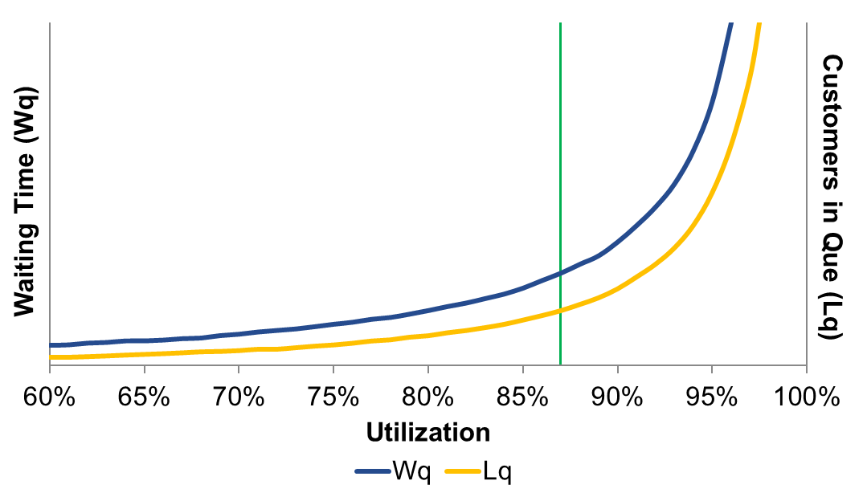


Drivers of Operations
DOM
7 AM
+.66
days
DOM
MN
MN
33

Slide 34

Sub-cycle Time
DISCHARGED PATIENTS
ADMITTED PATIENTS
Arrival to Provider: 1.1 hr
Provider to Decision: 3.8 hr
Decision to Depart: 0.9 hr
Arrival to Provider: 1.1 hr
Provider to Decision: 5.1 hr
Decision to Depart: 9.0 hr
Notes:
Tie back to boarding hours,
THINK ABOUT BED HOUR UTILIZATION

Slide 35
LOS Trend: Median LOS
Median Emergency Department Length of Stay
Hours

Slide 36
LOS Trend: Median vs Mean LOS
Total ED LOS: Mean vs Median
2.7 HR SPREAD
Hours
CONSISTENT 2.5 HR SPREAD

Slide 37
LOS Trend: Median vs Mean LOS
Discharged Patient Length of Stay
Hours

Slide 38
LOS Trend: Median vs Mean LOS
Hospitalized Patient Length of Stay
Hours

Slide 39
LOS Trend: Bed to Decision Time
Median “Main” Bed to Decision Time: Admit vs D/C
Hours
Notes:
No Changes for any metric

Slide 40
Boarding Time
Mean and Median Boarding Time
Hours

Slide 41


Inpatient Occupancy
All beds
Academic = 87%
DOM beds
Academic = 88%
DOM beds
Academic = 89%
Med Surg beds
Academic = 88%
Med Surg beds
Academic = 89%
Notes:
NEW QUESTION, added all beds to this slide.

Slide 42
Boarding Time
Total Boarding Hours
28% total bed hours
18.3 beds fully
dedicated to
Inpatient care
16.5 beds fully
dedicated to
Inpatient care
Hours
26% of all non-overflow bed spaces
14.4 beds fully
dedicated to
Inpatient care
14.5 beds fully
dedicated to
Inpatient care
18% total bed hours
13 beds fully
dedicated to
Inpatient care
9 beds fully
dedicated to
Inpatient care
10 beds fully
dedicated to
Inpatient care
Notes:
Doubling up in 7 years is ideal for investments but not what you want to see with boarding patients

Slide 43
Boarding Distribution
FY 2015 vs FY 2025
Median Percent of Patients
Boarding Hours
Notes:
BOARDING IS LEVELED DO NOT SAY DECREASING
HOSPITALIZATION IS INCREASING SO BOARDING TIME IS INCREASE BUT BOARDING FOR INDIVIDUAL PATIENTS IS GETTING BETTER, FIRST INDICATION
IF THE ABSOLUTE NUMBER OF ASBSOLUTE PATIENTS, PERCENTS ARE DECLINING, BUT GROWTH IN SHORTER STAYS (Steve wording so follow up with him)
BOARDED HOURS PER PATIENT
Weirdly enough, there is statistical significance in the difference between 4-8 hours mean → safe to say the middle is decreasing, why is what’s unknown

Slide 44
Baseline ED Space
16.5 beds fully
dedicated to
Inpatient care
14.4 beds fully
dedicated to
Inpatient care
14.5 beds fully
dedicated to
Inpatient care
13 beds fully
dedicated to
Inpatient care
9 beds fully
dedicated to
Inpatient care
10 beds fully
dedicated to
Inpatient care
Notes:
Doubling up in 7 years is ideal for investments but not what you want to see with boarding patients

Slide 45
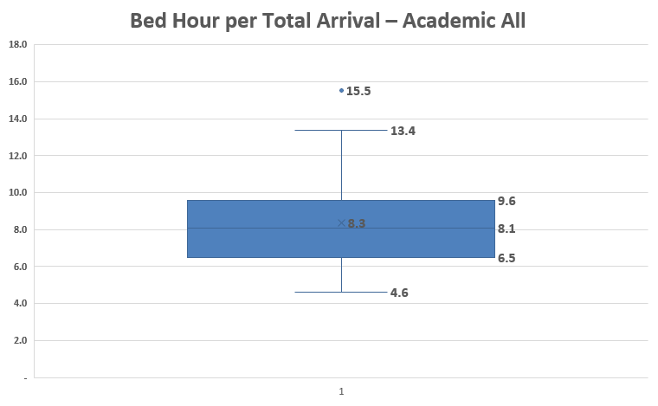
Baseline ED Space
16.5 beds fully
dedicated to
Inpatient care
14.4 beds fully
dedicated to
Inpatient care
14.5 beds fully
dedicated to
Inpatient care
13 beds fully
dedicated to
Inpatient care
9 beds fully
dedicated to
Inpatient care
10 beds fully
dedicated to
Inpatient care
Notes:
Doubling up in 7 years is ideal for investments but not what you want to see with boarding patients

Slide 46
Boarding Impact
16.5 beds fully
dedicated to
Inpatient care
14.4 beds fully
dedicated to
Inpatient care
14.5 beds fully
dedicated to
Inpatient care
13 beds fully
dedicated to
Inpatient care
9 beds fully
dedicated to
Inpatient care
10 beds fully
dedicated to
Inpatient care
Notes:
Doubling up in 7 years is ideal for investments but not what you want to see with boarding patients

Slide 47
Boarding Impact
16.5 beds fully
dedicated to
Inpatient care
14.4 beds fully
dedicated to
Inpatient care
14.5 beds fully
dedicated to
Inpatient care
13 beds fully
dedicated to
Inpatient care
9 beds fully
dedicated to
Inpatient care
10 beds fully
dedicated to
Inpatient care

Slide 48
Boarding Impact
16.5 beds fully
dedicated to
Inpatient care
14.4 beds fully
dedicated to
Inpatient care
14.5 beds fully
dedicated to
Inpatient care
13 beds fully
dedicated to
Inpatient care
9 beds fully
dedicated to
Inpatient care
10 beds fully
dedicated to
Inpatient care
Notes:
Doubling up in 7 years is ideal for investments but not what you want to see with boarding patients

Slide 49
LOS Behavioral Health: Average
Behavioral Health Patients = 6.3% of Arrivals or 4,400 patients

Slide 50
Observation Benchmarks
Emergency Department Observation
 | FY 19 | FY 20 | FY 21 | FY 22 | FY 23 | FY 24 | FY 25
% in Cohort with Obs Unit | 47% | 46% | 47% | 50% | 46% | 46% | 44%
% in Obs | 6% | 5% | 5% | 5% | 6% | 4% | 4%
Bed Turn | 0.9 | 0.8 | 1 | 0.9 | 1.1 | 0.8 | 0.8
% D/C | 69% | 75% | 70% | 73% | 74% | 80% | 78%
To Order | 4.6 | 5.1 | 5.6 | 5.4 | 6 | 4.5 | 4.6
To Decide | 14.0 | 14.8 | 14.0 | 14.8 | 13.5 | 14.3 | 13.7
Total LOS | 19.0 | 20.4 | 21.0 | 22.1 | 22.5 | 20.4 | 21.7
Consistent performance but increasing time

Slide 51
Ancillary Resource Utilization
Resource | FY 19 | FY 20 | FY 21 | FY 22 | FY 23 | FY 24 | FY 25
CT Utilization | 25.5% | 28.3% | 31.3% | 30.0% | 31.5% | 32.9% | 35.1%
MRI Utilization | 2.7% | 2.8% | 2.8% | 2.9% | 3.2% | 3.2% | 3.3%
Plain Film (% visits) | 40.2% | 43.0% | 44.0% | 42.0% | 40.3% | 39.7% | 41.5%
Laboratory (% visits) | 69.6% | 70.5% | 72.2% | 72.0% | 69.7% | 71.5% | 73.7%
EKG (% visits) | 33.0% | 36.0% | 40.0% | 38.0% | 38.5% | 39.8% | 42.8%
U/S (Radiology) | 7.9% | 6.9% | 7.6% | 7.8% | 7.8% | 7.6% | 7.6%
Consult & D/C | 7.0% | 7.5% | 8.5% | 9.4% | 8.8% | 7.8% | 8.5%
MRI Turnaround | 4.0 hr | 4.3 hr | 5.1 hr | 5.3 hr | 5.5 hr | 5.3 hr | 5.5 hr
Mean = 2.3 hours vs 2.8 hours
Mean = 5.0 hours vs 8.7 hrs

Slide 52
CT Utilization and LOS

Slide 53
CT Utilization and LOS

Slide 54
Professional Fee Billing
E & M Codes
Percent
90.0% Levels 4, 5 and CC

Slide 55
E&M Coding Benchmarks
Notes:
Academic Benchmark Cohorts
The academic cohorts are defined by their involvement in medical education, research, and high-acuity specialized care
Comprehensive Academic Medical Centers (AMCs): Approximately 118 institutions. This group includes 97% of all AMCs in the U.S..
Large, Specialized Complex Care Medical Centers: This cohort includes major non-university teaching hospitals that meet specific high-acuity criteria, such as performing a minimum of 25 solid organ transplants and 600 trauma cases annually.

Slide 56
Professional Fee Billing
AAAEM E&M Coding Level Groupings
80% - 90%
90% - 95%
>90%
>95%

Slide 57
Professional Fee Billing

Slide 58
Thank You

