Slide 1
AACEM Executive Committee Update

Slide 2
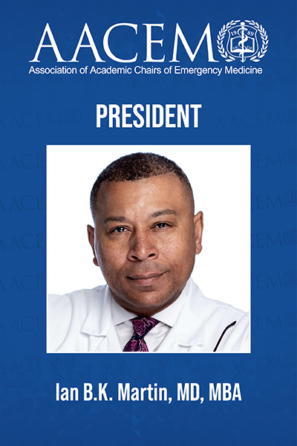
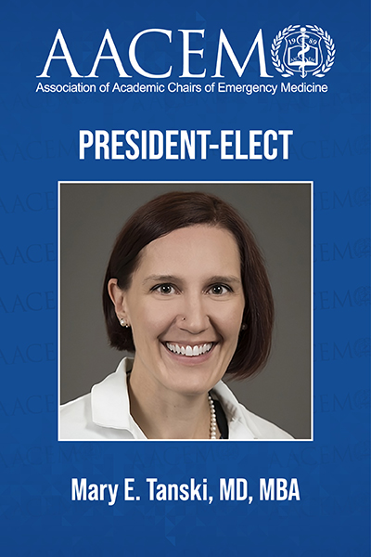
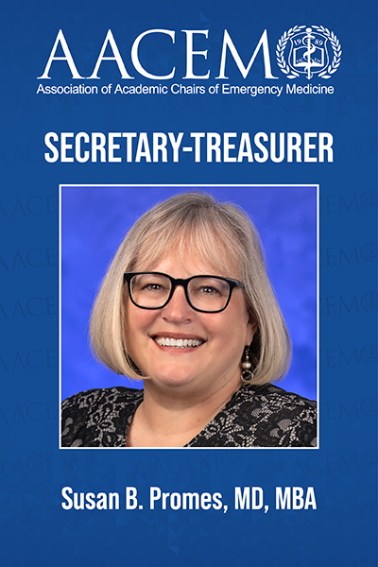
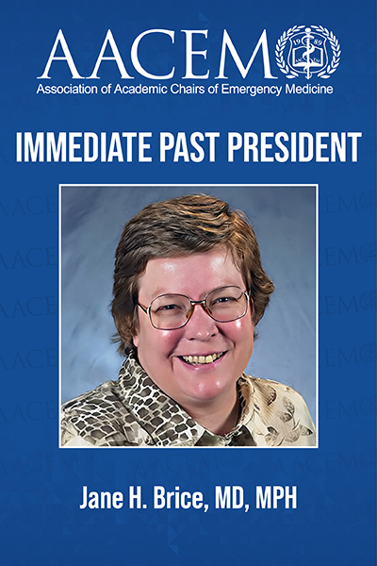
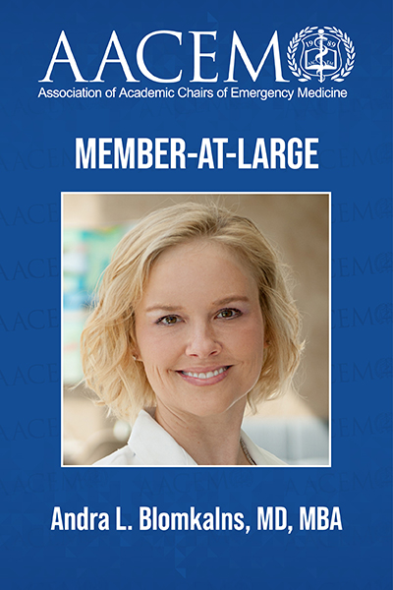
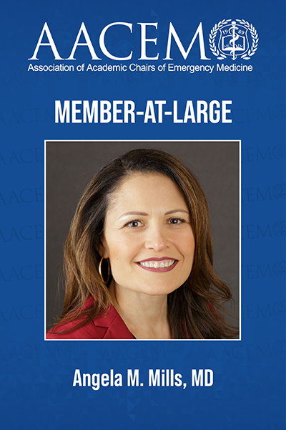
Welcome from Your Executive Committee
And congratulations to Dr. David Wright, joining the AACEM Executive Committee at SAEM26!

Slide 3
Mission and Values
Core Purpose (Mission)
AACEM supports academic Chairs of emergency medicine to lead innovative research, medical
education, clinical care, and faculty development in their institutions.
Core Organizational Values
Professional Integrity
Collaboration and Community
Diversity, Equity, and Inclusion

Slide 4
Vision and Pillars
Vision
Academic departments of emergency medicine are led by Chairs who are creating the future of emergency medicine through innovations in research, medical education, and clinical care, and fostering the development of future leaders.
LEADERSHIP DEVELOPMENT
ACADEMICS
INNOVATION
OUTREACH

Slide 5
AACEM Funding
AACEM is financially strong:
Funding set aside annually for AACEM project proposals.
  This year AACEM funded a networking event for Vice Chairs at SAEM26.
Project proposal submission form will be released in summer 2026 for 2027 funding.
Additional funding provided by AACEM for Scholarships (CDP, eLead).
At SAEM25, AACEM advanced research and career development through a generous $500k gift to the SAEM Foundation.

Slide 6
AACEM 2025-2026 Internal Highlights
AACEM 2025-2026 Highlights:
Highest membership in history, reaching 201 members in December 2025 (compared to 190 in December 2024)
AACEM launched a member attestation form to gain a clearer understanding of the depth and composition of our membership
AACEM is launching now the new Culture and Belonging Workgroup and Emeritus Task Force
AACEM advanced research and career development through a generous $500k gift to the SAEM Foundation

Slide 7
AACEM Collaborations
AACEM Regularly collaborates with SAEM, AAEM, ABEM, ACEP, ACOEP, CORD, EMRA and SAEM-RAMS
Service on the SAEM Board of Directors (Chair Rep: AACEM Past President)
AAAEM/AACEM Benchmark Committee
SAEM CEO Search Task Force
CORD-led EM Match Taskforce
ACEP-led All EM AI Task Force
SAEM-led ACGME Task Force
ABEM-led All-EM Collaborative Task Force
Association of American Medical Colleges (CFAS)
American College of Emergency Physicians (ACEP) Council
ACEP Unscheduled Procedural Sedation and Analgesia Guideline Writing Group
Coalition on Psychiatric Emergencies (CPE)
ABEM’s Coalition of Board-Certified Emergency Physicians (COBCEP)

Slide 8
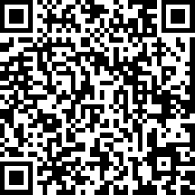
Call for Committees/Workgroups
Committee/Workgroups for 2026-2027
Membership Committee
Leader Development Workgroup
Innovations Workgroup
Research Workgroup
New! Culture and Belonging Workgroup
Apply Now!

Slide 9
Chair Mentorship Program
PURPOSE:
Provide a resource for newly appointed chairs of academic departments of emergency medicine
Provide an opportunity for established chairs to share their knowledge, insights, and experiences with developing chairs
Enhance networking among new and established members of the Association
Facilitate an on-site visit of either ($1,500 travel stipend provided by AACEM)
  The mentor to the new chair's program, or
  The new chair to the mentor's program
Mentee Eligibility: Any AACEM active/full or associate member in good standing who is within 18 months of assuming a chair position may apply to be a mentee. Email aacem@saem.org for more information!

Slide 10
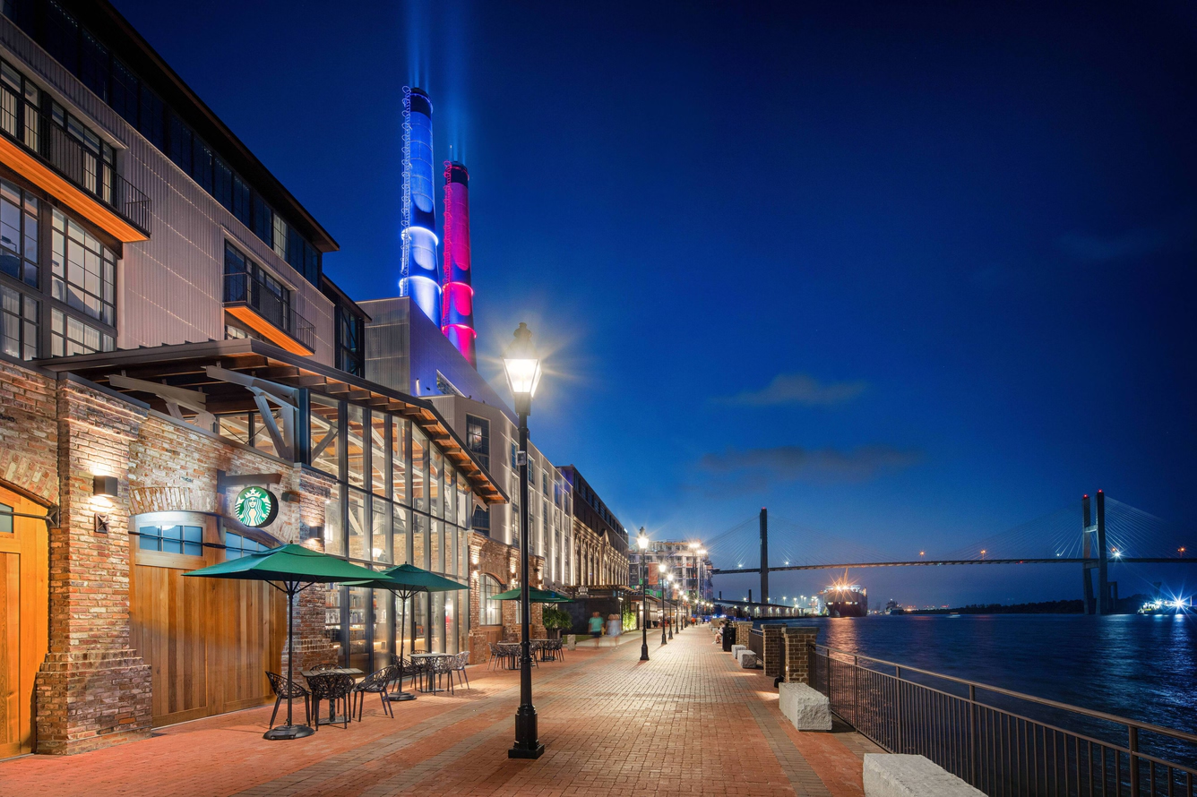
2027 AACEM/AAAEM Retreat
SAVE THE DATE!
2027 AACEM/AAAEM Annual Retreat
Dates: March 20 - 24, 2027
Location: JW Marriott Savannah Plant Riverside District
Savannah, GA
Institutions will be allowed a vice chair to attend this retreat!

Slide 11

Vice Chair Request
Check out the current roster and ask your Vice Chairs to check the box on their SAEM profile to join!
Goal: Vice Chair Interest Group is working to reach 300 members (current membership is 250)
Once the Interest Group reaches 300 members, they can begin a 2-year probation period, in hopes to become an SAEM Academy
Help the Vice Chairs achieve their 300 member goal!

Slide 12
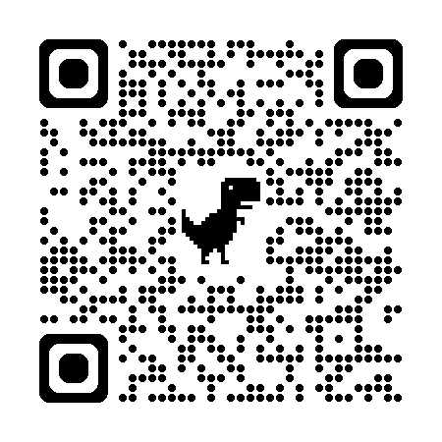
Vice Chair Request
Goal: The Vice Chairs group is surveying their membership to learn more about Vice Chair needs.
Share this survey with your Vice Chairs to complete!

Slide 13

SAEM Consultation Services
Current Consultations Available:
  Research (General)
  Research (Federal Funding)
  Operations
  Residency
  Academic Department
  Faculty Development
  Ethics
  Wellness

Slide 14

AACEM Events at SAEM26
Save the Date:
AACEM Chairs Dinner: Wednesday, May 20, 2026, 6:00-10:00 pm, Morton’s Steakhouse
  Register via the SAEM26 registration portal! This event is complimentary for AACEM members. Guests of AACEM members may attend for $75 per person.
AACEM Sponsored Didactic:
Cracking the Code: Career Advancement and Promotion Strategies for Faculty in Academic Emergency Medicine
Wednesday, May 20, 2026 1:00 PM to 1:50 PM
International Hall 1: Level I

Slide 15
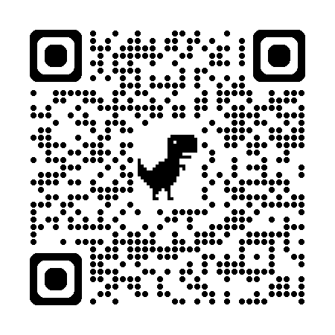
Residency and Fellowship Fair
Two high-impact recruiting opportunities
Live at SAEM26 on Wednesday, May 20, 2026 3–5 PM ET
Virtual on July 20–23, 2026 with flexible time slots
Participate in both and save!
To Register email Krystle at vrff@saem.org or call 847-257-7239
Full List as of 3/12

Slide 16
AACEM Medical Student Group Initiative
Join Today!
Cost is only $20 per student
To join, send your roster to Krystle at kansay@saem.org
Your students will enjoy all SAEM benefits including access to academies and interest groups, leadership opportunities, grant opportunities, and access to our two journals
Questions? Contact Krystle at kansay@saem.org or 847-257-7239

Slide 17

AACEM Medical Student Group Initiative
Carilion Clinic-Virginia Tech
Chicago College of Osteopathic Medicine
Duke University Hospital
Kansas City University
Keck School of Medicine of the University of Southern California
Louisiana State University (Shreveport)
Mayo Clinic Alix School of Medicine (Phoenix)
Medical College of Wisconsin
Michigan State University
Northeast Ohio Medical University
Ohio State
Oregon Health & Science University
Penn State Milton S Hershey Medical Center
Rutgers Health/New Jersey Medical School
Rutgers Robert Wood Johnson
Stanford
University of California (San Francisco)
University of Michigan
University of North Carolina Hospitals
University of Utah
University of Vermont
Wake Forest University
Washington University in St. Louis Yale-New Haven Medical Center
As of 3/12/26

Slide 18
Thank You!

Slide 19
Research Workgroup Report

Slide 20
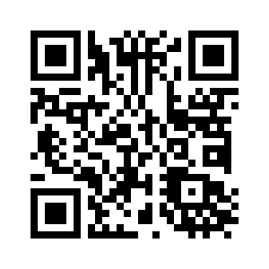
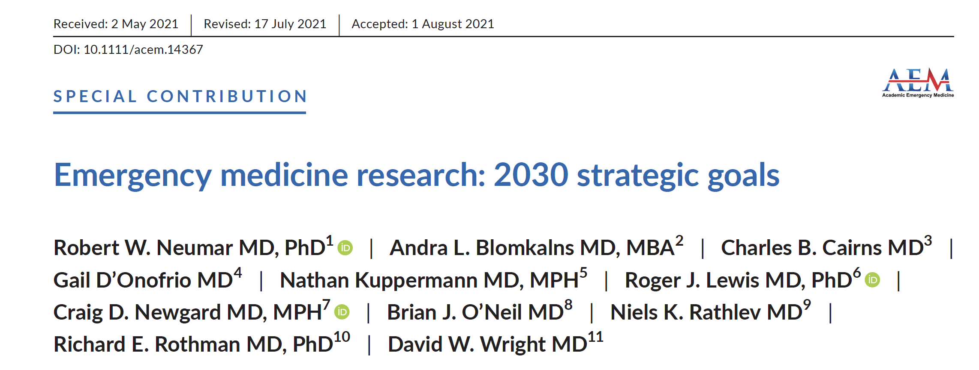

Slide 21



AACEM Dashboard To Monitor Progress Toward 2030 Goals
https://report.nih.gov
http://www.brimr.org/NIH_Awards/NIH_Awards.htm
https://www.aamc.org/data-reports/faculty-institutions/report/faculty-roster-us-medical-school-faculty

Slide 22
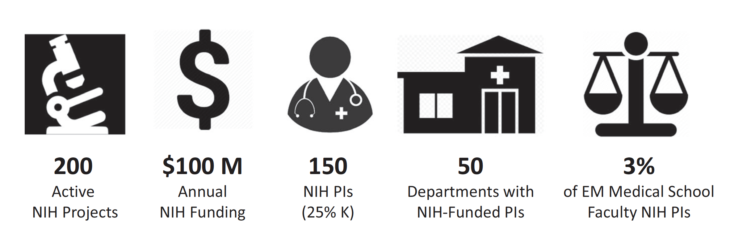
2030 Strategic Goals for Emergency Medicine NIH Funding
2025 2024 | 219 216 | $163 M $159 M | 168 (22% K) 169 (18% K) | 42 47 | 2.2% 2.3%
2023 | 206 | $137 M | 147 (15% K) | 45 | 2.2%
2022 | 157 | $102 M | 121 (13% K) | 41 | 1.8%
2021 | 149 | $101 M | 111 (15% K) | 39 | 1.7%

Slide 23


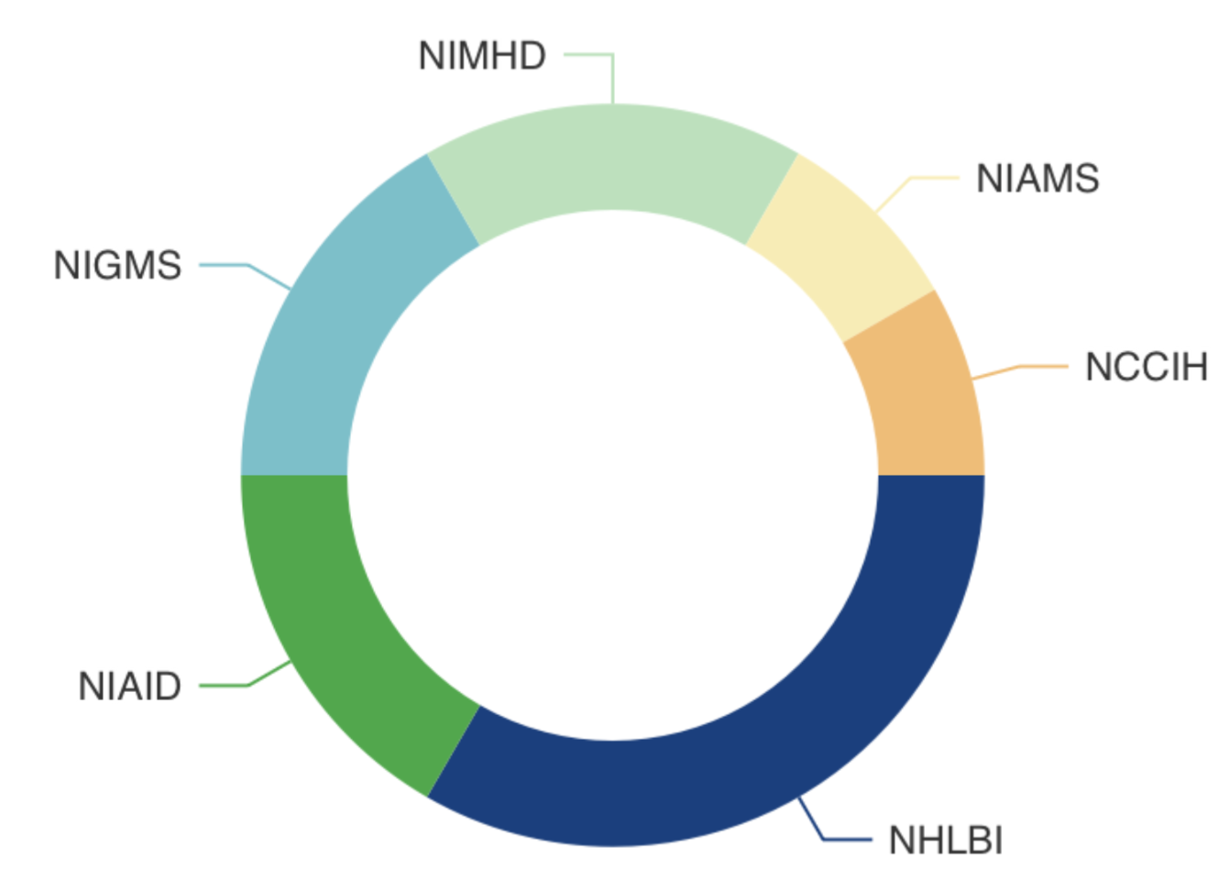
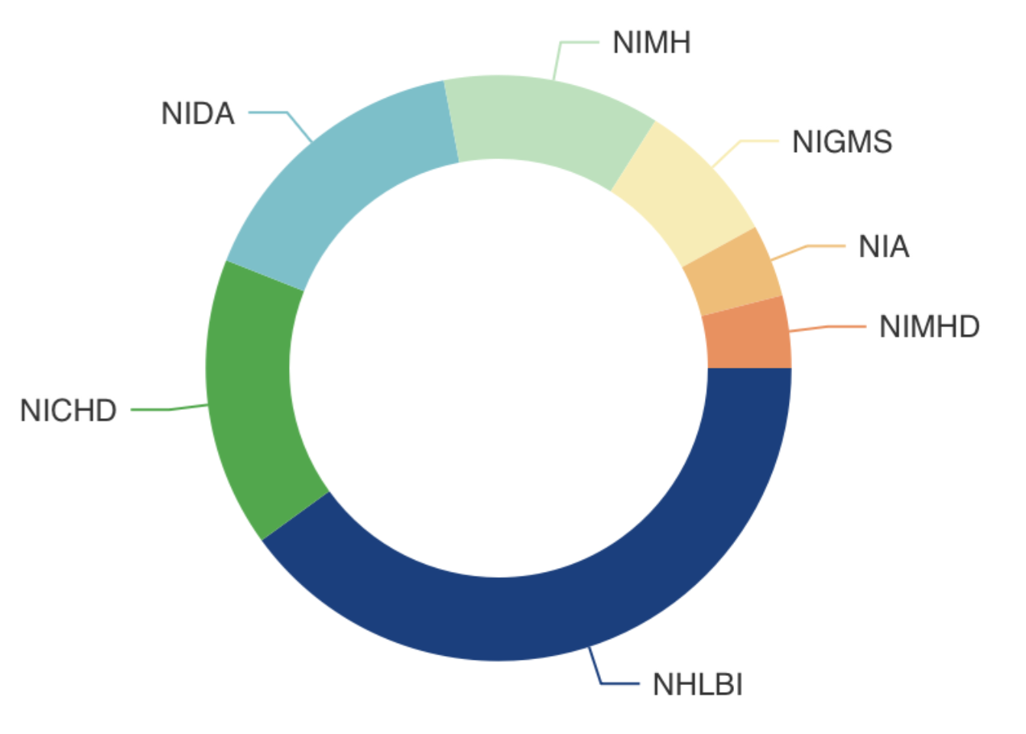









Active EM NIH Clinician-Scientist Training Awards: 2025
K23-Clinical Research
K08-Laboratory Research
3
2
4
2
1
2
25
1
12
1
1
4
2
4
10
https://reporter.nih.gov

Slide 24
Innovations Workgroup Report

Slide 25
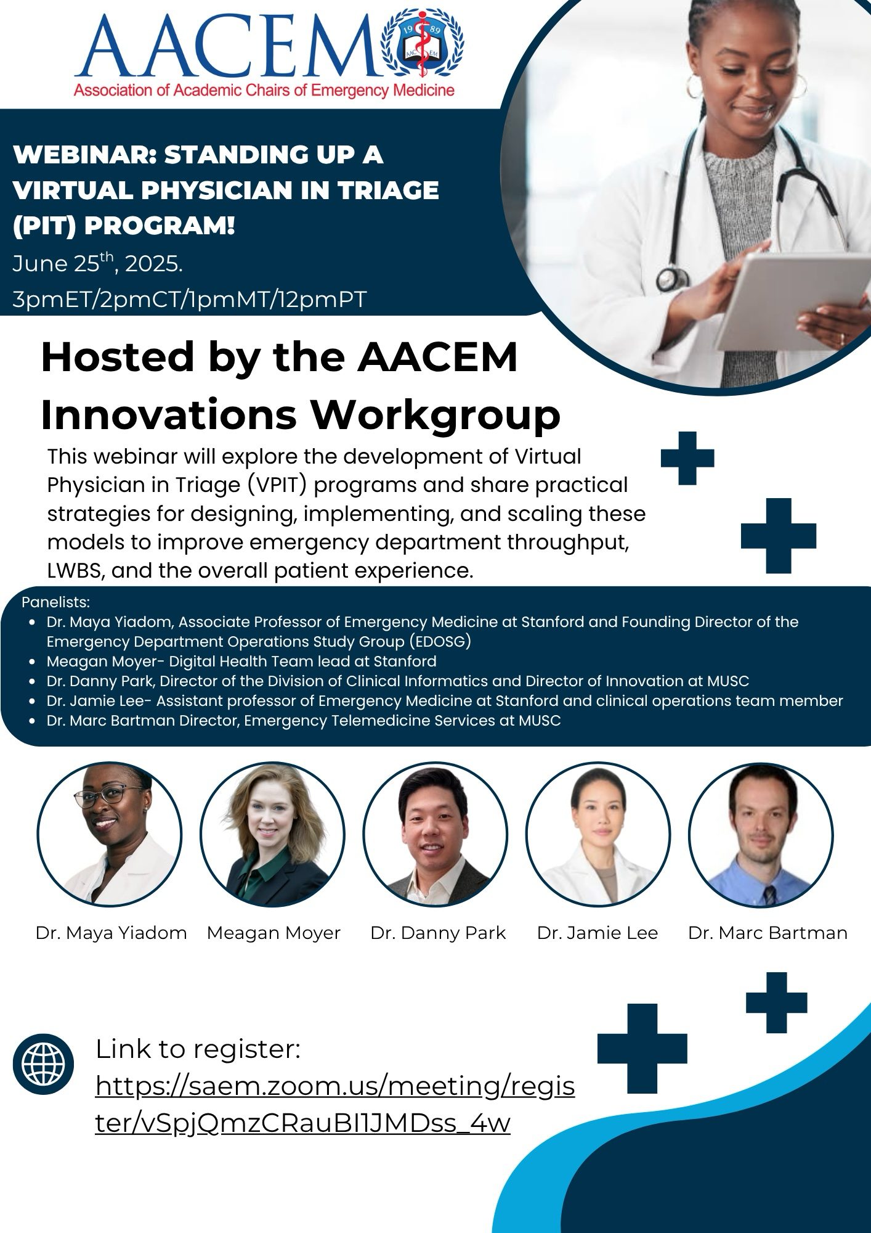
Workgroup Accomplishments
Accomplishments This Year
Advanced national dialogue on innovation in emergency medicine by bringing Dr. Graham Walker to the AACEM/AAAEM Annual Retreat to discuss the rapidly evolving role of AI in emergency medicine, building on last year’s session on boarding innovation.
Launched and sustained a quarterly webinar series for AACEM members, including sessions on AI innovation in education and AI applications to ED boarding, with strong engagement across academic emergency medicine departments. Expanded this to vice chairs.
Considering the national behavioral health capacity challenges, we will have an upcoming webinar focused on EMPATH units as a potential model for improving behavioral health flow and patient care.

Slide 26

Workgroup Accomplishments
Looking Ahead
Continue developing programming and collaborative discussions that help departments address critical system pressures such as boarding, behavioral health capacity, and workforce sustainability.

Slide 28
Membership Committee Report

Slide 29
Committee Members
Carl Chudnofsky, Chair
Eric Legome, Vice Chair
Adam Algren
Steven Goodwin
Richard Hamilton
Gregory Hendey
Denis Pauze
Susan Promes
Andrej Urumov
James Waymack
Jason Wilson

Slide 30
Committee Objectives
  Review the list of academic emergency medicine institutions and their membership levels quarterly and report to the AACEM Executive Committee once per year prior to elections.
  Review and provide recommendations for associate members requesting to be active members status.
  Actively reach out to newly announced chairs and interim chairs to join the organization.
  Submit nominees for the AACEM Distinguished Service and Lifetime Awards.
  Develop and submit at least one topic for presentation consideration at the AACEM/AAAEM Annual Retreat.
  Create an Attestation for membership renewal using recently implemented definitions for membership levels

Slide 31
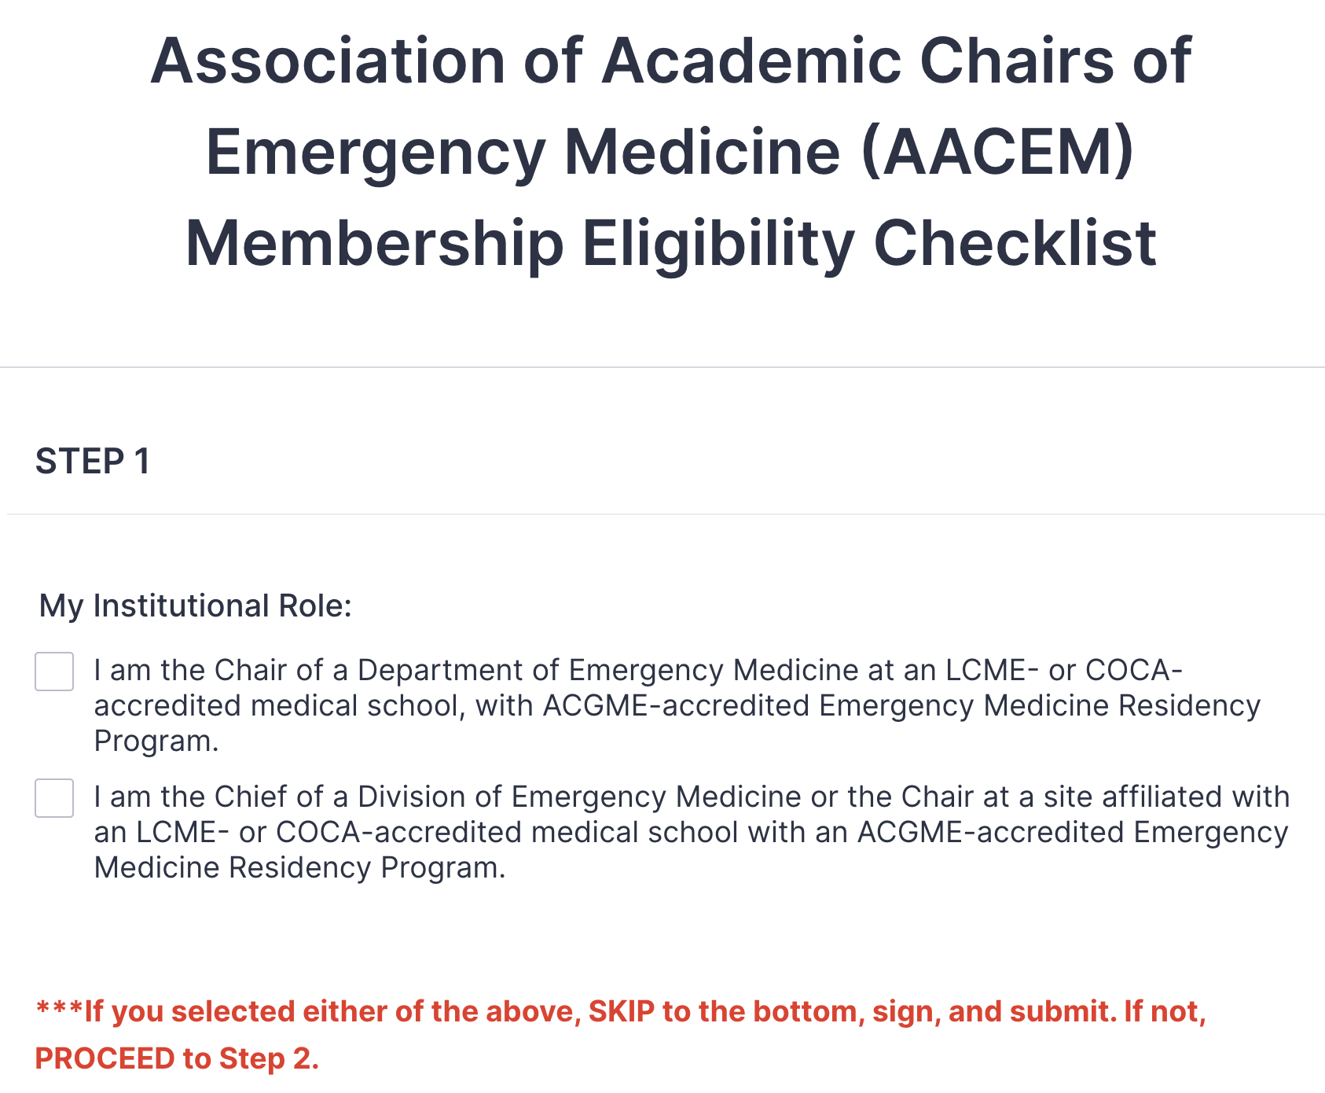
Membership Renewal Attestation

Slide 32
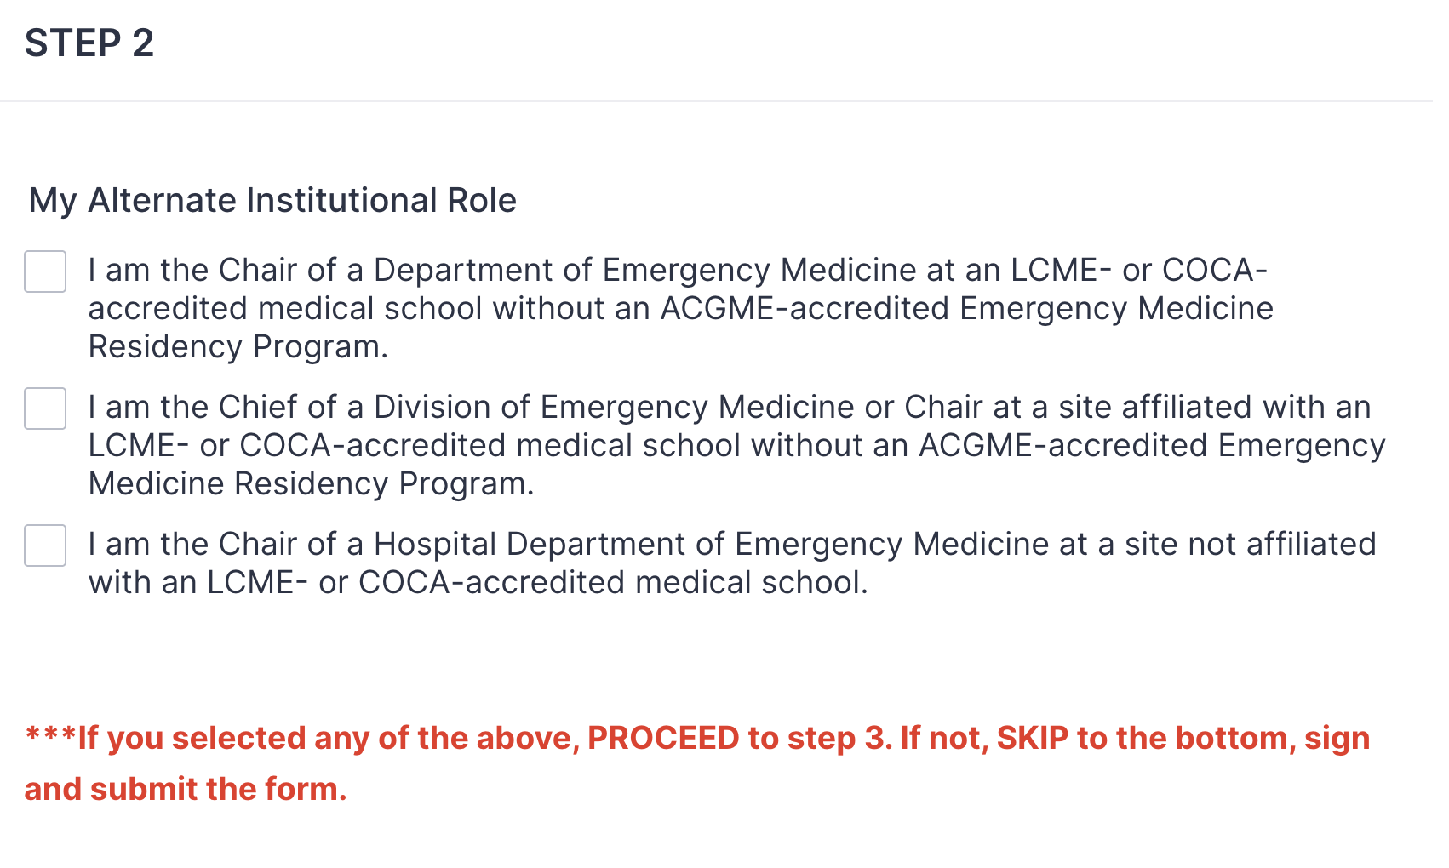
Membership Renewal Attestation

Slide 33
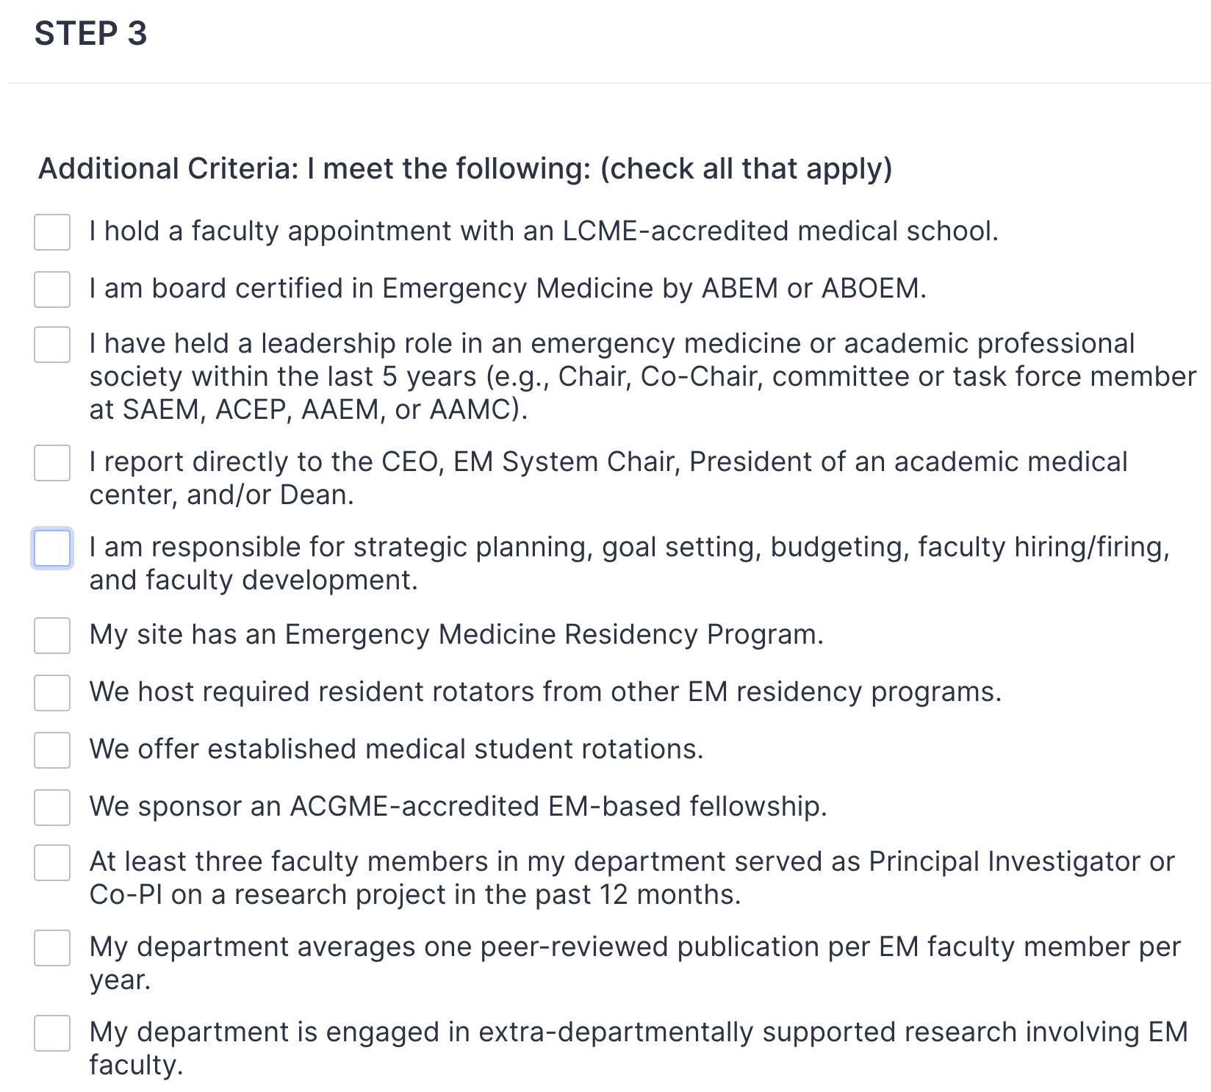
Membership Renewal Attestation

Slide 34
Membership Committee
QUESTIONS?

