Slide 1
Tools of the Trade
Becky McGowan, MBA
Lauren Tanzer, MBA, MS, PMP
Ken Taylor, MBA

Slide 2

Why
Nice to get access to external resources
  From Colleagues
  Best Practices
  Subject Matter Experts

Slide 3
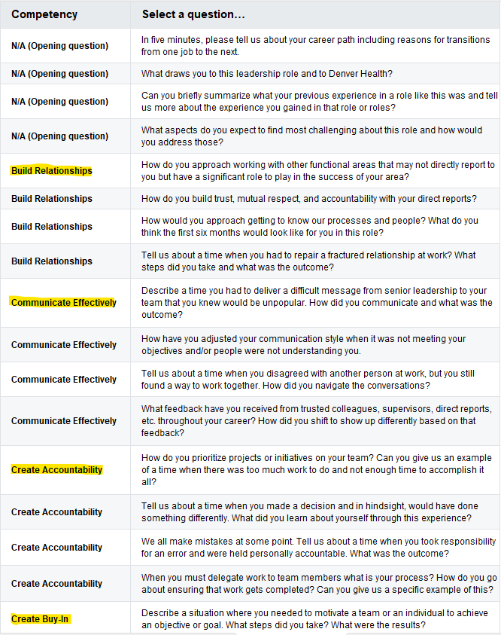
Standardized Interview Guide
Catalog of Questions
  Leader questions
  Team member questions
  Organized by topic (competency)

Slide 4
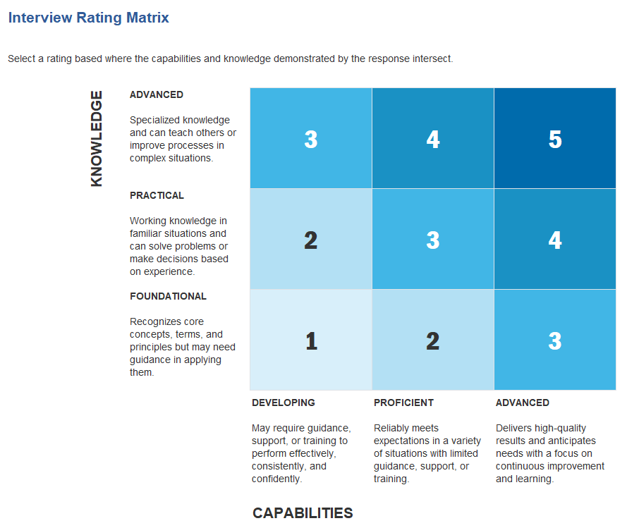
Scoring Matrix

Slide 5
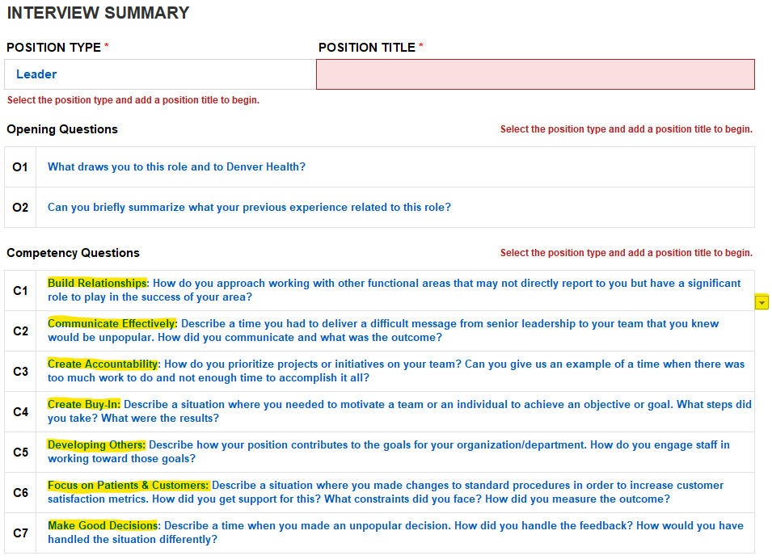
Select Questions on Summary Tab
Select Questions Using Drop Down Menu To Populate the Template

Slide 6
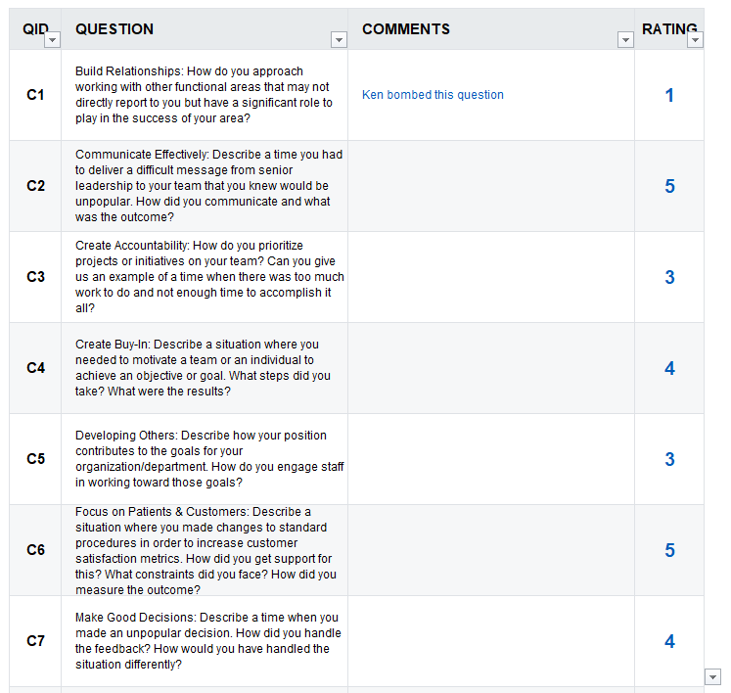
Select Rating on Individual Candidate Tab
Individual Candidate Form
Drop Down to Select Rating

Slide 7
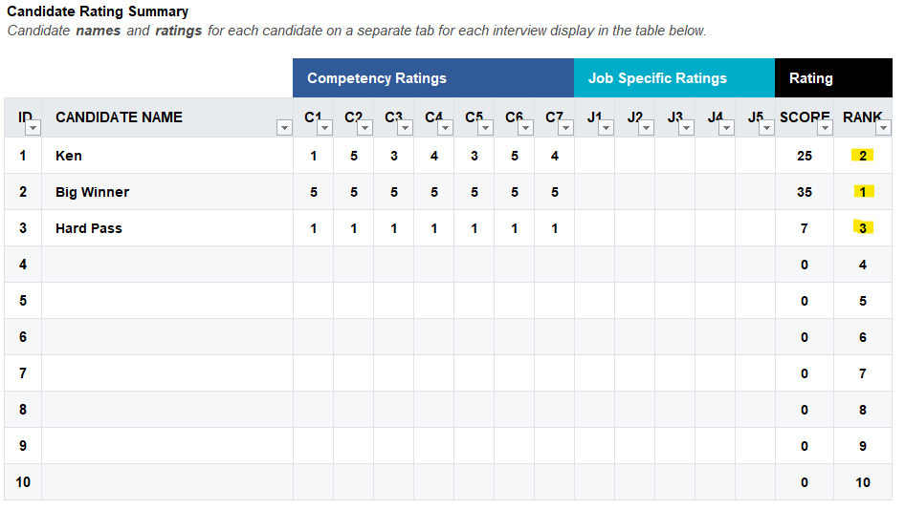
Rating Ranked on Summary Tab

Slide 8
Penn Medicine – Buydown Principles
How much buydown do I get for the role?
That depends … what type of role is it?
Buydown options:
    - Admin D – Roles that the Department supports, funding by Department and Health System
    - Vice Chair positions (Faculty Affairs, Community Engagement, Education, etc.), Wellness, Fellowship PD roles
    - Admin H – Health System roles, funded by system, fully covers all associated expenses for physician including base salary, incentive, malpractice, benefits, etc.
    - Medical Director, Quality & Safety Director, Sepsis Lead, Disaster Preparedness
    - Admin E – Education roles, covered by University support
    - Sub-I Director, Clerkship Director, Teaching roles, Residency PD
    Hours are bought down from the cFTE, reducing clinical time
    Track hours also impact buydown for Admin D and Admin H
    Admin E and research buydown is based on funds available to support the role

Slide 9
Buydown Methodology
Track | Base Hours @ 1.0 FTE | Clinical Hours | cFTE | 10% Admin H or Admin D Role | Updated Clinical Hours
Penn Medicine Clinician (Clinical Track) | 1656 | 1575 | 95% | 157.5 | 1422
Academic Clinician (Academic/Teaching Track) | 1656 | 1494 | 90% | 149.4 | 1341
Clinican Education or Tenure Track (Research Tracks) | 1656 | 1323 | 80% | 132.3 | 1188
Admin E and Research buydown is based on funds available to support the role/work
Cost/hour is calculated as follows:
Admin E buydown changes yearly as salary goes up, buydown tends to go down
Department does not currently subsidize any incremental support to what’s provided from the University

Slide 10
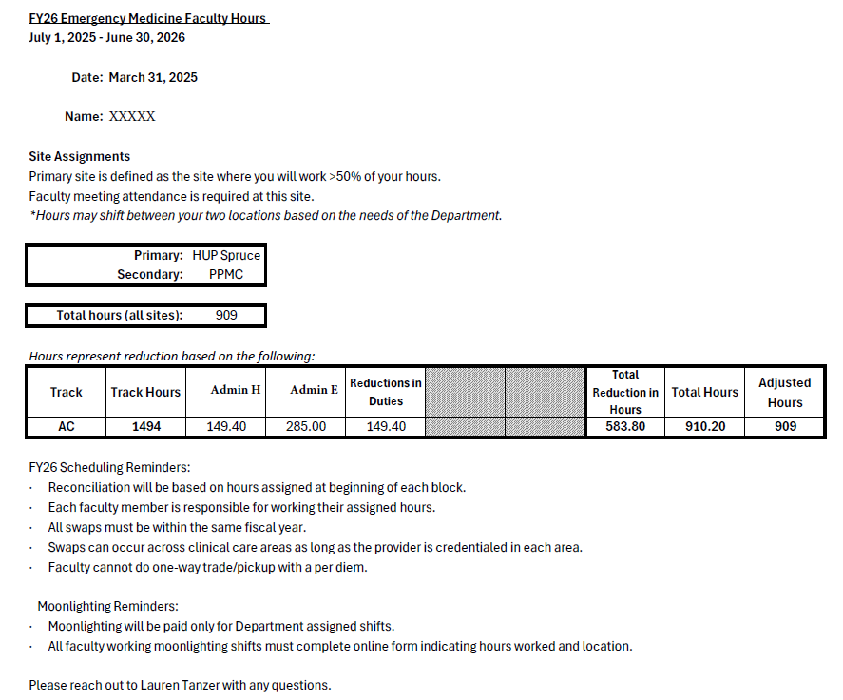
Communicating Hours to Faculty
Annual hours letters are launched each spring
Buydowns added mid-year are assessed in the next schedule block, whenever possible

Slide 11
University of Colorado
Individual Provider Incentive Dashboard
Purpose and Need for an Incentive Metric Dashboard
Objective: Improve transparency, engagement, and efficiency in the department incentive plan
Department has 7 incentive - multiple performance metrics tracked
”Administrative” data elements are stored in 9 different sources (Word, Excel, MyTip, Airtable, etc)
Incentive calculations (compiling and validating) required significant manual effort
Limited updates - reduced visibility into faculty performance and progress toward incentive goals.

Slide 12

Departmental Investment in Automation
SmartSheet and Power BI Implementation
The department invested resources to automate incentive tracking using Smartsheet and Power BI
Automation significantly reduced manual data compilation and reporting effort
The dashboard provides near real‑time visibility into incentive metrics throughout the incentive period
This investment resulted in measurable cost efficiencies and improved operational sustainability

Slide 13
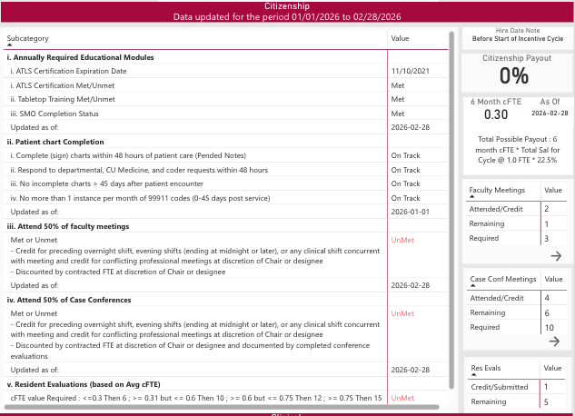

Slide 14
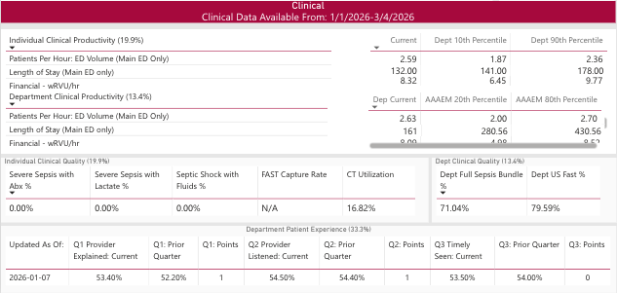

Slide 15

Outcomes and Long-Term Value
A collaborative and scalable model
Establishes a more transparent and collaborative incentive process
Strengthens trust through shared access to consistent, standardized data
Reduces administrative burden while improving accuracy and timeliness
Creates a scalable framework that can support future incentive plans and departmental growth

Slide 16

Tools of the Trade - Wrap Up
Questions?
Contact Information:
Becky.McGowan@cuanschutz.edu
Lauren.Tanzer@pennmedicine.upenn.edu
Kenneth.Taylor@dhha.org
Notes:
Would you like to see more of these from your colleagues
Could deliver via lunch ‘n’ learn sessions
Provide feedback on retreat survey

