Slide 1
Belonging and Wellness,
Where Intention Meets Impact
Becky McGowan, MBA
Paula Abercrombie, MPA
Katy Oksuita, MBA, MS
Christine Hendricks
Carlene Dewane, CPA
Notes:
Katy
Thank you for being here. In our fast paced and high-performance work environment, belonging and wellness can sometimes feel like secondary. We’re busy. The stakes are high.
most of us have experienced moments where we questioned whether we truly belonged or felt the burn out. I know I have.
What I’ve come to realize is this: belonging isn’t about comfort, it’s about safety. And wellness isn’t about ease, it’s about sustainability. They directly influence how we lead and show up for our teams.
So the reason we’re spending 45 minutes on this today is that this work is foundational. If we want high performance, innovation, and resilience, we have to talk about the conditions that continue to make them possible.
Our hope is that this feels less like a lecture and more like a shared conversation, one that gives you small practical and meaningful practices to carry back to your teams.

Slide 2
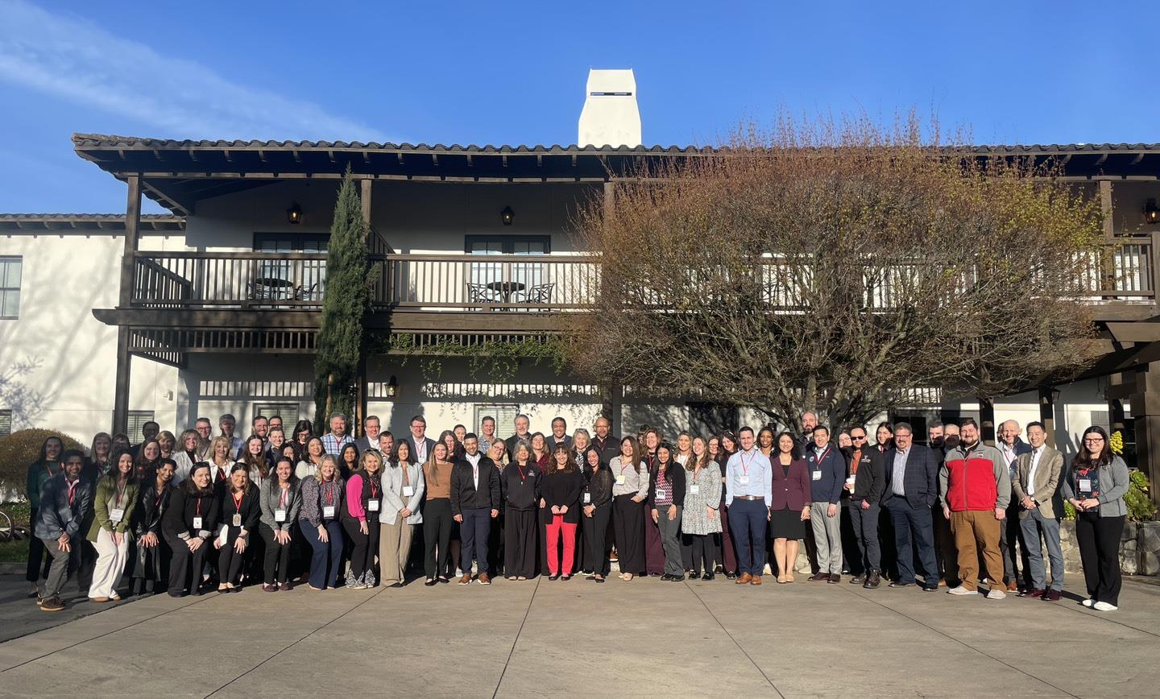

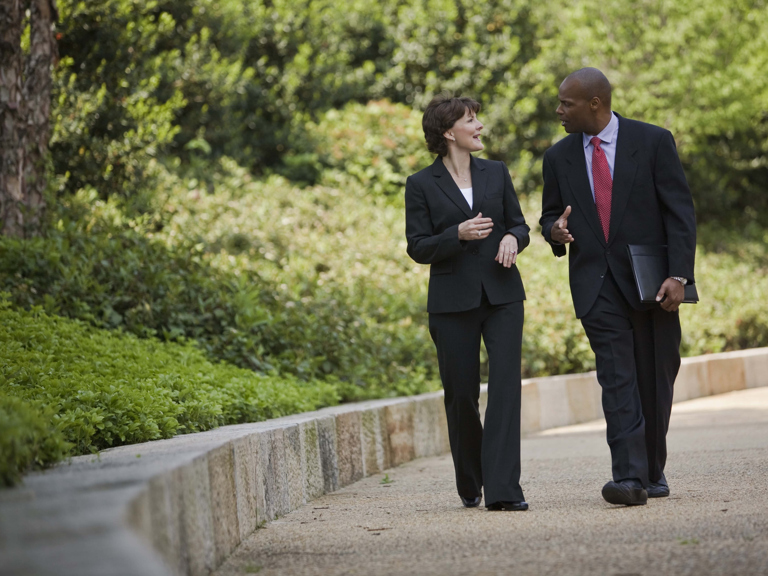
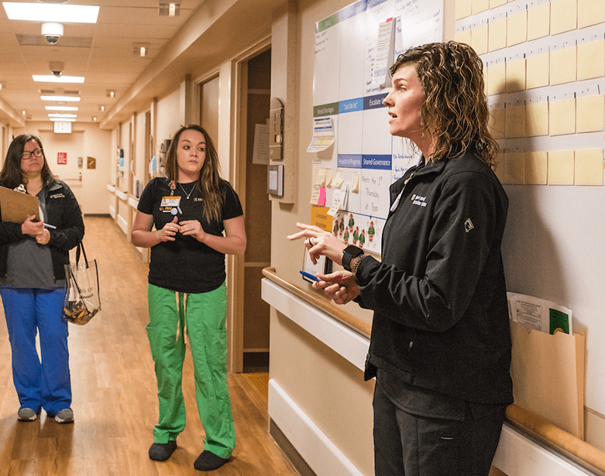

Defining Belonging and Wellness
Notes:
KATY
Belonging is the experience of being accepted, valued, and included as a meaningful member of a group. It means feeling safe to contribute, express ideas, and show up authentically without fear of exclusion or marginalization.
Wellness is a holistic state of health across physical, emotional, mental, social, and professional domains. It reflects a sustainable balance between demands and resources, enabling individuals to function effectively and thrive over time.
Wellness protects performance the same way belonging enhances it.
“Discomfort is the currency of your dreams” So we are going to get a little uncomfortable today and real about where we might push ourselves to show up better for ourselves and our team.

Slide 3
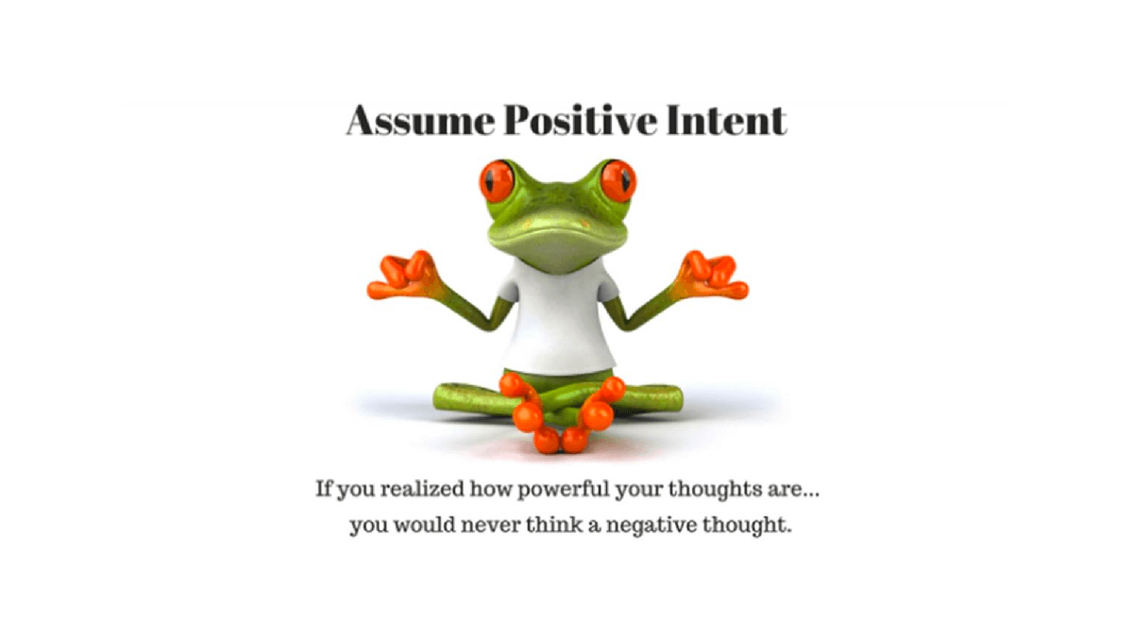
Behaviors Are Shaped by Social Norms
Unwritten rules about how people behave within a specific group or situation.
(Developed through observation and reinforcement of behavior)
Socialized Patterns | Common Expressions
Holistic Orientation | Integrate physical, emotional, and mental health
Performance Orientation | Emphasize strength, metrics, capabilities
Relational Coping | Seek support through conversation, counseling, or community
Independent Coping | Problem-solving, distraction, task focus, self-reliance
Notes:
Katy
Wellness and belonging are reinforced through shared behaviors—and those behaviors are often shaped by the social norms we have internalized and our individual social styles.
For example, think about how people show up at work differently:
Some people build connection by talking through challenges with colleagues, while others prefer to process independently and then share solutions.
Some individuals recharge through social interaction and team energy, while others restore their energy through quiet focus or stepping away briefly.
How many of you have completed StrengthsFinder or a similar assessment? They help us better understand our natural tendencies and also recognize where we may need to stretch outside our comfort zone to support both our own wellness and the belonging of others.

Slide 4
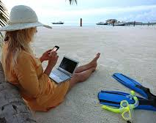

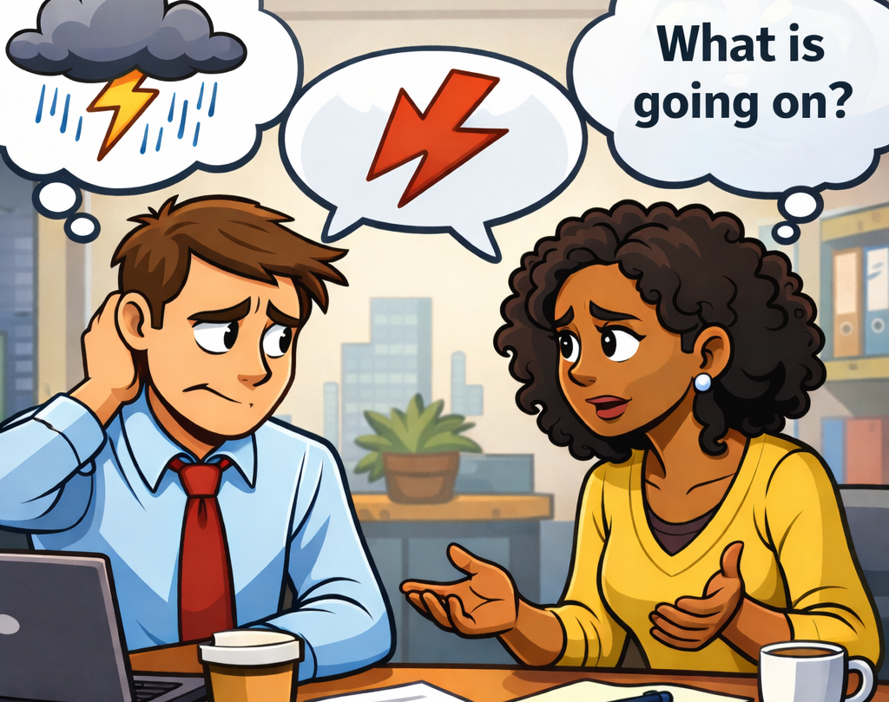

Behaviors Are Shaped by Cultural Norms
Shared expectations and values that develop within a broader culture or organization over time.
They are often deeply rooted and influenced by history, traditions, and collective beliefs.
Response to stress
Communication style
Comfort with help-seeking
Boundaries set
Notes:
KATY
In a similar way to social norms, cultural norms shape behavior, including how leaders model stress and whether they protect healthy boundaries. Paying attention to these differences, seeking to understand them, and recognizing their impact fosters belonging and wellness.
By understanding these influences is helps us recognize that leadership behaviors are not neutral, they are shaped by context, experience, and the environments in which we’ve developed.
Impact on Wellness & Belonging
Some may view asking for help as a strength; others may see it as vulnerability.
Some value public recognition; others prefer quiet contribution.
Some seek flexibility; others prioritize stability and predictability.
These differences matter.
As we all are aware, each school, department and culture is unique. Building reserves for our teams, whether emotional, relational, or operational, requires understanding those nuances and being intentional about how we support them.

Slide 5
Notes:
BECKY
Belonging and wellness are not individual issues —
they are cultural forces that ripple across the entire department.
They show up in:
How people speak in meetings
Whether concerns are raised early or hidden
How conflict is handled
How workload is distributed
Whether people feel energized or depleted
Feeling that you do or don’t belong in a team has a profound effect on the quality of work you actually produce.
When employees feel like they belong, companies enjoy 56% improved job performance, 50% lower turnover risk and 75% fewer employee sick days. (Barret, 2024)
Likewise, research shows that when organizations actively support employee well-being, they see: Up to 23% higher profitability, 41% lower absenteeism, which provide higher engagement and productivity, and reduced burnout and medical costs (Gallup, 2025)

Slide 6
Notes:
We’ve talked about how belonging and wellness shape norms. Now is your opportunity to pause and reflect,

Slide 7
Why Is It Still Hard??
Notes:
BECKY
You’ve all shared supporting wellness and belonging examples.
We have thoughtful leaders. We care deeply.
So that means we’ve solved it, right?
Culture is not a program, it’s a system, it’s intentional practice
Healthcare (and high-performance environments) operate under constant demand
People experience stress differently
Organizational incentives don’t always align with human sustainability
Belonging requires continual reinforcement
Wellness requires structural, not just personal, solutions
Next on to Pillars
BECKY - LEAD INTRO PILLARS

Slide 8

Pillars of Focus – Introduction
Pillar 1 - Building Belonging
Pillar 2 – Embedding Wellness
Pillar 3 – Leadership as Catalyst
Notes:
PAULA

Slide 9
Pillar 1 – Building Belonging
Replace This → With This
❌ “We already covered that.”
✅ “That’s helpful — can you expand on that perspective?”
❌ Silence when someone shares an idea
✅ “I appreciate you raising that.”
❌ “You’ll figure it out.”
✅ “Let’s walk through it together.
Notes:
PAULA
Belonging isn’t built in big speeches — it’s built in small, consistent behaviors.
Use validating language.
Practice micro-affirmations.
Intentionally connect people — especially new hires — so no one navigates alone.
Inclusive communication, micro-affirmations, peler connections programs.
• Script: ‘Use validating language, practice micro-affirmations, and pair new hires with buddies.’
Using someone’s name
Crediting ideas
Inviting quieter voices in
Following up after meetings
Recognizing and honoring individual styles
“What small behavior could we normalize that would strengthen belonging immediately?”

Slide 10
Pillar 2 – Embedding Wellness
Wellness Check-Ins
Taking a lunch (not at your desk)
Take a moment to honestly reflect on where you are today.
Notes:
PAULA
Wellness isn’t an add-on — it has to be embedded into how we operate.
Normalize brief wellness check-ins.
Increase autonomy where possible.
Make support resources visible and easy to access — not buried in policy.
Where are we unintentionally making wellness harder than it needs to be?

Slide 11
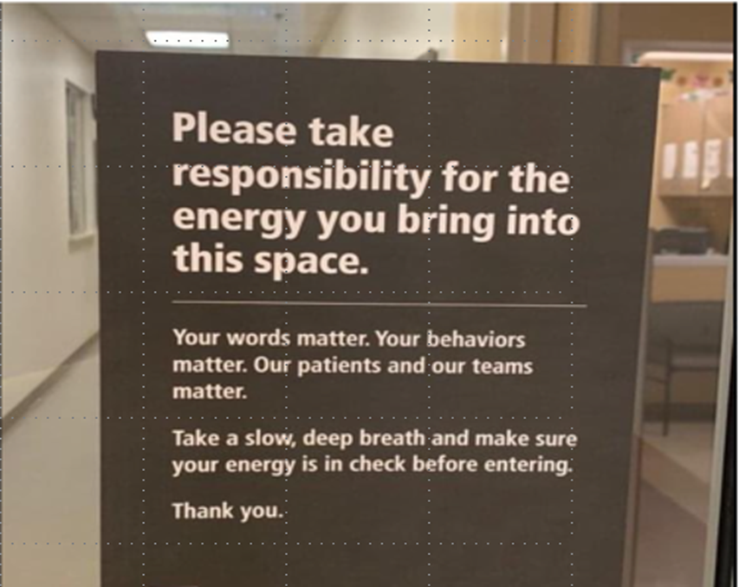
Pillar 3 – Leadership as Catalyst
Model Self-Care
  Blocking personal boundaries on calendar
  Taking PTO without apology
  Saying: “I don’t have capacity right now — let’s prioritize.”
Build Safety
  Thanking someone for raising a hard issue
  Admitting when you don’t know
  Inviting dissent respectfully
Broaden Recognition
  Celebrate collaboration, not just productivity
  Recognize behind-the-scenes contributors
  Acknowledge effort during high-stress periods
Notes:
PAULA
Leadership sets the emotional climate of a department.
What we reward becomes culture.
What we model becomes permission.
If we only reward output, we’ll get output at any cost.
If we reward empathy, teamwork, and sustainability — we build belonging and wellness.
What are we unintentionally rewarding? And what message does that send?
Leadership is not just positional — it is behavioral. And behavior shapes culture.

Slide 12
Notes:
PAULA

Slide 13
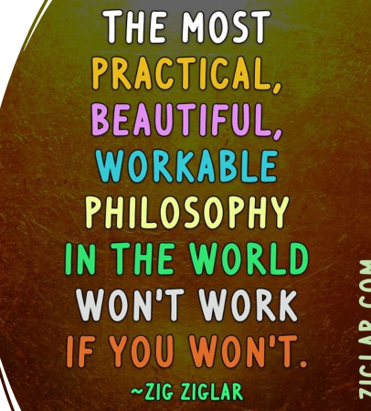
Key Considerations
What small behavior shift could make an immediate impact?
What norm might you reinforce more consistently?
Where could you model something differently?
What is one conversation you’ve been avoiding?
What is one practice you will start, stop, or continue?
Notes:
KATY
We’ve explored belonging, wellness, and leadership behaviors.
We’ve shared examples. We’ve named tensions.
What have you learned, or been re-reminded of, that you will intentionally bring back to your team?
Share examples

Slide 15
References
Barratt, B. (2024, February 27). Why feeling a sense of belonging at work matters and how to cultivate it. Forbes. https://www.forbes.com/sites/biancabarratt/2024/02/27/why-feeling-a-sense-of-belonging-at-work-matters-and-how-to-cultivate-it/
Clifton, J., & Harter, J. K. (2021). Wellbeing at work: How to build resilient and thriving teams. Gallup Press.
Westergaard, Mary. (2025). How to coach yourself. Circumstances, thoughts & emotions

Slide 16
Thank you

