Slide 1
The ‘Super’ Urgent Care
Steven A. Godwin, MD – Chairman and Associate Dean for Simulation
David Christiansen, MBA – Director of Healthcare Administration
Department of Emergency Medicine, College of Medicine Jacksonville
University of Florida

Slide 2
The ‘Super’ Urgent Care
Setting the Stage: 2019
Access to care
Inner City Urban Public Health environment
Highly competitive market
Limited growth potential
EM Community Expansion

Slide 3
The ‘Super’ Urgent Care
Strategy Forward: 2019
Wildlight – a ‘Super’ Urgent Care
Free Standing EM/UC Hybrid

Slide 4
Goals at the outset
Improve Access to Care
Meet community need for “non-emergent” care or “less resource intensive” emergent care
Improve payor mix
Expand market share

Slide 5
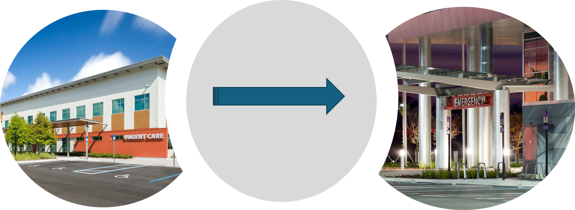
A New Space in Healthcare Delivery
Meeting the consumers need for an expanded Emergency Medicine Footprint

Slide 6
Wildlight Urgent Care
Not your ‘Care Spot’ Model
Ground Floor UC Clinical Space Included in Multi-specialty Ambulatory Care Center
11 bed ED modeled layout
EM Physician staffed
Advanced Imaging [CT, US]
On-site Lab during open hours
10 hours M-F, 7 hours Sat/Sun/Hol

Slide 7
Funding Source
Initially supported by the practice plan under the Dean’s control
Goal was to create an urgent care that utilized advanced imaging and a comprehensive lab to provide ED level care without the facility fee
Approach 3rd party payors for more favorable fee schedules

Slide 8
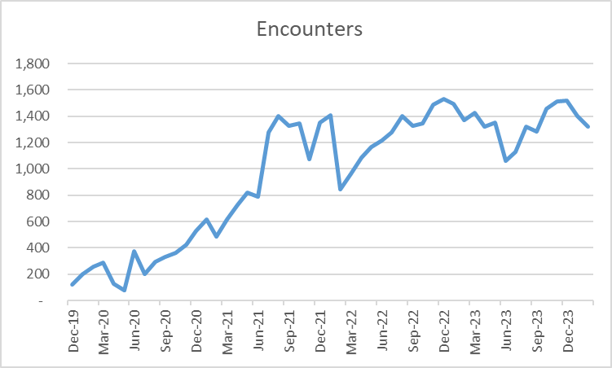
Wildlight Urgent Care

Slide 9
Wildlight Urgent Care
Downstream…
Over 10,000 new MRN's brought into the system
Roughly 28% came back to UC within 180 days
Roughly 48% had another appointment made within 180 days
Big 5 in 2022-23
  Primary Care 1,338
  Pediatrics 377
  OB/GYN 279
  Orthopedics 203
  Cardiology 196

Slide 10
Lessons Learned
Contracting is key
  Not as readily adopted by 3rd party payors as expected
Generally positive but mixed faculty engagement
Creating resource pool for support staff
  Normally hospital based personnel may not be as readily available to cross-train or use as back-up call
  Create agreements with hospital to allow sharing of personnel

Slide 11
Lessons Learned
Know ways to identify downstream revenue and thus your contribution margin
Expect reactions from competitors
    Every action invites response

Slide 12
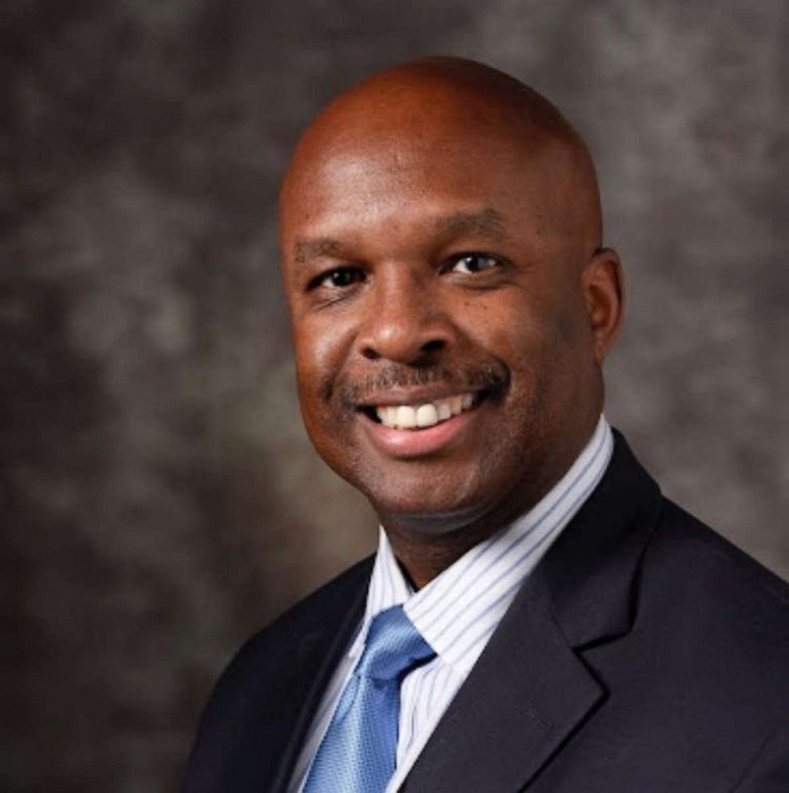
The Hybrid ED (UC/ED in 1 space)
-Goal of creating a market disruptor
-Identified a novel approach to combined ED/UC care in Texas

Slide 13
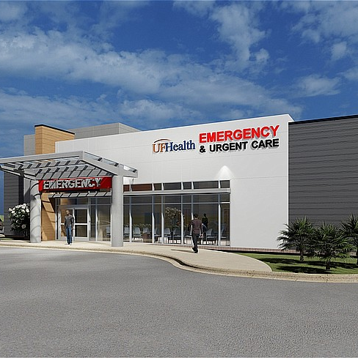
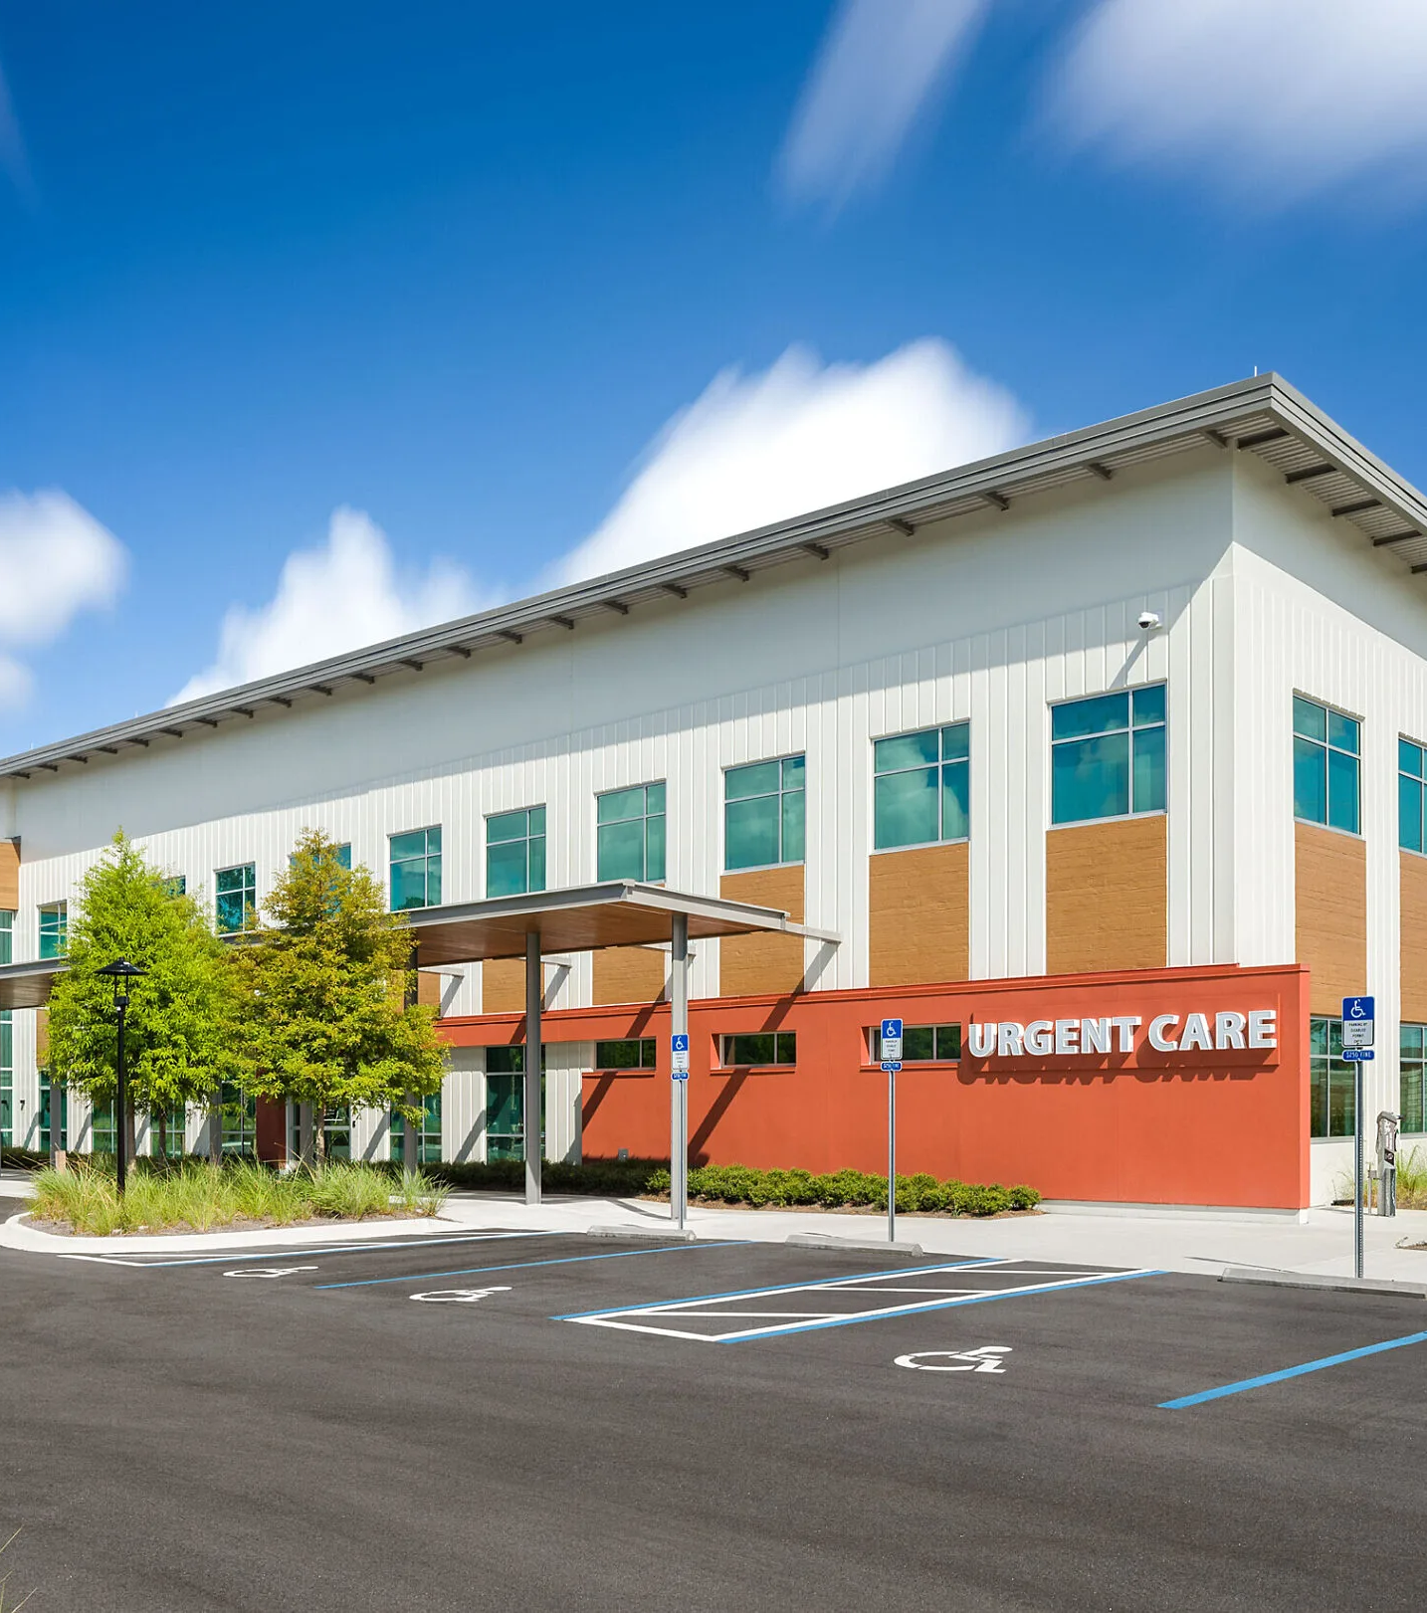
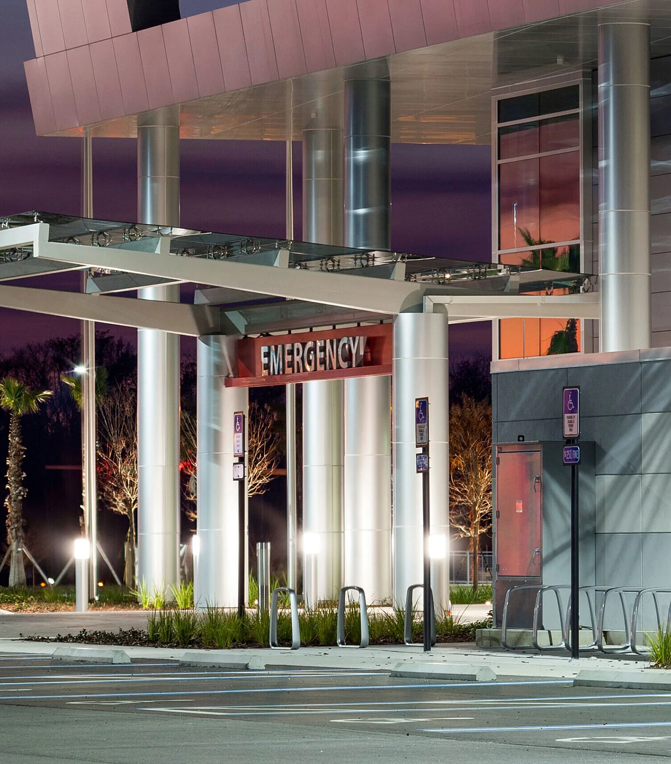
A New Space in Healthcare Delivery

Slide 14
Hybrid ED/UC
Regulatory challenges (AHCA, EMTALA, etc)
Provide more consumer friendly delivery of facility-based emergency care
Staffing based on expected volume in alignment with acuity defined by the ED vs UC visit allocation
Bold hospital decision to allow UC visits 24 hr vs 10-12hrs per day

Slide 15
ED vs UC
What classifies an ED vs UC visit?

Slide 16
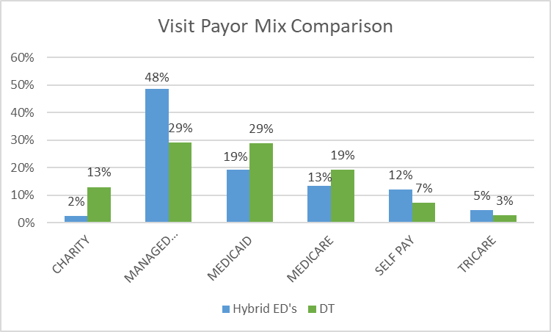
The 3 Hybrid EDs (UC/ED in 1 space)

Slide 17
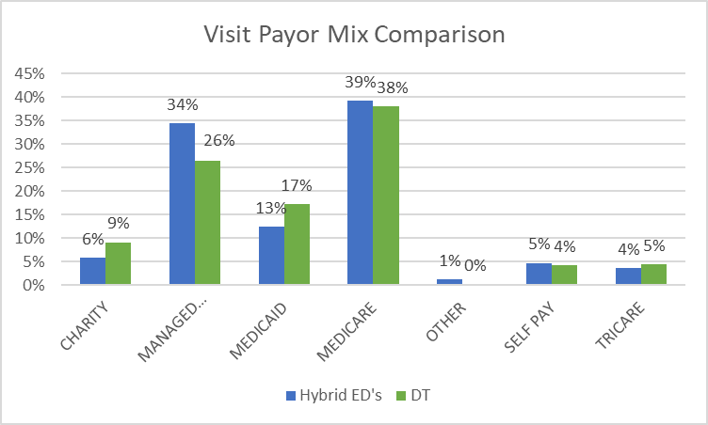
The 3 Hybrid EDs (UC/ED in 1 space)

Slide 18
Lessons Learned
Some repeat lessons- Contracting is still key!
Workforce differences
    Academic vs Community vs middle space?
At-risk vs staffing contracting
Downstream Revenue – need to know your impact to help drive better staffing contract!
Reactions from Competitors
    Every action invites response

Slide 19
Questions ?
Steven A. Godwin, MD
Andy.Godwin@jax.ufl.edu
David Christiansen
David.Christiansen@jax.ufl.edu
904-244-5044
Thank you!

