Slide 1
Moral Injury and Vicarious Trauma in America’s Healthcare System
J. Jeremy Thomas MD, MBA
Dan Danzl Endowed Chair and Chief of Service
University of Louisville, School of Medicine
Department of Emergency Medicine

Slide 2
Truths
In the United States in 2023, the practice of medicine is hard and does not support physicians!
Systems are not in place to protect physicians from the consequences of this practice environment.
Physicians are not good at dealing with the baggage that goes along with this profession.
Physicians physical and emotional well being, and those of the people around them are often impacted greatly.

Slide 3
TRUTHS
SYSTEMICALLY We must do better at supporting ourselves and our colleagues in healthcare.
  There is reason that 20% of the healthcare workforce left healthcare all together, during the pandemic.
  There is a reason that the average female Emergency Medicine trained physician leaves the practice of EM by the age of 45. (SAEM 2023)

Slide 4
Objectives of this talk:
To better understand secondary trauma, vicarious trauma, moral injury and burnout as EM physicians.
To appreciate that EM physicians are exposed to these stressors daily.
To acknowledge that to prolong our careers and promote our own emotional and physical wellbeing, there are things that we as physicians and especially as leaders, can and should do for ourselves and those we serve.

Slide 5
Conflict of Interest:
None!

Slide 6
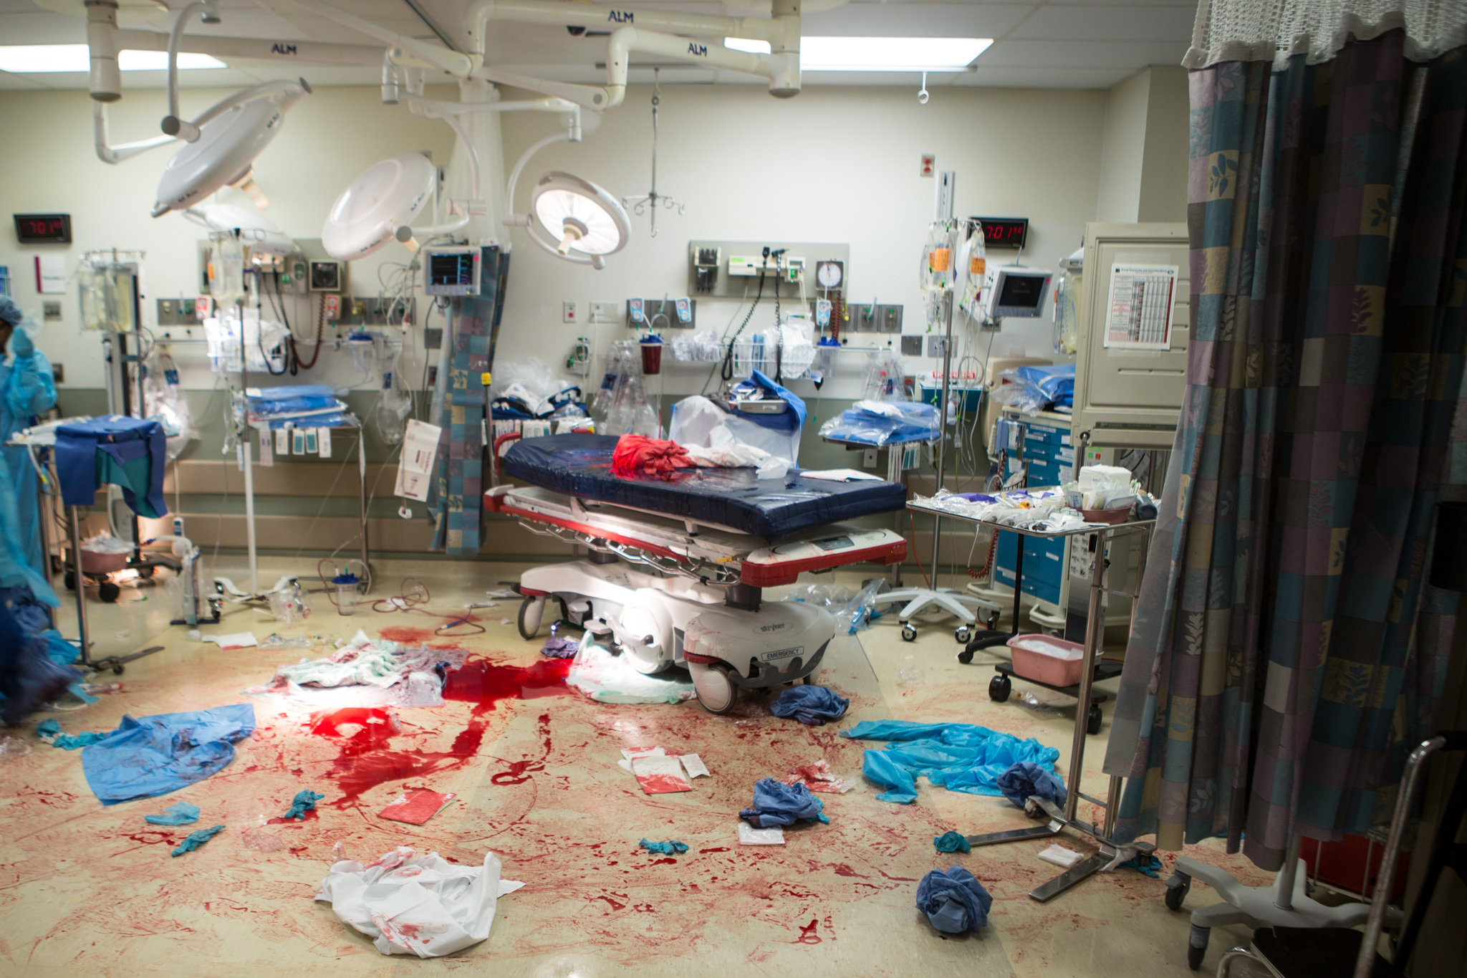
Trauma
noun
a deeply distressing or disturbing experience.
"a personal trauma like the death of a child"
2. physical injury.
"rupture of the diaphragm caused by blunt trauma"

Slide 7

Secondary Trauma
the emotional duress that results when an individual hears about or is engaged in the firsthand trauma experiences of another

Slide 8
The effect of Secondary Trauma
AAMC survey
  80% of doctors have experienced a truly distressing patient event in the last year.
Journal of Patient Safety (2019)
  >2/3 of providers involved in an adverse clinical event suffered from troubling memories, anxiety, anger, remorse or distress.
  Following these truly distressing event doctors may experience:
    Recurrent thoughts / memories
    Sleep disturbance
    Anxiety or PTSD type triggers
    Depressions symptoms
    Withdrawal / decreased physical activity and interpersonal interactions
    Increased volatility

Slide 9
Following these Acute Events
(unexpected death, extreme violence, highly emotional case, disaster…)
Debrief as a group
Follow up with individuals if needed
Offer resources / counseling / support services
Support those exposed to secondary trauma in the acute setting both professionally and emotionally (pull from schedule, …)

Slide 10
Put systems in place:
Harvard - (CPPS) Center for Professionalism and Peer Support
University of Missouri Health Center – “forYOU” program
Johns Hopkins – RISE (Resilience in Stressful Events) program
Provide specially trained individuals for physician support 24/7
The programs respond to an event – not waiting for the provider to seek support
“attend to the well being of caregivers,… so they, in turn, can give their best to patients”

Slide 11
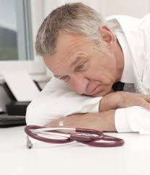
Vicarious Trauma
▪ The emotional residue of exposure to traumatic stories and experiences of others through work; witnessing fear, pain, and terror that others have experienced

Slide 12
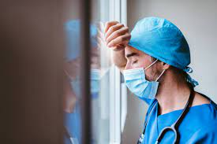
Secondary Trauma vs Vicarious Trauma
Secondary trauma may occur suddenly, after hearing or engaging a patient's story a single time
whereas,
vicarious trauma represents a shift in the clinician’s attitude and worldview after prolonged exposure to patients' suffering.

Slide 13
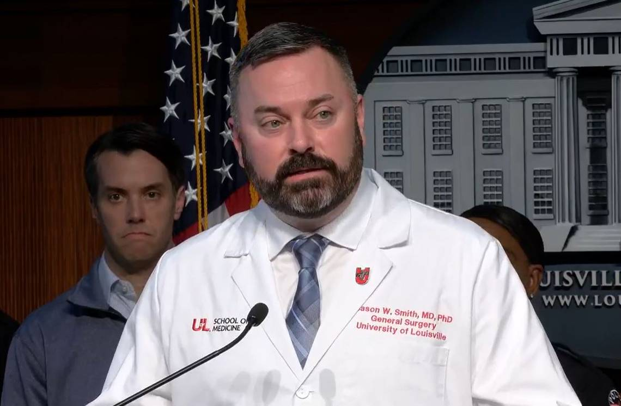
Vicarious Trauma in American Physicians
“We are tired…”
  Dr. Jason Smith

Slide 14
Then what is Burn out?
“a prolonged response to chronic emotional and interpersonal stressors on the job, … defined by 3 dimensions of exhaustion, cynicism, and inefficacy”
- Maslach
Maslach Burnout Inventory

Slide 15


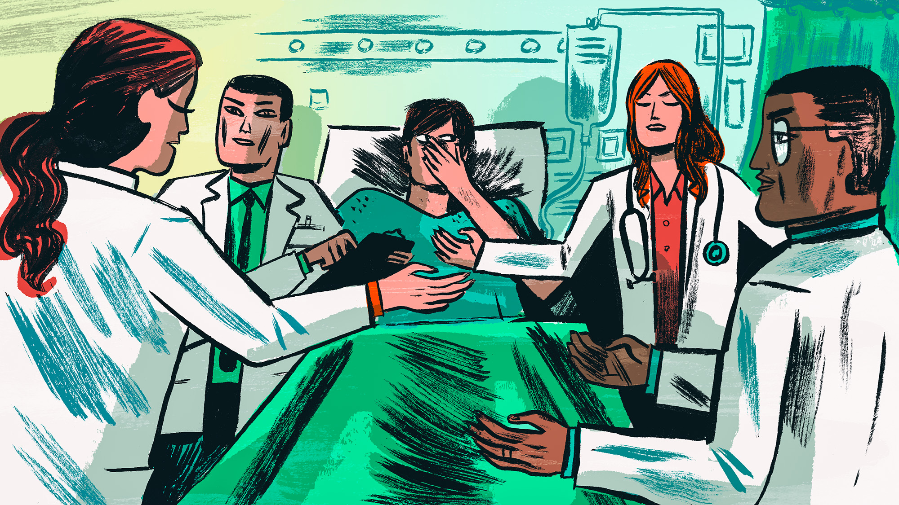
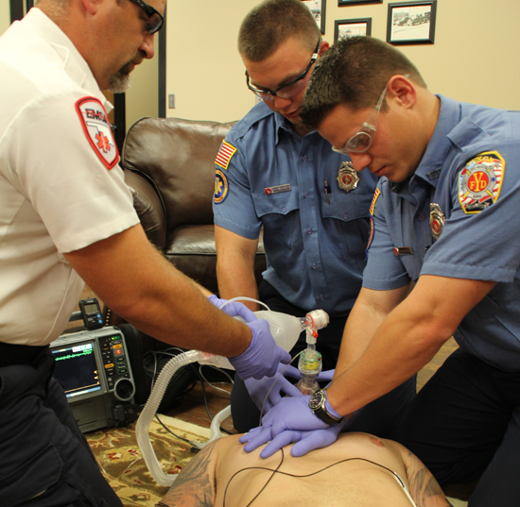
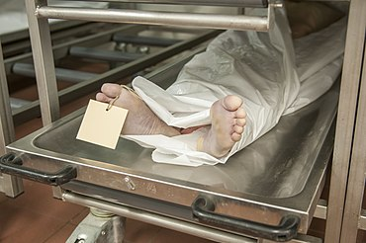

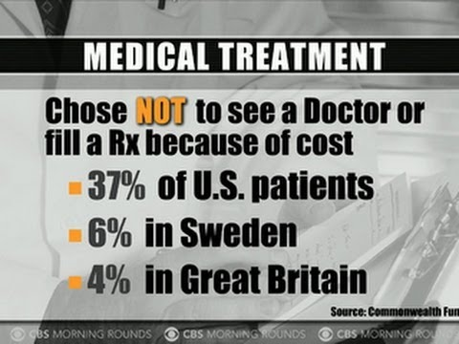
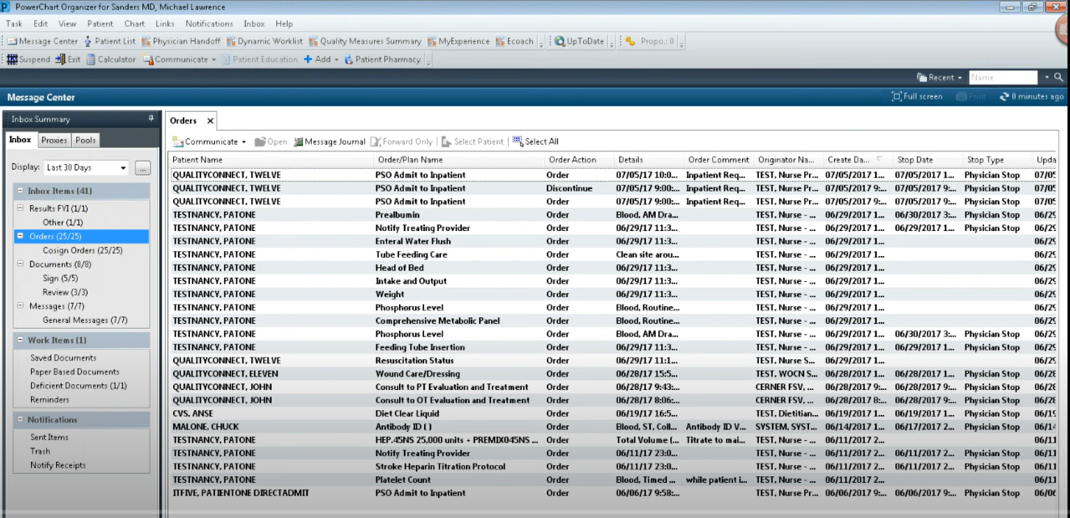

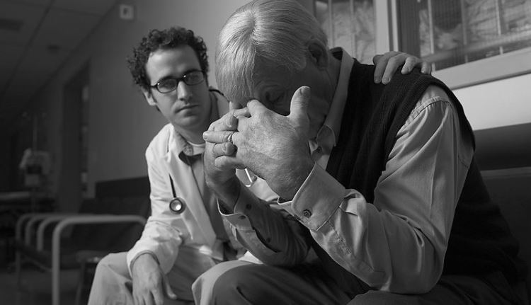
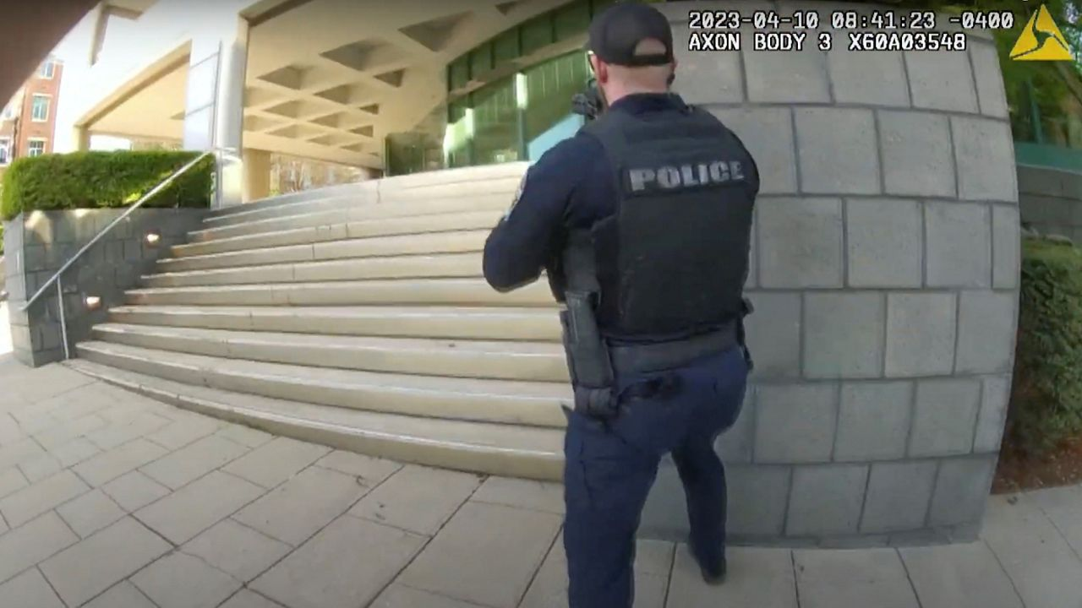
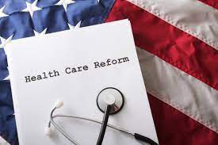
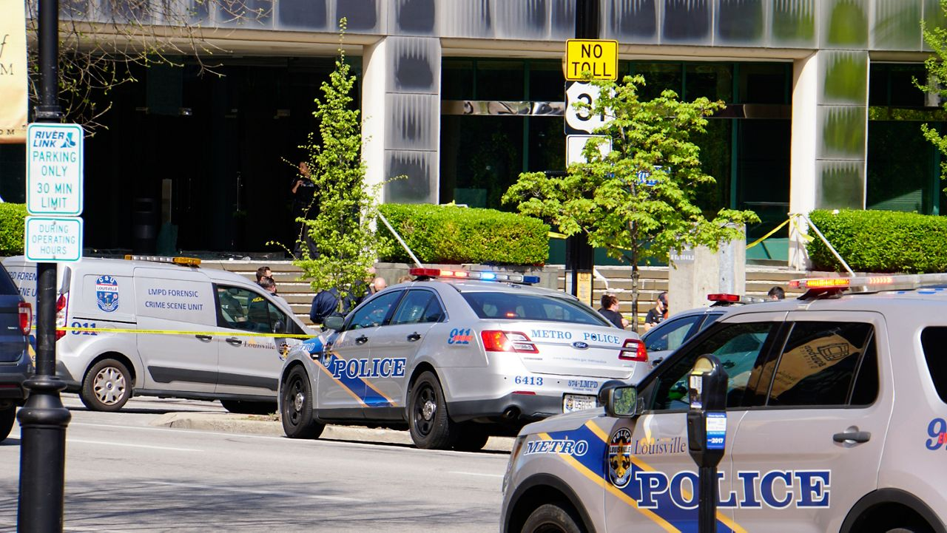
Why is our practice so difficult?

Slide 16
Physical trauma in Healthcare
Security – survey
  92% of healthcare workers have witnessed or directly experienced workplace violence in the last month (May 2022)
American Hospital Association
  Over an 18 month period from 2020-2022, 44% of hospital nurses reported physical violence and 68% reported experiencing verbal abuse in the workplace.
The Joint Commission
  During a 3-month study in mid 2022, a Press Ganey study showed the rate of nurses assaulted within hospitals in the United States was greater than 2 per hour every day.

Slide 17
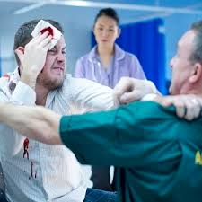
AAMC – Emergency Departments
47% of emergency physicians report having been assaulted while working clinically
70% of emergency nurses report having being hit or kicked while on the job.

Slide 18
”A workplace Problem, not a worker Problem”
Workplace Violence
Limited Staff/Resources
Boarding
Hostile work environment / conflict
Disasters
Lack of control of work environment / schedule
Misalignment of priorities and goals
A rescue care system with no preventative care focus
Compromised values/integrity – Hippocratic Oath

Slide 19
Drivers of Burnout in Academic EM
Toxic Cultures Collide
  Academia
    Competition
    Drive for Promotion
    Drive for funding
  Corporate Business
    Push for revenue
    Push for productivity
Lack of Control
  Front door
  Back door
  Our space
  What we get paid
  How we get paid
  When we get paid
  The EMR
  The Match

Slide 20
Is it more than Burnout ?
What is Moral Injury?
  “a wound that forms when a person’s sense of what is right is betrayed by leaders in high-stakes situations” - Jonathan Shay
  Originally a term for soldiers, as a form of PTSD (soldiers who felt they were forced to compromise their values based on situations they were placed in during the Vietnam War)

Slide 21
Moral Injury… In Medicine?
Have you ever felt that your care of a patient was negatively impacted by …
  System lack of resources/access
  Departmental Lack of space (or access to it)
  Patient Lack of insurance / support
  System Emphasis on RVU/PPH/$
  System Lack of efficiency
  EMR not optimized to support care

Slide 22
Moral Injury… In Medicine?
What does it look like?
Being unable to provide the quality of care that our patients need and deserve in the contest of our health care system (locally or nationally)
“Not only are clinicians feeling betrayed by their leadership, but when they allow these barriers to get in the way (of care), they are part of the betrayal, they are instruments of the betrayal”.
  Dr. Wendy Dean(Psychiatrist)

Slide 23
Moral Injury… In Medicine?
“We are training people to put the patient first, and they’re running into a buzz saw”
  Dr. Robert McNamara (Chair, Temple University)
  ”The Moral Crisis of American Doctors”
  The New Your Times Magazine
  June 15, 2023

Slide 24
Moral injury in Medicine!
What is Moral Injury?
  “a wound that forms when a person’s sense of what is right is betrayed by leaders in high-stakes situations” - Jonathan Shay
Hippocratic Oath / Personal Values
+
Current State of American Healthcare
=
Significant Risk of Moral Injury for Physicians

Slide 25
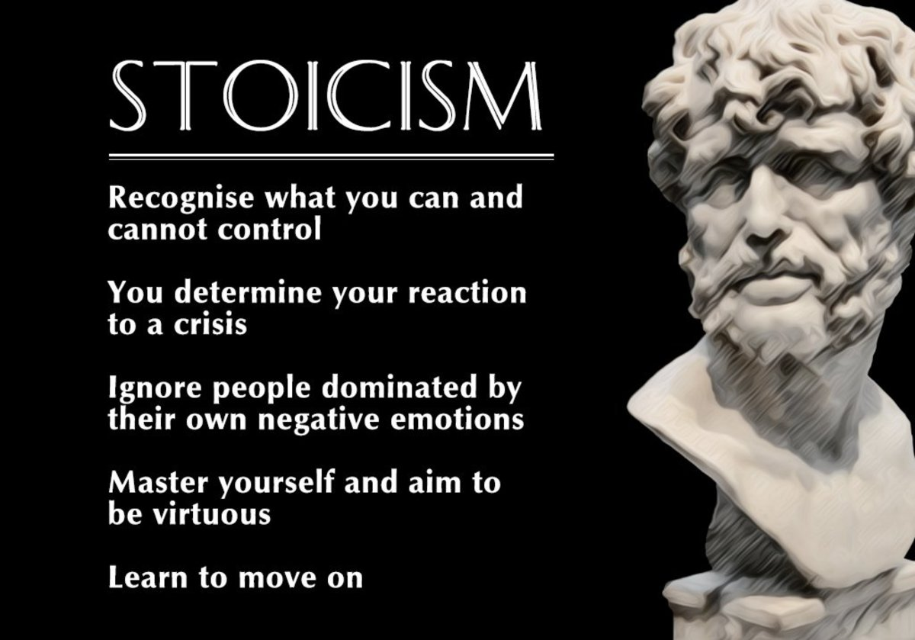
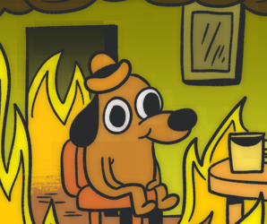
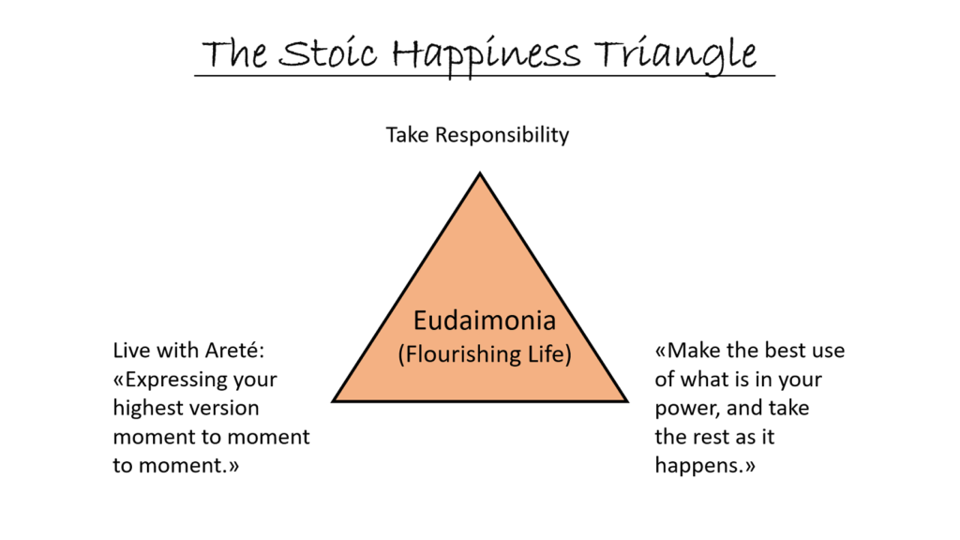
I’m Fine…. Everything’s fine!
sto·i·cism
noun
1.
the endurance of pain or hardship without the display of feelings and without complaint.

Slide 26
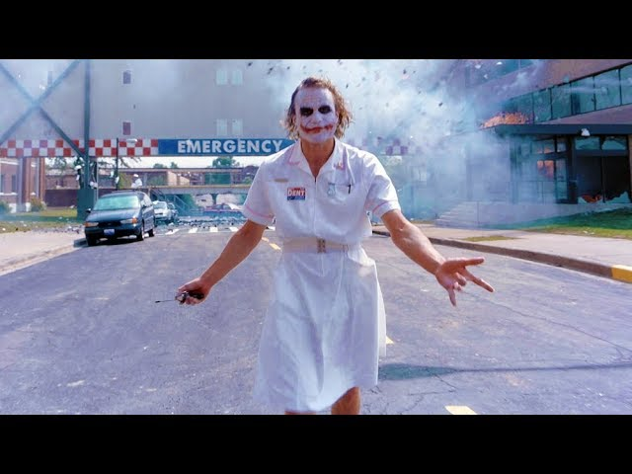
Everything is fine – until its NOT
And then one day you are ready to walk out of the department like……
But that explosion in the background can be:
  Your emotional wellbeing
  Your physical health
  Your career
  Your family
  Your life….

Slide 27
What keeps physicians from seeking support?
I made it this far on my own!
Seeking assistance is seen as weakness
Isolation is the normal practice of a struggling physician
Fear of stigmatism
Fear risk of licensure or practice issues
Lack of time / scheduling
Cost
Lack of previous experience or exposure to support resources or structure

Slide 28
What got us here is often not sustainable !
Tools of our Youth
Burdens of our lives and careers
Independence
Stoicism
Striving / competition
Future oriented / ladder climbing
Depersonalization in certain clinical settings
Isolation
Martyr mentality / resentment
Lack of satisfaction / joy for others
Inability to live in the present and have peace in the moment
Depersonalization of other parts of your life

Slide 29
Does this job and the trauma associated with it affect US? healthcare providers?
It is clear, that being a healthcare provider in the US has significant impact on the wellbeing of the healthcare providers and those close to them.

Slide 30
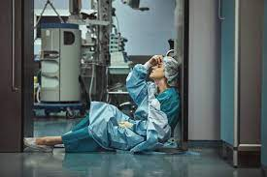
Burnout:
National Survey published in Yahoo Money – Oct. 2022 “13 stressful Jobs that Lead to Burnout”
3 of the top 6 are in healthcare
  Nurses
  EMT
  Physicians

Slide 31
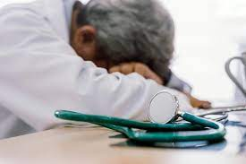
Depression and Anxiety
Jobs most at risk for depression:
  Health.com (2011) – Health Care workers #4
  Business Insider: Doctors, Nurses and EMT in the top 6 (2019)
  National Alliance on Mental Illness (2020) – Medical field #2
  Of Note: These were all before the Pandemic!

Slide 32
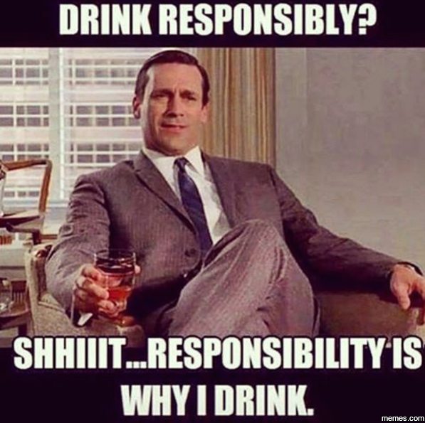
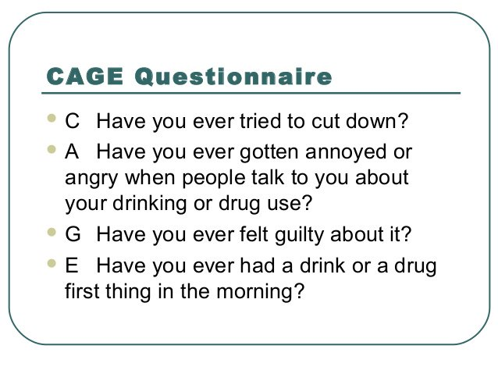
Problematic Alcohol Use
JAMA 2022
From 2006-2020 a rise in problematic alcohol use in physicians from 16% to 27% of physicians (trend of Male > Female)

Slide 33

Divorce
Divorce.com – April 2023
10 Professions with the Highest Divorce Rate
  #4 Medical and Healthcare Workers
  Right behind Bartenders and Exotic Dancers
  Right in front of Flight Attendants, Massage Therapists and Casino Workers

Slide 34
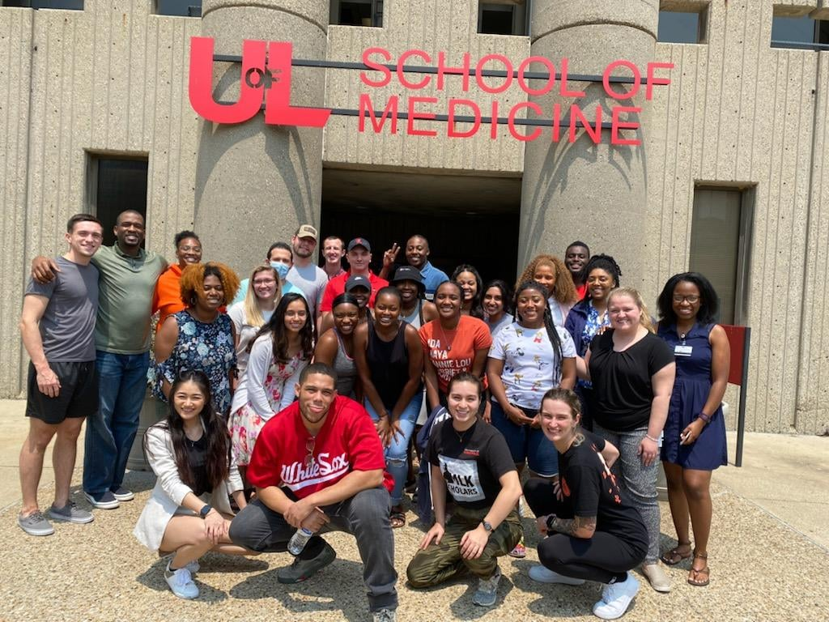
Suicidal Ideation and Suicide – our students
US Medical Students are 3x more likely than their peers to die by suicide (Academic Medicine, 2009)
10% of US med students surveyed, reported suicidal thoughts in the past 2 weeks (AAMC survey 2020)

Slide 35
Our Doctors in Training
ACGME Data shows that over a 15-year period ending in 2015
  Suicide is the leading cause of death in male US medical residents in training
  Suicide is 2nd only to neoplasm in female medical residents in training as the cause of death during this same time frame
(This data review only looked at deaths reported to the ACGME, not suicide attempts, gestures or other markers of wellbeing)

Slide 36

Suicide Risk by Profession
National Institute for Occupational Safety and Health (2020-22)
  Jobs with Highest Suicide Rates -
  Doctors #1 (1.87 x general public risk)

Slide 37
Surgeons Specifically
Arch Surg. 2011;146(1):54-62
Special Report
Suicidal Ideation Among American Surgeons
  Among individuals 45 years and older, SI was 1.5 to 3.0 times more common among surgeons than the general population
  Only 26.0% with recent SI had sought psychiatric or psychologic help
  60.1% were reluctant to seek help due to concern that it could affect their medical license.

Slide 38
But it’s Doctors and HealthCare everywhere …. Right?

Slide 39
British Suicide and Occupation Study – Comparing 1979-82 to 2001-05 Data

Slide 40
Where do we go from here?
Understand and Acknowledge the issues
Open the dialogue
Own the changes that are possible
Provide the tools to be the best doctors in the environment that is not in our control.

Slide 41
Start in our departments
Open Dialogue around uncomfortable topics
  Depression and trauma
  Alcohol and other coping mechanisms
  Therapy
Didactics dedicated to emotional and physical wellness. And Compassion!

Slide 42
Teach and Show Compassion
We have been trained that we must keep an emotional distance from our patients for our own emotional wellbeing.
Evidence based medicine does NOT support this!
Extensive research shows that Compassionate Care is better for our patients! And for us as Physicians!
Empathy + Action = Compassion (acts of kindness)
  -Dr. Stephen Trzecizk (anesthesiologist / author)

Slide 43
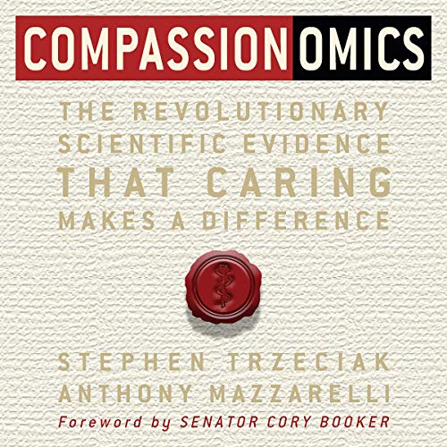
Teach Compassion !
Literature shows that Acts of Compassion:
  Improves patient outcomes
  Improves patient’s compliance with care
  Improves physician perspectives on their job
  Decreases physician burnout
    and
  Decreases depression / anxiety
  Decreases BP
  Decreases CV mortality risk
  Increased survival (all cause)

Slide 44
Start in our departments
Proactive plans for faculty and resident support
  Consider opt out opportunities, rather than opt in
  Make taking care of yourself and your colleagues – the Norm. Leadership sets the Culture!
  Compassion towards our colleagues, our learners, and our patients – HELPS YOU TOO!
  Be aware and willing to confront a colleague who you may see concerning signs or changes in.

Slide 45
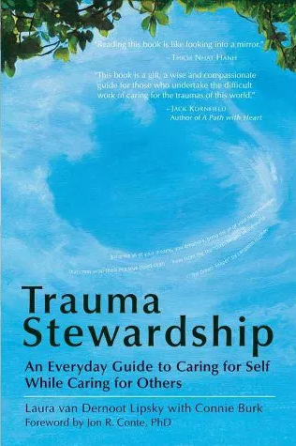
Questions and Discussion?

Slide 46
Thank You!
jj.thomas@louisville.edu

