Slide 1
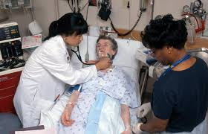


“Our patients are sicker…”
“Our patients are different…”
“Our patients need more…”

Slide 2
The impact of the patient population
on ED operations
James Scheulen & Heather Blonsky
AAAEM Benchmark Committee
March, 2024

Slide 3
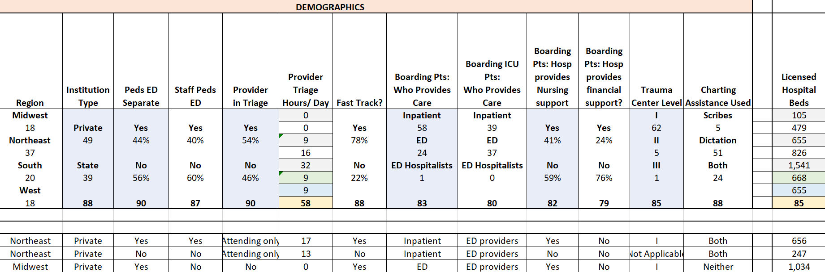
Benchmarking in EM
Comparing the activity or operations of one emergency department with others for the purpose of quality or process improvement
Operational data
“Defines” the department
Develop a cohort to compare
Data is not patient level data

Slide 4




Benchmarking in EM
How does the composition or complexity of
the patient population impact operations

Slide 5
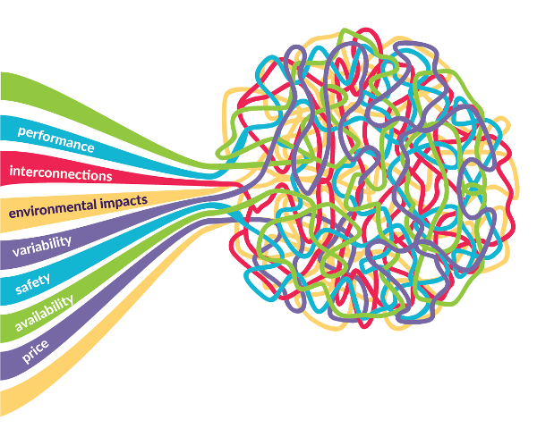
Patient Population Definition
Understanding the composition and complexity of the patient population in each emergency department as a way to better understand the resources required to care for that patient population.
Time as a proxy for resource demands
Patient level data
On any given day, what do we face?
  Interactions between patient variables

Slide 6
Defining your department
Developing the right cohort
Understanding resource needs
Operational Variables
  Visit volume
  Teaching vs Community
  Hospitalization rate
  State vs Private
Patient Population
  Patient history
  Presenting complaint
  Co-morbidities
  Social needs

Slide 7
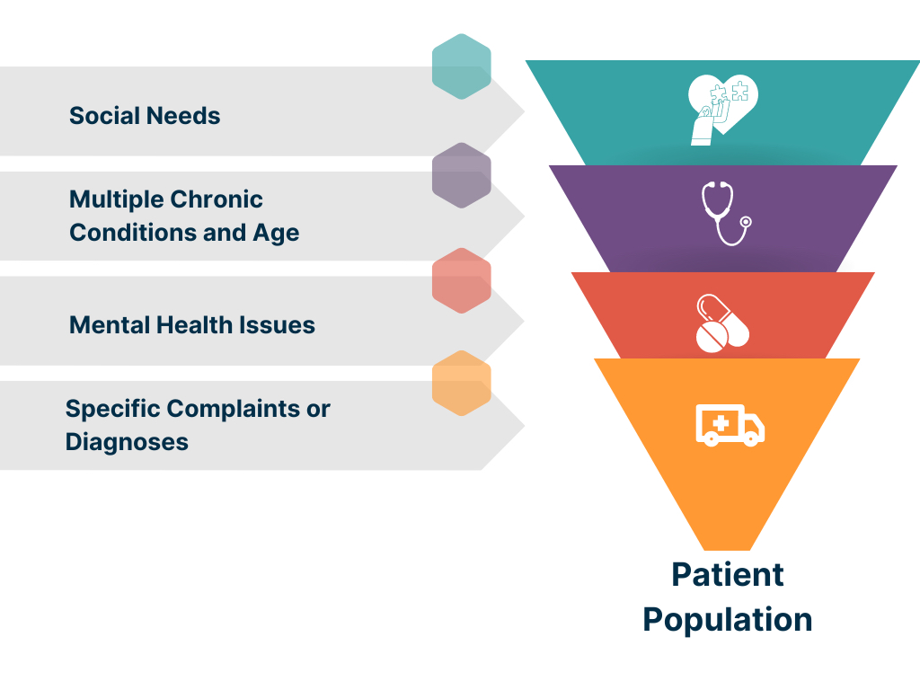

Slide 8
Our Challenge
A way to describe a patient population
A way to consider multiple patient based variables
A way to compare among ourselves
A way to compare ourselves to ourselves over time
Notes:
…Here are the 5 things I want you listen to during this presentation because at the end I want us to come to some consensus on direction and next steps for some tools…

Slide 9

Acuity versus Complexity
Acuity
Severity of illness
Priority setting
Implies SPEED is required
Complexity
Multiple care needs
Personal, social and clinical needs together
Implies TIME is required

Slide 10
Operational metrics
Case mix index for ED admissions complexity index development
Previous Efforts

Slide 11
Inpatient Case-Mix Index
Inpatient Case Mix Index: Hospitalized from ED
  Resource based index
  Indicates acuity/complexity but impacted by high cost treatments
 | CMI w/o HAC
Primary Academic | 1.94
ED Admissions | 1.80
Non-ED | 2.07
Community | 1.45
ED Admissions | 1.45
Non-ED | 1.49
AMC > Community Hospital
AMC ED > Community ED
Non-ED > ED Hospitalizations
Community ED = Non-ED

Slide 12
Complexity Metrics: As a group

Slide 13
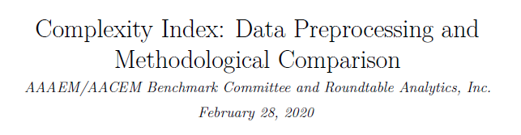
Operations Based Complexity Index
Produce an Index Score and Rank for each Academic Center
Number of Arrivals
Ratio of % ESI-1/2 to % ESI-4/5
% ED Arrivals Hospitalized
% Arrivals by EMS
% EMS Arrivals Hospitalized
% Profee 4/5/CC
4 Versions of Complexity Index
Principal Component Analysis
Blended Versions
Notes:
There are 2 options we can pursue.
Looking at acuity as a stand-alone concept for our patient population where we seek to quantify and contrast how sick our patients are. High acuity patients are more likely than low acuity patients to die, require surgery, or be medically admitted. Question: is your average behavioral health patient high or low acuity?
The other option is to expand this concept and incorporate additional factors that serve as indicators of how complex it is to clinically and operationally manage these patients. This option isn’t just about how sick the patients are but how resource intensive they are and how much pressure the place on the internal system of the ED.

Slide 14
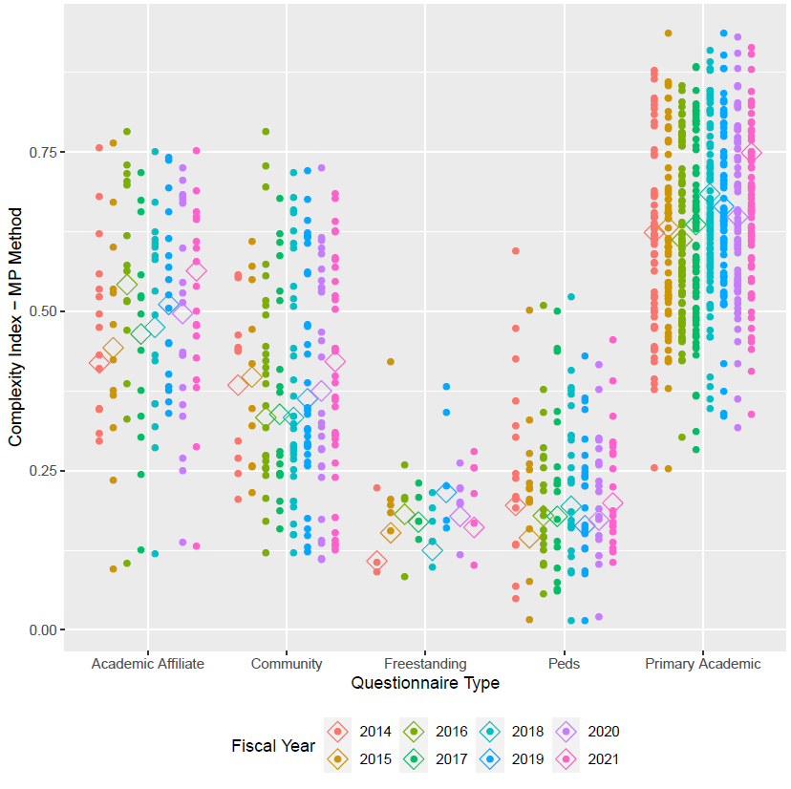
Operations Based Complexity Index
Fiscal Year 2021
.749
Hospitalization rate
EMS Arrivals
EMS Admissions
High Acuity Codes
Acuity 1&2 vs 3&4
.564
.421
.161
.199
Notes:
There are 2 options we can pursue.
Looking at acuity as a stand-alone concept for our patient population where we seek to quantify and contrast how sick our patients are. High acuity patients are more likely than low acuity patients to die, require surgery, or be medically admitted. Question: is your average behavioral health patient high or low acuity?
The other option is to expand this concept and incorporate additional factors that serve as indicators of how complex it is to clinically and operationally manage these patients. This option isn’t just about how sick the patients are but how resource intensive they are and how much pressure the place on the internal system of the ED.

Slide 15
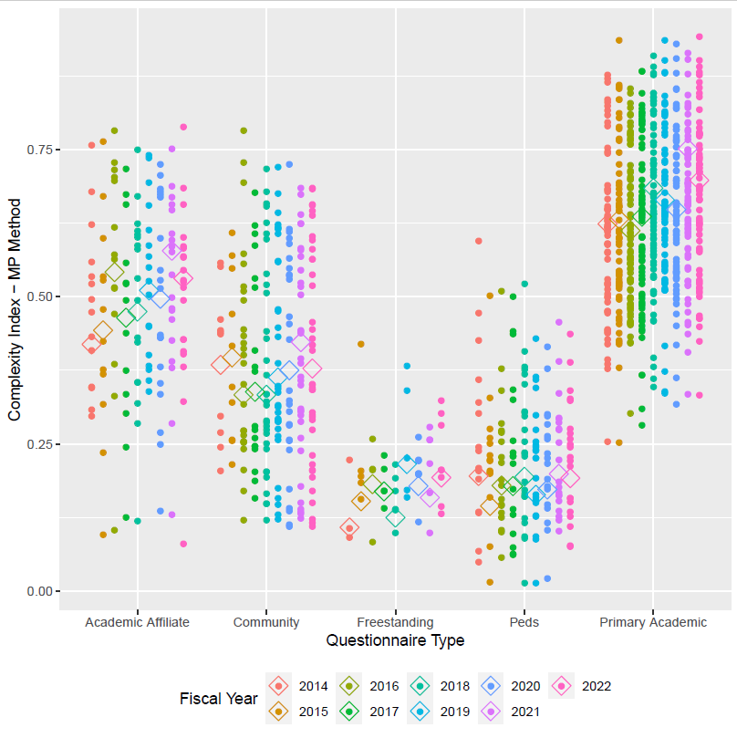
Operations Based Complexity Index
Fiscal Year 2021
Fiscal Year 2022
.749
.697
.564
.531
.421
.378
.161
.199
.193
.192
Notes:
There are 2 options we can pursue.
Looking at acuity as a stand-alone concept for our patient population where we seek to quantify and contrast how sick our patients are. High acuity patients are more likely than low acuity patients to die, require surgery, or be medically admitted. Question: is your average behavioral health patient high or low acuity?
The other option is to expand this concept and incorporate additional factors that serve as indicators of how complex it is to clinically and operationally manage these patients. This option isn’t just about how sick the patients are but how resource intensive they are and how much pressure the place on the internal system of the ED.

Slide 16
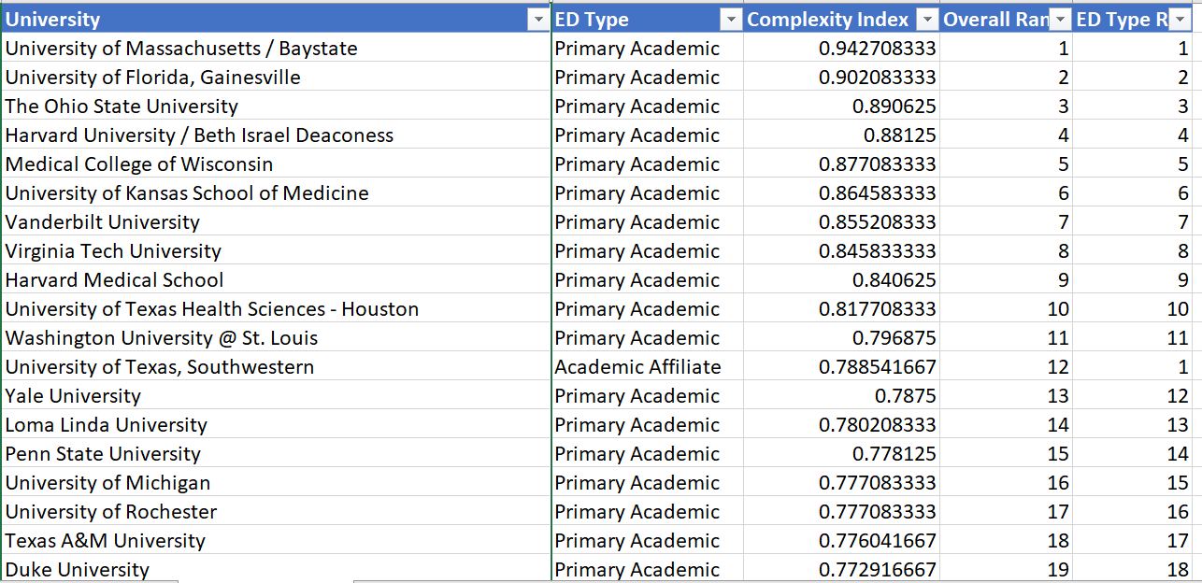
Operations Based Complexity Index
Complexity Index Ranking
Notes:
There are 2 options we can pursue.
Looking at acuity as a stand-alone concept for our patient population where we seek to quantify and contrast how sick our patients are. High acuity patients are more likely than low acuity patients to die, require surgery, or be medically admitted. Question: is your average behavioral health patient high or low acuity?
The other option is to expand this concept and incorporate additional factors that serve as indicators of how complex it is to clinically and operationally manage these patients. This option isn’t just about how sick the patients are but how resource intensive they are and how much pressure the place on the internal system of the ED.

Slide 17
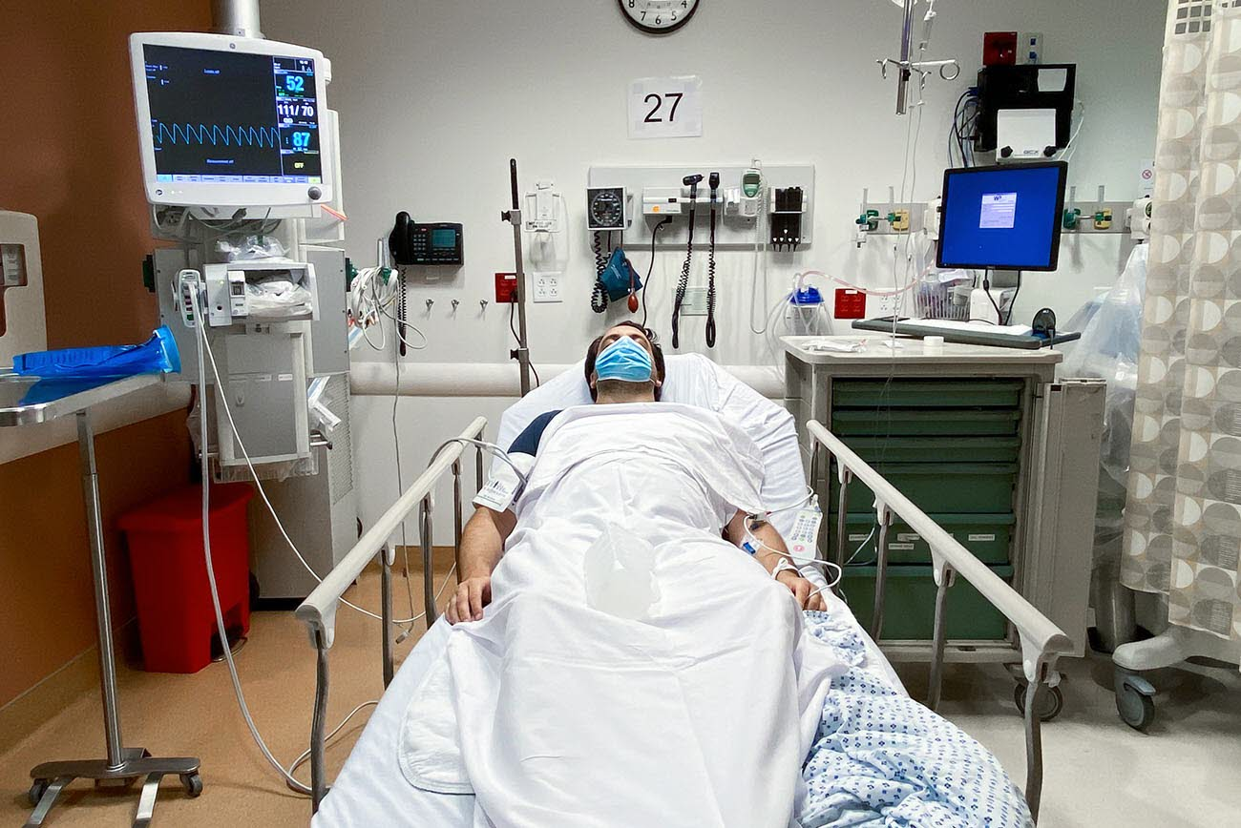
Operations Based Complexity Index
Positive
Negative
Variables are familiar
Data is available
We have historic data
Allows for ranking
Annual computation
Ranking does not allow for direct comparison between hospitals
Ranking does not allow to compare a single ED over time
Notes:
There are 2 options we can pursue.
Looking at acuity as a stand-alone concept for our patient population where we seek to quantify and contrast how sick our patients are. High acuity patients are more likely than low acuity patients to die, require surgery, or be medically admitted. Question: is your average behavioral health patient high or low acuity?
The other option is to expand this concept and incorporate additional factors that serve as indicators of how complex it is to clinically and operationally manage these patients. This option isn’t just about how sick the patients are but how resource intensive they are and how much pressure the place on the internal system of the ED.

Slide 18



Patient Based Complexity
Collaboration with Vizient
  Membership PI Organization
  Most AMCs (95% of our members)
  Clinical Data Base from members
Patient Based Complexity Measure
  Patient level data
  Encounter specific metrics: Hospital Coding
    Demographics (Age)
    Presentations
    Diagnoses
    Co-morbidities
    Social needs
  Impact on Throughput
Heather Blonsky
Jaie
Lavoie
Notes:
There are 2 options we can pursue.
Looking at acuity as a stand-alone concept for our patient population where we seek to quantify and contrast how sick our patients are. High acuity patients are more likely than low acuity patients to die, require surgery, or be medically admitted. Question: is your average behavioral health patient high or low acuity?
The other option is to expand this concept and incorporate additional factors that serve as indicators of how complex it is to clinically and operationally manage these patients. This option isn’t just about how sick the patients are but how resource intensive they are and how much pressure the place on the internal system of the ED.

Slide 19


Patient Based Complexity
Quantify differences in the complexity of cases or definition of the patient population seen in different EDs or one ED over time
  Provide context to understanding variables impacting throughput
    Patient Clinical Data
    Social Needs
    Variability (Operations)
Hypothesis:
  An emergency department that sees patients with more clinical needs and patients with more social needs will have longer throughput times.
Notes:
There are 2 options we can pursue.
Looking at acuity as a stand-alone concept for our patient population where we seek to quantify and contrast how sick our patients are. High acuity patients are more likely than low acuity patients to die, require surgery, or be medically admitted. Question: is your average behavioral health patient high or low acuity?
The other option is to expand this concept and incorporate additional factors that serve as indicators of how complex it is to clinically and operationally manage these patients. This option isn’t just about how sick the patients are but how resource intensive they are and how much pressure the place on the internal system of the ED.

Slide 20
Vizient Clinical Data Base
280 patient level variables
Small sample size for model
Provided throughput data points
2 years of daily patient level data
Patient Based Complexity Model
Principal Component Analysis
Streamlined variables
Creating the Model
Initial Data Set: 4 Hospitals
On this day in the ED
Age and co-morbidities
Current diagnoses
  Psychosis
  Alcohol and/or drugs/depression
  Trauma
Complex history
PCP desert and 7 day returns
Patients from neighborhoods with high social needs (transportation domain)
Notes:
There are 2 options we can pursue.

Slide 21

Patient Based Complexity Model
Expanded the number and type of hospitals
  10 Health Systems
    JHHS, UC Health, Northwestern, Mass General Brigham, UMass, Michigan, Cincinnati, OSU, Jefferson, U Virginia
  27 Hospitals
    11 Academic Medical Centers
    7 Large Community Hospitals (Affiliates)
    7 Small Community Hospitals
    2 Critical Access Hospitals
Notes:
There are 2 options we can pursue.

Slide 22
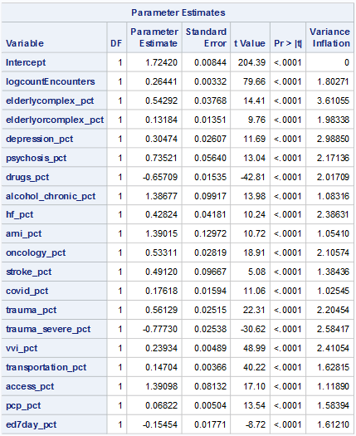
Patient Based Complexity Model
Variables provide a good fit
(r² = 0.71)
More patients
More patients with chronic ETOH
More patients with psychosis
More elderly and/or with comorbidities
More patients with oncology Dx
Patients from neighborhoods with high social needs/PCP desert
Reduced time = more patients with:
  Current drug or alcohol overdose
  History of 7-day returns to the ED
  Severe trauma
Removed % admits & transfers
Notes:
There are 2 options we can pursue.
Looking at acuity as a stand-alone concept for our patient population where we seek to quantify and contrast how sick our patients are. High acuity patients are more likely than low acuity patients to die, require surgery, or be medically admitted. Question: is your average behavioral health patient high or low acuity?
The other option is to expand this concept and incorporate additional factors that serve as indicators of how complex it is to clinically and operationally manage these patients. This option isn’t just about how sick the patients are but how resource intensive they are and how much pressure the place on the internal system of the ED.

Slide 23
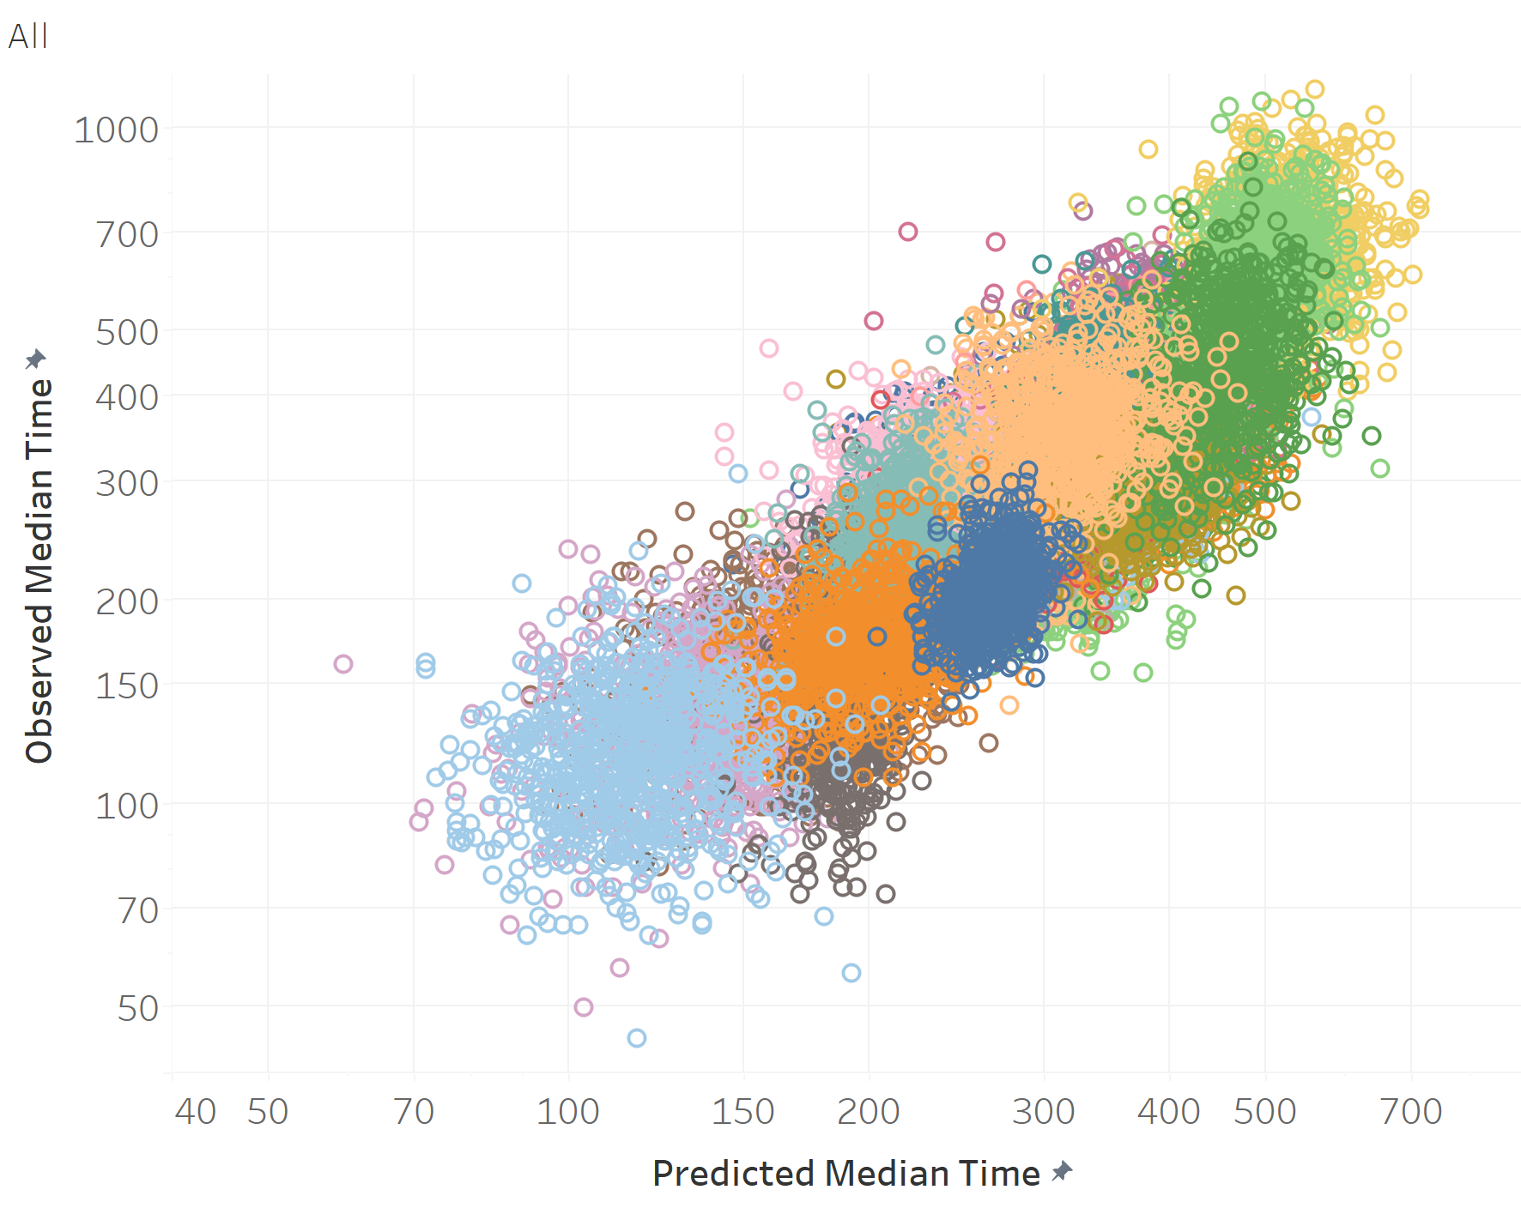
Notes:
There are 2 options we can pursue.
Looking at acuity as a stand-alone concept for our patient population where we seek to quantify and contrast how sick our patients are. High acuity patients are more likely than low acuity patients to die, require surgery, or be medically admitted. Question: is your average behavioral health patient high or low acuity?
The other option is to expand this concept and incorporate additional factors that serve as indicators of how complex it is to clinically and operationally manage these patients. This option isn’t just about how sick the patients are but how resource intensive they are and how much pressure the place on the internal system of the ED.

Slide 24
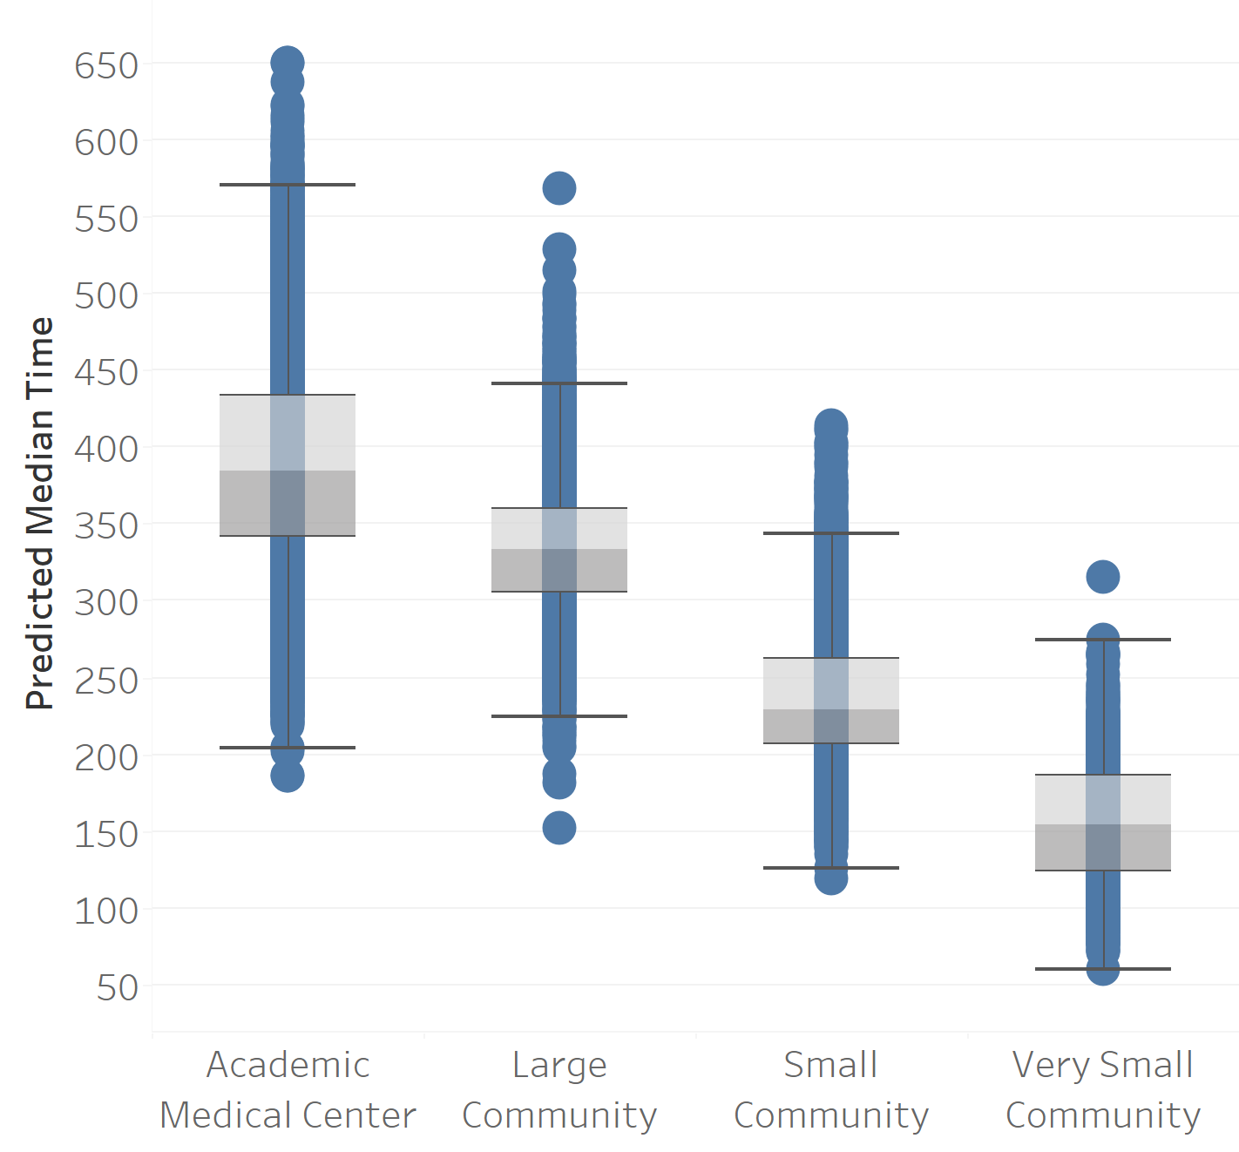
Patient Based Complexity Model
  Higher complexity for AMCs than for any other cohort
  Highest complexity within any one cohort tends to include higher numbers of patients with increased social needs
>500 beds
>200 beds
50-199 beds
<50 beds
Notes:
There are 2 options we can pursue.
Looking at acuity as a stand-alone concept for our patient population where we seek to quantify and contrast how sick our patients are. High acuity patients are more likely than low acuity patients to die, require surgery, or be medically admitted. Question: is your average behavioral health patient high or low acuity?
The other option is to expand this concept and incorporate additional factors that serve as indicators of how complex it is to clinically and operationally manage these patients. This option isn’t just about how sick the patients are but how resource intensive they are and how much pressure the place on the internal system of the ED.

Slide 25
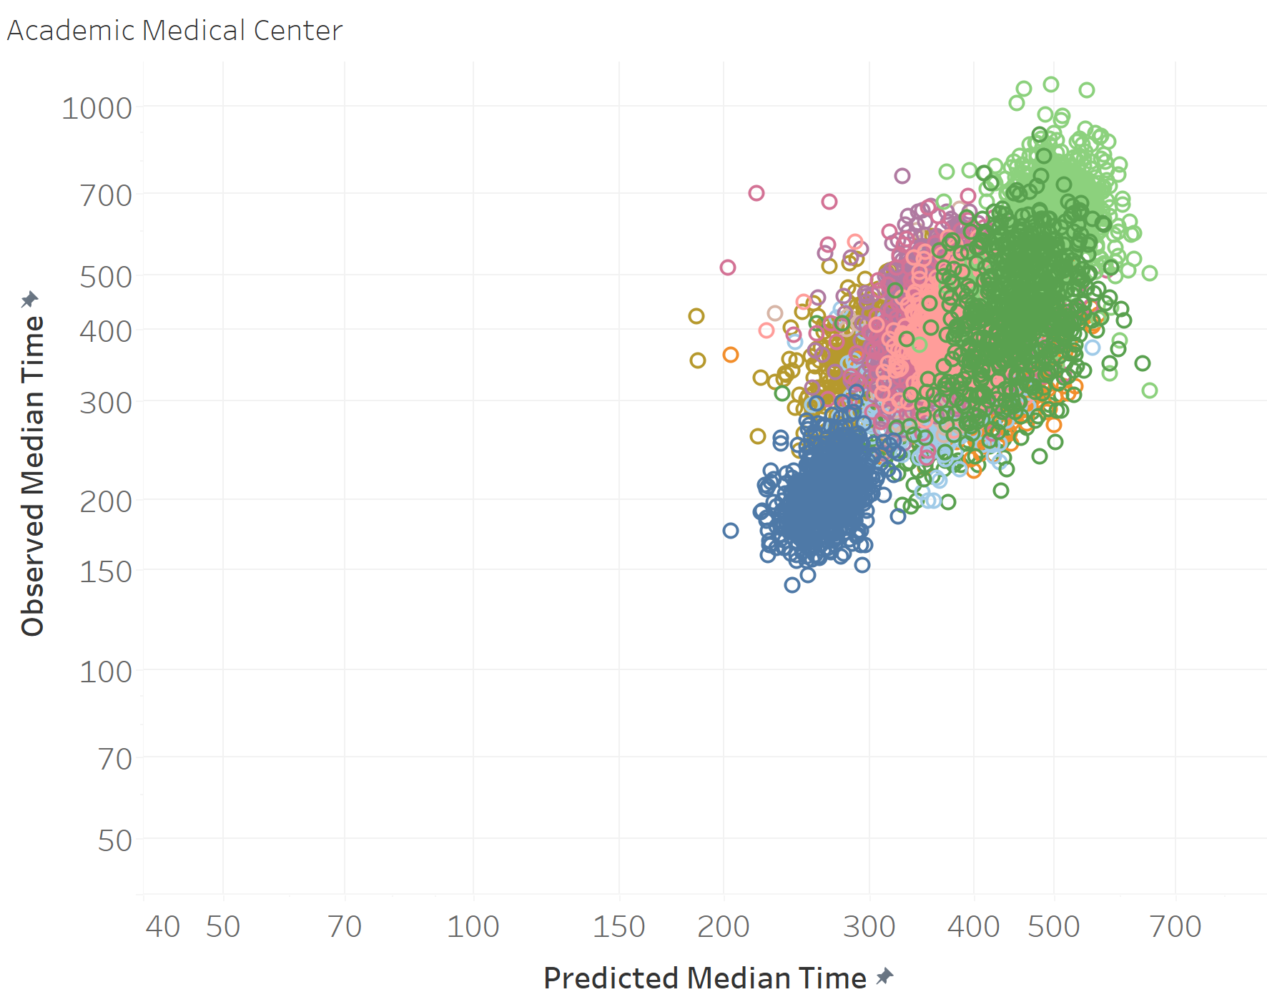
Notes:
There are 2 options we can pursue.
Looking at acuity as a stand-alone concept for our patient population where we seek to quantify and contrast how sick our patients are. High acuity patients are more likely than low acuity patients to die, require surgery, or be medically admitted. Question: is your average behavioral health patient high or low acuity?
The other option is to expand this concept and incorporate additional factors that serve as indicators of how complex it is to clinically and operationally manage these patients. This option isn’t just about how sick the patients are but how resource intensive they are and how much pressure the place on the internal system of the ED.

Slide 26
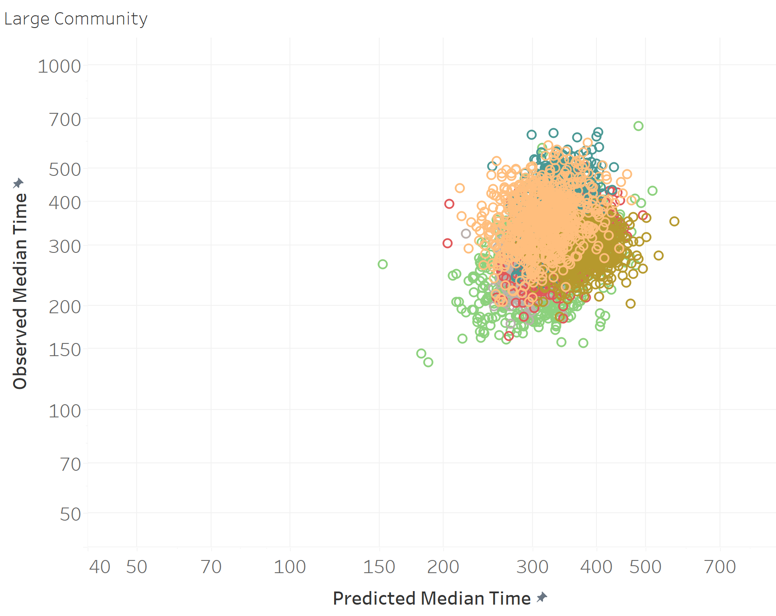
Notes:
There are 2 options we can pursue.
Looking at acuity as a stand-alone concept for our patient population where we seek to quantify and contrast how sick our patients are. High acuity patients are more likely than low acuity patients to die, require surgery, or be medically admitted. Question: is your average behavioral health patient high or low acuity?
The other option is to expand this concept and incorporate additional factors that serve as indicators of how complex it is to clinically and operationally manage these patients. This option isn’t just about how sick the patients are but how resource intensive they are and how much pressure the place on the internal system of the ED.

Slide 27
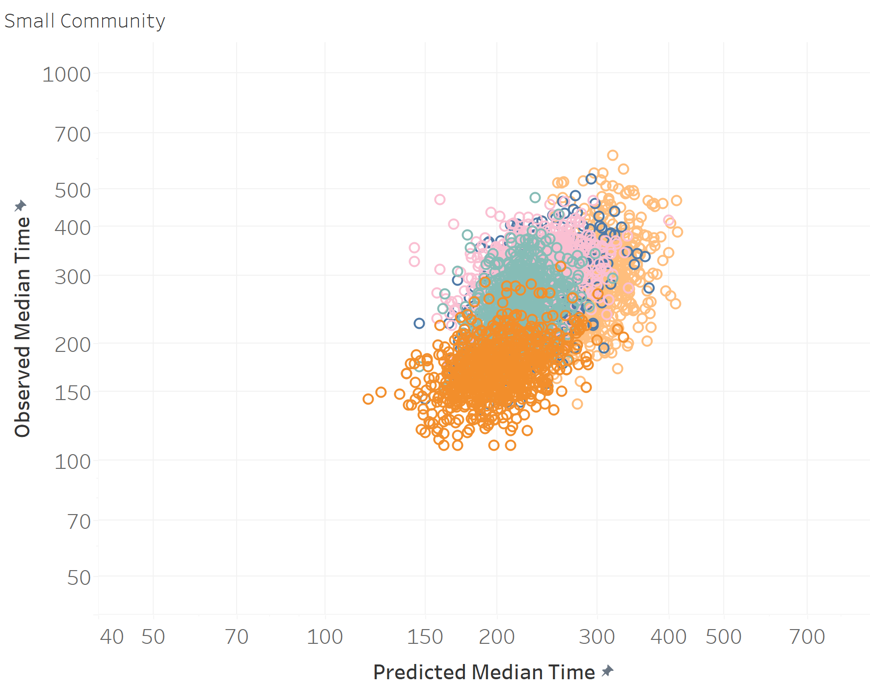
Notes:
There are 2 options we can pursue.
Looking at acuity as a stand-alone concept for our patient population where we seek to quantify and contrast how sick our patients are. High acuity patients are more likely than low acuity patients to die, require surgery, or be medically admitted. Question: is your average behavioral health patient high or low acuity?
The other option is to expand this concept and incorporate additional factors that serve as indicators of how complex it is to clinically and operationally manage these patients. This option isn’t just about how sick the patients are but how resource intensive they are and how much pressure the place on the internal system of the ED.

Slide 28
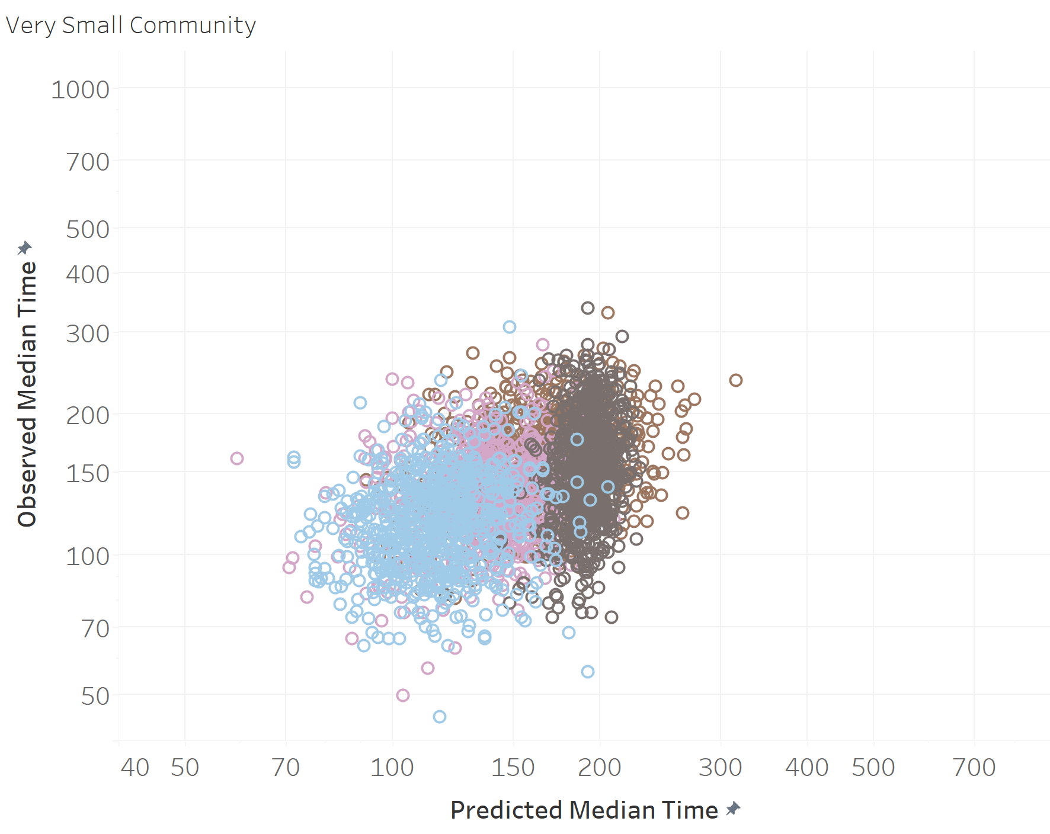
Notes:
There are 2 options we can pursue.
Looking at acuity as a stand-alone concept for our patient population where we seek to quantify and contrast how sick our patients are. High acuity patients are more likely than low acuity patients to die, require surgery, or be medically admitted. Question: is your average behavioral health patient high or low acuity?
The other option is to expand this concept and incorporate additional factors that serve as indicators of how complex it is to clinically and operationally manage these patients. This option isn’t just about how sick the patients are but how resource intensive they are and how much pressure the place on the internal system of the ED.

Slide 29
Notes:
There are 2 options we can pursue.
Looking at acuity as a stand-alone concept for our patient population where we seek to quantify and contrast how sick our patients are. High acuity patients are more likely than low acuity patients to die, require surgery, or be medically admitted. Question: is your average behavioral health patient high or low acuity?
The other option is to expand this concept and incorporate additional factors that serve as indicators of how complex it is to clinically and operationally manage these patients. This option isn’t just about how sick the patients are but how resource intensive they are and how much pressure the place on the internal system of the ED.

Slide 30
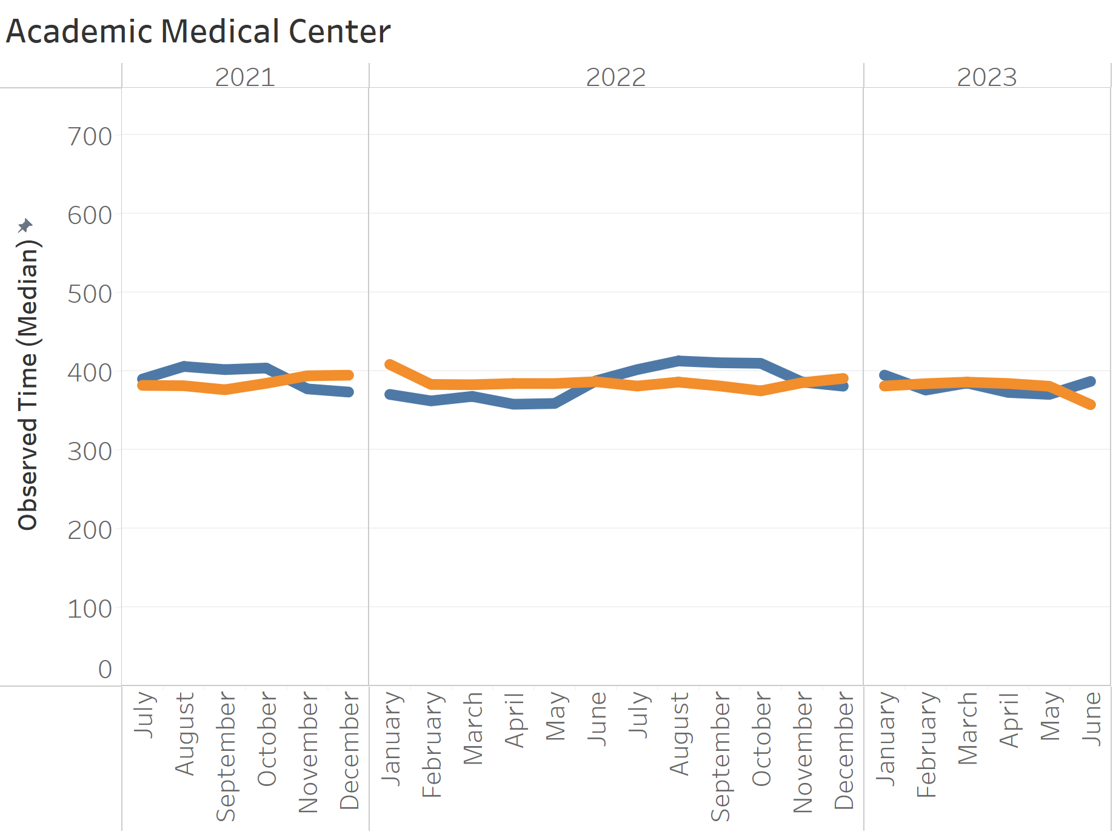
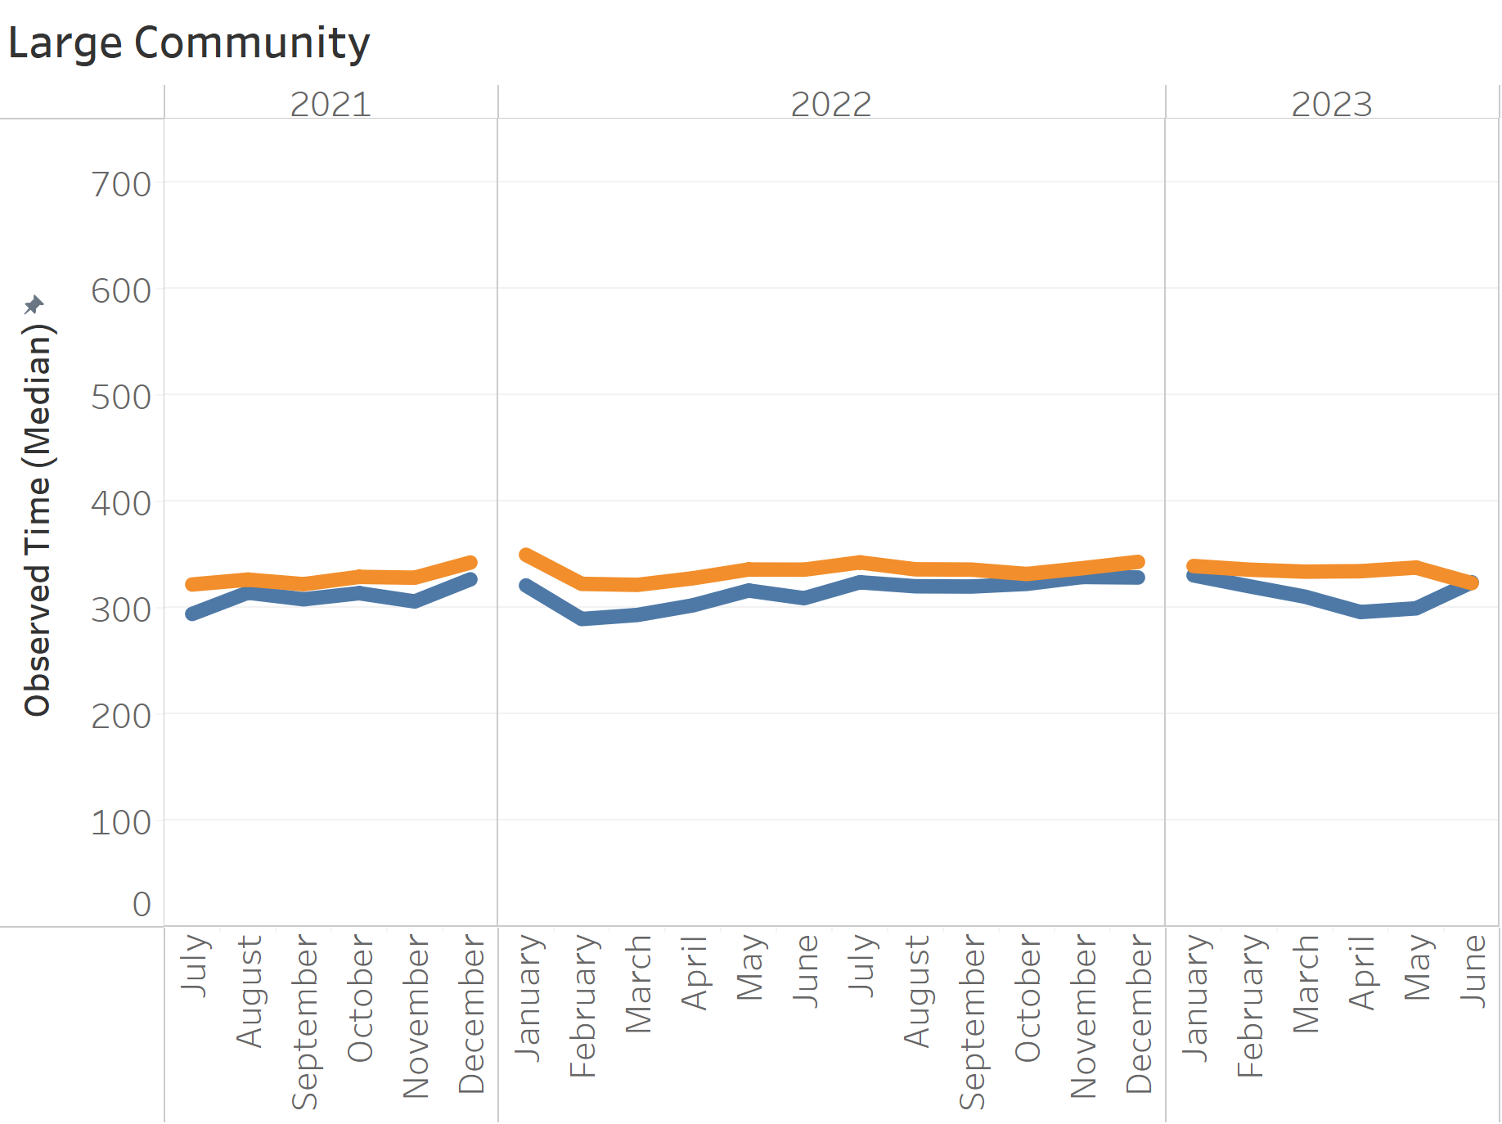
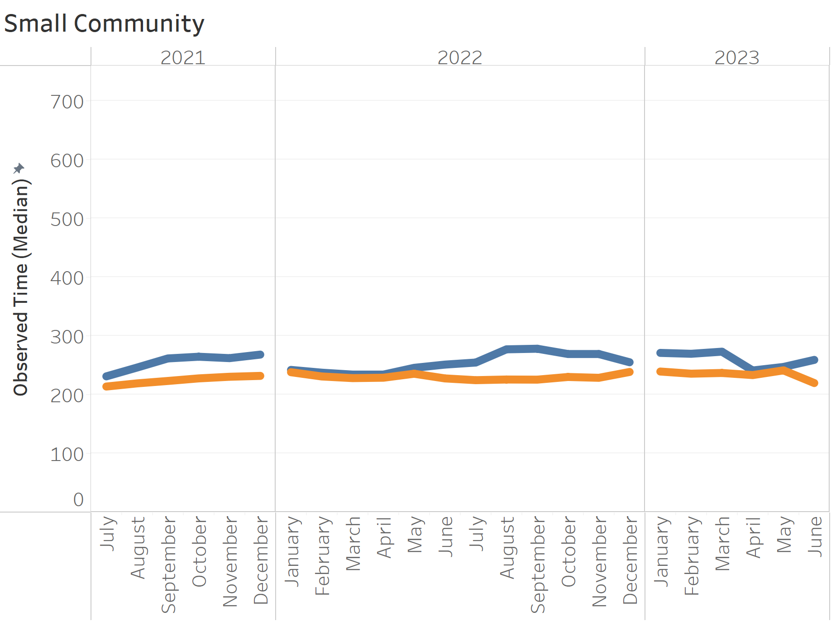
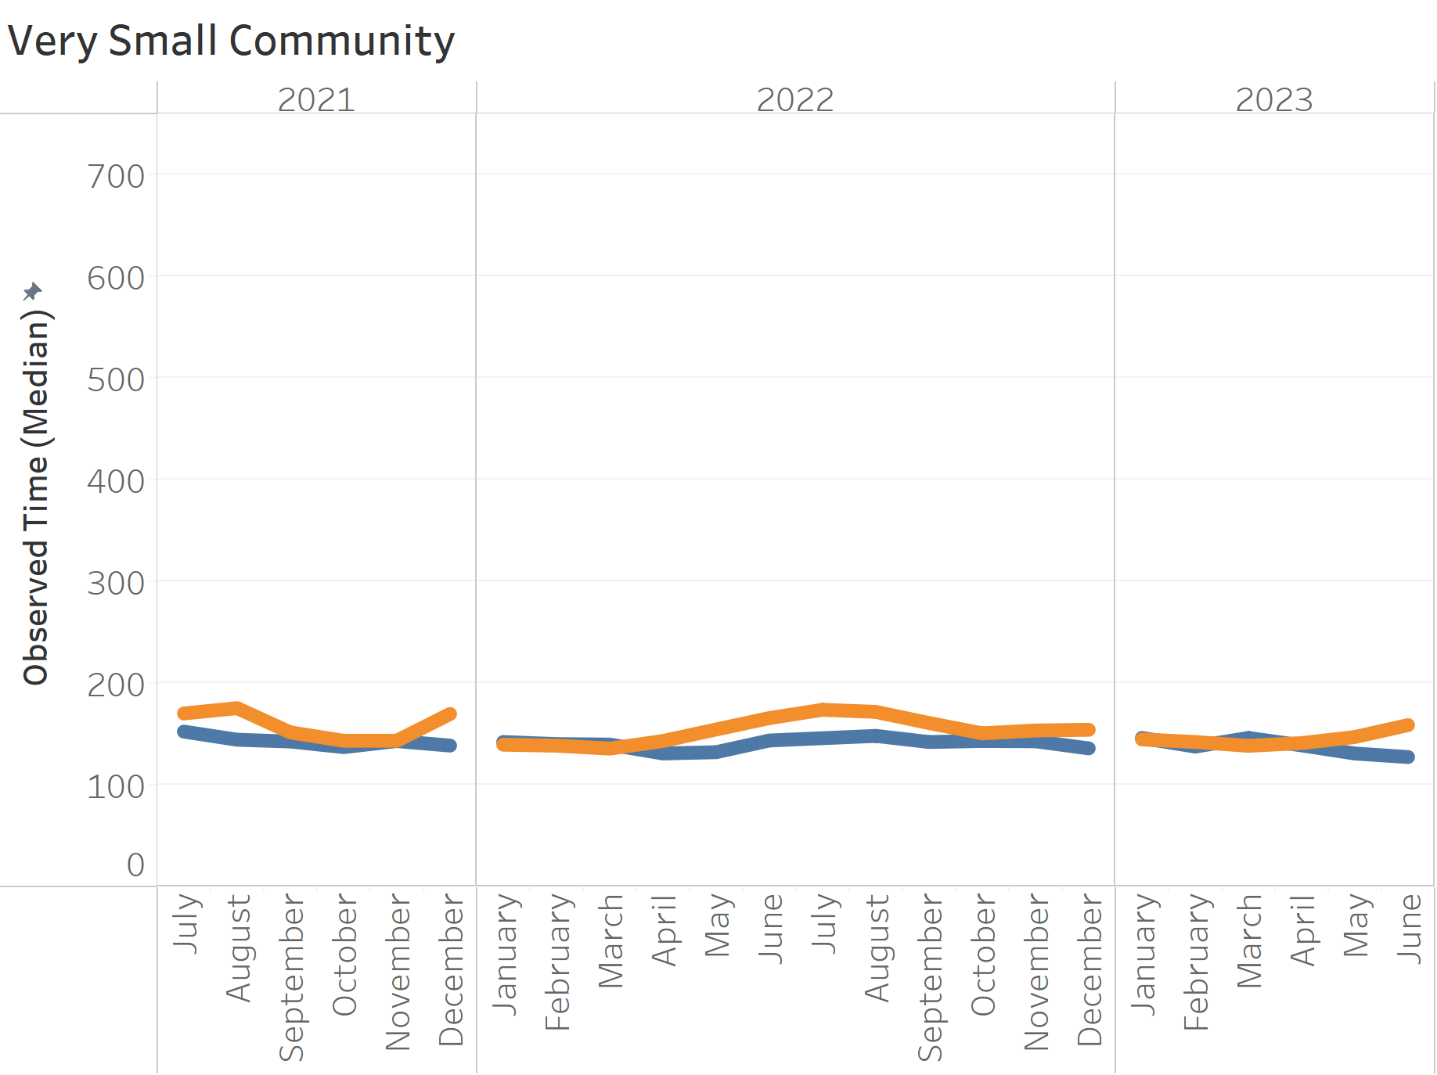
Hospital Cohorts: Predicted vs Actual
Notes:
There are 2 options we can pursue.
Looking at acuity as a stand-alone concept for our patient population where we seek to quantify and contrast how sick our patients are. High acuity patients are more likely than low acuity patients to die, require surgery, or be medically admitted. Question: is your average behavioral health patient high or low acuity?
The other option is to expand this concept and incorporate additional factors that serve as indicators of how complex it is to clinically and operationally manage these patients. This option isn’t just about how sick the patients are but how resource intensive they are and how much pressure the place on the internal system of the ED.

Slide 31
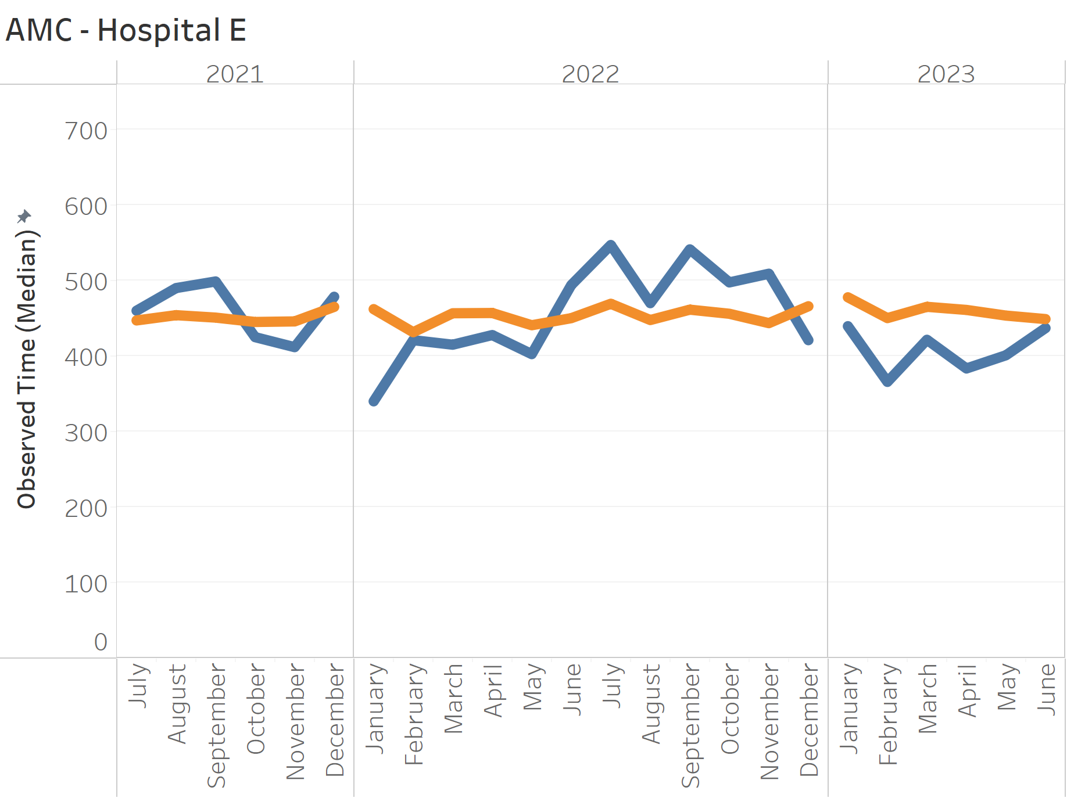
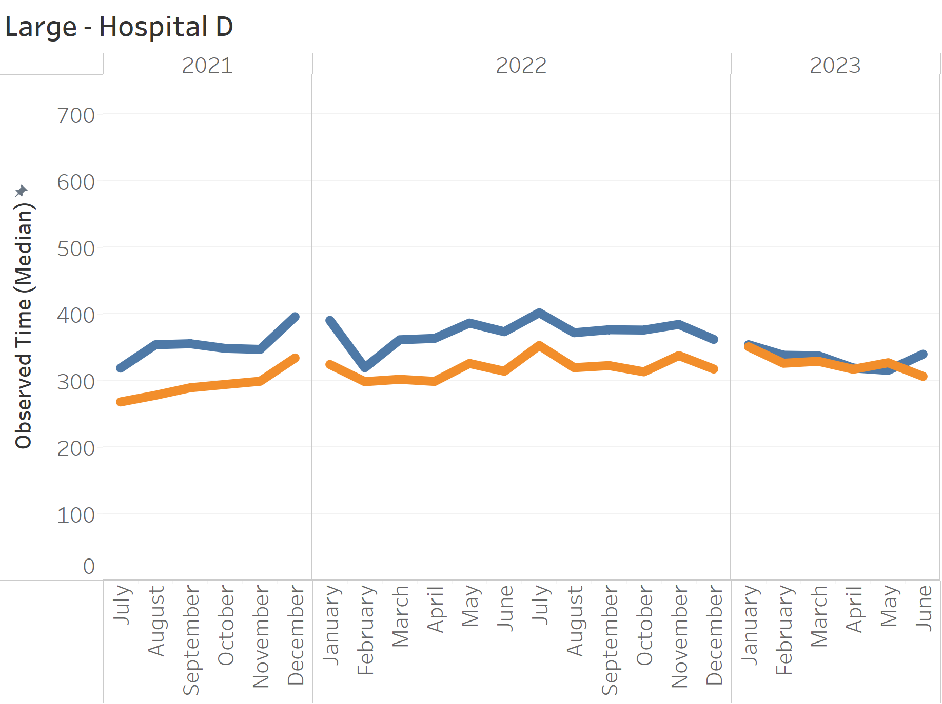
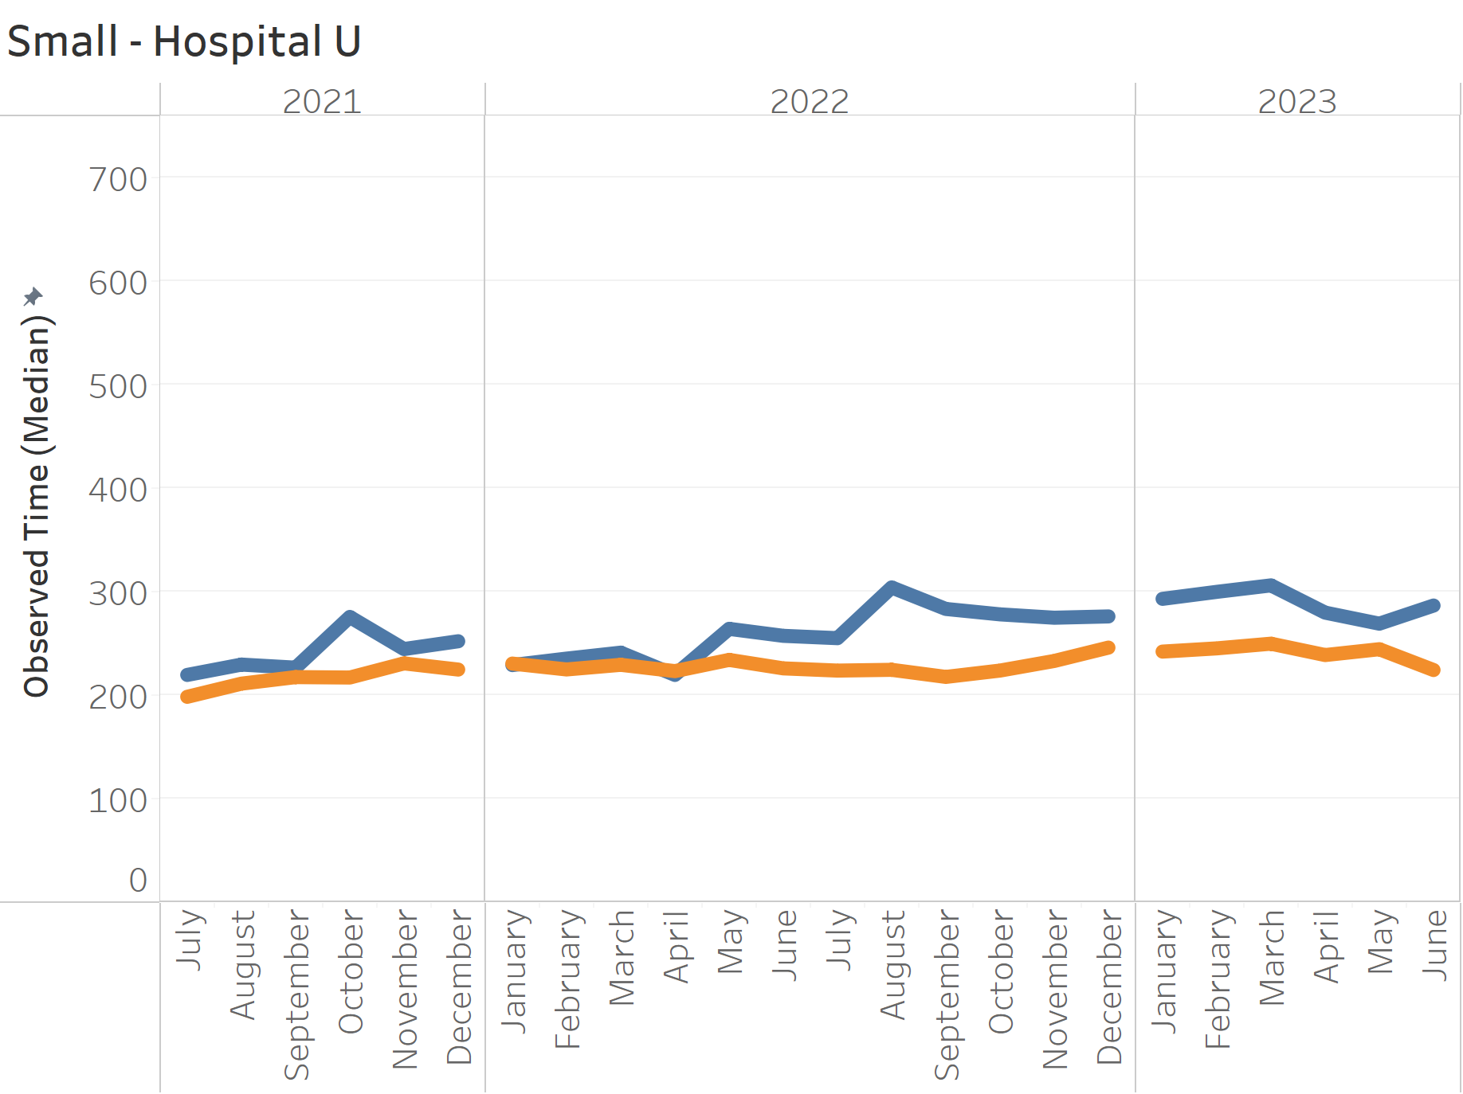
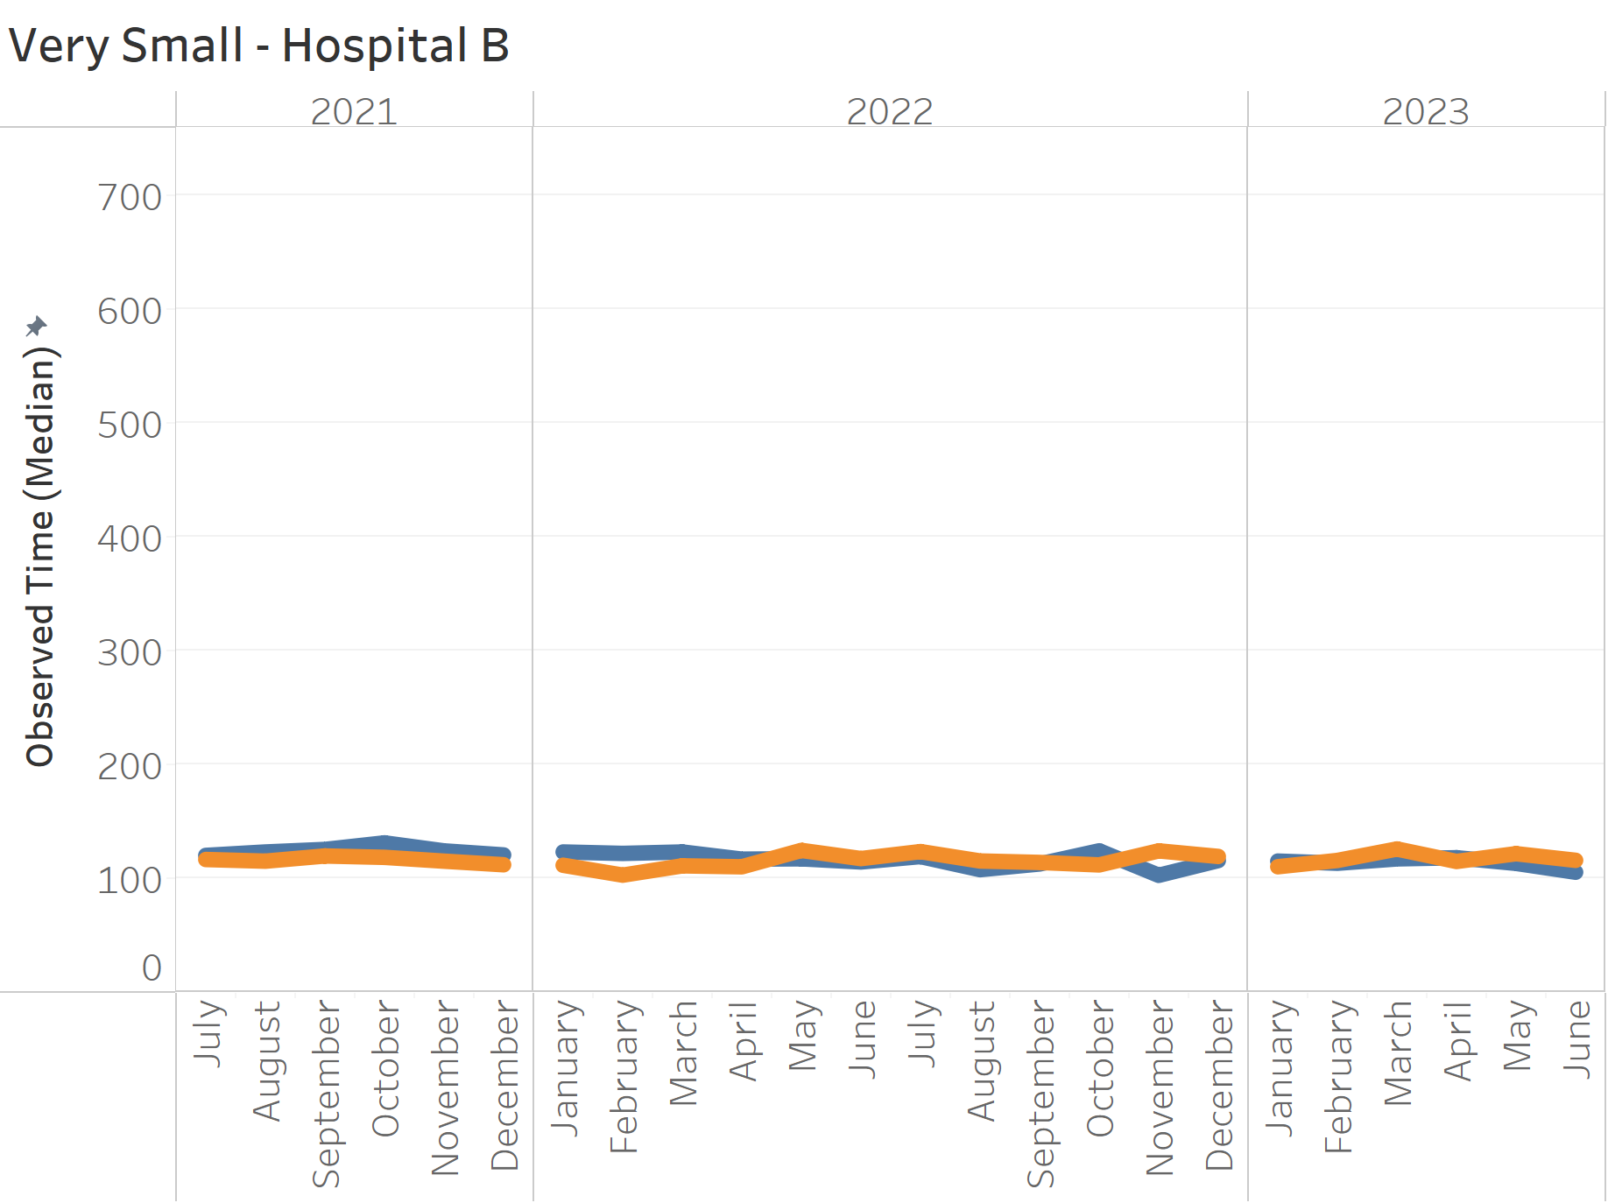
Individual Hospital by Month: Predicted vs Actual
Notes:
There are 2 options we can pursue.
Looking at acuity as a stand-alone concept for our patient population where we seek to quantify and contrast how sick our patients are. High acuity patients are more likely than low acuity patients to die, require surgery, or be medically admitted. Question: is your average behavioral health patient high or low acuity?
The other option is to expand this concept and incorporate additional factors that serve as indicators of how complex it is to clinically and operationally manage these patients. This option isn’t just about how sick the patients are but how resource intensive they are and how much pressure the place on the internal system of the ED.

Slide 32
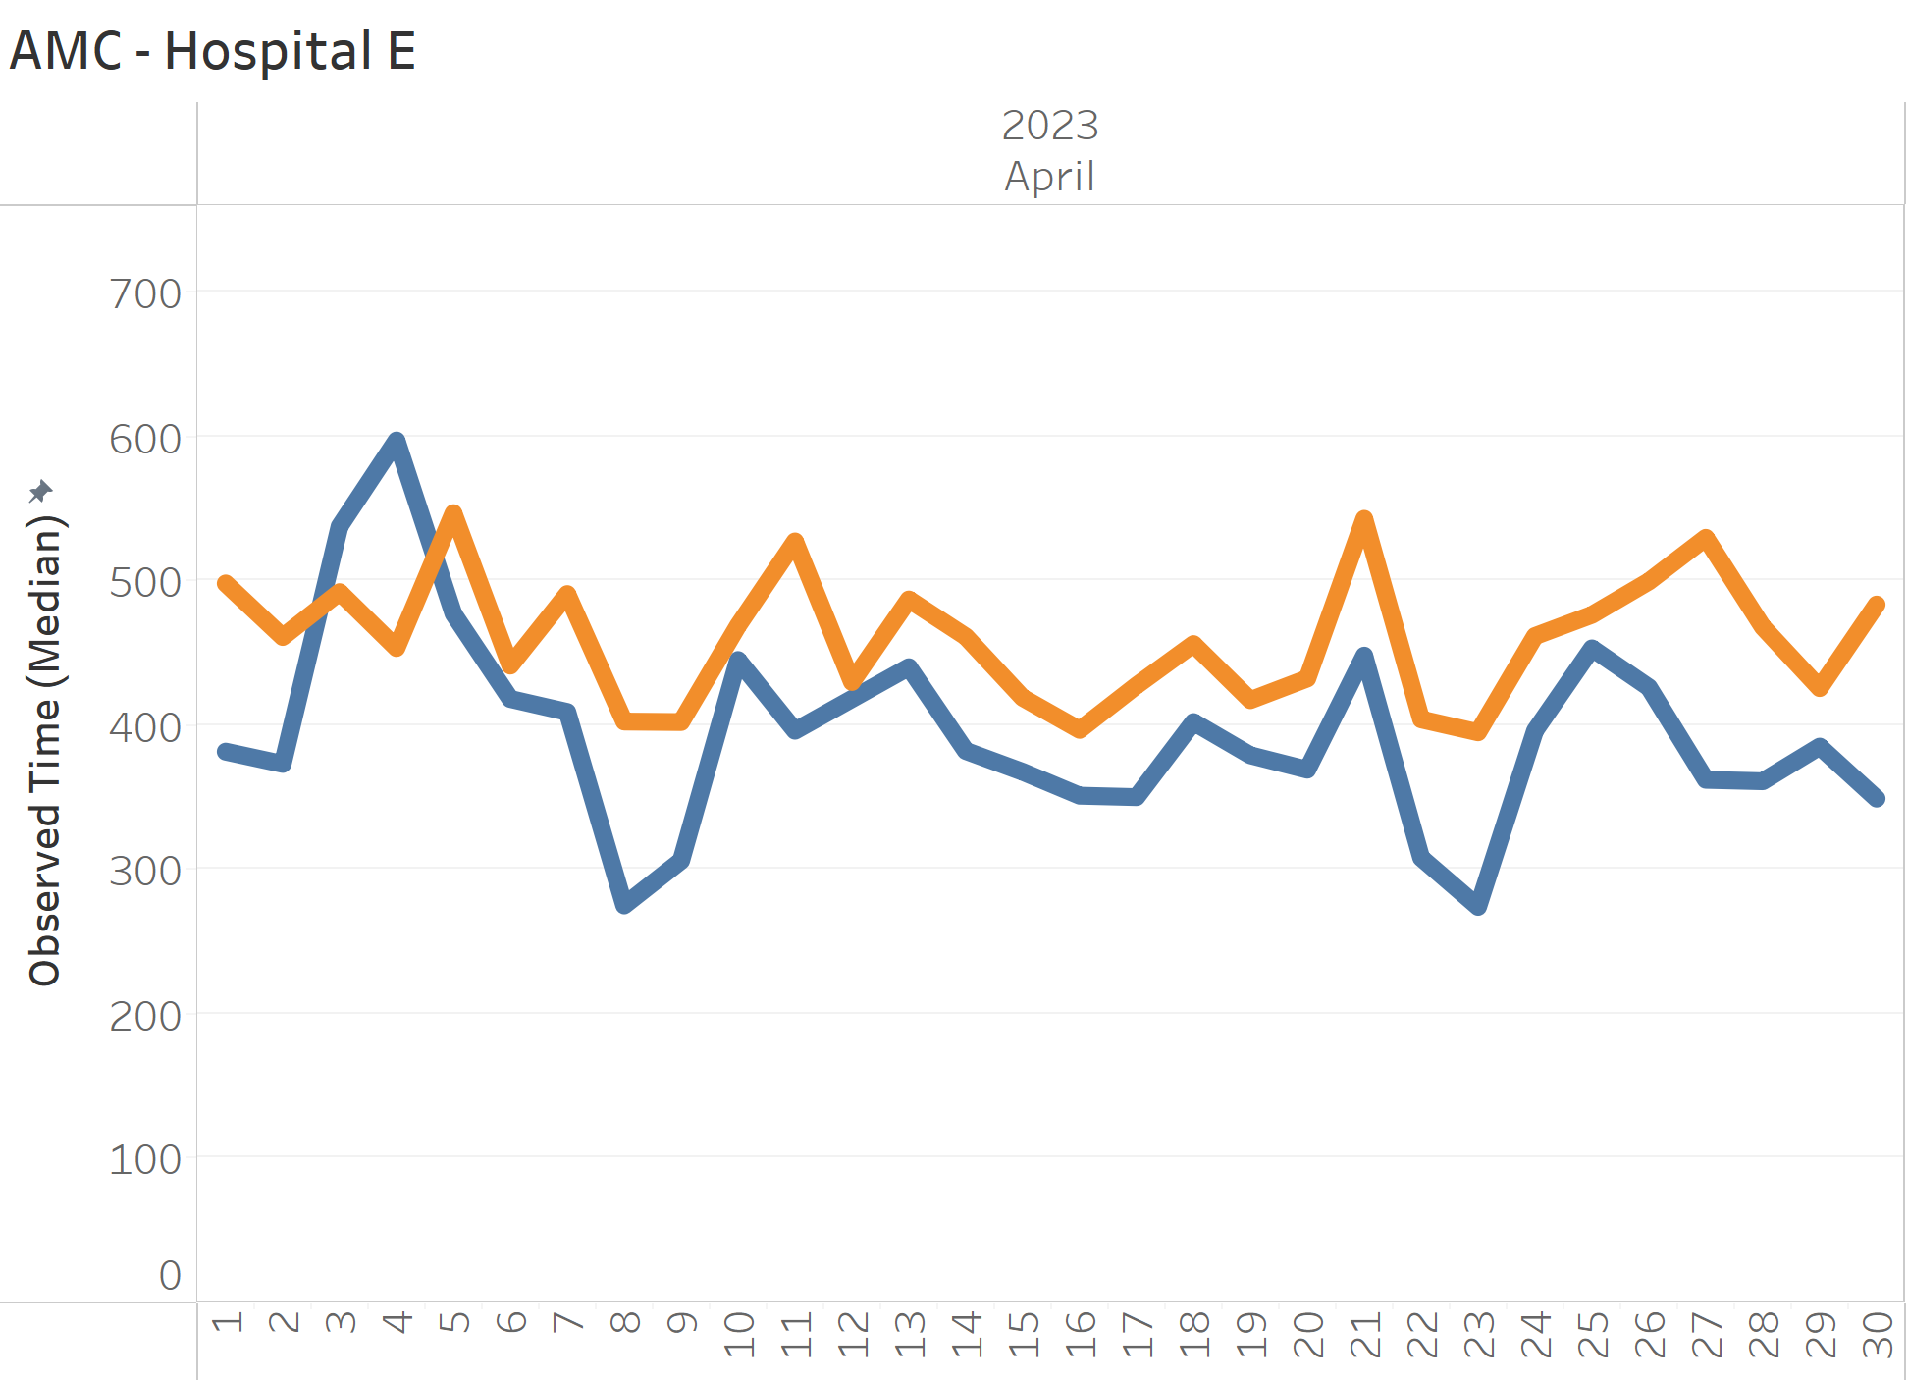
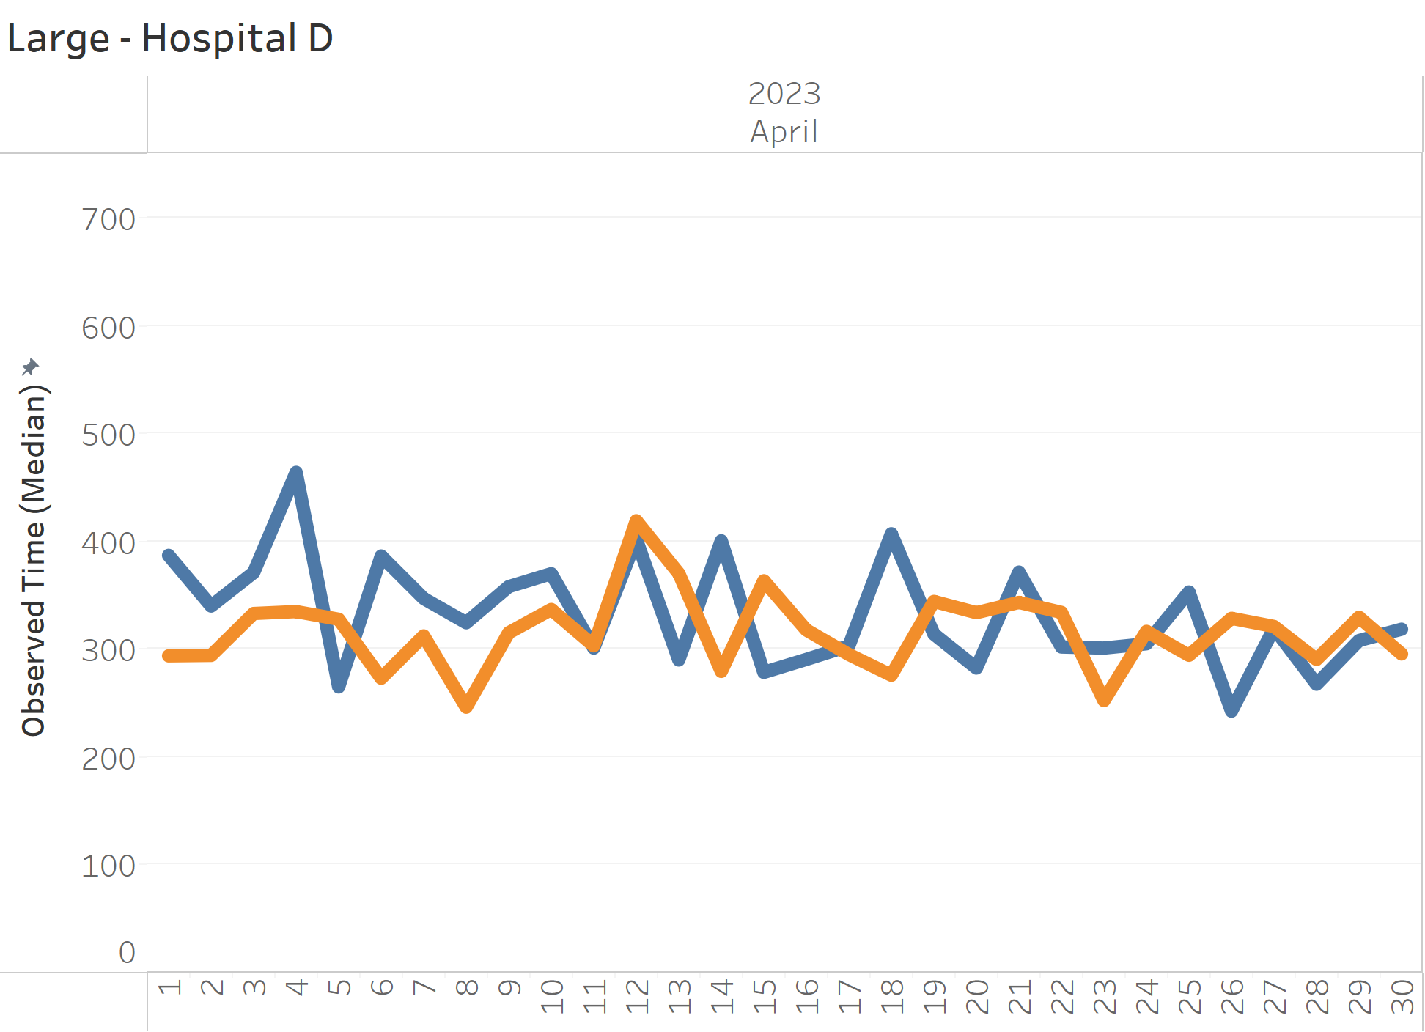
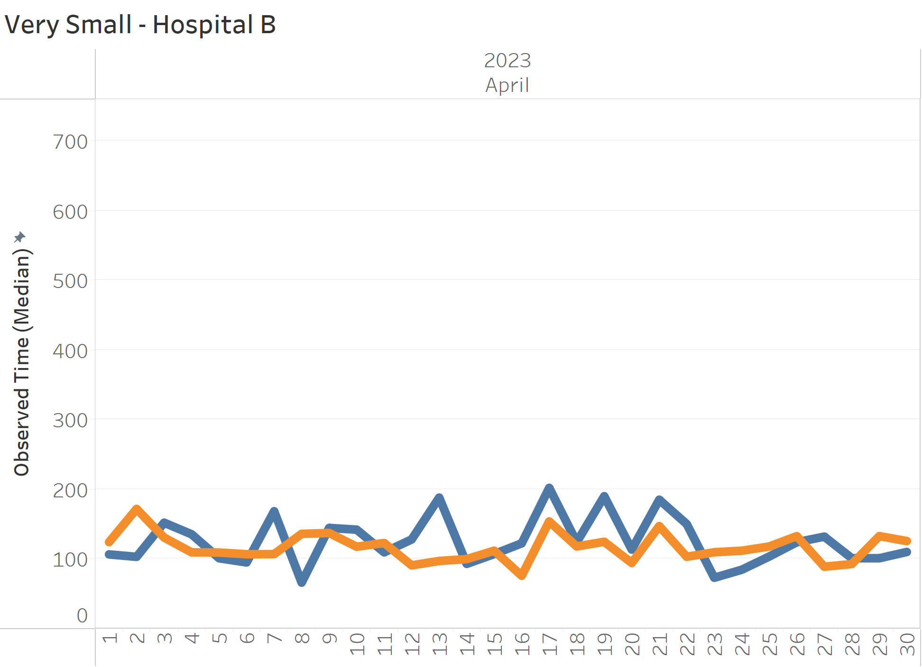
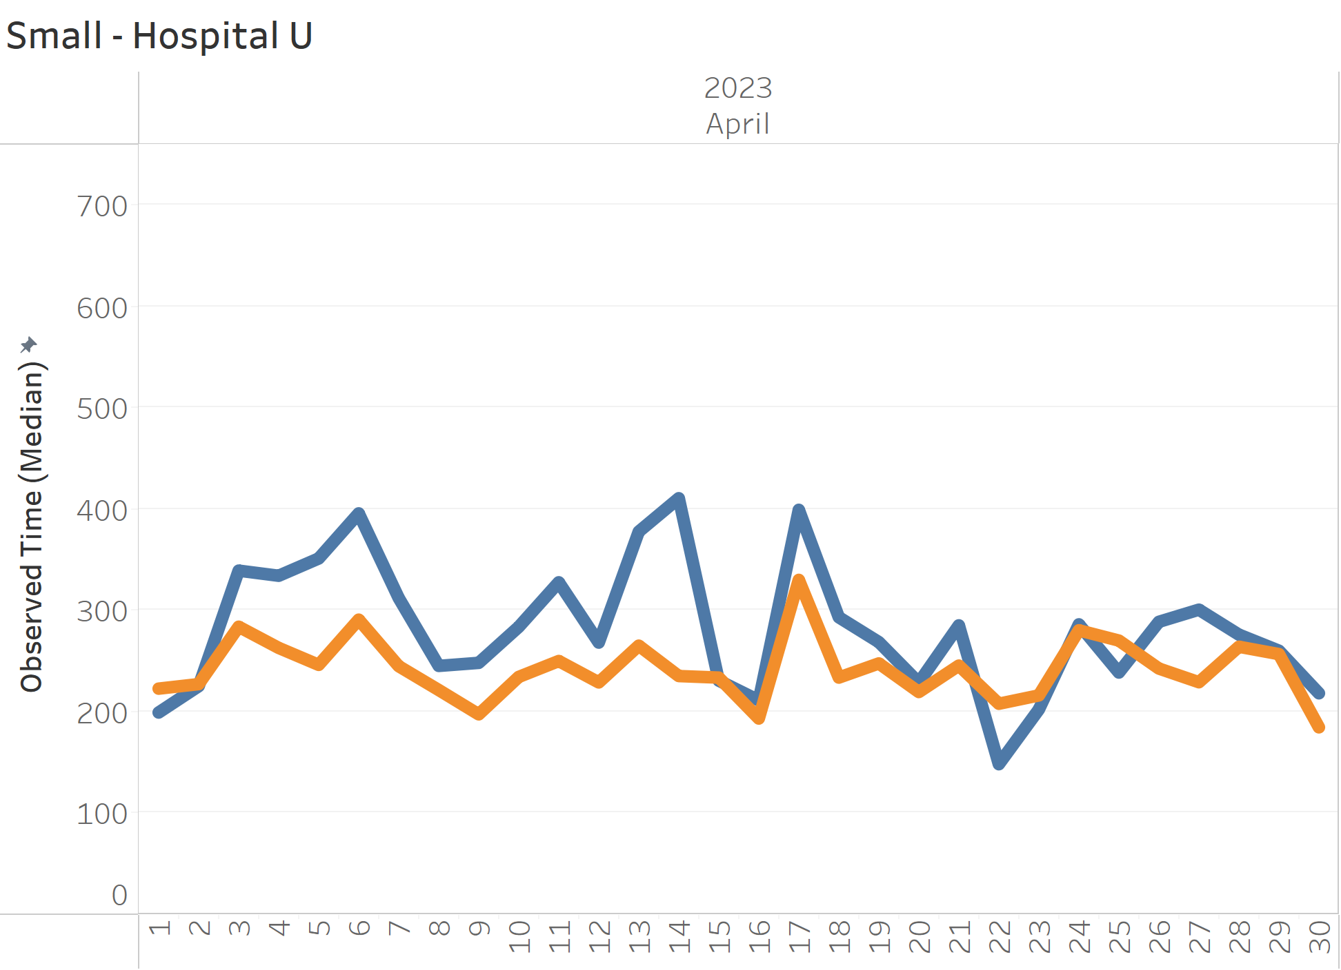
Individual Hospital by Day: Predicted vs Actual
32
Notes:
There are 2 options we can pursue.
Looking at acuity as a stand-alone concept for our patient population where we seek to quantify and contrast how sick our patients are. High acuity patients are more likely than low acuity patients to die, require surgery, or be medically admitted. Question: is your average behavioral health patient high or low acuity?
The other option is to expand this concept and incorporate additional factors that serve as indicators of how complex it is to clinically and operationally manage these patients. This option isn’t just about how sick the patients are but how resource intensive they are and how much pressure the place on the internal system of the ED.

Slide 33
Population most impacting operations:
Summary Patient Based Model
More patients
Higher proportion of patients with chronic effects of ETOH
Higher proportion of patients with mental health issues (Psychosis)
Higher proportion of elderly and/or complex patients
  More than 4 Elixhauser comorbidities
Higher proportion of patients with oncology Dx
Patients from neighborhoods with high social needs
  Transportation challenges
  Access to health care/PCP desert
Notes:
There are 2 options we can pursue.
Looking at acuity as a stand-alone concept for our patient population where we seek to quantify and contrast how sick our patients are. High acuity patients are more likely than low acuity patients to die, require surgery, or be medically admitted. Question: is your average behavioral health patient high or low acuity?
The other option is to expand this concept and incorporate additional factors that serve as indicators of how complex it is to clinically and operationally manage these patients. This option isn’t just about how sick the patients are but how resource intensive they are and how much pressure the place on the internal system of the ED.

Slide 34





Use Case:
Patient Based Complexity Model
Build a cohort
Demonstrate comparison
Observed over Expected
Notes:
There are 2 options we can pursue.
Looking at acuity as a stand-alone concept for our patient population where we seek to quantify and contrast how sick our patients are. High acuity patients are more likely than low acuity patients to die, require surgery, or be medically admitted. Question: is your average behavioral health patient high or low acuity?
The other option is to expand this concept and incorporate additional factors that serve as indicators of how complex it is to clinically and operationally manage these patients. This option isn’t just about how sick the patients are but how resource intensive they are and how much pressure the place on the internal system of the ED.

Slide 35
The list and cohorts
Large/Academic Affiliate: Hospital H = 561
EXPECTED
OBS:EXP
Cohort | Hospital Code | Mean Predicted
AMC | Hospital A | 267
AMC | Hospital E | 454
AMC | Hospital F | 500
AMC | Hospital L | 388
AMC | Hospital O | 392
AMC | Hospital Q | 356
AMC | Hospital T | 371
AMC | Hospital V | 375
AMC | Hospital W | 430
AMC | Hospital Y | 403
AMC | Hospital 2 | 319
Cohort | Hospital Code | Mean Predicted | Mean Observed
AMC | Hospital A | 267 | 207
AMC | Hospital E | 454 | 444
AMC | Hospital F | 500 | 643
AMC | Hospital L | 388 | 409
AMC | Hospital O | 392 | 430
AMC | Hospital Q | 356 | 434
AMC | Hospital T | 371 | 419
AMC | Hospital V | 375 | 343
AMC | Hospital W | 430 | 361
AMC | Hospital Y | 403 | 353
AMC | Hospital 2 | 319 | 363

Slide 36
Next Steps:
Patient Based Complexity Index
Make available to Vizient members
  Flat file of data to Vizient or allow Vizient access to data by way of existing BAA
  LOS data for 2 calendar years
  95% of hospitals completing AAAEM Survey are Vizient clients
Consider other outcome variables
  Length of stay with more precision
  Other outcomes
Consider combining with operations variables
  Provider staffing
Notes:
There are 2 options we can pursue.
Looking at acuity as a stand-alone concept for our patient population where we seek to quantify and contrast how sick our patients are. High acuity patients are more likely than low acuity patients to die, require surgery, or be medically admitted. Question: is your average behavioral health patient high or low acuity?
The other option is to expand this concept and incorporate additional factors that serve as indicators of how complex it is to clinically and operationally manage these patients. This option isn’t just about how sick the patients are but how resource intensive they are and how much pressure the place on the internal system of the ED.

Slide 37

Conclusion
  Emergency Departments that care for patients with more clinical and social needs can expect longer throughput times than those who care for a population with fewer clinical and social needs.
Notes:
There are 2 options we can pursue.
Looking at acuity as a stand-alone concept for our patient population where we seek to quantify and contrast how sick our patients are. High acuity patients are more likely than low acuity patients to die, require surgery, or be medically admitted. Question: is your average behavioral health patient high or low acuity?
The other option is to expand this concept and incorporate additional factors that serve as indicators of how complex it is to clinically and operationally manage these patients. This option isn’t just about how sick the patients are but how resource intensive they are and how much pressure the place on the internal system of the ED.

Slide 38
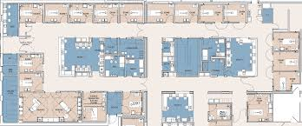


Implications

Slide 39
THANK YOU

