Slide 1
Funds Flow and Models of Institutional Support
Frank Jurkiewicz, M.B.A.; Brendan Russell, M.B.A.; Sara Engel, M.B.A.

Slide 2

Agenda
Introductions
Departmental Structures
& Fund Flow Models
Success Stories

Slide 3
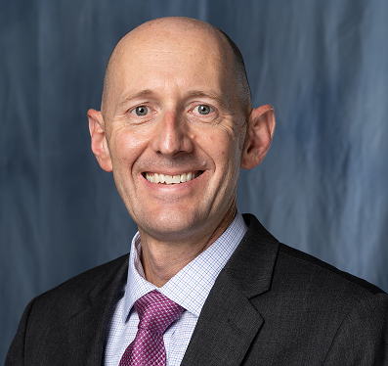
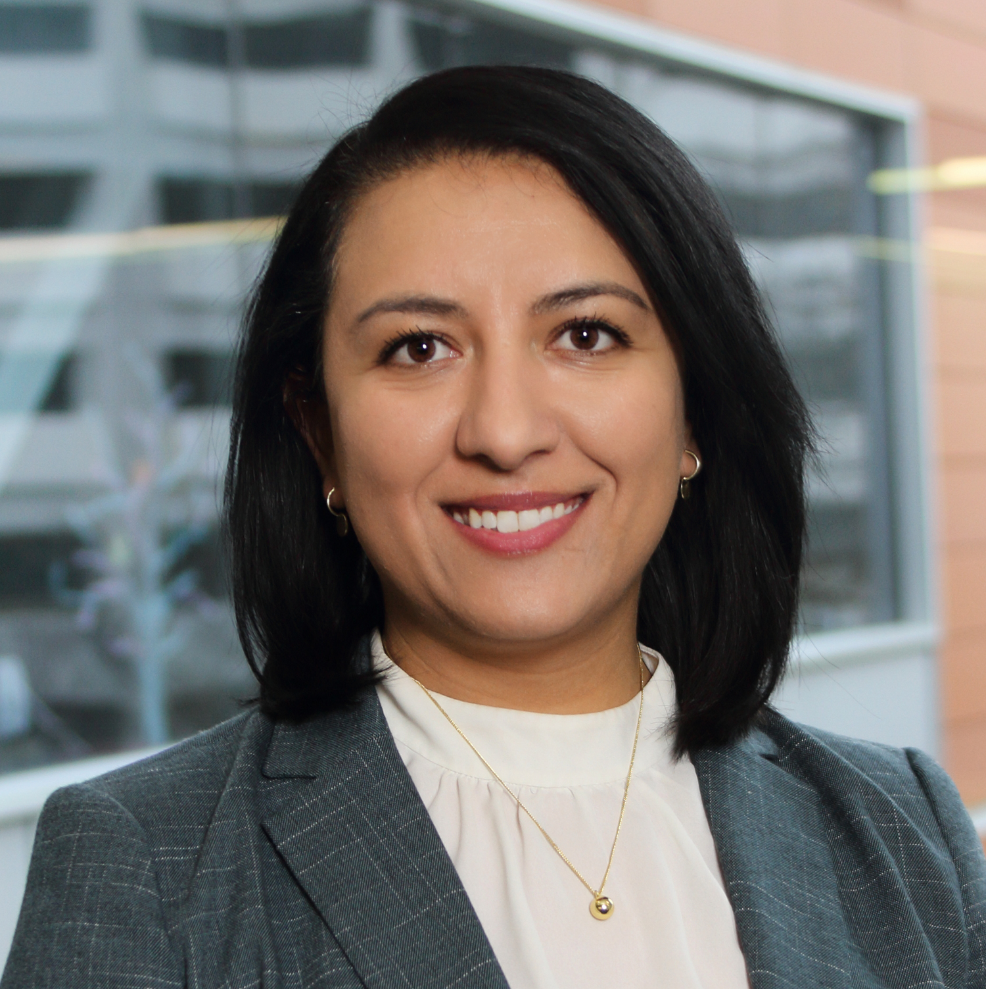
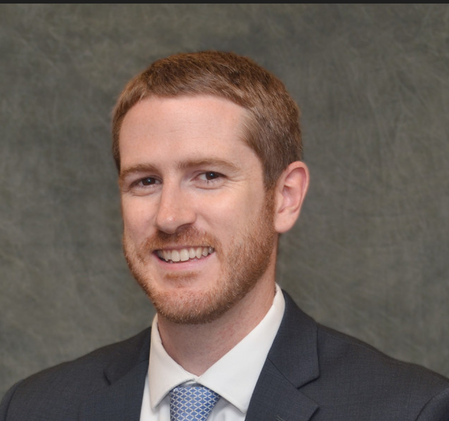
Today’s panel
Frank J. Jurkiewicz, M.B.A.
Department Administrator
University of Florida, Gainesville (UF)
Sara Engel, M.B.A.
Department Administrator
Medical College of Wisconsin (MCW)
Brendan Russell, M.B.A.
Enterprise Vice President
Mass General Brigham

Slide 4

MCW & Department of EM
Clinical financial support models
Main Campus – Level 1 trauma center
  Shortfall support funded – strict categories
  Medical direction support
Community hospitals– Level 3 trauma centers
  Medical direction support only
Neighborhood hospitals
  Contracted hourly rates + quality incentive
  Medical direction support
Other: EMS community Medical Directorship support
MCW Background
Private University, owns physician practice
Clinical revenue 78% of MCW total revenue
Hospital direct support & % of revenue v
Academic financial support models
Other
Dean’s strategic funds
Education leadership roles support
Research – startup and bridge funds
Endowment funds
Notes:
- Afiliate support for institution is direct and % of revenue
In addition:
Grants and contracts
Departmental endowment

Slide 5



MCW New clinical fund flow model
Creation of a Central Revenue Practice Model
Single Economy
Fiscal Stewardship
Levels the playing field
across departments
Majority of clinical revenue moved to central practice finance (MCP)
Departments paid based on MGMA compensation $/wRVU
Overhead Allocation based on $10k/MD FTE to cover
Administrative Support
    Provider CME
    Discretionary Support
Department Administrator Overhead Allocation (flat rate)

Slide 6
UF Gainesville – Department of EM
Academic Support
Centralized via pass through from
hospital/health system to COM then DEM (includes ACGME required support)
Dean’s commitments and endowment funds
UF Health
UF Health Physicians
External Contracts
DEM
COM
Clinical Support
Hospital funded Medical Director roles
Shortfall support – clinical services
External Contracts
Mostly EMS
Other
Academic/education support through State General Revenue
Notes:
Academic support centralized via pass through from hospital/health system to COM then DEM (includes ACGME required support)
Dean’s commitments and endowment funds
Clinical support:
Hospital funded Medical Director roles
Shortfall support – clinical services
External Contracts (mostly EMS)
Potential differences...
Some academic/education support through State General Revenue

Slide 7


Mass General Brigham - Funds Flow Types
Hospital Support
Break Even Margin Support (community sites)
Block Grants
APPs
Capacity Management Programs
Medical Directors
Blended Administrative Roles
Residency Program Costs
Margin Retention
Endowed Chairs
IDC Incentive

Slide 8

Success Story – MCW
Delineation of faculty roles & tracks
Created 3 faculty categories – traditional academic, blended academic, and community academic
Utilize AAMC + MGMA for salary alignment
Determined financial feasibility
Profit and loss statements per clinical model
Utilized to determine sustainability at each location
Renegotiated where possible
Example: In neighborhood hospitals, MGMA benchmarks were being divided by 2,080 annual contact hours, lowering hourly rates paid to EM.
Educated hospital leadership on EM hours and renegotiated, resulting in over $1M in new revenue to department.

Slide 9

Success Story - UF
The Department of Emergency Medicine (DEM) implements overhead assessments for both hospital and external contracts.
Overhead assessments play a vital role in funding departmental administration.
These assessments also support faculty roles that may lack funding.
The department chair has discretion over the allocation of these funds.

Slide 10
Success Story – Brigham and Women’s Hospital
Objective
Implement an enhanced front end model with additional MDs, PAs, and RNs
Compete with other hospital-wide new initiative requests in a financially constrained environment
Analysis
Determine the financial value to the hospital per inpatient boarding in ED
Understand how actual financial value compared to hospital inpatient revenue assumptions/budgets
Findings
Inpatient revenue budgets were not adjusted for actual discharge volume as inpatient census and boarding increased
Favorable inpatient revenue was effectively funding other deficits across the organization
Outcomes
Submitted an ROI+ new initiative using the previously unbudgeted inpatient revenue* to fund staffing for new front end model
Funds transferred to the practice to fully cover all MD and PA FTEs hired to staff the pod
*Some risk in pushing the hospital to budget for higher levels of census and discharge activity

Slide 11

Thank you!
Sara Engel, M.B.A.
saraengel@mcw.edu
Frank Jurkiewicz, M.B.A.
fjurkiewicz@ufl.edu
Brendan L. Russell, M.B.A.
blrussell@mgb.org

