Slide 1

AAAEM / AACEM
Annual Benchmark Survey Report
James Scheulen, PA, MBA
On behalf of the
AAAEM Benchmark Committee
March, 2023

Slide 2
Benchmark Reports this year
Three reports this year
  Report on recovery from the pandemic
  Report on salary and faculty operations
  Report on operational and research benchmarks
Three new discussions
  Beyond the tipping point: The LBTC outcome
  Fellowships: Who and How
  Patient based ED Complexity Index: Next chapter

Slide 3
AAAEM / AACEM
Pandemic Recovery
Emergency Department Operations
Pre and Post Pandemic
James Scheulen, PA, MBA
On behalf of the
AAAEM Benchmark Committee
March, 2023

Slide 4

COVID Operations
March 15, 2020

Slide 5
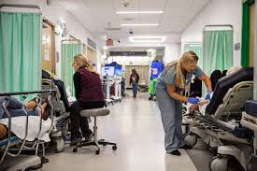
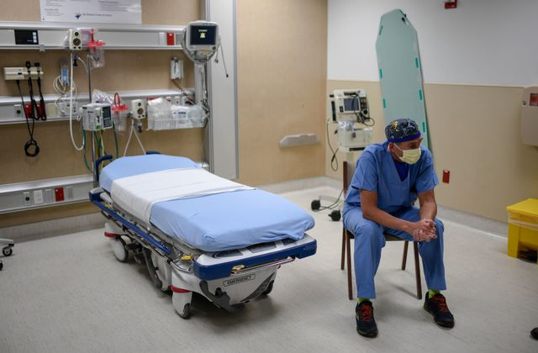

Survey Timeline
4 Calendar Years
Jul
Aug
Sep
Oct
Nov
Dec
Jun
May
Apr
Mar
Feb
Jan
2019
Jul
Aug
Sep
Oct
Nov
Dec
Jun
May
Apr
Mar
Feb
Jan
2020
Jul
Aug
Sep
Oct
Nov
Dec
Jun
May
Apr
Mar
Feb
Jan
2021
Jul
Aug
Sep
Oct
Nov
Dec
Jun
May
Apr
Mar
Feb
Jan
2022

Slide 6
Pandemic Recovery Data
Our participants
Columbia/NY Presbyterian
Dartmouth-Hitchcock
Johns Hopkins University
Medical University of South Carolina
Northwestern University
Penn State University
Robert Wood Johnson/ Rutgers University
Stanford University
The Ohio State University
University of North Carolina, Chapel Hill
University of Arizona/Maricopa District
University of California, San Francisco
University of Colorado
University of Florida, Gainesville
University of Illinois, Chicago
University of Louisville
University of Michigan
University of Missouri, Columbia
University of Nebraska
University of Pennsylvania
University of Wisconsin
Yale University

Slide 7
Pandemic Recovery Data
Five separate rounds of data collection
10 Common Data Elements
• Total ED Registrations
• Total ED Hospitalizations
• Total ED LWBS
• Total ED SAL
• Total ED Discharges + Other Dispos
• Total EMS Arrivals
• Total EMS Hospitalizations
• Triage Level 1-5 (individual #s)
• Total Boarding Hours (monthly sum)
• Profee Level 1-5, CC (individual #s)

Slide 8
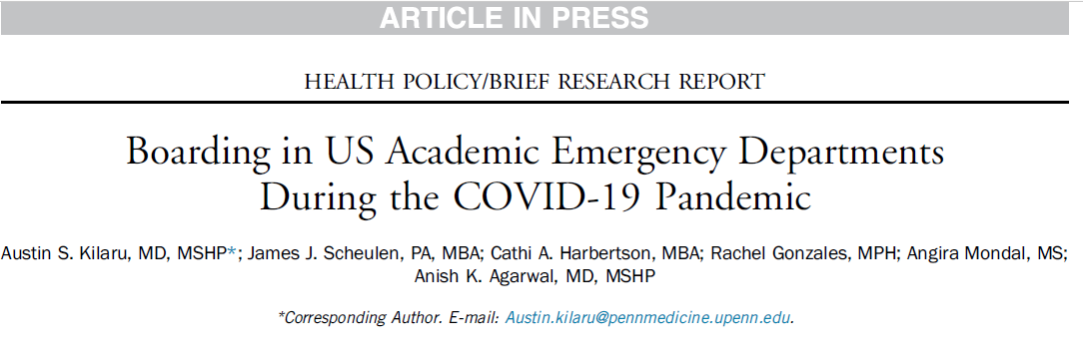

Conclusions: A sustained and considerable increase in boarding observed in selected US academic EDs during later phases of the COVID-19 pandemic may reflect ongoing stresses to the health care system, with potential consequences for patient outcomes as well as clinician well being.

Slide 9

WE BROKE.
WE FINALLY BROKE.

Slide 10
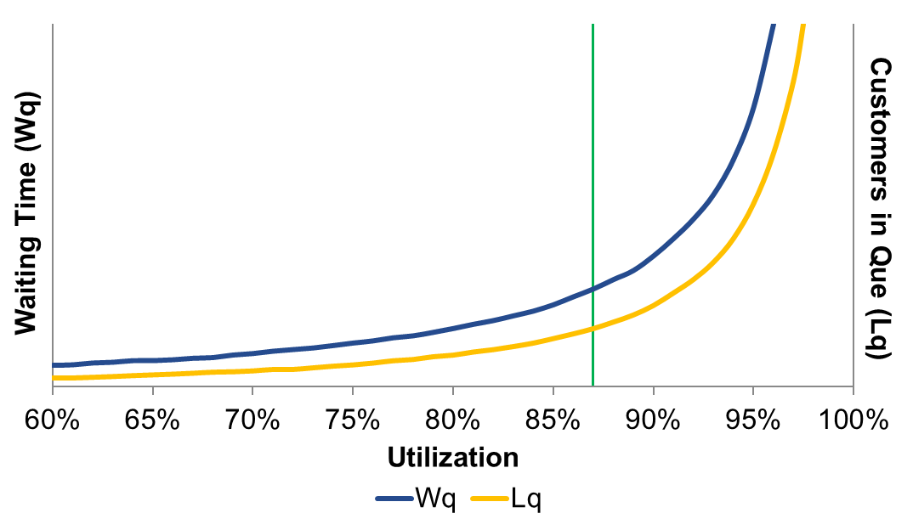
Queuing Theory:
Matching fixed resources with unscheduled demand
Utilization Tipping Point
NOT High ED Volume and LOS
High Inpatient Occupancy = Queues
Boarding in ED, PACU, Other

Slide 11
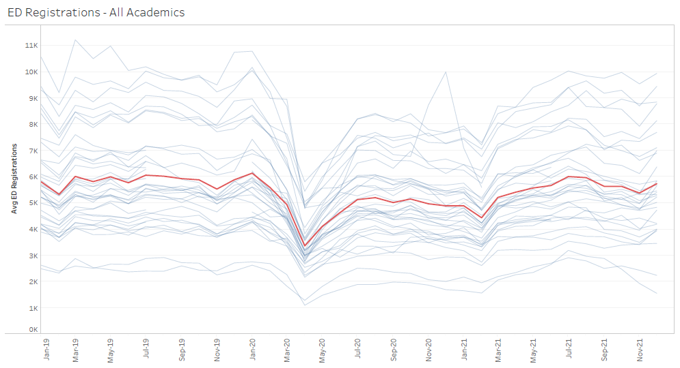
What we knew last year
Pre-COVID
Jan 2019 thru Dec 2019
January 2020
6126
1 year
Since peak
April 2021
Recovery
Dec 2021
Recovery
July 2020
Peak loss
April 2020
5,803
5,312
5,708
5,134
3,360

Slide 12
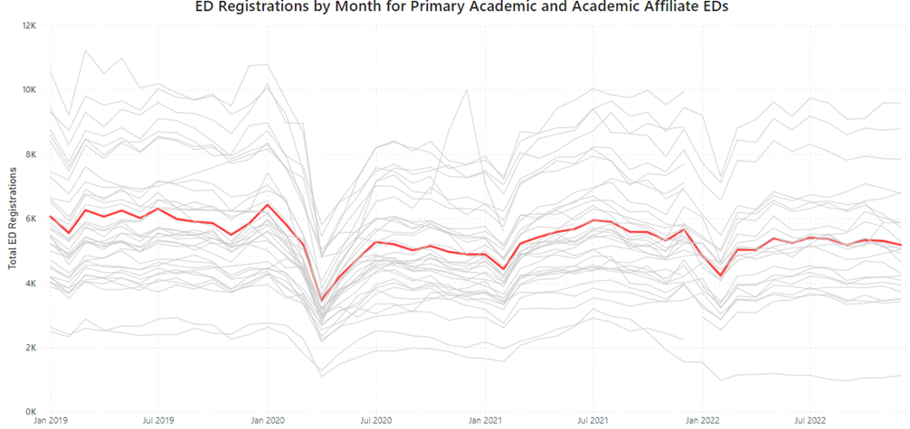
What we know now
January 2020
6126
Recovery
July 2020
1 year
Since peak
April 2021
Recovery
Dec 2021
Pre-COVID
Jan 2019 thru Dec 2019
New Normal
Dec 2022
Peak loss
April 2020
5,803
5,134
5,312
5,708
5,180
3,360

Slide 13
Mean Volumes
2019
Pre-COVID
5,822
2021
Recovery
5,435
69,860
59,088
65,222
61,552
2020
COVID
4,924
2022
Level Set
5,129

Slide 14
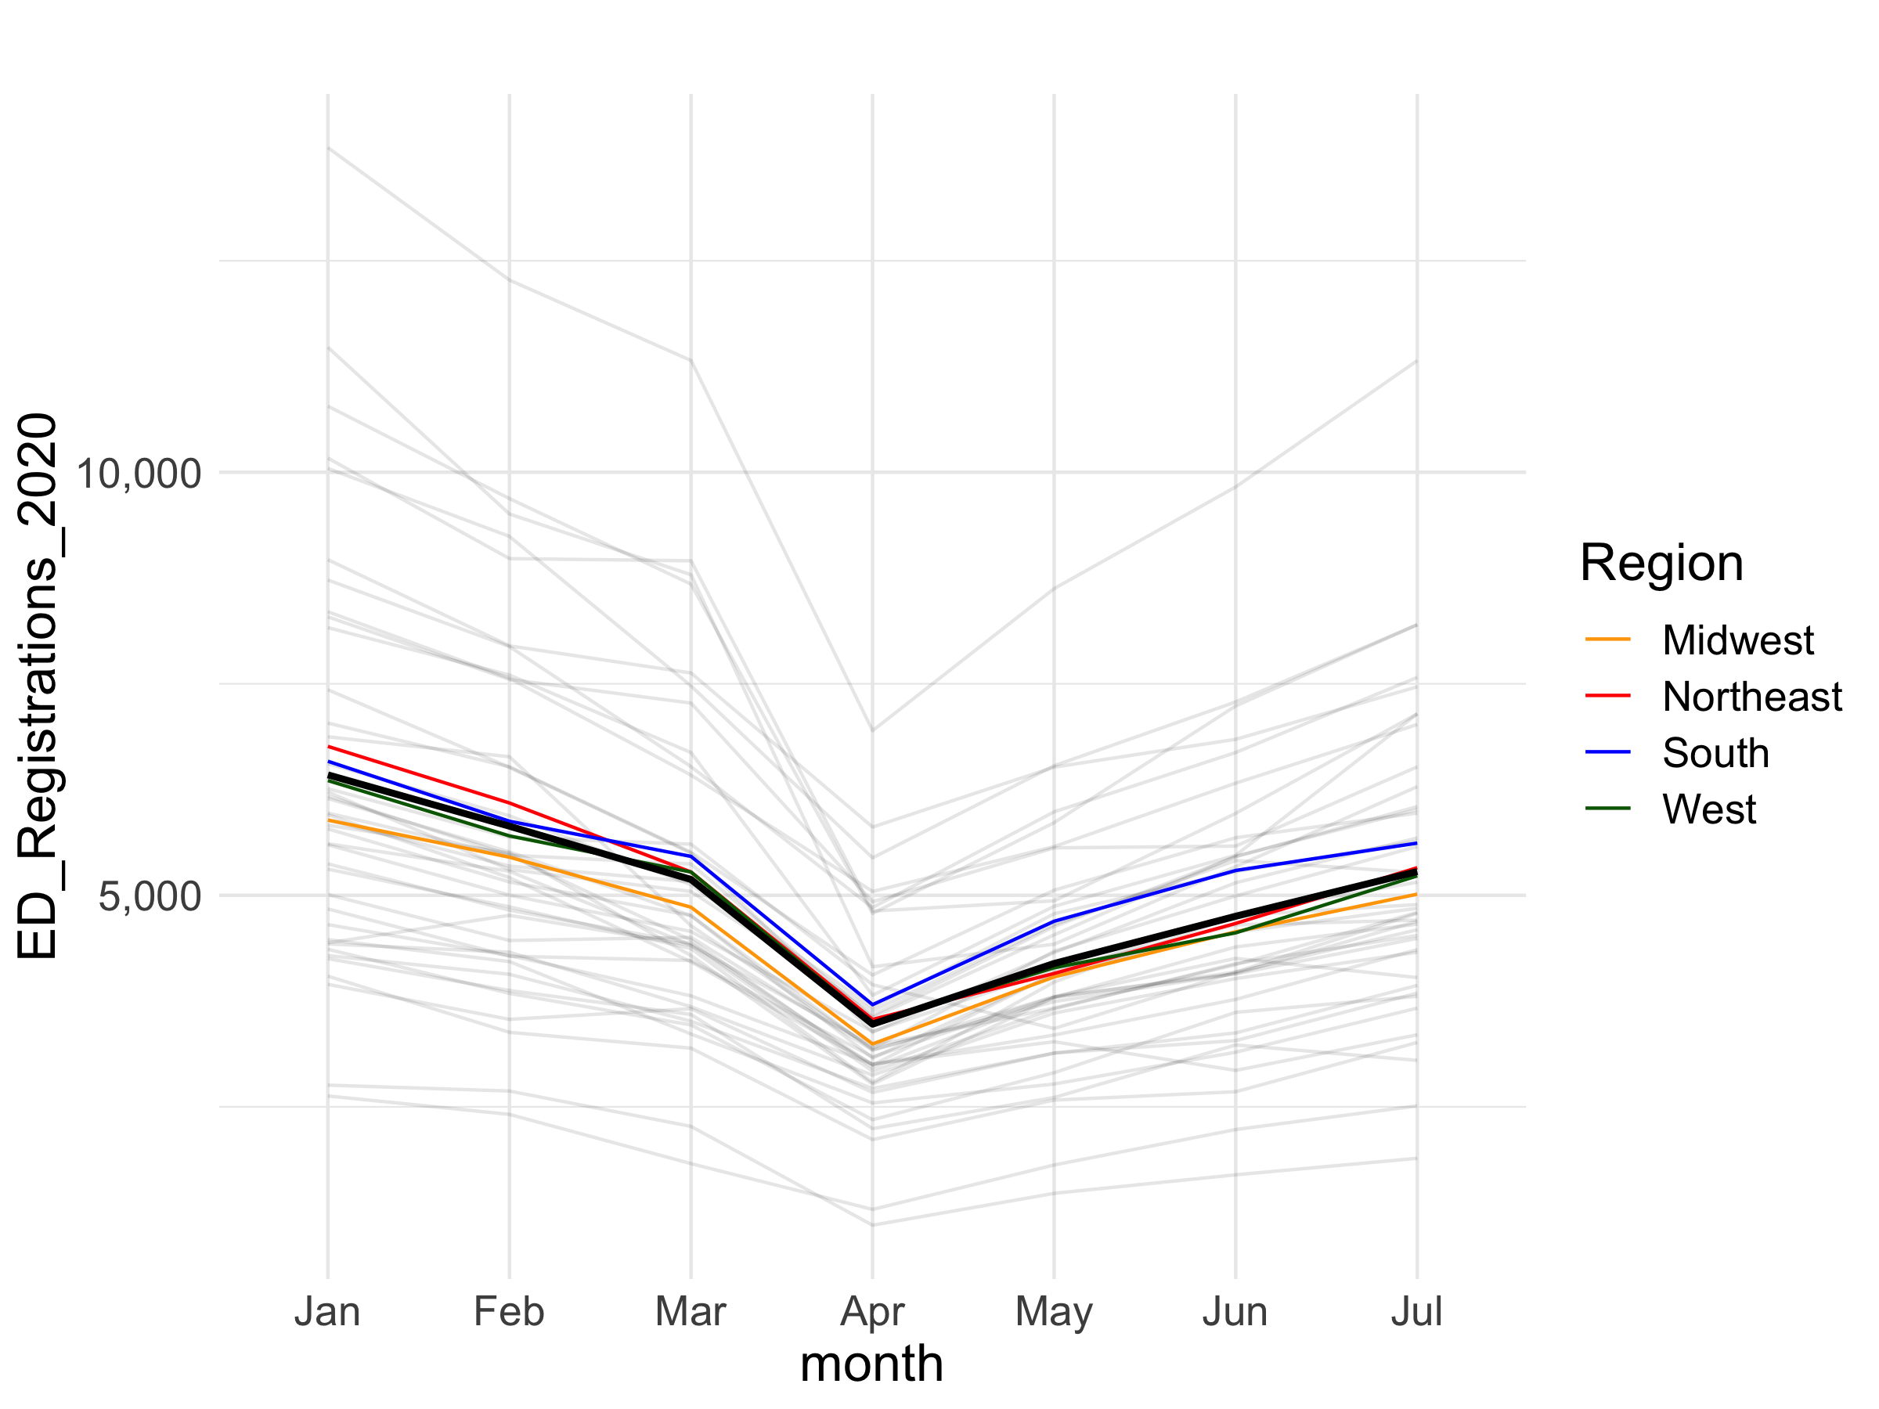
Regional Patterns

Slide 15

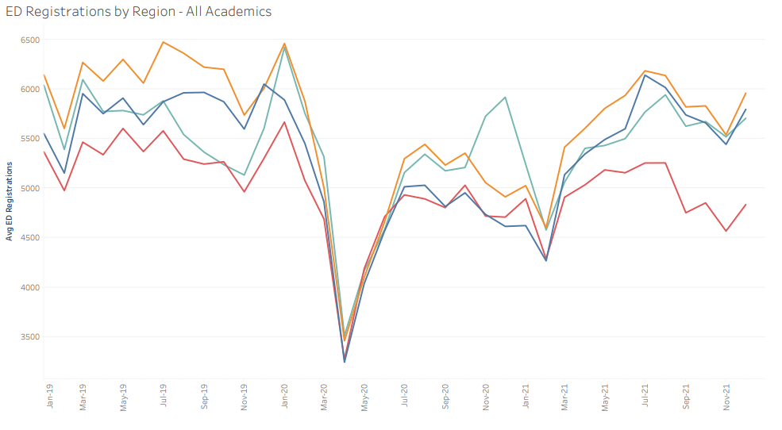
Regional Patterns through 12/21
February
volume dips
January
spike
June
recovery
FY 21
end
CY 21
end
February
volume dips

Slide 16
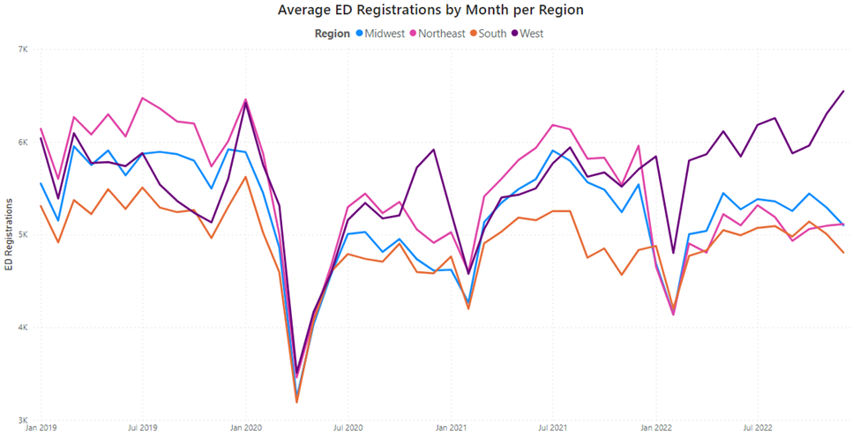
Regional Patterns through 12/22
CY 21
end
CY 22
end

Slide 17
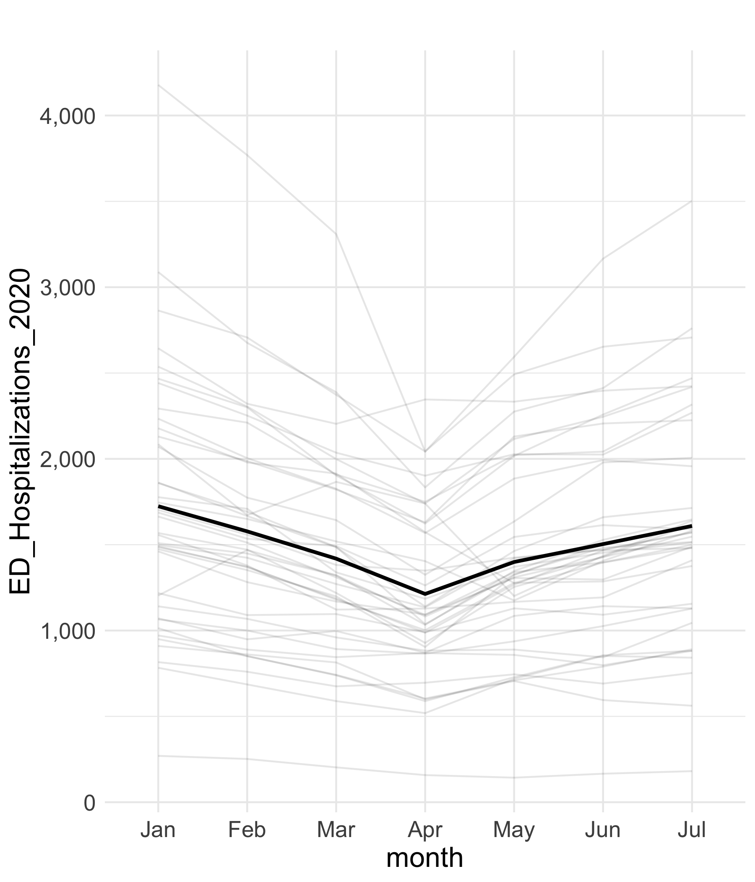
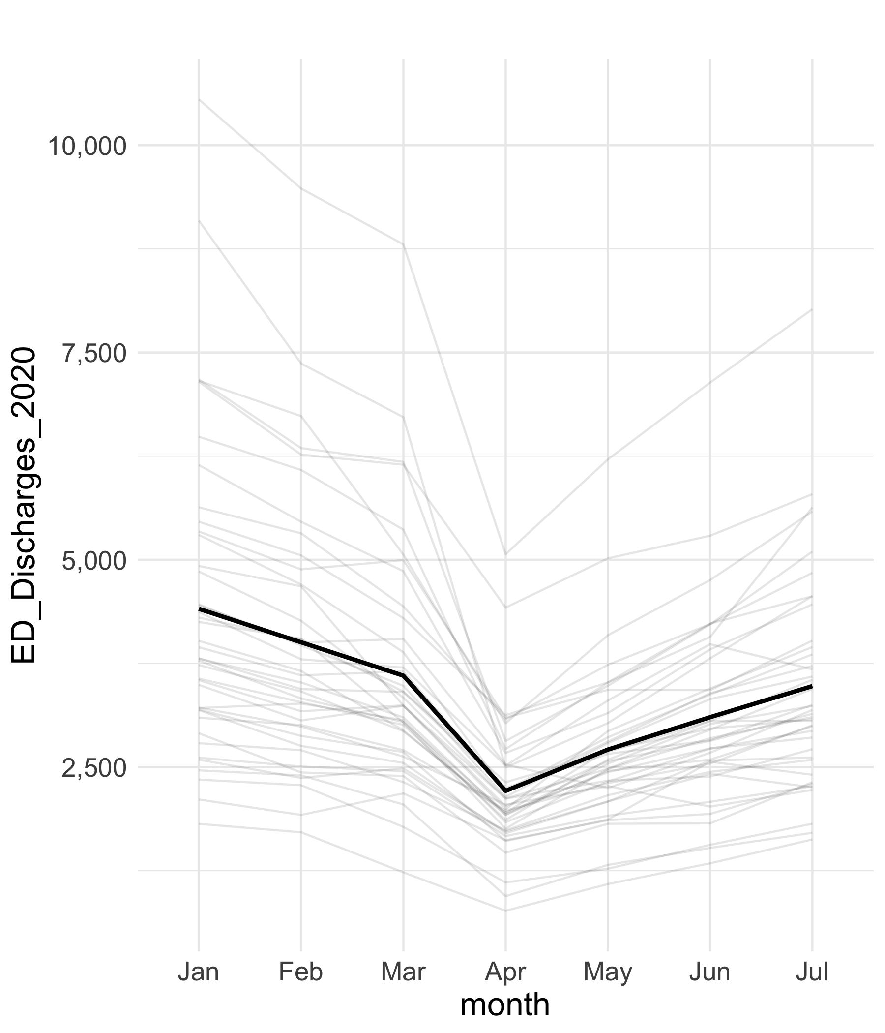
Discharged vs Hospitalized
Discharges
Hospitalizations
While Total Visits fell by 46%,
Discharges fell by 49%
Discharges have recovered
to 79% of pre-COVID volume
While Total Visits fell by 46%,
Hospitalizations fell by 30%
Hospitalizations have recovered
to 93% of pre-COVID volume
-49%
-30%
Notes:
Total Discharges: Drop from an average of 3,602 March to 2,212 April discharges) 38.5% drop
Dropped from 4,408 in Jan which represents a 50% drop to April
Percent Discharged: Decrease from 69% in March to 64% April
Looking at Jan to April:
Largest Drop: MAIMON decreased by 72.5%
Smallest Drop: JHBMC decreased by 23.3%
Looking at January to July:
Largest Drop: MAIMON decreased by 49.8%
Smallest Drop: JHBMC increased by 8.9%

Slide 18
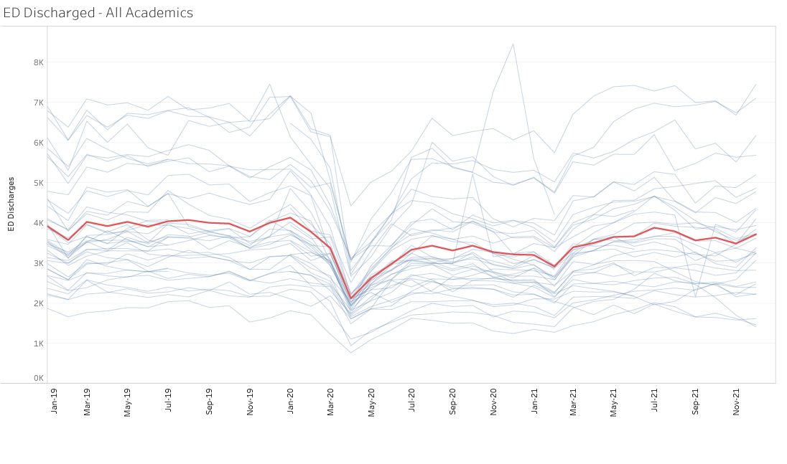
Discharged: Through 12/21
Initial
Recovery
July 2020
Pre-COVID
Jan 2019 thru Dec 2019
Next 12
Months
Next 6
Months
3,362
3,604
Peak loss
April 2020
3,100
3,414
2,130
~95% of
pre-COVID
~86% of pre-COVID

Slide 19
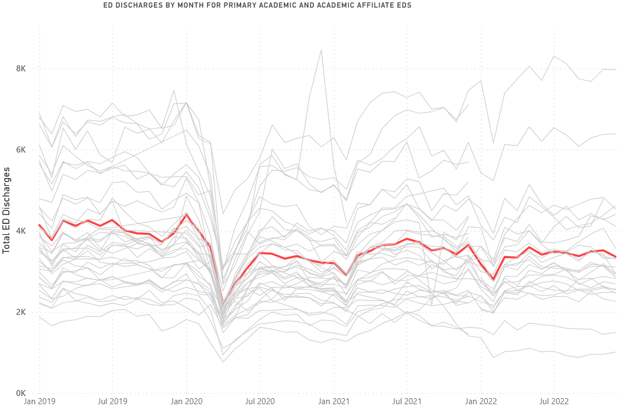
Discharged: Through 12/22
2019
Pre-COVID
3,917
2020
COVID
3,249
2021
Recovery
3,501
2022
Level Set
3,365
~83% of pre-COVID
~89% of pre-COVID
~86% of pre-COVID
47,001
38,993
42,014
40,381
Last 6 months = 300 patients
higher per month than first
6 months

Slide 20
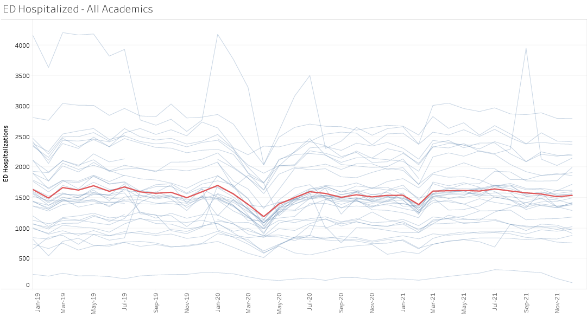
Hospitalized: Through 12/21
Initial
Recovery
July 2020
Pre-COVID
Jan 2019 thru Dec 2019
Next 12
Months
Next 6
Months
1,578
Peak loss
April 2020
1,541
1,510
1,548
1,179
~98% of pre-COVID
@ pre-COVID

Slide 21
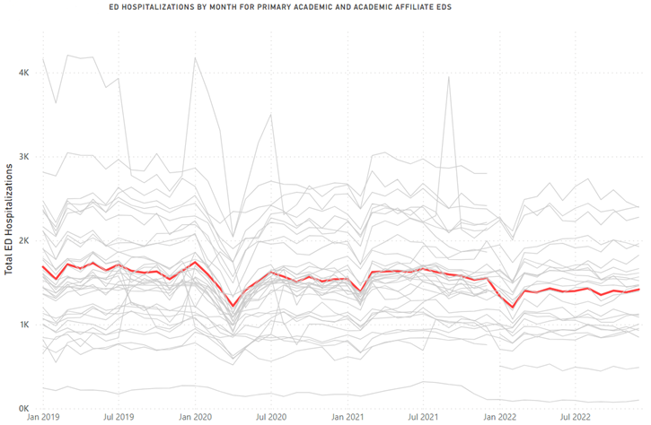
Hospitalized: Through 12/22
2019
Pre-COVID
1,618
2020
COVID
1,500
2021
Recovery
1,583
2022
Level Set
1,378
~93% of pre-COVID
~98% of pre-COVID
~85% of pre-COVID
19,418
18,000
19,000
16,534

Slide 22
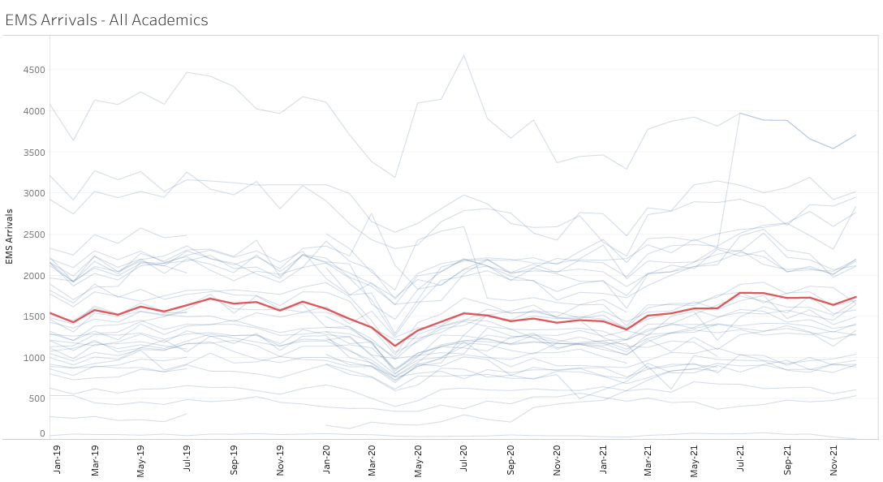
EMS Arrivals through 12/21
Initial
Recovery
July 2020
Pre-COVID
Jan 2019 thru Dec 2019
Next 12
Months
Next 6
Months
Peak loss
April 2020
1,538
1,352
1,530
1,477
1,141
~92% of pre-COVID
> pre-COVID

Slide 23
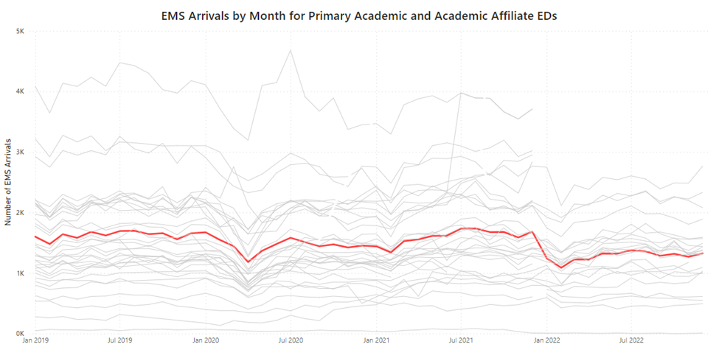
EMS Arrivals
2019
Pre-COVID
1,580
2020
COVID
1,420
2021
Recovery
1,600
2022
Level Set
1,280
~85% of pre-COVID
18,955
17,040
19,197
15,362

Slide 24
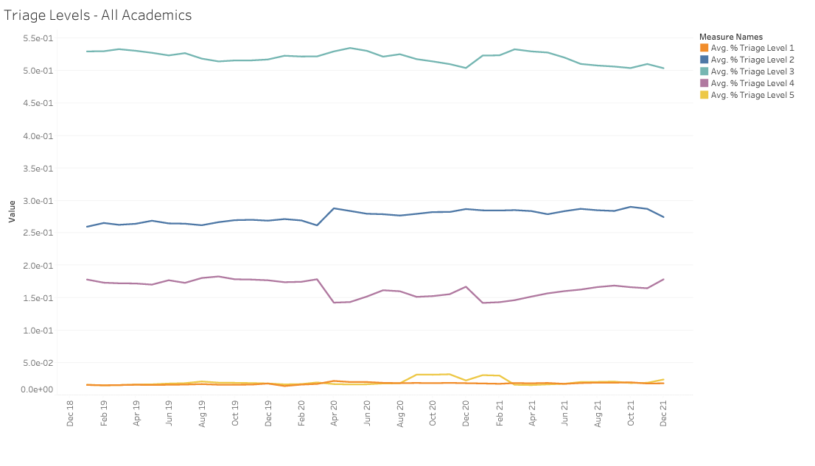
Patient Acuity: Triage Levels
Acuity Ratio Triage Levels 1&2 vs 4&5
Pre-COVID
Jan 2019 thru Dec 2019
Initial
Recovery
July 2020
Next 12
Months
Next 6
Months
Peak
3.0
2.0
2.8
2.5
2.3
Level 2
Level 4
Notes:
Defined as: Triage Ratio = Triage Level 1 + 2 / Triage Level 4 + 5
Triage Ratio Values:
Jan: 2.11
Feb: 2.11
Mar: 1.96
Apr: 3.02
May: 2.81
Jun: 2.67
Jul: 2.43

Slide 25
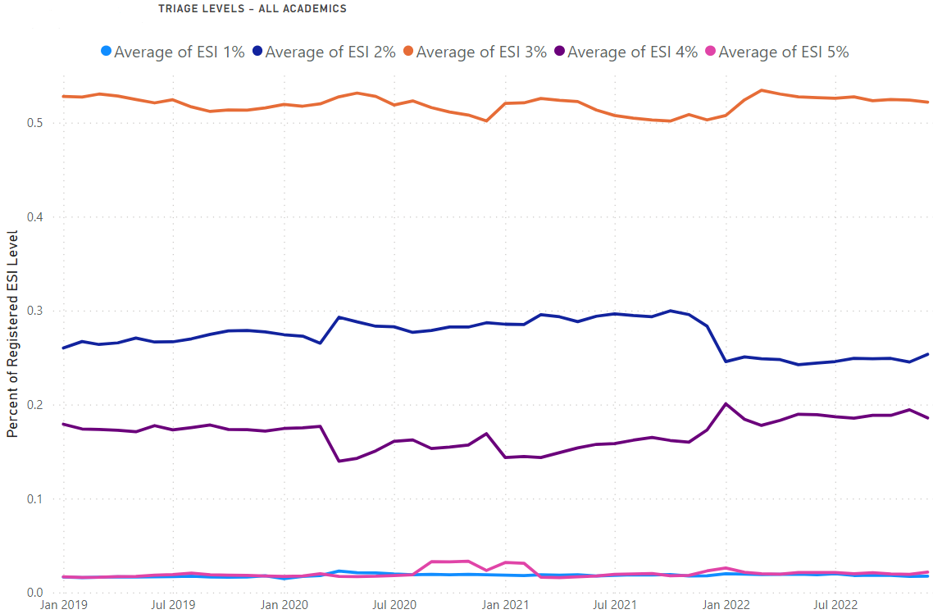
Patient Acuity: Triage Levels
Acuity Ratio Triage Levels 1&2 vs 4&5
Pre-COVID
CY 2019
CY 2020
CY 2021
CY 2022
2.0
2.5
2.4
1.7
Level 2
Level 4
Notes:
Defined as: Triage Ratio = Triage Level 1 + 2 / Triage Level 4 + 5
Triage Ratio Values:
Jan: 2.11
Feb: 2.11
Mar: 1.96
Apr: 3.02
May: 2.81
Jun: 2.67
Jul: 2.43

Slide 26
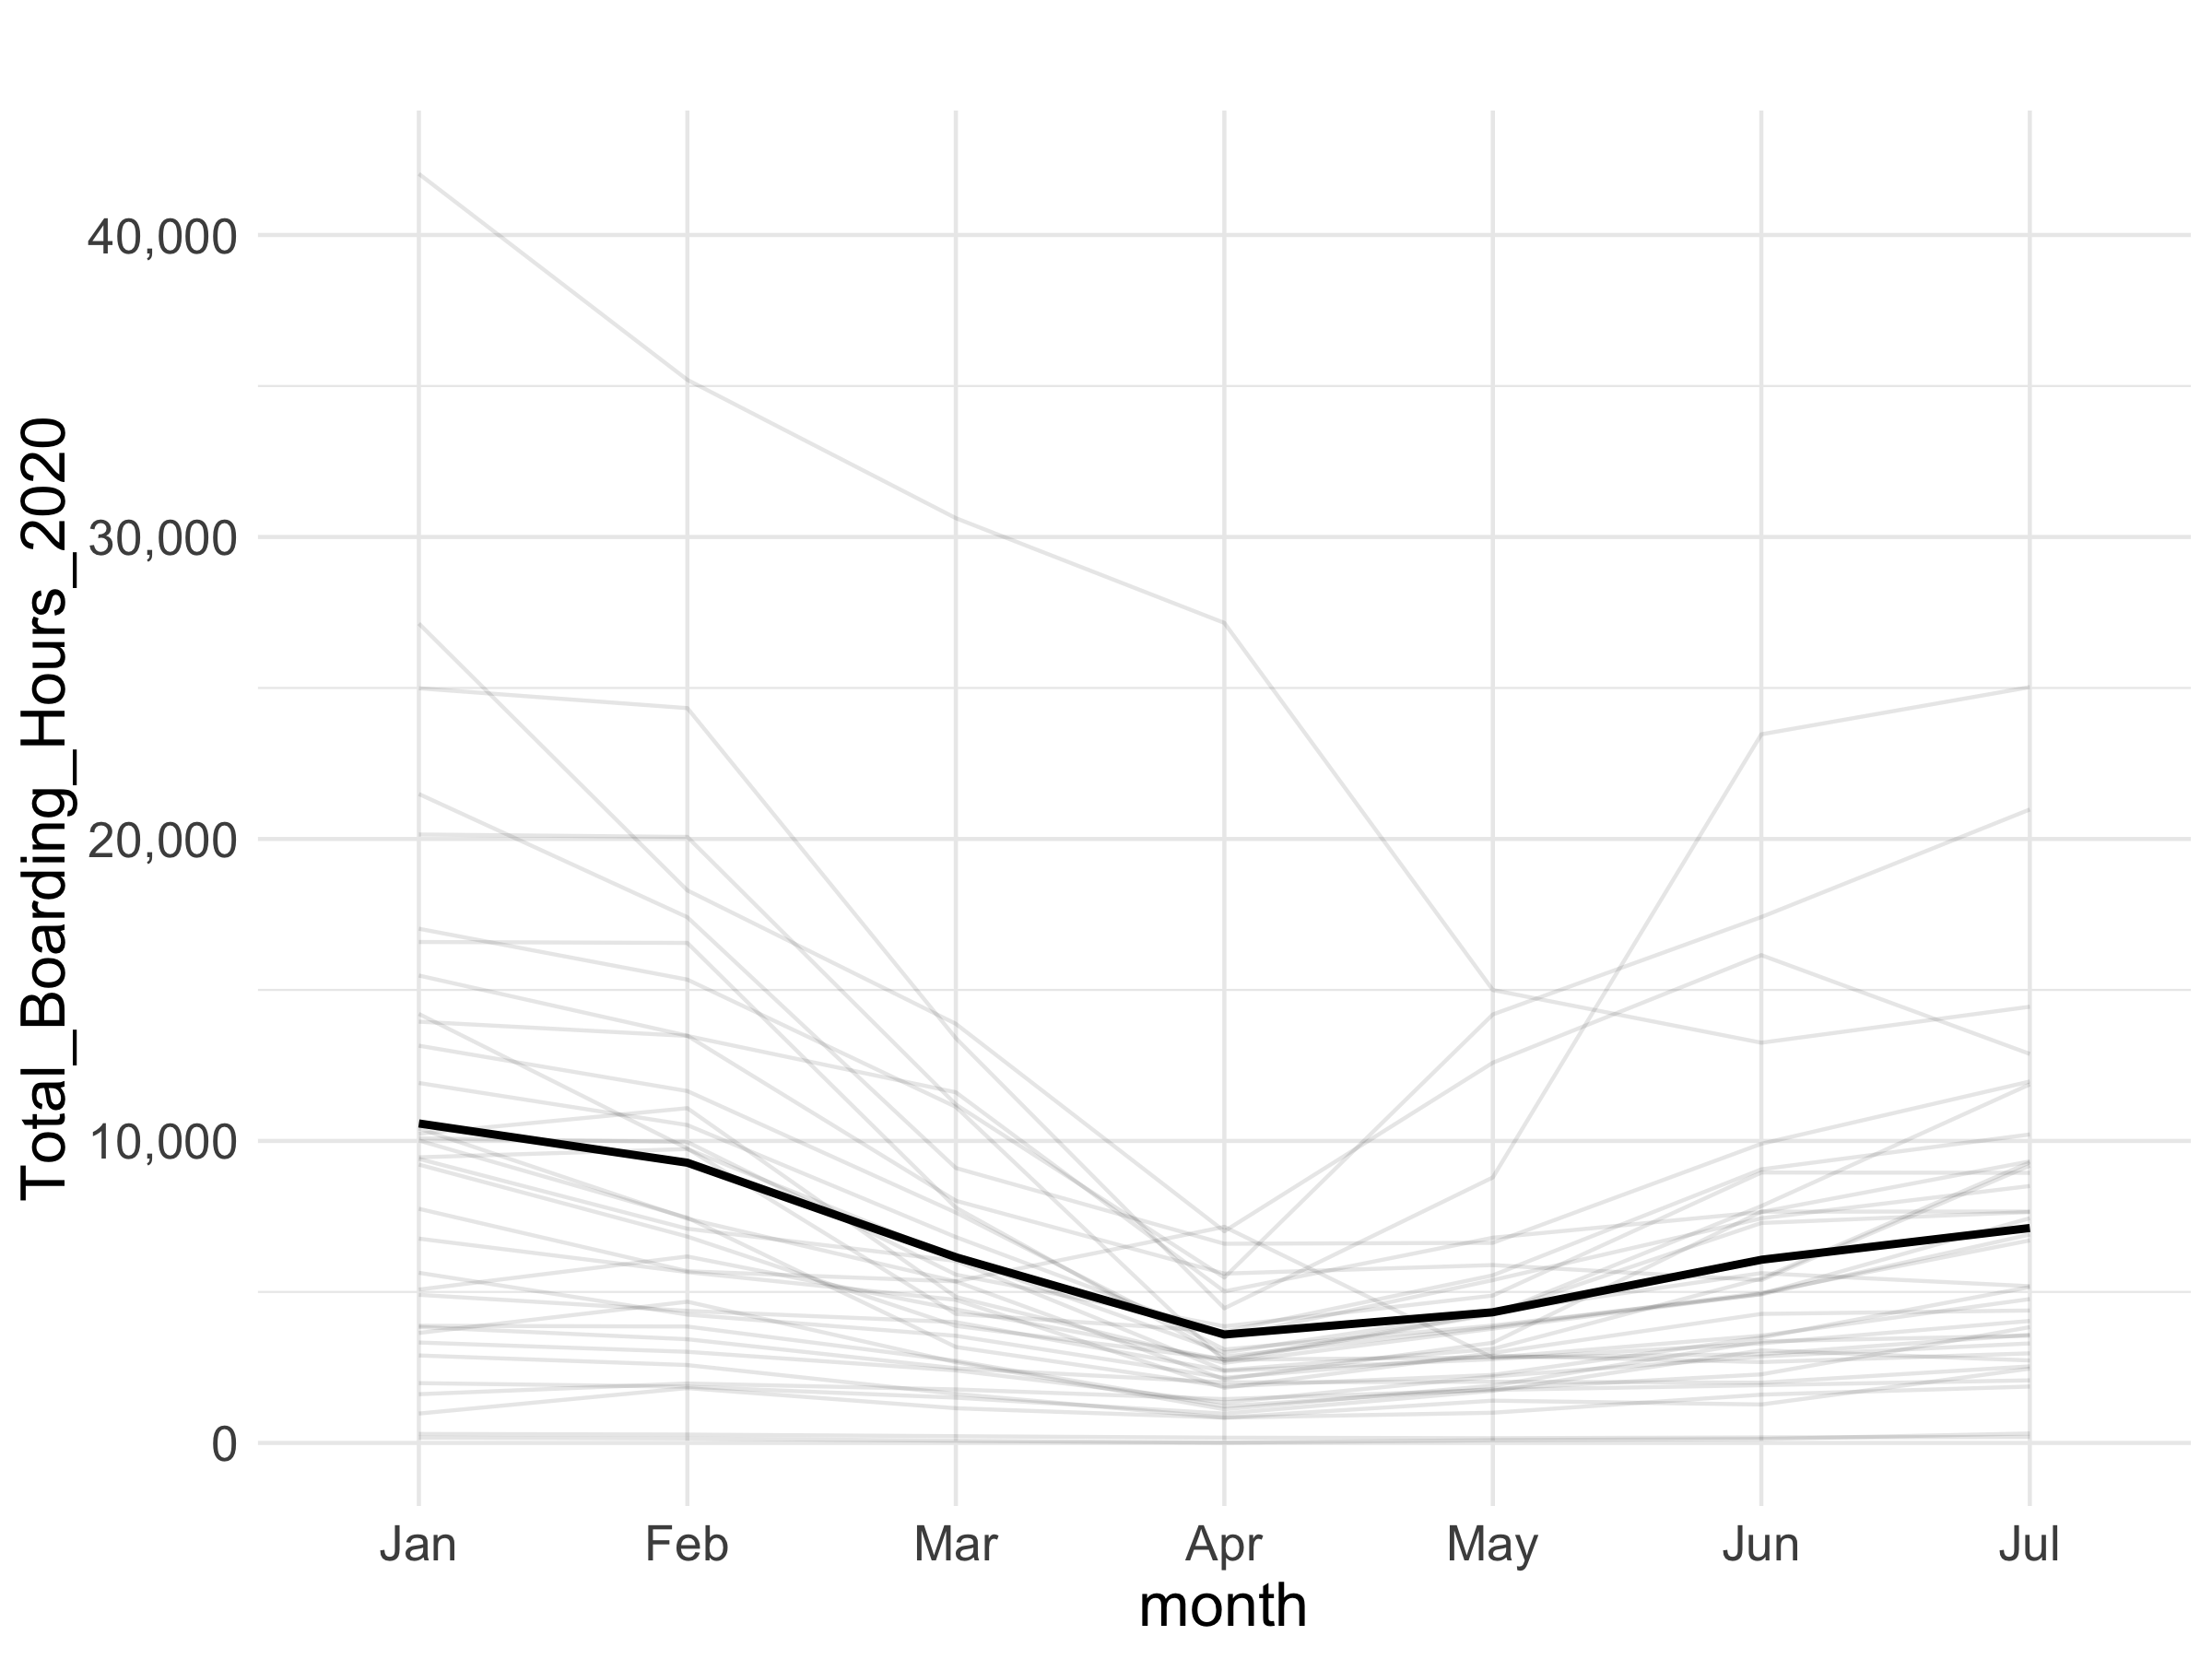
Initial Impact
Total Boarding Hours
Total boarding hours
fell by 66% in April
and were still down
by 33% in July
Notes:
Jan to April: 66.1% Decrease
April to July: 98.3% Increase
Numbers
Jan: 10580
April: 3589.7
July: 7116

Slide 27
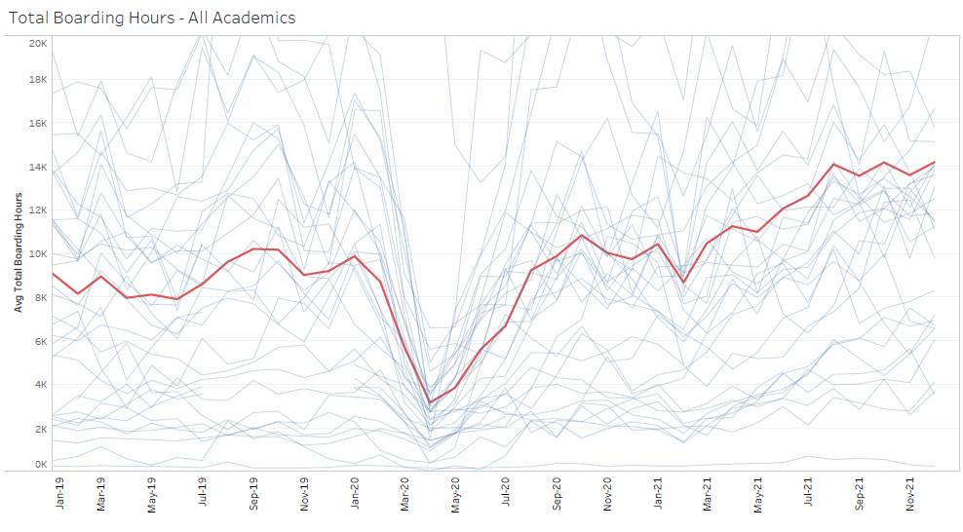
What we knew last year
Next 6
Months
Next 12
Months
11,740
Peak impact
April 2020
8,361
Pre-COVID
Jan 2019 thru Dec 2019
3,217
8,353
Initial
Recovery
July 2020
6,696

Slide 28
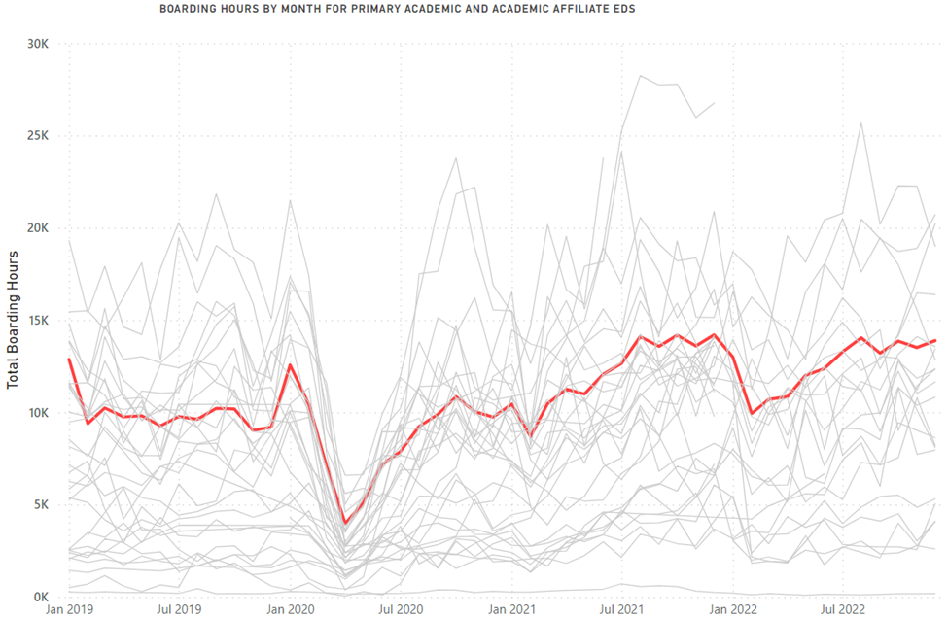
Boarding through 2022
2019
Pre-COVID
8,923
2020
COVID
7,782
2021
Recovery
12,184
2022
Level Set
12,553
107,073
93,386
146,211
150,636

Slide 29
Boarding through 2022
41%
increase vs
pre-pandemic

Slide 30
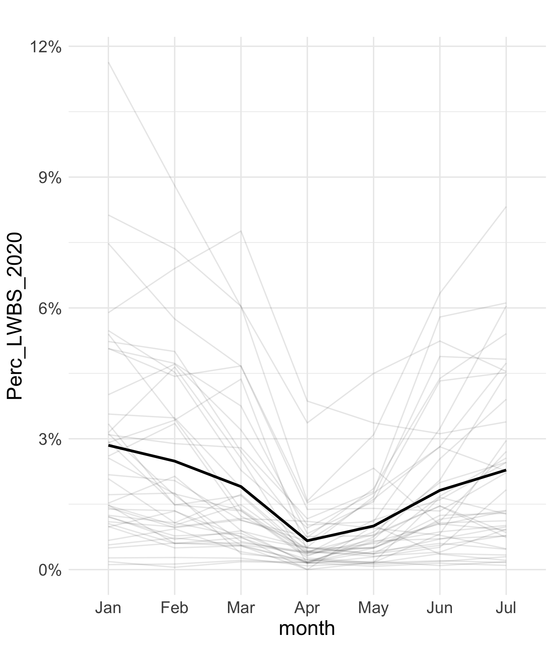
LWBS in 2020
2.7%
2.3%
0.6%

Slide 31
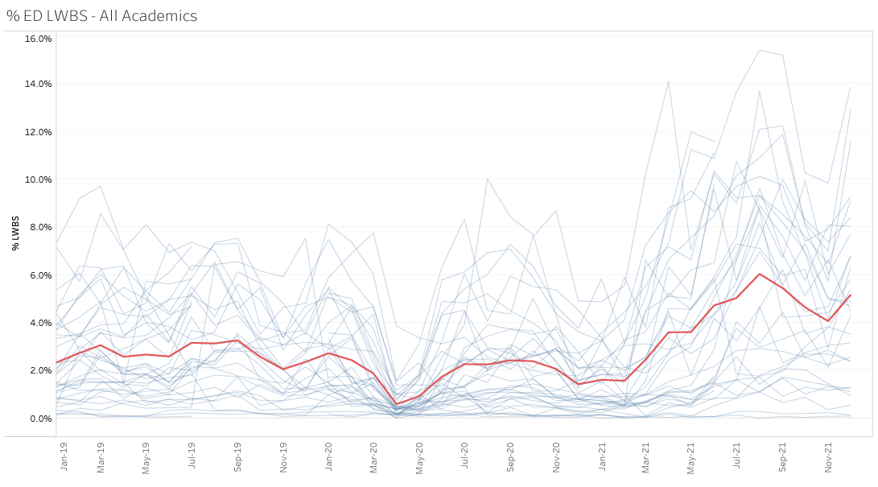
LWBS through 12/21
Aug
2021
6.4%
Dec
2021
5.1%
Initial
Recovery
July 2020
April
2021
3.6%
Peak
2.3%
0.6%
2.3%
2.7%

Slide 32
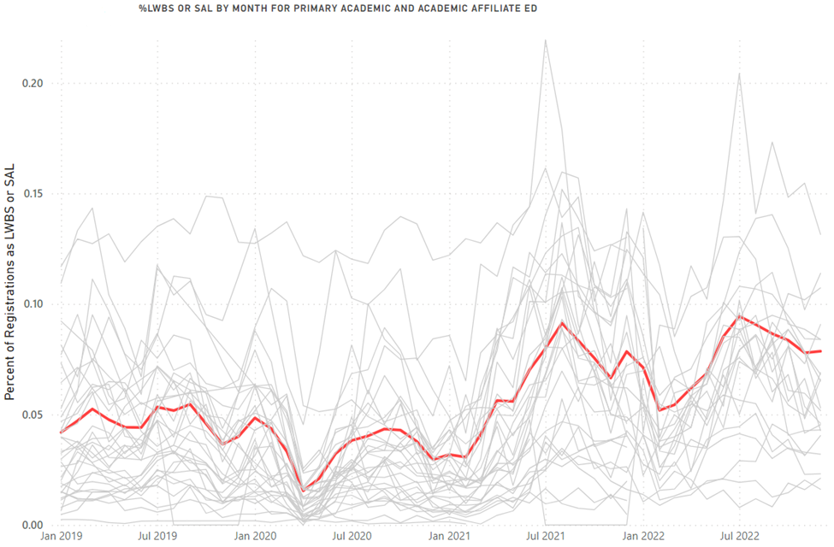
LWBS and SAL through 2022
Left Without Being Seen AND Seen/Screened and Left
7.9%
8.2%
6.9%
3.8%
1.4%
3.5%
2.3%
0.6%
2.4%
6.4%
5.1%
6.2%
4.9%
Left Without Being Seen

Slide 33
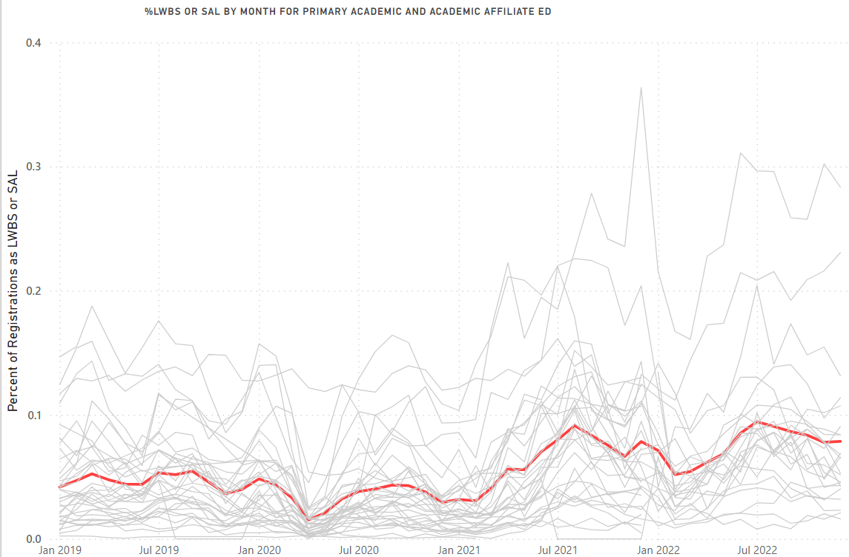
LWBS and SAL through 2022

Slide 34
LWBS and SAL through 2022
A 63% Increase since Pre-pandemic
TOTAL LBTC for FY 22 = 8.5%

Slide 35
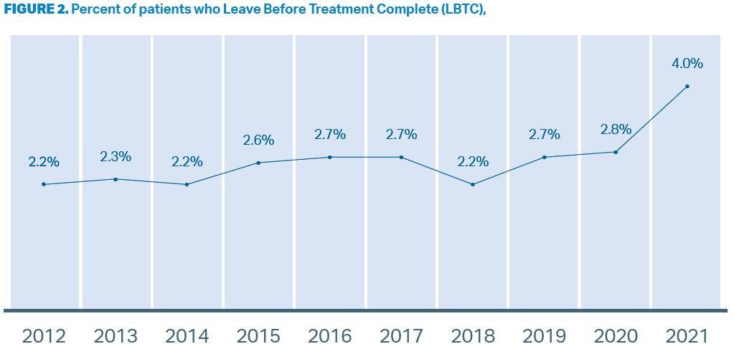
EDBA Data
Thank you Nick Jouriles and Jim Augustine, EDBA

Slide 36
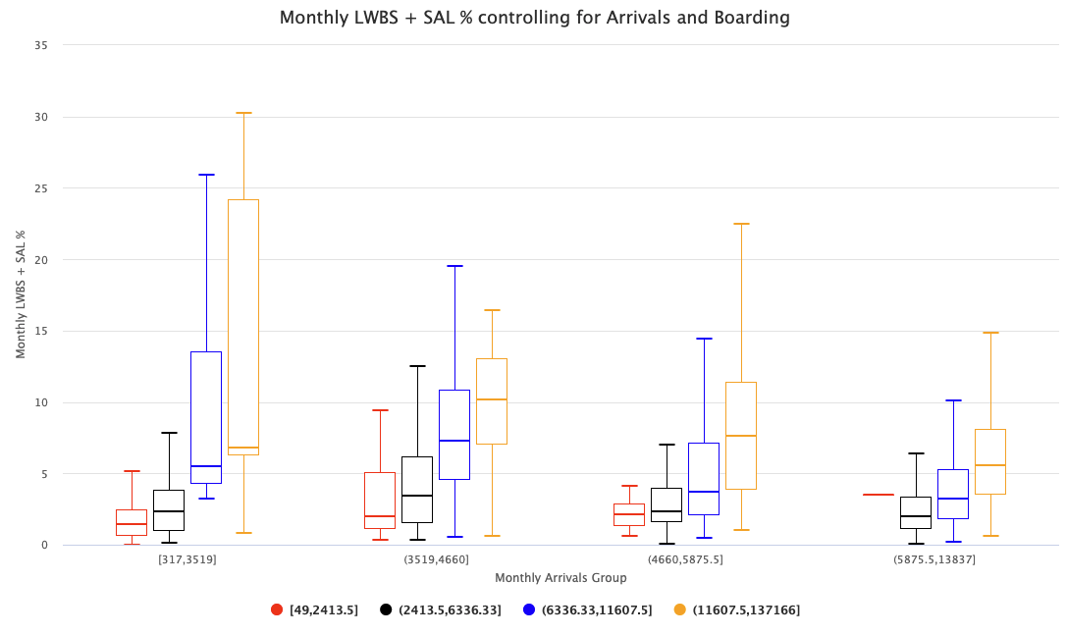
LWBS & Boarding Hours
Min – 25th % ile
< 42,00 visits
25th -- 50th % ile
42,000 -- 56,000 visits
50th -- 75th % ile
56,000 -- 71,000 visits
75th -- Max
71,000 -- 166,000 visits
At every level of patient volume.
As boarding hours increase, the
Rate of LWBS and SAL patients increase

Slide 37
Queuing Theory:
Matching fixed resources with unscheduled demand

Slide 38


Describes a patient experience
Describes ACEP letter:
EDs at “breaking point”
Describes MHA perspective:
ED wait times are a symptom
Describes a NEJM Op Ed
“canary in the health care system”
Describes a new task force:
Find the “root cause”

Slide 39
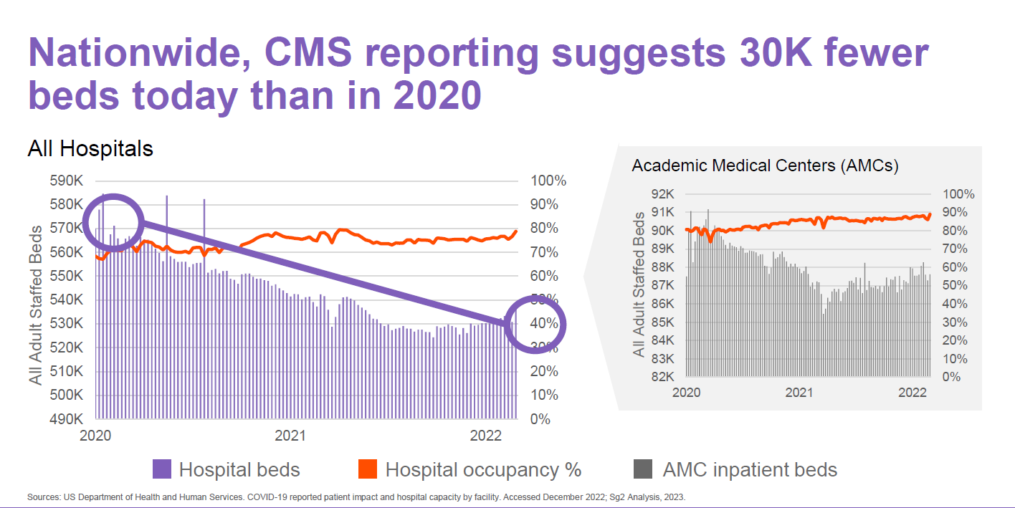
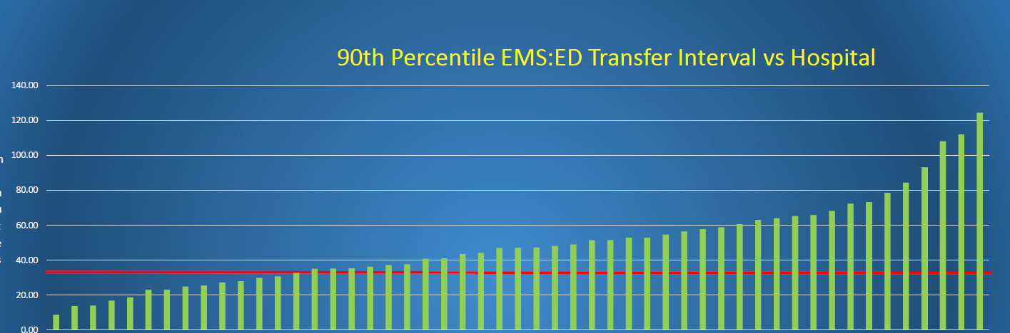
Vizient/Sg2 Analysis
Extended Medic Unit Offload Time

Slide 40
Queuing Theory:
Matching fixed resources with unscheduled demand
Utilization Tipping Point
Increasing Inpatient Occupancy
  Increasing Hospitalizations
    Non-ED inpatients are increased
  Increasing Inpatient LOS
    Observed and Expected LOS are increased
Increased patients + Increased days = Increased patient days = High Occupancy

Slide 41
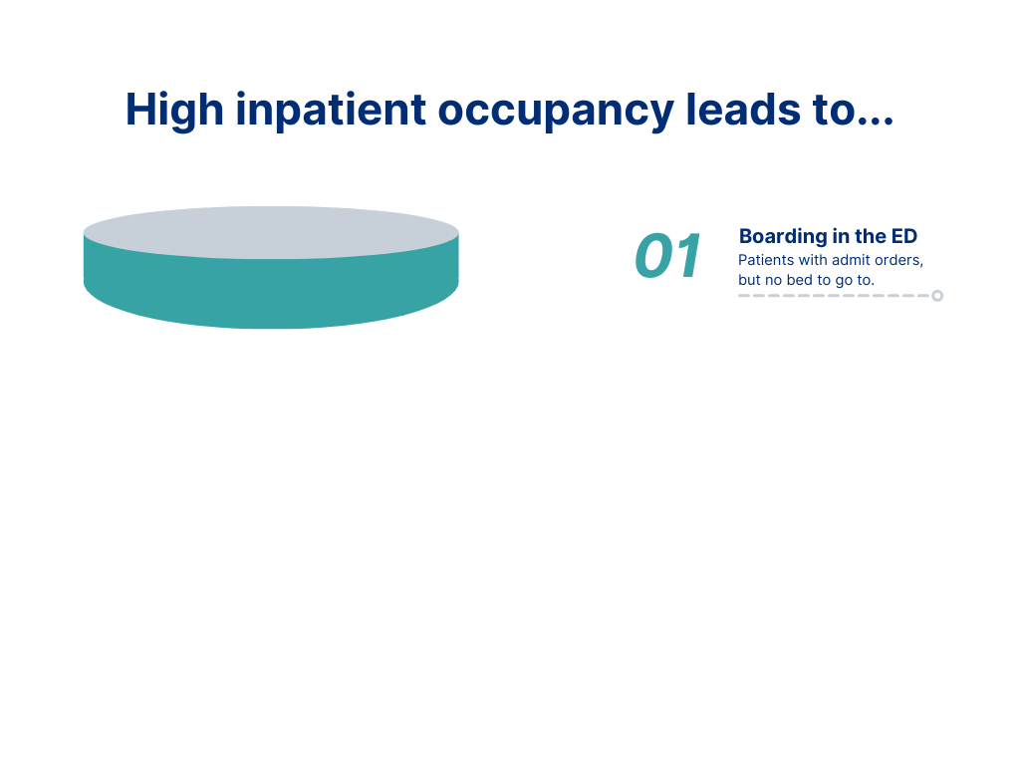


Slide 42
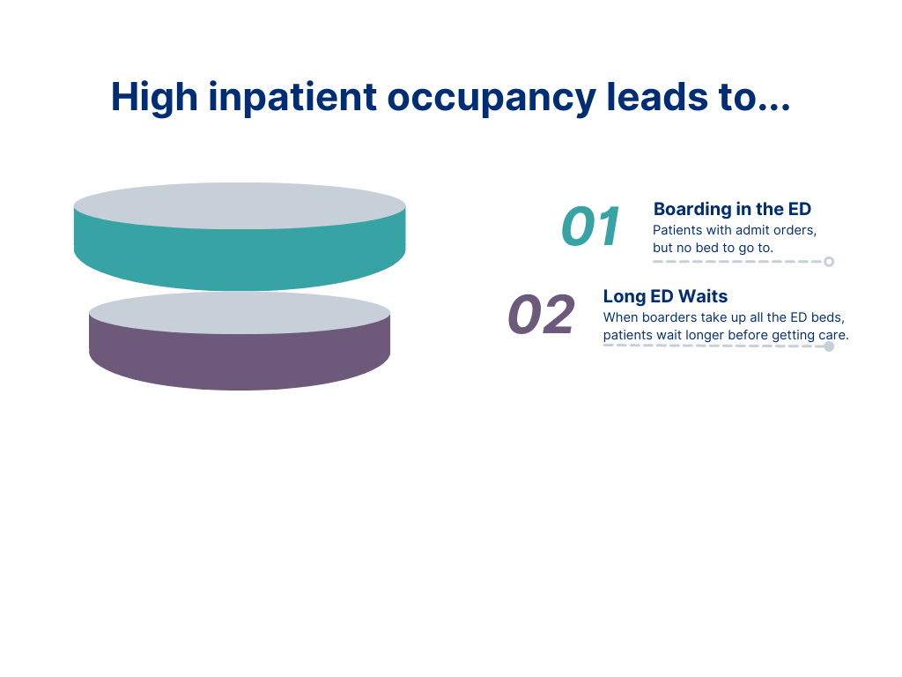


Slide 43
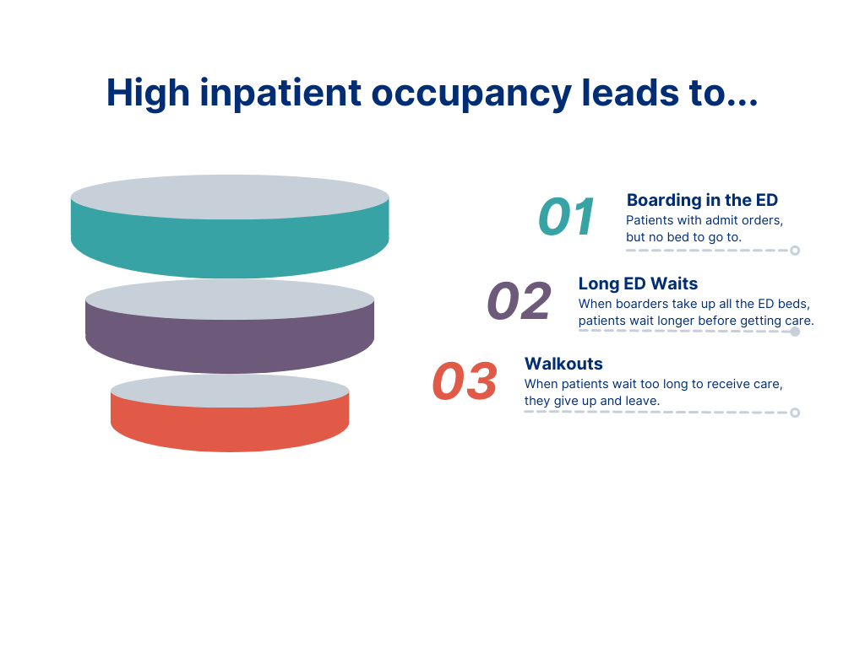


Slide 44
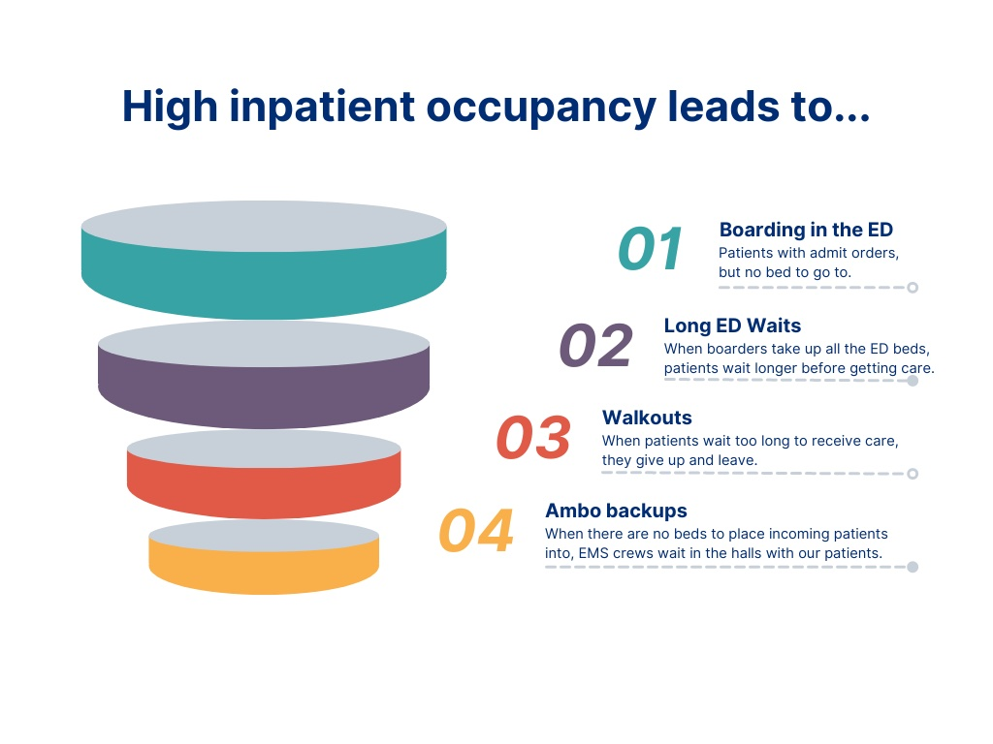



Slide 45
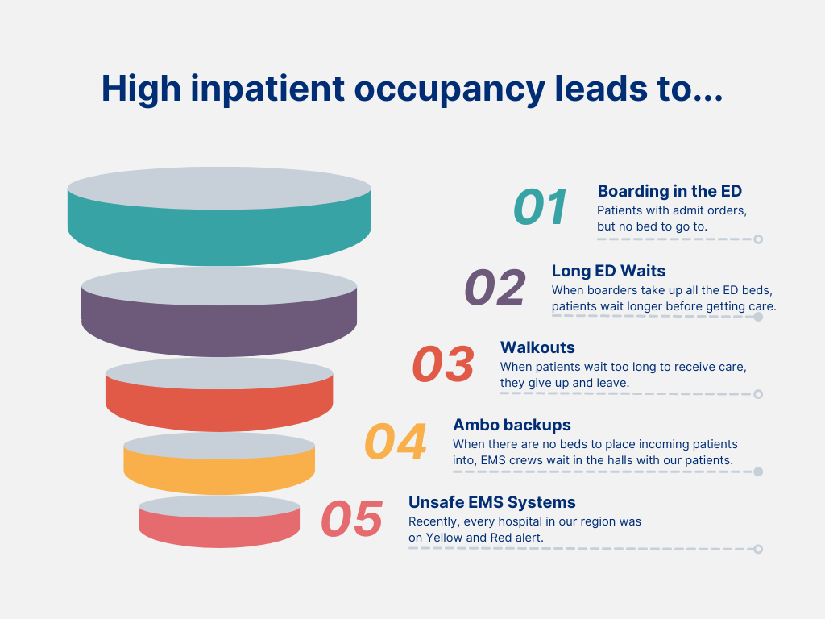

Slide 46
Changes in Patient population between 2019 and 2022

Slide 47
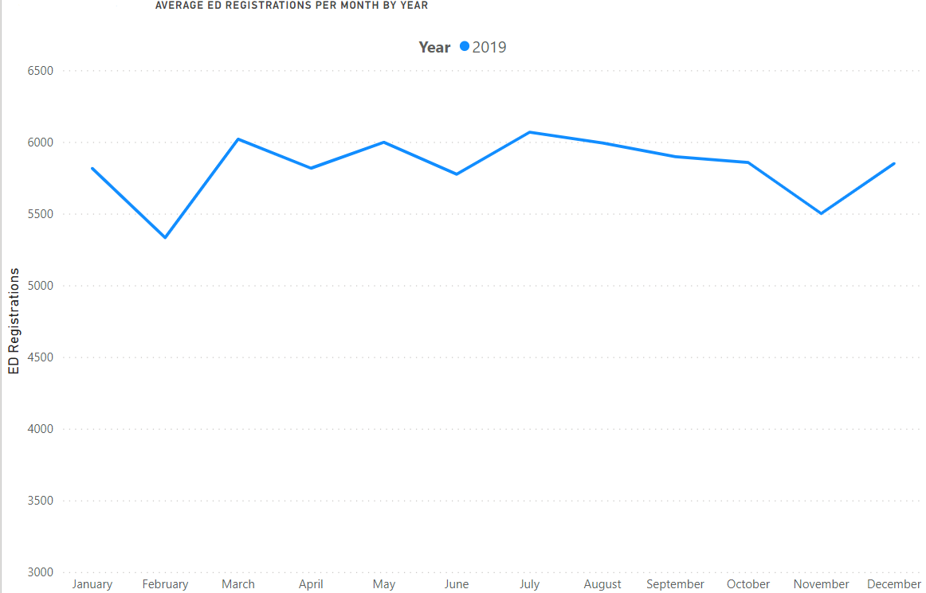
2019—2022 Visits
69,860

Slide 48
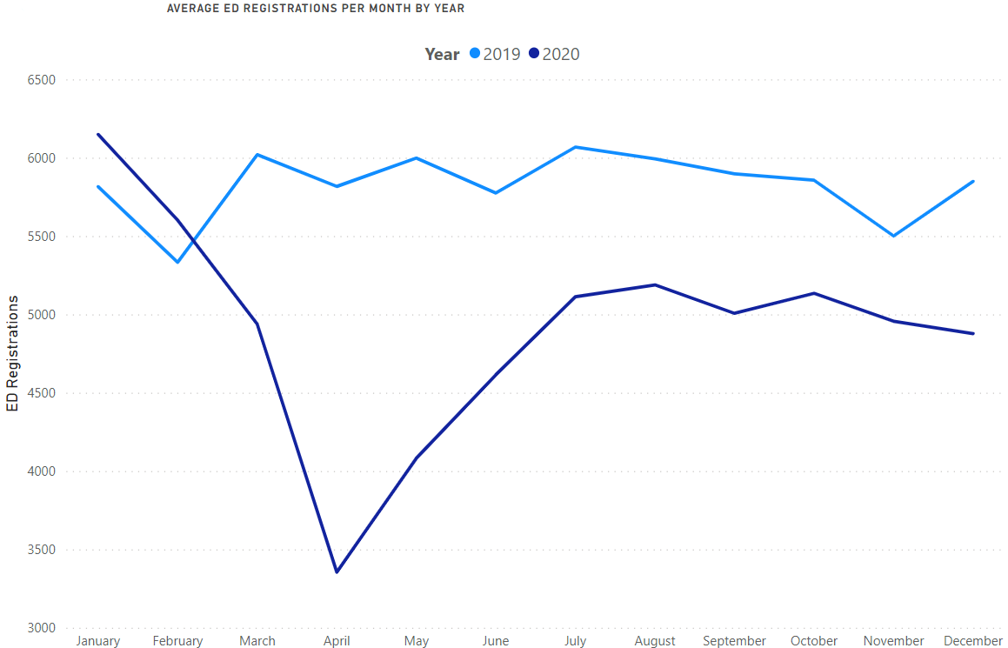
2019—2022 Visits
+593
69,860
(10,772)
59,088
Similar billing patterns as pre-COVID
  Collections @ $140/visit
  Revenue impact = $1.5 million

Slide 49
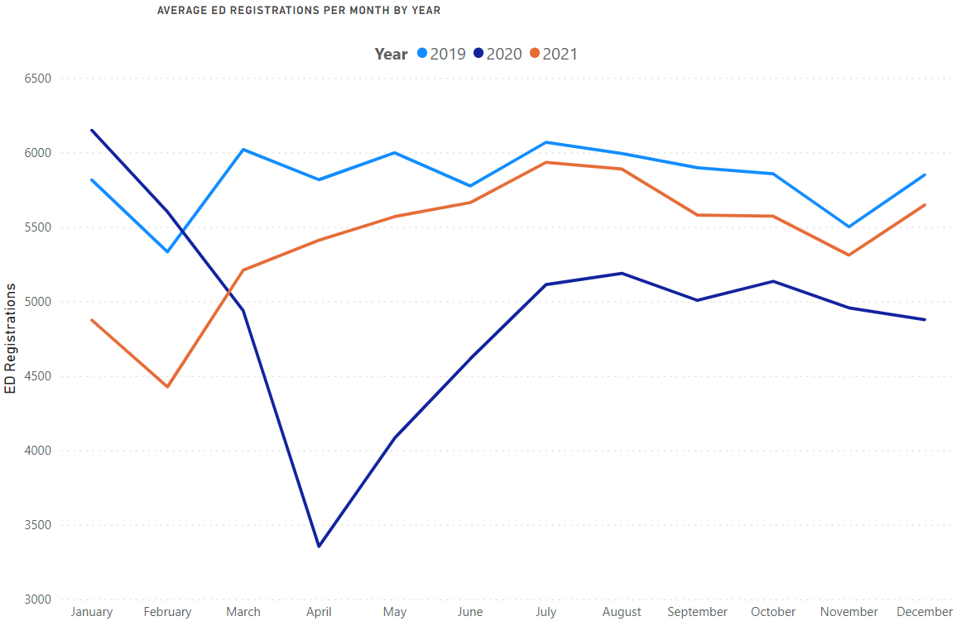
2019—2022 Visits
69,860
65,222
59,088
Calendar Year 2021
4,639 less than 2019
6,134 more than 2020
Revenue impact = $650,000

Slide 50
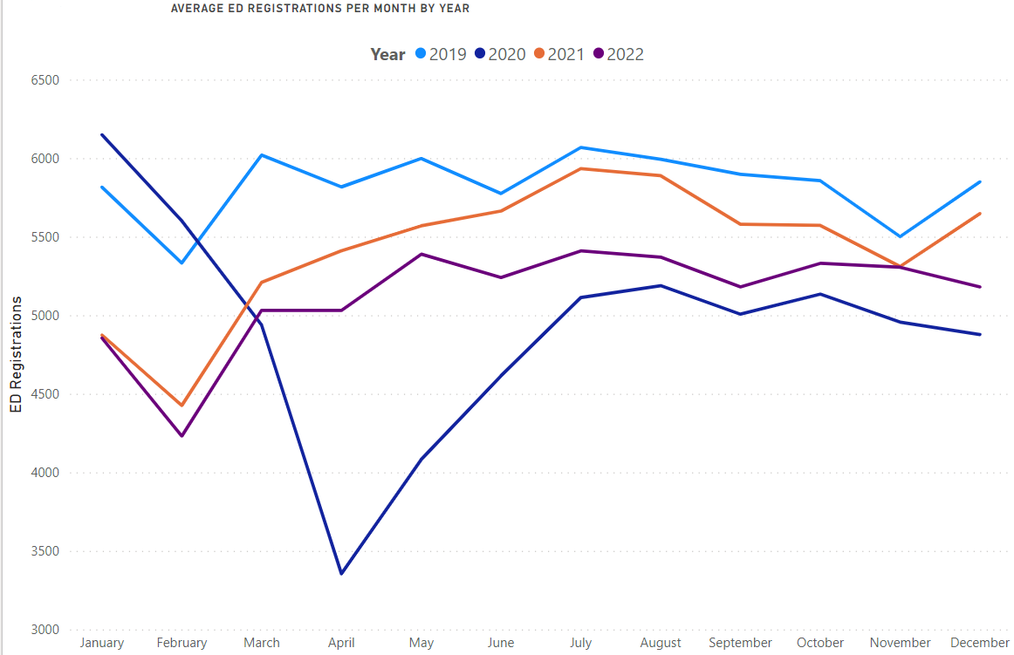
2019—2022 Visits
69,860
65,222
61,552
Calendar Year 2022
8,308 less than 2019
23,719 cumulative patient loss
Revenue impact = $1.2 Million
Three Year Impact = $3.35 Million
59,088

Slide 51
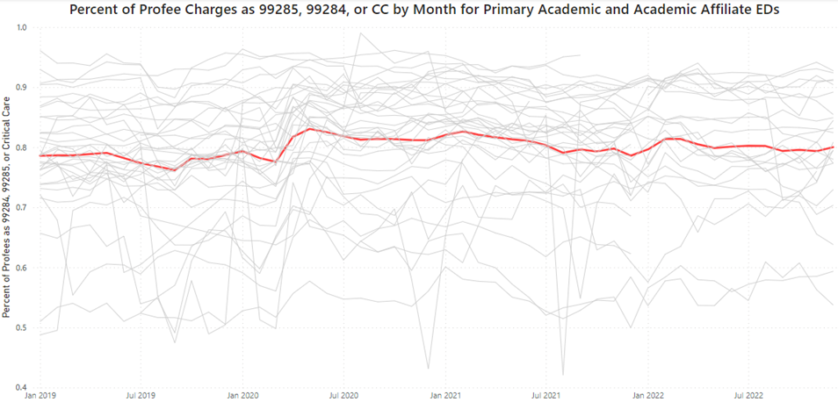
Professional Fee Charges
2019
Pre-COVID
78.3%
2020
COVID
80.9%
2021
Recovery
80.6%
2022
Level Set
80.4%

Slide 52
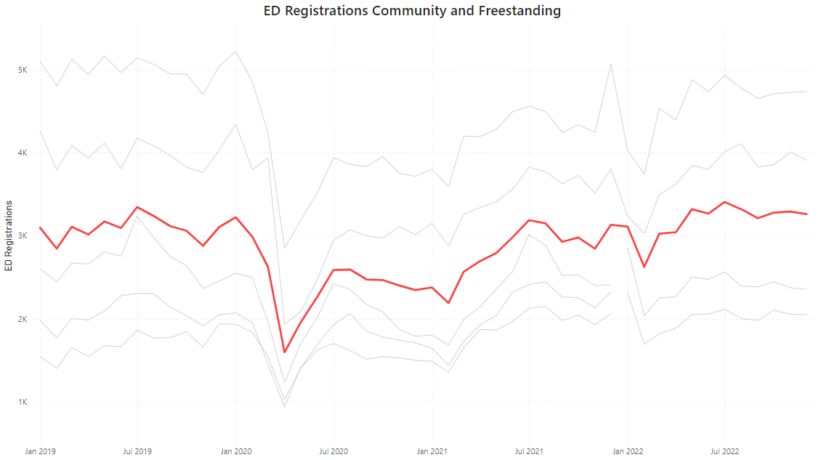
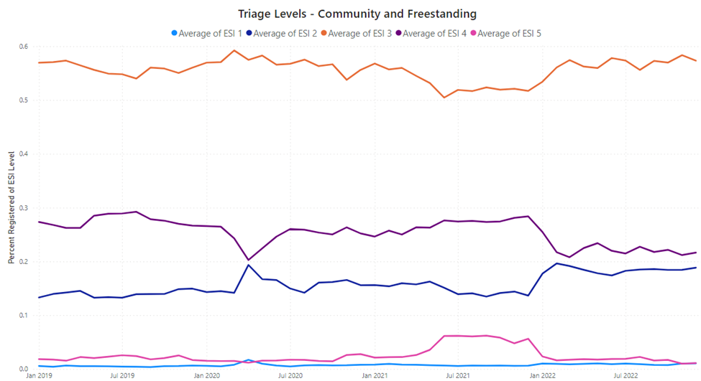
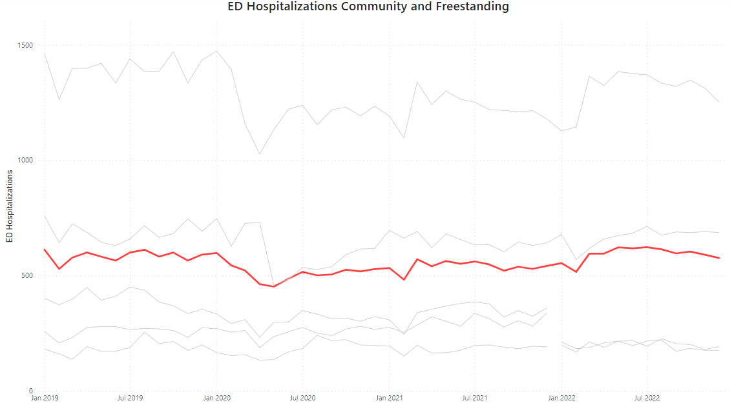
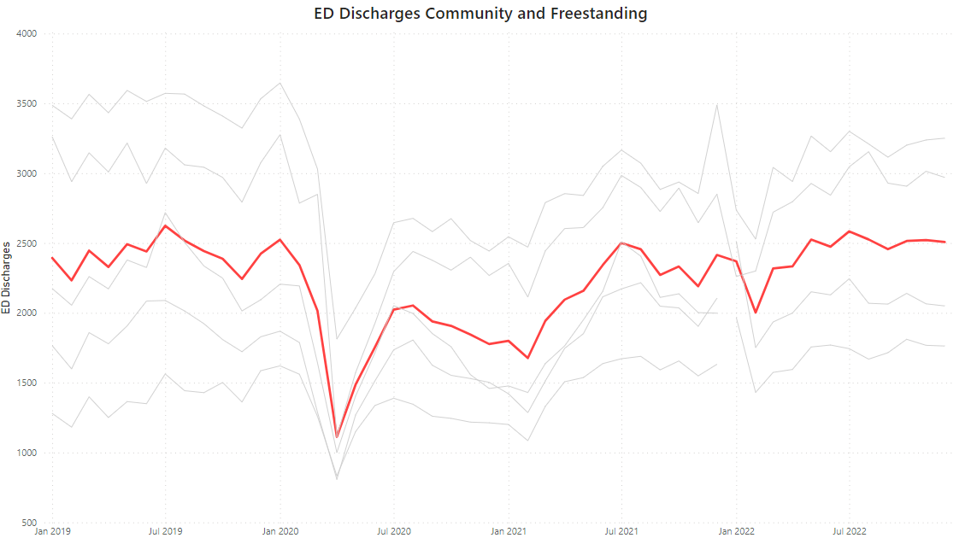
Community Hospitals
Total Visits
Triage Levels
Hospitalizations
Discharges

Slide 53
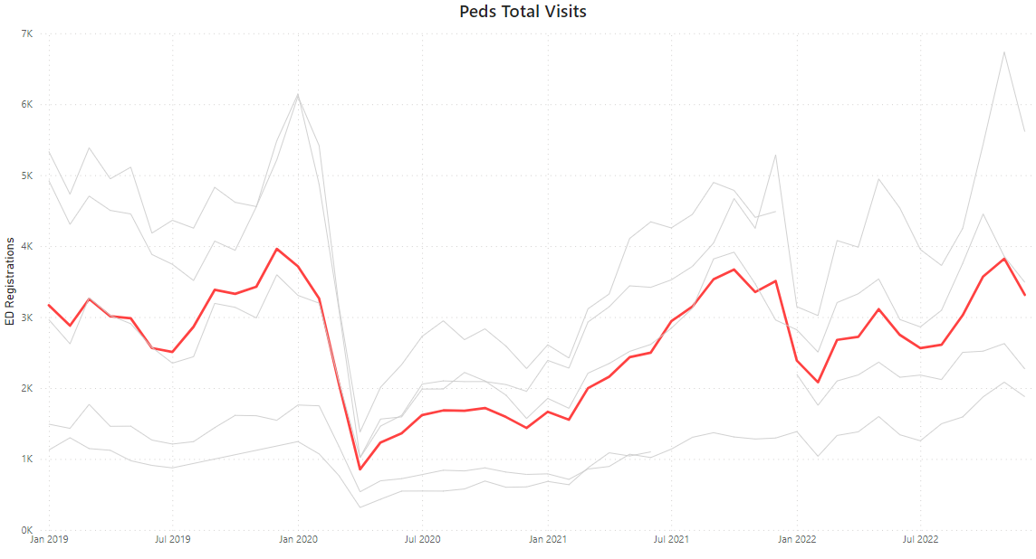
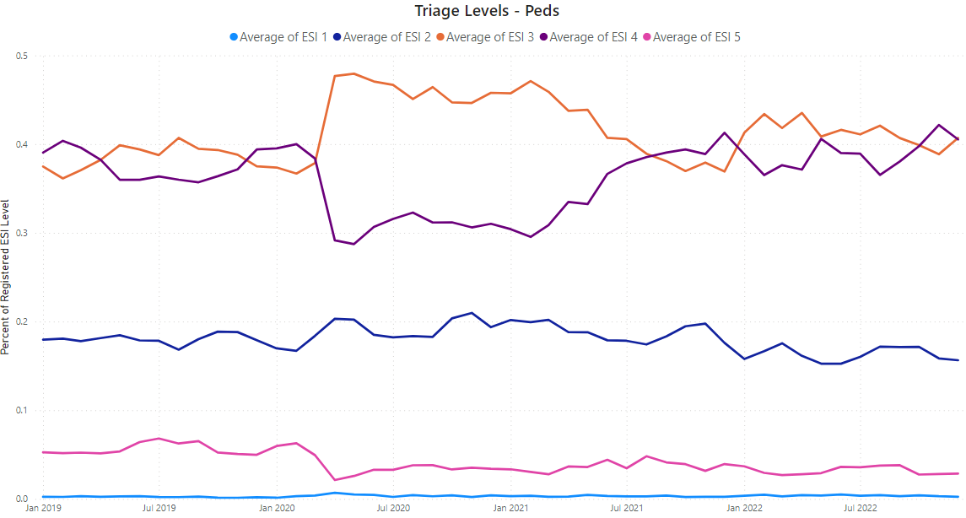
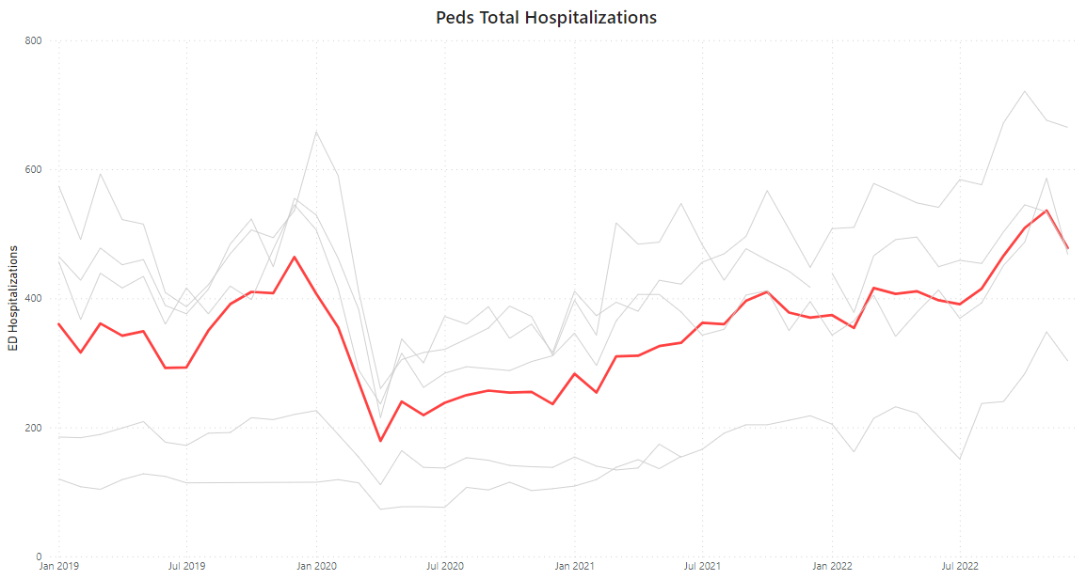
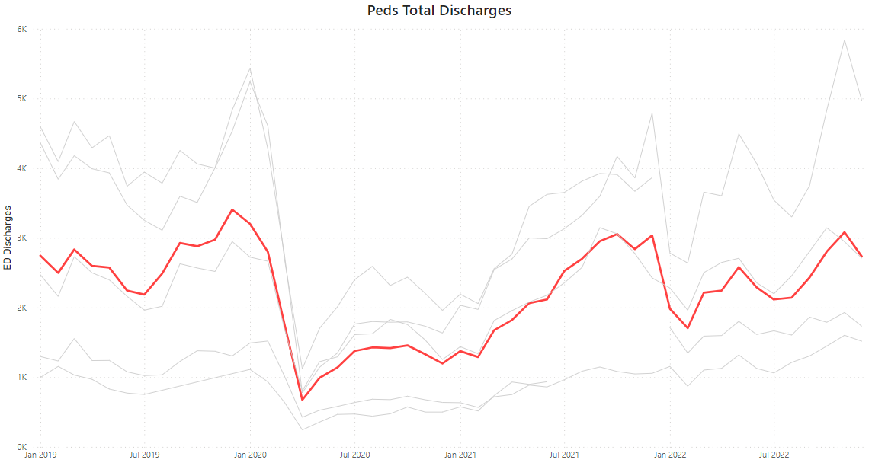
Pediatric ED 2022
Total Visits
Triage Levels
Hospitalizations
Discharges

Slide 54
Questions

