Slide 1
Fundamentals to support faculty career development by mission focus
Jane H. Brice MD, MPH
University of North Carolina
March 21, 2023

Slide 2
Objectives
What is the point?
What is faculty career development?
What are the requirements?
How does this translate to specific missions?

Slide 3
Disclosures
I do NOT do this any better than you, but I want to.

Slide 4
What is the point?

Slide 5
Retention

Slide 6
Retention – Academic Medicine
Within 10 years
36% leave permanently
Within 18 months of appointment
15.8% (accounts for half of those who will leave within 10 years)

Slide 7
Retention – Emergency Medicine
Intent to leave within next year
9.3%
Actual Attrition
5.5%

Slide 8
Reasons for leaving (Bucklin)
Perceived lack of Chair interest in the faculty professional development (OR 3.84; 95% CI: 1.25, 11.81)
Lack of scholarly environment (OR 6.03; 95% CI: 1.84, 19.69)
Lack of a departmental climate of inclusiveness, respect, and open communication (OR 3.21; 95% CI: 1.04, 9.98)

Slide 9
Diversity

Slide 10
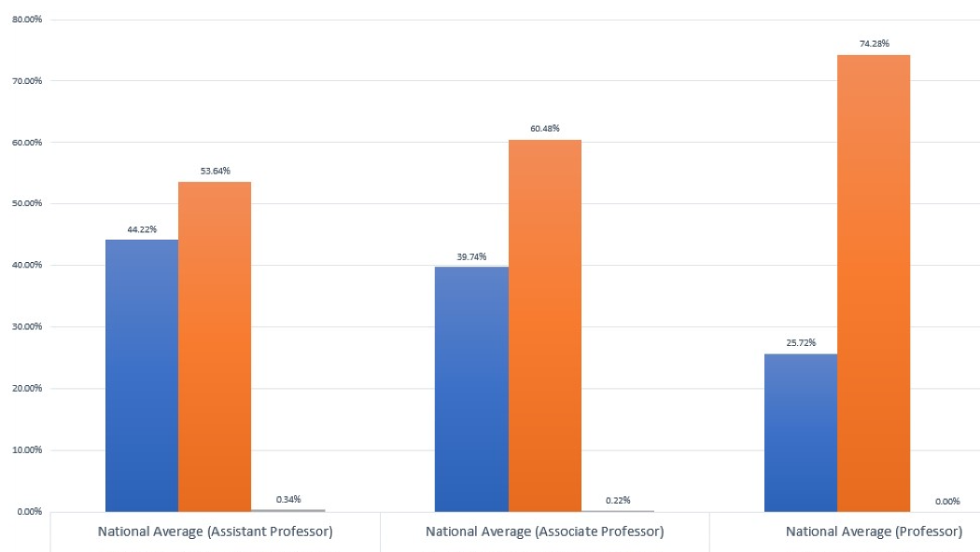
AACEM Data- Gender by Rank
Women Men Non binary
Assistant
Associate Professor
Professor
AAMC: 42% women 58% men
AAMC: 34% women 66% men
AAMC: 22% women 78% men
60%
74.3%
54%
44.2%
39.7%
25.7%
Women
Men
Non binary
0.34%
0.22%
0%

Slide 11
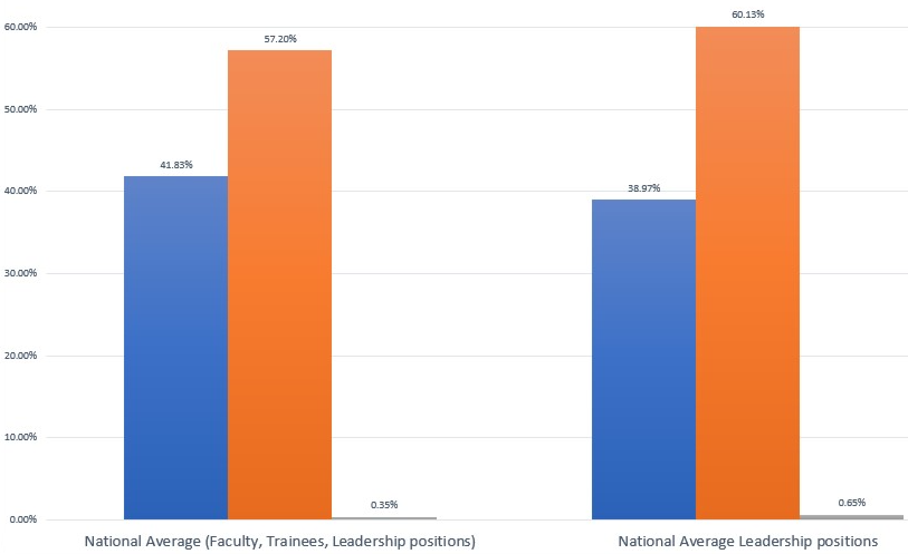
AACEM Data- Gender, Leadership
All (faculty/trainees)
Leadership
60%
57.2%
42%
39%
0.35%
0.65%

Slide 12
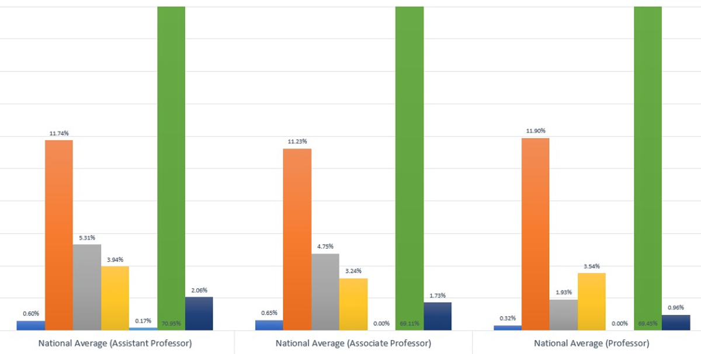
AACEM Data- Race/Ethnicity by Rank
Assistant
Associate
Professor
71%
69%
69.5%
11.7%
11%
12%
5.3%
4%
4.8%
3.5%
3.2%
1.9%
2%
0.2%
1.7%
1%
0.6%
0.7%
0%
0.3%
0%

Slide 13
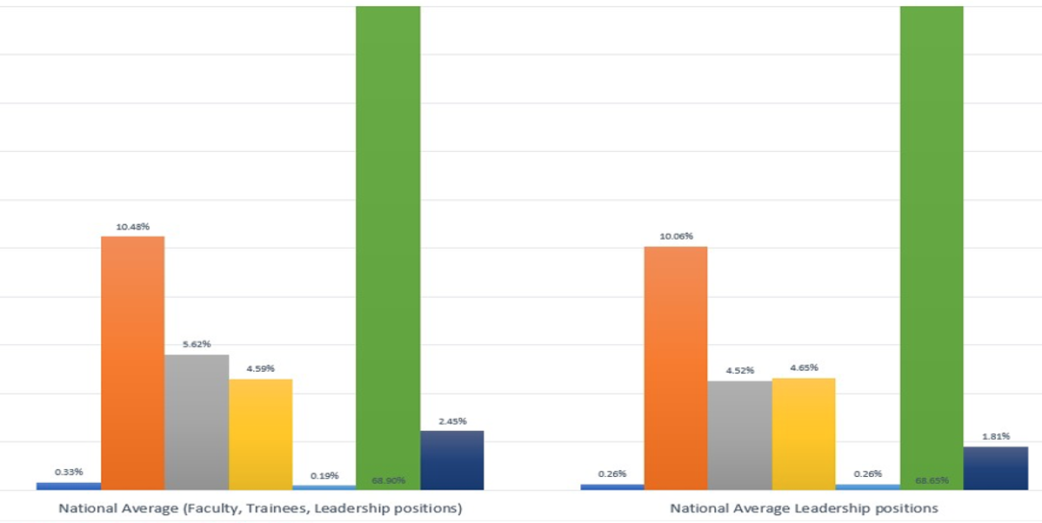
AACEM Data- All, Leadership Race/Ethnicity
69%
69%
All
Leadership
10.5%
10%
5.6%
4.6%
4.5%
4.7%
2.5%
0.26%
1.8%
0.33%
0.2%
0.26%
Notes:
Scale the graph

Slide 14
Why do diverse faculty leave academia
Lack of perceived positive role models
Insufficient
Support
Mentorship
Preparation

Slide 15
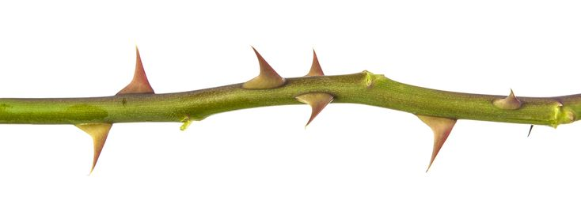
Our Future
We have a lot of thorny problems in Emergency Medicine
Nurturing and developing our brightest minds is the way forward

Slide 17
So, what’s the point?
Retention
Diversity
Our future
The Bootstraps theory died

Slide 18
What is Faculty Career Development?

Slide 19
Faculty Career Development
Investment
Profession
Department
Person

Slide 20
Faculty Career Development
Intent
Support skill acquisition
Navigation tools for our complex organizational structures
Faculty satisfaction
Career success
Recruitment and retention of high-quality faculty members

Slide 21
So, what is faculty career development?
Investment with Intent

Slide 22
Faculty Career Development Requirements

Slide 23
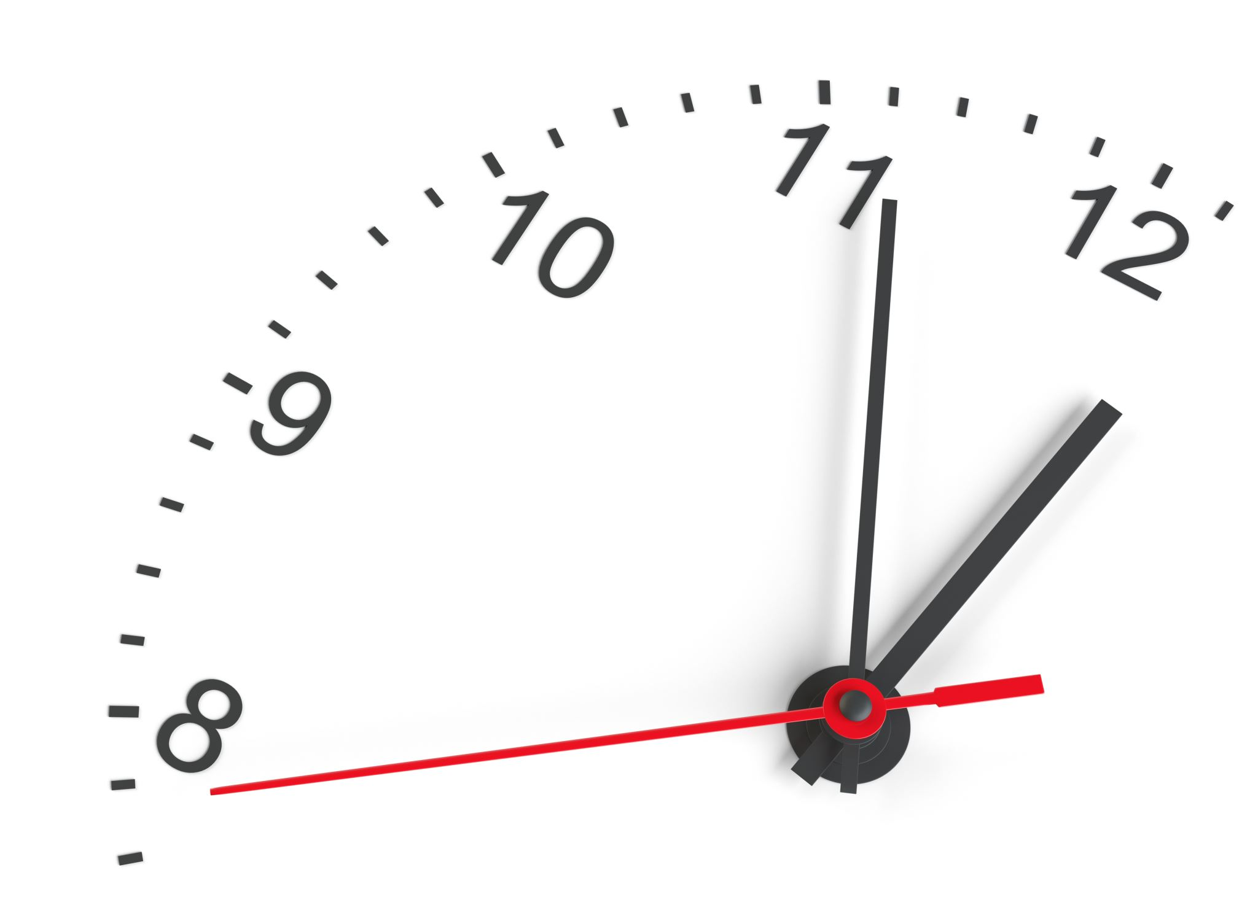
Faculty Development Basics
Begin with the end in mind
Overall career goal
Clear goal for each year
Milestones
Steps in the path clearly defined
Resources
Clear discussion / agreement on resources
Ticking Clock
Specific time frame for each milestone
Measures of Success

Slide 24
Individualized Development Plan
Self-Assessment
Assigned Mentor/ Coach
Develop the Toolbox
Knowledge
Skill
Behavior
Mentored Practice
Performance Coaching

Slide 25
So, what are faculty career development requirements?
A roadmap with a clear destination, defined waypoints, and the gas to get there.

Slide 26
Faculty Career Development with a Mission Focus

Slide 27
Commonalities
Self-Assessment
Not a CV
Detailed inventory of
Knowledge
Skills
Behaviors
Assigned Mentor/ Coach
Specific to area of concentration
Required frequent check-ins
At least annual report out to Leadership

Slide 28
Toolbox - Knowledge
Administration | Education | Research | Leadership
MBA | MEd | MPH | MBA
MHA |  | PhD | MS (Org Leadership)
 |  | Msci
Doctoring took most of us 7-8 years of post-graduate education and training
Becoming an expert in a mission focus requires formal education

Slide 29
Toolbox - Skill
Administration | Education | Research | Leadership
Quality Improvement | Teaching Methodology | Grant Writing | Change Management
Budgeting | Evaluation and Feedback | Project Management | Team Building
Project Management | Curriculum Development | Statistical Analysis | Ethics
Change Management | Educational Scholarship | Budgeting | Communication
Just as developing clinical skill took us 3-4 years to acquire
So, too, does skill in a mission focus

Slide 30
Toolbox - Behavior
Professional Dress
Use Proper Workplace Etiquette
Responding to emails quickly and efficiently
Checking your emails for spelling and grammatical errors before sending
Keeping your cellphone on silent
Maintaining a tidy workspace
Respecting the privacy and boundaries of others
Avoid common workplace pitfalls such as gossip or oversharing your personal issues with coworkers.
Be Punctual
Be Organized
Show Your Dedication to Your Job
Get things done (in a timely and thorough matter)
Be disciplined and focused
Be honest, polite, and fair to others
Maintain a positive attitude and demeanor
Be flexible and cooperative
Listening diligently to the person who is speaking to you, and not interrupting
Taking a seat at the Big-Kids table requires manners and new behaviors

Slide 31
Mentored Practice

Slide 32
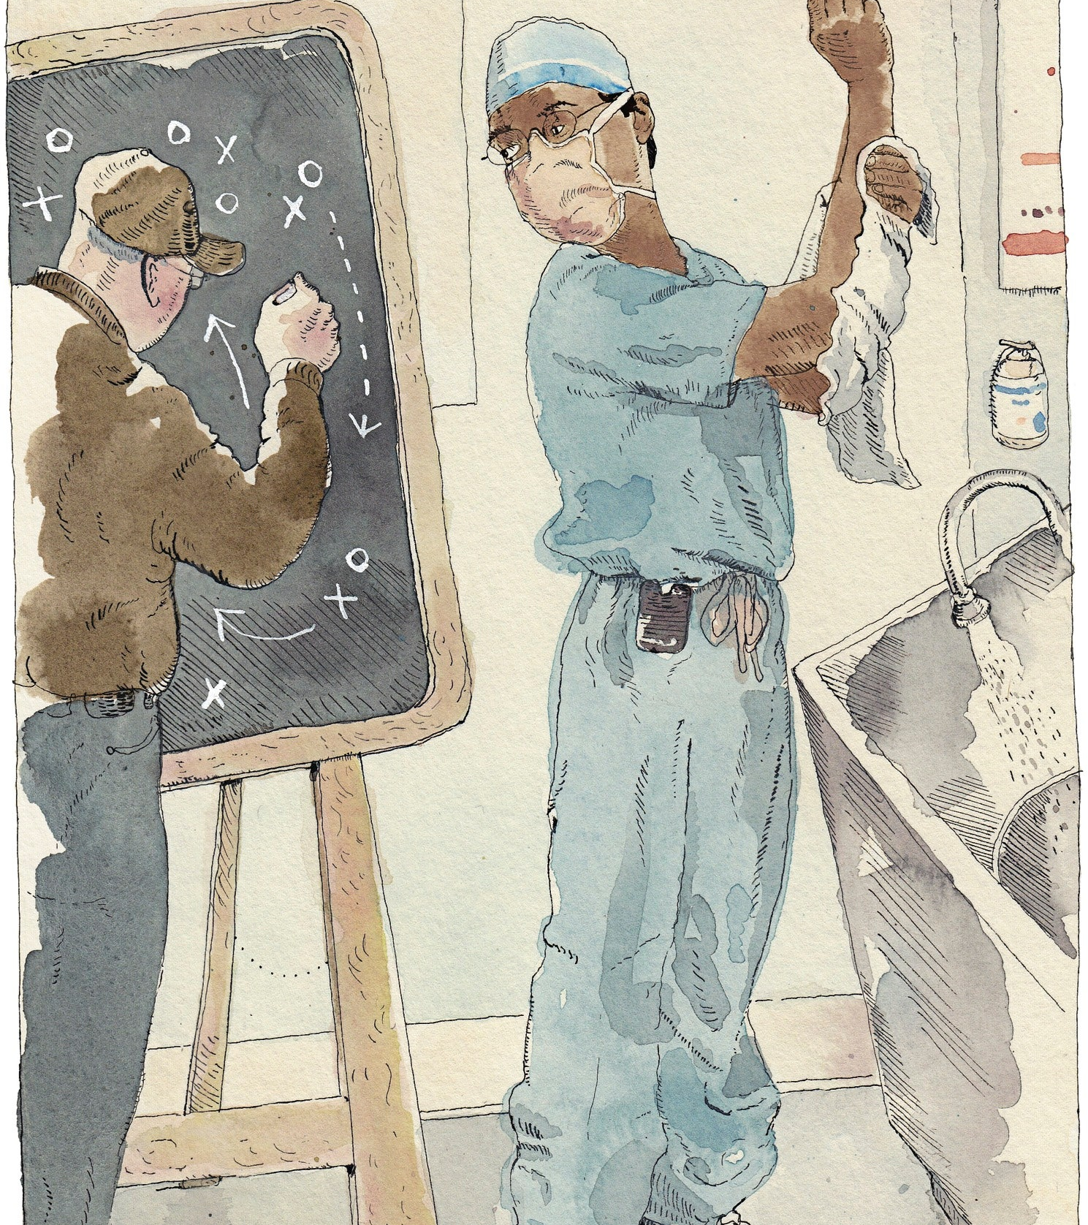
Performance Coaching
No matter how well-trained people are, few can sustain their best performance on their own. That’s where coaching comes in.
- Gwande

Slide 33
Faculty Development with Mission Focus
Self-Assessment
Mentor / Coach
Toolbox
Knowledge
Skill
Behavior
Mentored Practice
Performance Coaching

Slide 34
Thank you

Slide 35
References
Bucklin, B. A., Valley, M., Welch, C., Tran, Z. V., & Lowenstein, S. R. (2014). Predictors of early faculty attrition at one Academic Medical Center. BMC Medical Education, 14(1). https://doi.org/10.1186/1472-6920-14-27
Gettel, C. J., Courtney, D. M., Janke, A. T., Rothenberg, C., Mills, A., Sun, W., & Venkatesh, A. K. (2022). The 2013 to 2019 Emergency Medicine Workforce: Clinician Entry and Attrition Across the US Geography. Annals of Emergency Medicine, 80(3), 260–271. https://doi.org/10.1016/j.annemergmed.2022.04.031
Jeffe, D. B., Yan, Y., & Andriole, D. A. (2019). Competing Risks Analysis of Promotion and Attrition in Academic Medicine. Academic Medicine, 94(2), 227–236. https://doi.org/10.1097/acm.0000000000002441
U.S. Medical School Faculty Trends: Promotion and Attrition | AAMC. (2013). AAMC. Retrieved March 20, 2023, from https://www.aamc.org/data-reports/faculty-institutions/interactive-data/https/wwwaamcorg/data-reports/interactive-data/us-medical-school-faculty-trends-promotion-attrition
Williams, J. C., Blair-Loy, M., & Berdahl, J. L. (2013). Cultural Schemas, Social Class, and the Flexibility Stigma. Journal of Social Issues, 69(2), 209–234. https://doi.org/10.1111/josi.12012

