Slide 1
2023 Business Meeting March 19, 2023

Slide 2
Agenda
Welcome and overview
Ice Breaker
Introduction of the Member Insider Program (MIP)
Discussion of the Member Assistance Program
Change in Benchmark Committee Structure
Committee Chair changes
Committee Sign up Time
Break
SWOT Analysis
Awards Recognition
Transition of AAAEM Leadership

Slide 3
Executive Committee
President – Amy Jameson, University of New Mexico
Past President – Kain Robbins, Penn State University, Milton S. Hershey Medical Center
President Elect – David Christiansen, University of Florida College of Medicine, Jacksonville
Treasurer – Becky McGowan, University of Colorado Denver School of Medicine
Secretary – Jennifer Muir, The Brody School of Medicine at West Carolina University
Member at Large – Travis W. Schmitz, Northwestern University, Feinberg School of Medicine – McGaw
Member at Large – Steve Maxwell, University of Michigan
SAEM Board Liaison – Erin Campo
SAEM Staff Liaison – Pooja Agrawal, MD, MPH
Member at Large AACEM Liaison - Open

Slide 4
Incoming EC Members/Committee Chairs
Steve Maxwell – Secretary, University of Michigan
Diane C. Lee, Einstein Healthcare Network
Brendan Russell, Mass General Brigham
Strategic Planning – Ambrosya Amlong
Communications - Cali Sanford
Wellness – TBA, based on Tuesday’s discussion

Slide 5
Ice Breaker
Ambrosya Amlong, University of Kansas
Mingle Bingo
Stand Up and Confess

Slide 6
Member Insider Program (MIP)
Presented by Becky McGowan, University of Colorado School of Medicine

Slide 7
Member Assistance Program (MAP)
Goal of the program is to increase participation and attendance to AAAEM events.
AAAEM can help support the cost registration or lodging/airfare but generally not all expenses to attend a meeting. The employee’s department/institution would be asked to contribute towards the expense.
Prioritization of requests – all applicants will need to have an active membership
Administrators – full members
Associate Members enrolled in CAEMA
Associate Members
Emeritus Members

Slide 8
AAAEM Code of Professional Conduct
AAAEM
Code of Professional Conduct
Members have an ethical obligation to professionally act in a manner that upholds the purposes, values, and objectives of AAAEM
Members shall conduct themselves in a professional manner while attending or participating in AAAEM sponsored events and in all communications with SAEM Staff
While alcohol is served at many AAAEM events, members shall not use any substance to an excess that negatively impacts the member’s ability to act in a professional manner
Members shall be honest, fair, and act respectfully and with integrity
Members shall endorse Diversity, Equity, and Inclusion and shall not discriminate against members or AAAEM staff regarding religion, race, ethnicity, color, national origin, sex, sexual orientation, or disability
Conduct unbecoming of an AAAEM Member should be reported to the AAAEM President and SAEM CEO. The AAAEM Executive Committee, including but not limited to the SAEM Ethics Committee, will investigate any reported breaches of professional conduct and reserves the right to enforce the AAAEM Code of Professional Conduct up to and including removal of AAAEM Membership

Slide 9
Benchmark Committee Membership
AAAEM Executive Committee approved Benchmark Committee membership structure
2 Co-Chairs, Data Manager, Roundtable representative, & AACEM members are not included in numbers below
15 AAAEM members (must have completed surveys for the past 2 years)
5-year terms, 3 members per term, can be renewed once
Accepting applications for 3 new members for a 5-year term
Co-Chairs will select new members
Diversity (e.g race, ethnicity, geographic, size of institution, private v state owned, etc) of committee will be considered when selecting new members
Applicants must email their CV & letter of intent to the Data Manager (Alyssa.Tyransky@osumc.edu) by April 14th

Slide 10
New Committee Chairs
Strategic Planning – Ambrosya Amlong
Communications - Cali Sanford
Wellness – TBA, based on Tuesday’s discussion

Slide 11
AAAEM 2022-2023 Committee Chairs
Benchmark
Communications
Inclusiveness, Diversity, Equity and Anti-Racism (IDEA)
Education Committee
Membership Committee
Strategic Planning
Wellness Committee
Nominating Committee

Slide 12
Break

Slide 13
SWOT Analysis
Introduction – Drew Kennedy
SWOT Process - Ambrosya Amlong

Slide 14
AAAEM Award Descriptions and Guidelines
James J. Scheulen Lifetime Achievement Award in Academic Emergency Medicine Administration
The AAAEM Lifetime Achievement Award in Academic Emergency Medicine Administration is the highest recognition the Academy gives an individual. It recognizes an academic emergency medicine administrator who has demonstrated noteworthy achievement, exceptional leadership, and management proficiency. One who has enhanced the strategic and operational effectiveness of academic emergency departments, emergency medicine education or emergency medicine research in his or her institution, and/or the broader academic emergency medicine community.
Minimum requirement: Must be AAAEM member for greater than 5 consecutive years and work a minimum of 10 years in academic emergency medicine. Member should demonstrate the following:
Advances interprofessional education, be involved in professional growth, and educational programs within the Academy
Commitment to the organization through AAAEM leadership
Provides leadership and service within our profession
Evidence of research and/or creative scholarship activities related to academic emergency medicine
Creates and cultivates sharing of ideas and best practices amongst AAAEM members
Significant Contributions to Academic Emergency Medicine Administration Annual Award
The AAAEM Annual Academy Award recognizes an academic emergency medicine administrator who has demonstrated exceptional leadership within the past three years.
Minimum requirement: AAAEM member with demonstration of the following:
Exhibits exemplary leadership qualities (i.e. Sharing best practices, Mentoring, Advocacy of the profession, Participation in AAAEM activities)
Shows outstanding dedication, competence, and exceptional performance
Shows strategic and operational effectiveness
Contributes to emergency medicine education and/or research via presentations or other
Noteworthy contribution/s to the growth and success of AAAEM
The Rising Star Academy of Administrators in Academic Emergency Medicine Award
This recognizes an academic emergency medicine administrator affiliated with AAAEM who has demonstrated significant participation and/or leadership within the academy during their first five years of membership.
Minimum requirement: AAAEM member for 5 years or less with a demonstration of the following:
Significant participation in AAAEM activities (e.g. projects) and/or committees
Demonstrated leadership skills
Positive peer to peer interactions
Works effectively with AAAEM leadership (either at committee or organizational level or both)
Demonstrated initiative to further AAAEM goals and outcomes

Slide 15
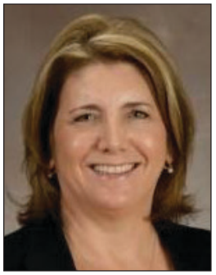
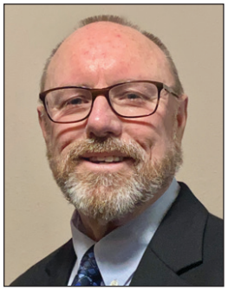
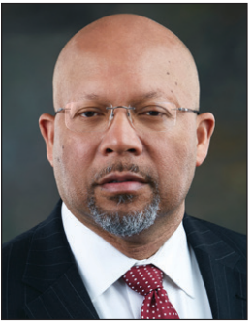
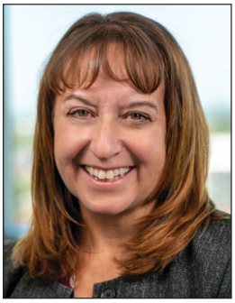
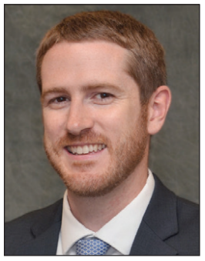
Award Winners
James J. Scheulen Lifetime Achievement Award in Academic Emergency Medicine Administration
Significant Contributions to Academic Emergency Medicine Administration Annual Award
The Rising Star Academy of Administrators in Academic Emergency Medicine Award

Slide 16
Thank you
Erin Campo – SAEM Liaision

Slide 17
Change in Leadership
President – Dave Christiansen, University of Florida College of Medicine, Jacksonville
Past President – Amy Jameson, University of New Mexico
President Elect – Becky McGowan, University of Colorado Denver School of Medicine
Treasurer – Jennifer Muir, The Brody School of Medicine at West Carolina University
Secretary – Steve Maxwell, University of Michigan
Member at Large – Diane C. Lee, Einstein Healthcare Network
Member at Large – Brendan Russell, Mass General Brigham

