Slide 1

Academy of Administrators in Academic Emergency Medicine
Salary and Productivity Survey
Fiscal Year 2024
Deborah Diercks, MD, Alyssa Tyransky, MTDA
On behalf of the
AAAEM Benchmark Committee
March, 2024

Slide 2

Faculty Salary
APP Salary

Slide 3


PA and NP Demographics
778 Advanced Practice Providers
  9.28 years post training
  71% Physician Assistant
  29% Nurse Practitioner
  66% Female
  34% Male
  1 Do not disclose

Slide 4

PA and NP Demographics
ED area worked
More than one area | 68%
Main ED only | 22%
Observation only | 6%
FT/Arrival/Triage | 3%
1,653 Total hours
$147,414 Total salary
Minimal difference PA/NP
300 hour reduction for lead or administration
$29,000 difference between administrative role and none

Slide 5
PA and NP Salary

Slide 6
PA and NP Salary

Slide 7
PA and NP Salary
Salary by Region
 | Total Salary | Total Hours Worked | Avg Base Hourly Rate
West | $165,752 | 1673 | $89.27
Midwest | $156,356 | 1772 | $87.08
Northeast | $150,926 | 1587 | $84.90
South | $136,663 | 1721 | $79.14
Notes:
Average hourly rate on base is $85.00

Slide 8
Faculty Salary Survey
Fiscal Year 2024 Data

Slide 9
Faculty Demographics
2024 Salary Survey Demographics
 | FY 20 | FY 21 | FY 22 | FY 23 | FY 24
# Faculty | 2530 | 2560 | 2454 | 2677 | 2383
Experience
Years at Current EM | 8.8 | 8.5 | 8.9 | 8.9 | 9.3
Years post Residency | 11.6 | 10.8 | 11.0 | 10.9 | 11.2
Degree
MD/Master/PhD | 96% | 95% | 95% | 94% | 93%
DO | 4% | 5% | 5% | 6% | 7%

Slide 10
Faculty Demographics
Years as EM Faculty
53.35% < 10 years
30.5% = 10 to 20 years
16.15% > 20 years

Slide 11
Faculty Demographics
Faculty Rank
In EM: 3.8
In EM: 7.2
In EM: 21.8
In EM: 14.7

Slide 12
Faculty Demographics

Slide 13
Faculty Demographics

Slide 14
Faculty Demographics

Slide 15
Clinical Hours: Rank & Site
What is the hours workedfor a pure 1.0 FTE, no buydown, accounting for vacation?
1440
Do you require a minimum number
of clinical hours?
75% = Yes
Median = 384
Do shifts recognize sign in & out?
42% = Yes
Assumed work week hours for 1.0?
40 hours

Slide 16
Salary Trends: No Chair & Chief
Mean Total Salary = $334,956
Mean Total Salary All Faculty = $341,257
Chairs and Chiefs and Pure Pediatrics excluded from graph

Slide 17
Salary Trends
Mean Total Salary = $334,956
Mean Base Salary = $278,554
2024 Base = 83% of total
Chairs and Chiefs and Pure Pediatrics excluded

Slide 18
Total Salary by Rank
Chairs, Chiefs, pure Peds EM excluded

Slide 19
Total Bonus/Incentive by Rank

Slide 20
Salary Trends
First Year Faculty
Mean Total Salary = $310,156 (+5.5%)

Slide 21
FTE Breakdown by Rank
 | FY23 | FY24 | Delta
Instructor | 0.92 | 0.93 | 0.01
Assistant Professor | 0.94 | 0.95 | 0.01
Associate Professor | 0.97 | 0.95 | (0.02)
Professor | 0.98 | 0.96 | (0.02)
20% of faculty have an FTE < 1.0 in FY24
Notes:
Be direct, if you want to highlight something

Slide 22
Salary Trends: Regions
Notes:
12.5% difference between northeast and west

Slide 23
Gender Salary Breakdown
Metric | Male Average | Female Average
Base Compensation | $282,531.7 | $272,335.20
Total Salary | $343,850.30 | $321,061.80
Metric | Male Average | Female Average
FTE Adjusted Base | $296,297.90 | $295,906.50
FTE Adjusted Total | $360,311.30 | $349,200.70
Metric | Male Average | Female Average
FTE | 0.96 | 0.93
Metric | Male Average | Female Average
Clinical Base | 932.9 hours | 916.6 hours
Extra Clinical Hours | 102.1 hours | 73.5 hours
Adjusted Bonus/Incentive | $34,336.14 | $33,356.82
Bold denotes significance, no chairs, chiefs or peds included
Notes:
FTE in FY23 is the same as FY24
This data is based on the exclusion of chairs and chiefs (75% male/25% female), and pure peds (65% female/35% male).
Give time to talk about this slide
This is an important slide
Maybe put in bullet points
What’s important?

Slide 24
Gender Years in Rank
Rank | Female | Male | Rank Average
Instructor | 4.5 | 5.5 | 5.0
Assistant Professor | 4.9 | 5.3 | 5.1
Associate Professor | 4.7 | 5.7 | 5.3
Professor | 6.7 | 7.2 | 7.1
Notes:
FTE in FY23 is the same as FY24
Check years in rank and FTE
LOOK AT RANGE/BELL CURVE – I have this information but it’s better to first discuss than blindly show
One of the things that we thought when looking at salary difference was longevity but not truly the case

Slide 25
Nocturnists
14% of our workforce is a nocturnist
 | Not Nocturnist | Nocturnist
Average Total Salary | $331,697.78 | $347,520.35
Average Base Compensation | $276,576.96 | $287,461.83
Average Extra Hour Pay | $23,607.42 | $34,240.50
Average Annual Extra Clinical Shift Hours | 88.61 | 113.19
Average Annual Base Clinical Hours | 921.02 | 1061.11
Notes:
Even when adjusted for FTE, nocturnists still make out with more money across the board

Slide 26
New Q on Salary Composition
Does this faculty member work more than 20 percent of their clinical effort in at least two of these types of sites Primary Academic, Academic Affiliate, or Community and is their pay different based on where they work
  34% answered Yes

Slide 27
Comparison of Primary Academic and Community Sites
Notes:
What’s the importance? Huge difference?
Change axis?

Slide 28
Compensation Plans

Slide 29

How do we pay our faculty?
Faculty Compensation Plans
Single component: 4.3%
Salary only
Three component: 26.0%
Base + Extra + Stipend
Base + Extra + Bonus
Base + Stipend + Bonus
Two component: 4.3%
Base + Extra hours
Base + Stipend
Base + Bonus
Four component: 65%
Base + Extra+ Stipend + Bonus
Notes:
Part of this is self selection. We are only basing this off the information they provide for us

Slide 30
Salary Components
100%
Base
89%
Base
88%
Base
81%
Base
Chairs, Chiefs, pure Peds EM faculty excluded
Notes:
This shows that no matter the model, it appears we are paying our docs about the same, regardless of components, which is not what last year’s model showed

Slide 31
Salary Components
Notes:
I think benefits was calculated based on the base salary and not total salary
Also my calculation was a slight estimate (average of average) but was still greater than last year’s values.
Bases went down and everything else pretty much stayed the same, except bonuses

Slide 32
Faculty Productivity

Slide 33
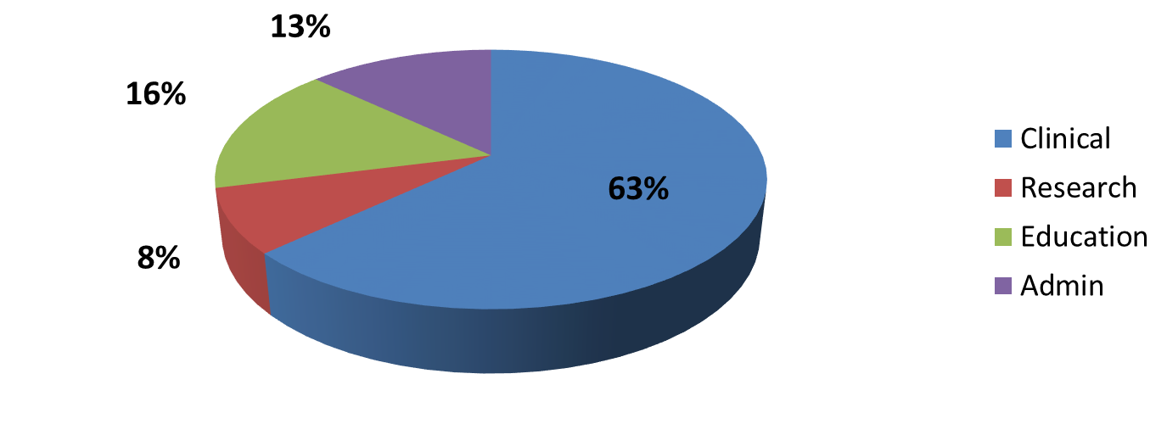
Faculty Effort
Percent Faculty Effort: Multiple Missions
Increasing clinical effort
FY 2015
FY 2024
Academic Centers
Notes:
From FY23, Faculty Effort Clinical 72% Research 6% Education 11% Admin 10%

Slide 34


Faculty Benchmarks
RVU Productivity
  Per hour
  Total
Publications
  First vs any author
External Funding
  What percentage of your effort is externally funded research grants and research contracts including all sponsors (federal, non-federal, foundations and industry) and subcontracts from other institutions?
Notes:
2016 =160356 total median COLLECTION $44.44, PER MD HOUR 6.54; PER PATIENT BILLED 2.88; RVU PER CLINICAL fte 10613
2017= 173902 total median; Collection $45.76; PER MD HOUR 6.73; PER PATIENT BILL 2.86, PER FTE 10127
Work RVU per MD hour up slightly from last yeas as is collection per RVU.
RVU collection range 93.63-9.92
25th percentile = 39.08
75th percentile 51.77

Slide 35
Faculty Benchmarks
Clinical Productivity
 | Mean | Median
Annual Physician Hrs | 30,134 | 28,705
Patients per Hour Staffed | 2.6 | 2.3
Patients per Hour Billed | 2.14 | 2.16
WRVU/CFTE | 10,360 | 9,779
WRVU per MD Hour | 6.7 | 6.4
Note: CFTE based upon the FTE reported as clinically based FTE
Notes:
Mean
Median
Annual Physician Hrs
28540
27375
PPH Staffed
2.3
2.3
PPH Billed
2.09
1.96
WRVU/CFTE
13751
9751
WRVU per MD Hour
6.8
6.5

Slide 36
Mean and Median RVUs/Hour

Slide 37


Faculty Benchmarks
Authorship
  625 faculty reported having a publication this year (26%)
    17% First Author
    28% Senior Author
    55% Other Authorship position
External Funding
  13.1% of faculty reported having “external funding”
  Of those reporting:
    22% of effort is supported
    Range: 1 to 84%

Slide 38
Thanks
Let’s talk…
Notes:
Talk about participation bias and when compared like to like only a 1% increase overall

