Slide 1
Translating a Faculty Evaluation Rubric into Dashboards for Monitoring Faculty Productivity
Leigh Patterson, MD, MAEd
Jennifer Muir, EdD, MBA

Slide 2

Getting Started
Identifying the Why
Platform
Resources
Data to Display
How to Display Data
Who Has Access to The Data

Slide 3
History
"The residents are getting enough evaluations – the faculty need to do their jobs. Why aren’t they?"
"Why did you give me that score on my annual evaluation? I am outstanding."

Slide 4
What is Good Enough?
Teaching
Clinical
Research
Administrative Roles
Notes:
Department Goal Setting – these are our department goals, not individual goals
Everything Matters but not everything Couns

Slide 5
Quantify the Performance Criteria
How many faculty-hours does it take to run our resident curriculum? Our M4 rotation? Our EMS fellowship?
What other tasks are needed? What would enhance our program?
How many shift evaluations per resident would be enough?

Slide 6
Rubric – Two Approaches
Analytic
  Teaching and Clinical
  Enough = Score of Good
Checklist
  Research and Roles
  Points Accumulated map to Scores
5 Point Scale
Notes:
Reference developmental rubrics – like milestones

Slide 7
Teaching Scoring
Very Good (3.5-4.49)
  1.5 evals/shift worked
  AND 45 hours assorted educational activities
  (OR specific focused area of education contribution)
  Positive evaluations from students/residents
Good (2.5-3.49)
  1 Shift eval/Shift worked with resident
  AND 30 hours assorted educational activities
  No serious issues in student/resident evaluations

Slide 8
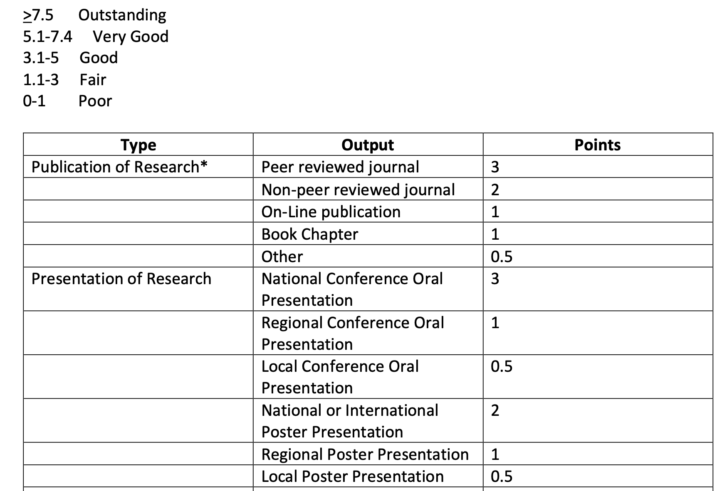
Research Scoring

Slide 9
The List - 2025
EM Resident Conference Didactics and Simulation (Leading, not attending)
Medical Student Didactics and Simulation
Chart Reviews (3 chart reviews = 1 hour of teaching)
Direct Observation (1 hour = 1 hour)
Resident Interviews (1 hour = 1 hour)
Clinical Competency Committee
Faculty Mentor for Resident Research Groups (5 hours per year)

Slide 10
Early Results
2 Evaluation Cycles
Clinical was Easy
Initial Calculations Underestimated Faculty
Admin Roles Points Overemphasized New
Onboarding
Faculty needed more Interval Feedback

Slide 11
Timeline
2019-20 – Initial Targets Disseminated
2020-21 – Annual Evaluation Rubric
2021-22 – Power BI Dashboard
2022-23 Targets Incorporated into Comp Plan
2023-24 Dashboard updated
2024-25 Targets Refined, 3 Point Scale

Slide 12

The Why
Faculty Evaluation
Citizenship
Transparency
Self-Monitoring
Continuous Feedback

Slide 13




Platform and Resources

Slide 14

Access
Security Based On Role
  Department
  Division
  Individual
Institutional Enterprise Authentication System Controls Login/Access

Slide 15
Benefits
Early Recognition
Informs Business Decisions
Meaningful Evaluations and Mentoring
Education Innovations and Accomplishments
Notes:
Jennifer – Rev cycle error, Fletcher
Leigh – Right people, right place. Goff.
Lastly – Education for the medical school quantify and get recognition. Growth. CBME

Slide 16
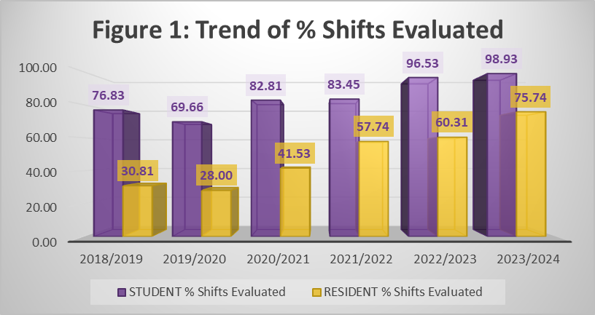
Benefits

Slide 17
Challenges/Opportunities
Not All Items Can Be Automated
Data Monitoring (Education)
Identifying Source of Truth for Data
Ensuring Users Have the Correct Access

Slide 18
Recommendations
Standardize Definitions to Ensure Accuracy of Data Collected
Identify any Opportunities for Interoperability/Interconnectivity Between Systems (i.e Epic, ShiftAdmin, etc.) to Cut Down on Manual Data Entry
Ensure Data Entry Is Being Conducted as Intended Based on Standardized Definitions

Slide 19


Slide 20

Questions

