Slide 1
2024 Business Meeting March 17, 2024
San Juan, Puerto Rico

Slide 2
Agenda
Welcome and overview
Ice Breaker
Introduction of the Member Insider Program (MIP)
Committee Reports & Updates
BREAK - Committee Sign up Time
CAEMA Recognition
Awards Recognition
The Year Ahead
Transition of AAAEM Leadership

Slide 3
Ice Breaker
Presented by
Becky McGowan
and
Amy Jameson

Slide 4
Member Insider Program (MIP)
Becky McGowan, MBA
President Elect, AAAEM
University of Colorado School of Medicine

Slide 5
Member Insider Program (MIP)
About MIP:
A year long program that serves as a structured mentoring program to help connect AAAEM members and to provide insight in the AAAEM experience.
The program was designed to elevate and accelerate the personal and professional development of Mentees.
Mentees and Mentors will enter into the program for a 1-year period

Slide 6
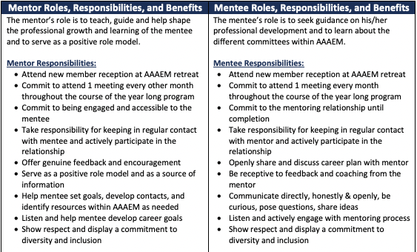
Member Insider Program (MIP)

Slide 7
Member Insider Program (MIP)
Month | Meeting Topic | Month | Meeting Topic
February | Mentees and Mentors are matched | September | Midpoint – feedback requested from mentees and mentors
March | Kick-off meeting at Annual Retreat | October | Mentees meet with Representatives from Strategic and Communications Committee
April | Mentees meet with Membership Committee | November | 1:1 meetings with Mentors
May | 1:1 meetings with Mentors | December | Mentees meet with Representatives from Nominating and Membership Committee
June | Mentees meet with Benchmark Committee | January | 1:1 meetings with Mentors
July | 1:1 meetings with Mentors | February | Mentees meet with Representatives from Wellness and Executive Committee
August | Mentees meet with Education and IDEA Committees | March | Graduation

Slide 8
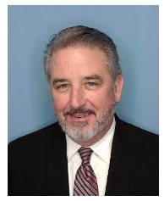
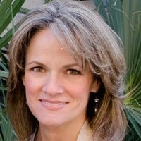
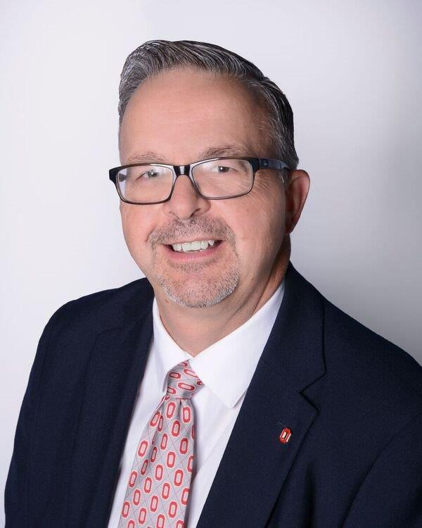
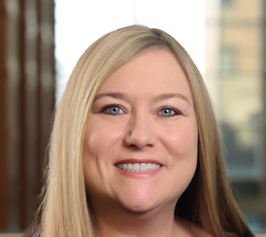
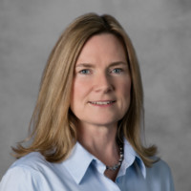
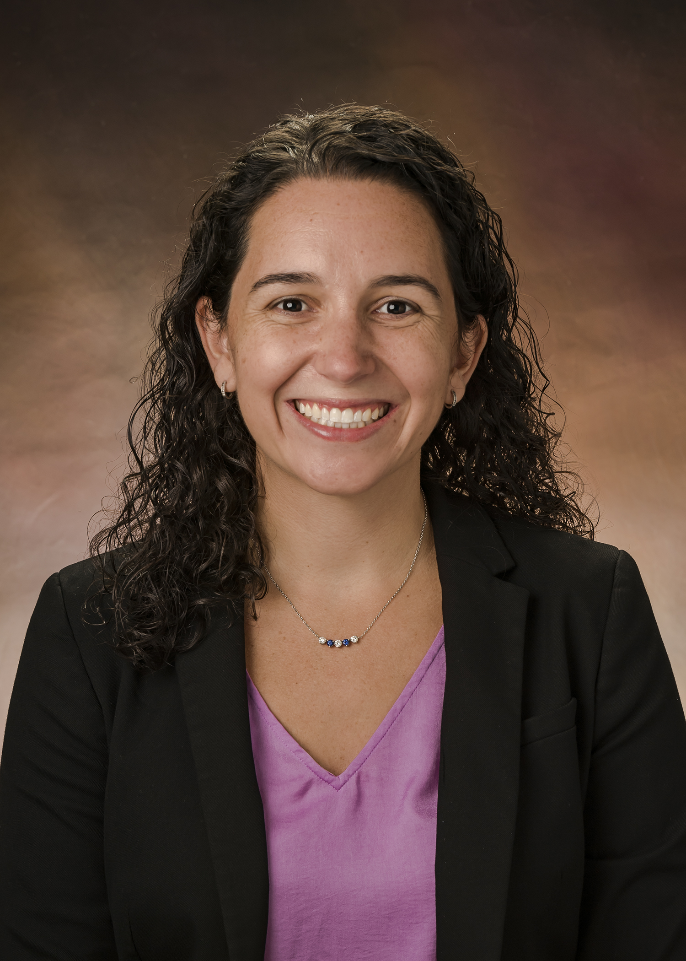
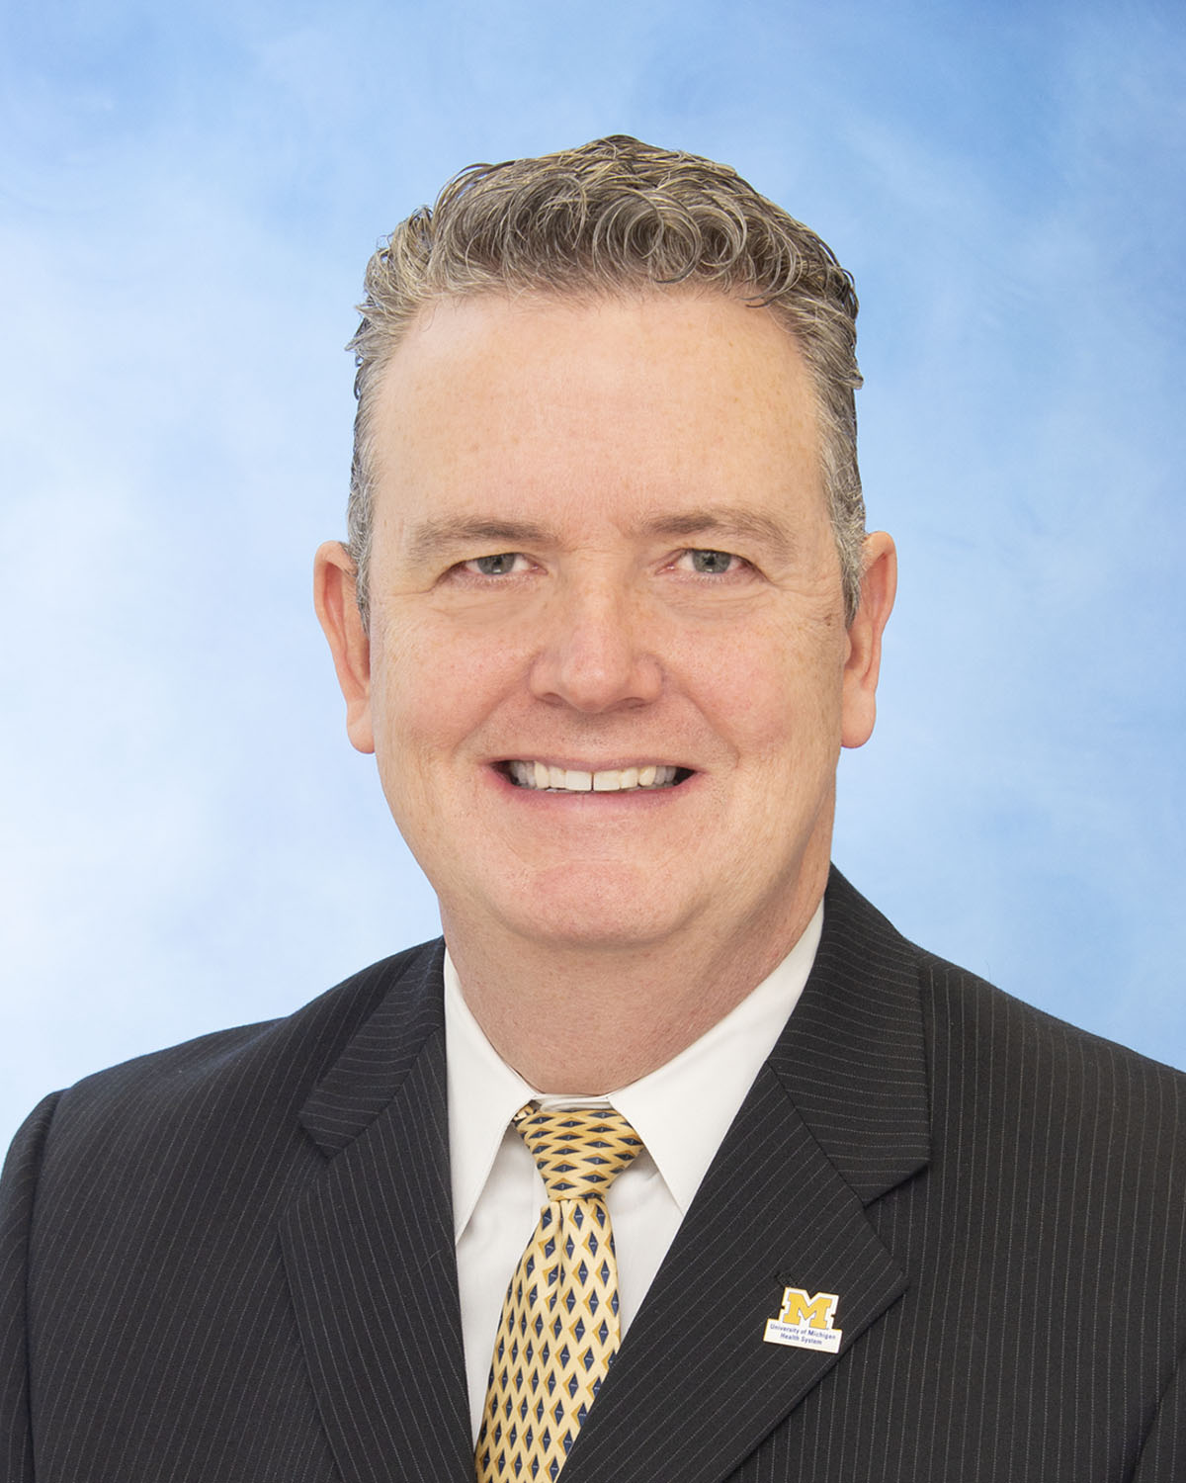
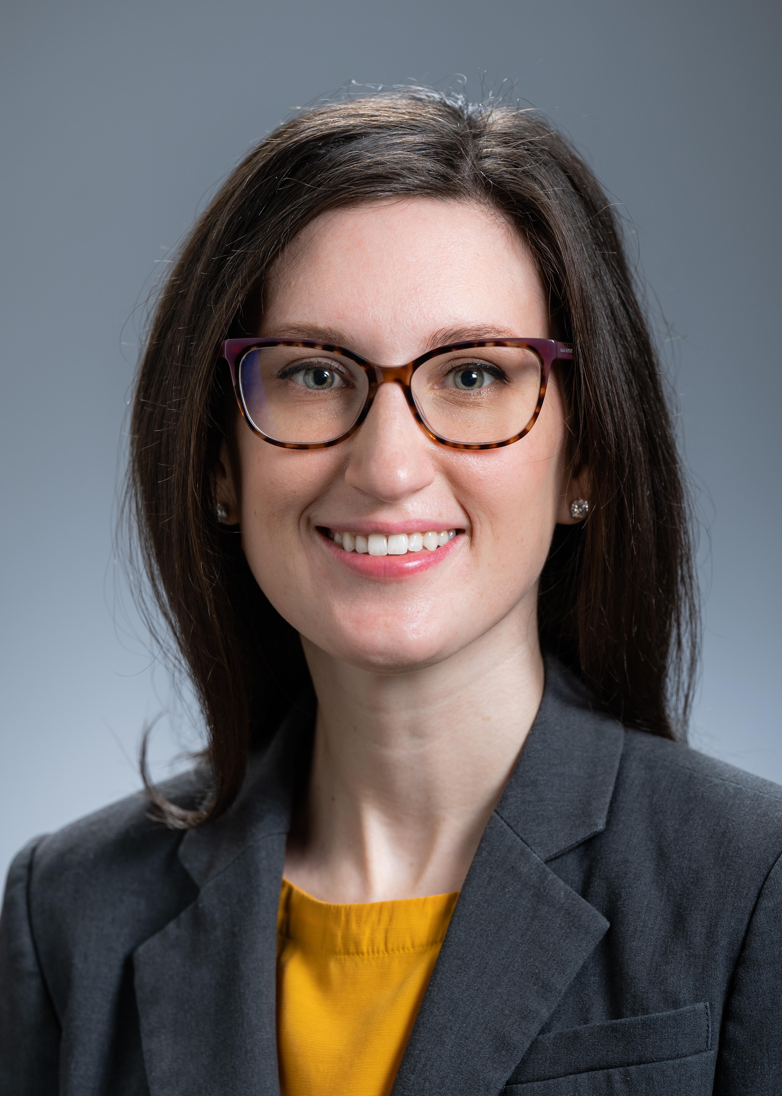
Member Insider Program (MIP)
Mentors |  |  | Mentees
 | David Christensen |  |  | Victoria Feather
 | Greg Archual |  |  | Stephanie Hazard
 | Rhea Begeman |  |  | Lauren Tanzer
 | Stephen Maxwell |  |  | Cali Myers

Slide 9
Committee Reports

Slide 10
BREAK

Slide 11
CAEMA Recognition
The purpose of the Certificate in Academic Emergency Medicine Administration (CAEMA) program is to provide education and a certificate for those professionals who have attended the program and demonstrated proficiency in the body of knowledge required of Administrators in Academic Emergency Medicine.
The program is specifically geared towards the knowledge base of Administrators in an Academic environment, encompassing resident education, post residency training, inclusion of medical students, and research in Emergency Medicine.
Applications open May 2024 and close January 31, 2025

Slide 12
Congratulations to the CAEMA Class!
Sherrie MacFarlane, University of New Mexico
Tisha L Hanson, SUNY Upstate Medical University
Ryan A. Pauline, MBA, Thomas Jefferson University
Elizabeth Lee Savage, The Ohio State University
Melanie Blackburn, University of Florida
Sara Engel, MBA, Medical College of Wisconsin
Robin Barton, Brown Emergency Medicine
Jennifer Pacheco, Brown Emergency Medicine
Lauren Tanzer, MBA, Penn Medicine
Lauren Tanzer, MBA, Penn Medicine
Dana Kaplan, Brown Emergency Medicine
Colin Reilly, Brown Emergency Medicine
Layla Anderson, University of Washington
Bonnie Lemelin, Yale University
Anthony A.E. Ho, Boston Medical Center
Amy Smith, RN Rutgers University
Jesse Perez, Stanford School of Medicine
Michael Cadiz, Rush University Medical Center

Slide 13
AAAEM Award Descriptions and Guidelines
James J. Scheulen Lifetime Achievement Award in Academic Emergency Medicine Administration
The AAAEM Lifetime Achievement Award in Academic Emergency Medicine Administration is the highest recognition the Academy gives an individual. It recognizes an academic emergency medicine administrator who has demonstrated noteworthy achievement, exceptional leadership, and management proficiency. One who has enhanced the strategic and operational effectiveness of academic emergency departments, emergency medicine education or emergency medicine research in his or her institution, and/or the broader academic emergency medicine community.
Minimum requirement: Must be AAAEM member for greater than 5 consecutive years and work a minimum of 10 years in academic emergency medicine. Member should demonstrate the following:
Advances interprofessional education, be involved in professional growth, and educational programs within the Academy
Commitment to the organization through AAAEM leadership
Provides leadership and service within our profession
Evidence of research and/or creative scholarship activities related to academic emergency medicine
Creates and cultivates sharing of ideas and best practices amongst AAAEM members
Significant Contributions to Academic Emergency Medicine Administration Annual Award
The AAAEM Annual Academy Award recognizes an academic emergency medicine administrator who has demonstrated exceptional leadership within the past three years.
Minimum requirement: AAAEM member with demonstration of the following:
Exhibits exemplary leadership qualities (i.e. Sharing best practices, Mentoring, Advocacy of the profession, Participation in AAAEM activities)
Shows outstanding dedication, competence, and exceptional performance
Shows strategic and operational effectiveness
Contributes to emergency medicine education and/or research via presentations or other
Noteworthy contribution/s to the growth and success of AAAEM
The Rising Star Academy of Administrators in Academic Emergency Medicine Award
This recognizes an academic emergency medicine administrator affiliated with AAAEM who has demonstrated significant participation and/or leadership within the academy during their first five years of membership.
Minimum requirement: AAAEM member for 5 years or less with a demonstration of the following:
Significant participation in AAAEM activities (e.g. projects) and/or committees
Demonstrated leadership skills
Positive peer to peer interactions
Works effectively with AAAEM leadership (either at committee or organizational level or both)
Demonstrated initiative to further AAAEM goals and outcomes

Slide 14
The Year Ahead
Alignment of Strategic Plan with SAEM and AACEM
Membership Expansion – Full/Associate
Education – CAEMA, Didactics and SAEM
Financial – impact of inflation
Call to Service and Networking

Slide 15
Thank you!
Thank you to Erin Campo, SAEM Director of Governance!
Thank you to the Executive Leadership Team and all of the Committee Chairs!
Thank you in particular to the Immediate Past Chair – Amy Jameson!
Looking forward to Becky’s leadership! We are in great hands!

Slide 16
Change in Leadership
President – Becky McGowan, University of Colorado Denver School of Medicine
Past President – Dave Christiansen, University of Florida College of Medicine, Jacksonville
President Elect – Jennifer Muir, The Brody School of Medicine at West Carolina University
Treasurer – Steve Maxwell, University of Michigan
Secretary – Brendan Russell, Mass General Brigham
Member at Large – Diane C. Lee, Einstein Healthcare Network
Member at Large – Kashwayne Williams, Washington University St. Louis

Slide 17
The Final Slide….
Motion to Adjourn
See you next year!

