Slide 1
LGBT Health: Educating EM Physicians to Provide Equitable and Quality Care
Paul Krieger MD
Ellen Slaven MD
Thea James MD
Theodore Corbin MD MPP
Joel Moll MD

Slide 2
NO FINANCIAL DISCLOSURES

Slide 3
Goals and Objectives
Understand LGBT terminology/definitions to help enhance physician communication and the role of EM physicians in providing a better health care experience for LGBT patients
Understand LGBT health care disparities and the complex variables, including current laws, that affect LGBT health
Be able to discuss Public Health implications for LGBT Health
Review the results of the survey from EM programs related to educating residents on LGBT Health

Slide 4
Government, Law and LGBT Health
Paul Krieger MD
Beth Israel Medical Center
New York, NY

Slide 5
Langbehn v. Jackson Memorial
Notes:
Janice Langbehn and 3 of 4 children, partner Lisa Pond.
Still did not allow visitation even after health care proxy sent to hospital
Lost

Slide 7
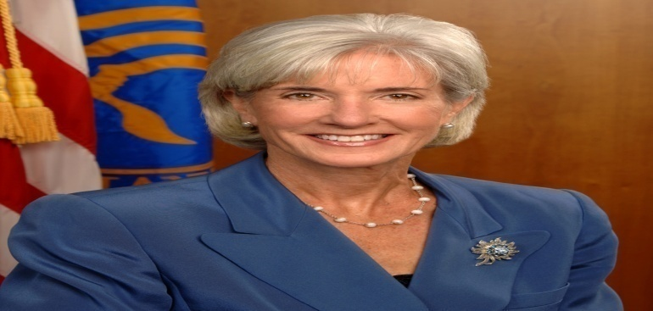
HHS and Visitation
Centers for Medicare and Medicaid
Inform each patient (or support person, where appropriate) of the right, subject to his or her consent, to receive the visitors whom he or she designates, including but not limited to, a spouse, a domestic partner (including a same-sex domestic partner), another family member, or a friend, and of his or her right to withdraw or deny such consent at any time.
Not restrict, limit, or otherwise deny visitation privileges on the basis of race, color, national origin, religion, sex, gender identity, sexual orientation, or disability.
Ensure that all visitors enjoy full and equal visitation privileges consistent with patient preferences.
“Notably, the final rule makes it clear that Medicare and Medicaid participating hospitals and critical access hospitals (CAH) may not restrict, limit, or otherwise deny visitation privileges on the basis of, among other things, sexual orientation or gender identity.”
Notes:
Kathleen Sebelius
April 15th obama memo to hhs
Nov9th 2011 CMS publishes “Changes to the Hospital And critical Access hospital Conditions of participation to ensure visitation rights of all people”
If more than 1 person claims to be patients representative will ask for supporting documentation. Who would the patient want to make there decisions
This is a joint commission requirement!!!

Slide 8
Laws and LGBT Health
ENDA
LGBT HEALTH
Marriage Inequality
(DOMA)

Slide 9
Marriage and Healthcare
1138 rights and privileges
Employer sponsored health plans
Taxes
Survivor benefits and Medicaid liens
Visitation rights and advanced directives
Nursing home separation
Marriage and the literature

Slide 10
Employment Non-Discrimination ACT (ENDA)
What is ENDA and how does it affect health?
ENDA State Map
Would protect Americans from simply be fired for being LGBT
90% of Americans think this law already exists & polls show over 70% support this law
Health Insurance & Lower incomes
Higher number of LGBT people live below the poverty line
Negative health impact of not being out at work

Slide 11
Additional Resources
Lambda Legal
www.lambdalegal.org
The Human Rights Campaign
www.hrc.org
Freedom to Work
http://www.freedomtowork.org/

Slide 12
Effective Communication - LGBT Terminology
Ellen Slaven, MD FAAEM
Louisiana State University Health Sciences Center in New Orleans

Slide 13
Differentiate
Gender (sex)
Gender identity
Sexual orientation

Slide 14
Terminology
GENDER/SEX refers to attributes that characterize biological maleness or femaleness; the gonads, sex hormones, internal and external genitalia and secondary sex characteristics.
GENDER IDENTITY is used to describe a person’s fundamental sense of being men, women, or of indeterminate sex.
SEXUAL ORIENTATION can be defined by a person’s relative responsiveness to sexual stimuli. The most salient dimension of sexual orientation is the sex of the person to whom one is attracted sexually.
Notes:
Sexual orientation or gay
NOT homosexual or sexual preference
GENDER IDENTITY DISORDER (GID) is a DSM diagnosis. This psychiatric diagnosis is given when a strong and persistent cross-gender identification, combined with a persistent discomfort with one’s sex or sense of inappropriateness in the gender role of that sex, causes clinically significant distress.

Slide 15
Do not use…..
Homosexual
Queer, homo, dyke, etc.
Sexual preference
INSTEAD say….
Gay, gay man or lesbian
Gay people
Sexual orientation
Notes:
Don’t describe anybody or anything as “homosexual” unless you would similarly use the term “straight”
Obviously don’t say homo, queer, carpet muncher, fag, dyke,
Homosexual couple/sex/relationship
Gay couple, gay sex or gay relationship

Slide 16
Transgender Female
MALE-TO-FEMALE (MTF)
TRANSGENDER PERSON - a biological male who identifies as, or desires to be, a member of the female gender

Slide 17
Transgender Male
FEMALE-TO-MALE (FTM) TRANSGENDER PERSON - a biological female who identifies as, or desires to be, a member of the male gender

Slide 18
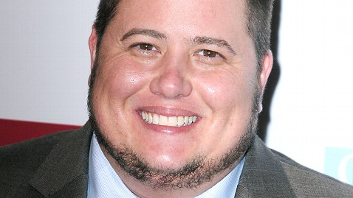
Do NOT Say….
Sex Change
Pre-operative/Post-operative
Transgendered
He-She
It
Tranny
Shim
Gender-Bender
PREFERRED TERM - transition
Notes:
Transgender is an adverb – to describe
NOT a noun nor a verb
Sex change / pre and post op inaccurately suggests surgery must take place

Slide 19
Crucial Concepts
Respect the patient's preferred gender identity
Okay to ask
Name that the patient prefers
NEVER use quotes (i.e. “Betty” or “she”)
Pronouns that the patient prefers
if unknown go with the one that’s most appropriate

Slide 20
Health Care Concerns
A transgender patient's body likely has elements that do not conform to the patient's gender identity:
Trans female – erections, prostate
Trans male – menses, breasts

Slide 21
Health Care Concerns
History taking and physical examinations
Sexually transmitted diseases
Pregnancy
Routine screening

Slide 22
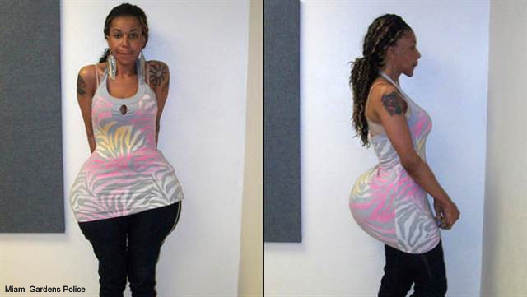
Health Care Concerns
Widespread self-medication with hormones
No clinical research on long-term effects
Widespread use of injectable silicone
“pumping parties”
Multiple risks including infections, embolisms, disfigurement and death

Slide 24
Born a Boy ….. Gender or sex
Identifies as a Girl ….. Gender identity
Transgender Female

Slide 25
Born a Boy ….. Gender or sex
Identifies as a Girl ….. Gender identity
Likes girls …. Sexual orientation
Transgender Gay Female

Slide 26
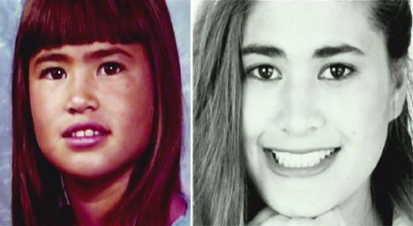
Story of Thomas Beatie
Born a girl -- Tracy LaGondino
Identifies as a male - Likes girls
Transgender heterosexual male
Legally becomes a male
Gets married

Slide 27
BUT wife is infertile - he gets pregnant
Transgender heterosexual pregnant man
1st "legally" pregnant man on record

Slide 28
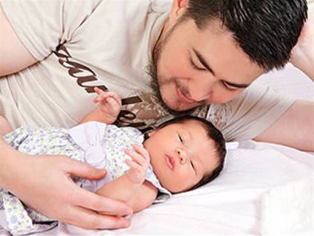

Slide 29
Resources
Educational Resources
Center of Excellence for Transgender Health, University of California, San Francisco, Department of Family and Community Medicine.
World Professional Association for Transgender Health (WPATH)
Gender Spectrum (trans youth focus)
www.latransadvocates.org/resources

Slide 30
Understanding LGBT Health and Healthcare Disparities
Thea James, M.D.

Slide 31
LGBT(Q)ueering?

Slide 32
?

Slide 33
Unspoken Rules of Oppression

Slide 34
Awareness
Notes:
34

Slide 35
Facts We Should Be Aware of
LGBT people are in all populations and communities
All races and ethnicities
All levels of socioeconomics
All ages
Throughout the United States and across the globe
Social inequalities can lead to health disparities

Slide 36
Inequities
Perpetual Discrimination and Stress
Stigma
Lack of Rights
Victimization
Low rates of health insurance coverage

Slide 37
Challenges for LGBT Individuals in the Healthcare System

Slide 38
LGBT Patients
Fear of discrimination
>1/3 do not disclose sexuality
Negative experiences with health care providers
Homophobia and silence in African American communities

Slide 39
Elderly and LGBT
Elderly LGBT people face barriers to good health because of isolation and a lack of social services and culturally competent providers

Slide 40
Deficits in Medical System
Lack of Provider and System Awareness and Education
Not user friendly, uncomfortable
Homophobia
Multiple missed opportunities
LGBT avoid the medical system
Provider Awareness, Education and Training not a “requirement” in healthcare organizations

Slide 41
Disproportionate Levels in LGBT Community
Substance use
Suicide
Psychiatric Disorders
Youth Homelessness
Obesity
Tobacco
Disease
Lesbians/Bisexual Women: Less Routine care and screenings than other women

Slide 42
How Healthcare Providers Can Improve LGBT Health and Healthcare Outcomes

Slide 43
Medical Education
Pre-clinical and Clinical years
5 hours: Average medical school curriculum dedicated to LGBT Health Awareness and inclusion LGBT health
Residency Training
Curriculum
Exposure to patients
Provider education

Slide 44
Boston U: MEDGlo
…….We are here to educate future and current health professionals on the social issues and health concerns of the LGBT community in order to break down prejudices and misconceptions that can undermine patient care and personal growth. We encourage professional and personal development through discussions, conferences, socials, community activism and advocacy………

Slide 45
Boston Pride Parade Award Winners

Slide 46
More….
Support
Coming out
Transgendered “transitions”
Self Education about resources
Self Evaluation: comfort, language, demeanor

Slide 47
Public Health Implications for LGBT Health
Ted Corbin, MD, MPP
Associate Professor, Emergency Medicine
Drexel University College of Medicine

Slide 48
CARE
Standards of care
Access to care
Provision of culturally sensitive care

Slide 49
STIGMA AND DISCRIMINATION IMPACT HEALTH
Direct routes:
Exposure to violence and discrimination
Poor clinical care
Indirect routes:
Inadequate attention to health concerns
Lack of knowledge of health issues
Insensitivity to cultural concerns

Slide 50
ISSUES IN PUBLIC HEALTH
Increased risk for disease because of unique exposures
High prevalence of disease or problems that are not caused by unique exposures
Require specialized culturally competent approaches

Slide 51
EVIDENCE
Lack of quality research
Methodological obstacles

Slide 52
The Prevalence LGBT Health Education &Training in Emergency Medicine Residency Programs: What do we know?
Joel Moll MD, Paul H Krieger MD, Benjamin I Lee MPH, Lisa Moreno-Walton MD MS MSC, Susan B Podolsky MD, Dustin N Hill MD MS, Ellen Slaven MD, Thea James MD, Theodore Corbin MD MPP Sheryl Heron MD MPH

Slide 53
Objectives
To determine to what degree LGBT health is taught in EM residency programs
To determine whether program demographics affect inclusion of LGBT health topics

Slide 54
Methods
An anonymous survey link was sent via the CORD listserv
LSU IRB approved
Instructions requested that Program Directors fill out
The 12-item descriptive survey
Number actual & desired hours of LGBT health issues in the past year
Perceived barriers
program demographics
State
Faculty employer type
Same sex domestic partner (SSDP) benefit availability
Presence of out LGBT faculty and residents

Slide 55
Response Rate By State
Washington
Montana
North Dakota
Maine
Oregon
Idaho
Minnesota
Vermont
New
Hampshire
South Dakota
Wisconsin
New York
Massachusetts
Wyoming
Michigan
Rhode Island
Connecticut
Nebraska
Iowa
Pennsylvania
Nevada
Ohio
New Jersey
Utah
Illinois
Indiana
Delaware
Colorado
West
Maryland
California
Kansas
Virginia
Virginia
United States
Missouri
Kentucky
North Carolina
Arizona
Oklahoma
Tennessee
New Mexico
Arkansas
South Carolina
Mississippi
Alabama
Georgia
Texas
Louisiana
Hawaii
0-25%
26-50%
51-75%
76-100%
Florida
0
500 Miles
0
500 KM
There were 124 responses , with a response rate of 78%
Notes:
INCLUDE

Slide 56
Demographic: Size Metro Area

Slide 57
Demographic: Employer

Slide 58
Demographic: Open LGBT

Slide 59
LGBT Curriculum in past year

Slide 60
Current vs. Desired
 | CURRENT | DESIRED
Mean | 0.75 | 2.23
Medium | .00 | 2.00
Standard Deviation | 1.382 | 2.099
Range | 0 to 8 | 0 to 10
*14.8% of Programs desire no time devoted to LGBT Health Curriculum

Slide 61
Barriers Reported

Slide 62
Significant Demographic Associations
Presentation of LGBT didactic lecture in past year and presence of known LGBT faculty
Support of LGBT didactic lectures and having presented LGBT lectures in past year

Slide 63
Significant Regional Associations
Mean number of didactic hours that should be devoted to LGBT issues at programs in the Northeast compared to South or West
NE Mean 3.17 (SD 2.3)
South Mean 1.75 (SD 2.0)
West Mean 1.73 (SD 1.4)
Having out LGBT residents as part of your residency program and region of the US
Northeast compared to South and West

Slide 64
Limitations
Survey Response Bias
Self Reporting by respondants
Some states had more responses than programs
Some characteristics could not be captured due to anonymous nature of survey

Slide 65
Conclusions
The majority of EM residency programs do not have curriculum specific to LGBT health
Most programs support inclusion of LGBT health curriculum
Barriers exist, most prominent is perceived lack of need
Further curriculum development is needed

Slide 66
Acknowledgements
CORD EM Program Directors
SAEM Academy of Diversity and Inclusion in Emergency Medicine
LSU IRB
LSU and Emory Emergency Medicine data analysis

Slide 67
Make a Difference! Join the ADIEM LGBT Subcommittee
Contact Joel Moll, MD Subcommittee Chair
molljoel@med.umich.edu

Slide 68
QUESTIONS
Contact Information
Paul Krieger MD: Pkrieger@chpet.org
Ellen Slaven MD: eslaven@aol.com
Thea James MD: tljlcj@gmail.com
Theodore Corbin MD MPP: Theodore.Corbin@DrexelMed.edu
Joel Moll MD: molljoel@med.umich.edu

