Slide 1
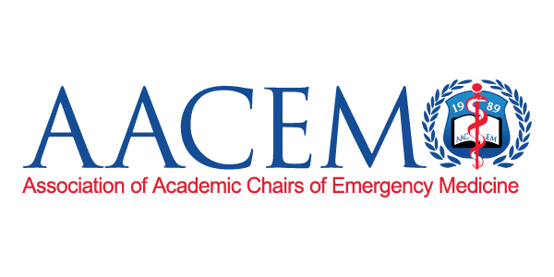
SERVICE LINE MODELS
How do they function and what are their advantages
Notes:
Structure
• How it formed or evolved
• Organizational resistance
• Challenges
• What works well and what doesn't
• Would you advocate for it or do it this way again?

Slide 2
A Service Line is a specific grouping or population of “like” patients and is based on patient encounter attributes
Through service line analysis, hospital leaders can use a wide range of data from multiple departments to understand the contribution that each line makes to the institution’s financial sustainability and position in the community. That analysis allows decisionmakers to understand how a given service line is affecting the overall hospital; how that service line compares to others; and how the line might be improved.
“ If you’re only providing the services that are the most profitable, you might not be doing the best service for the patient.”
Jill Horwitz, Professor of Health Policy and Management | University of Michigan School of Public Health

Slide 3
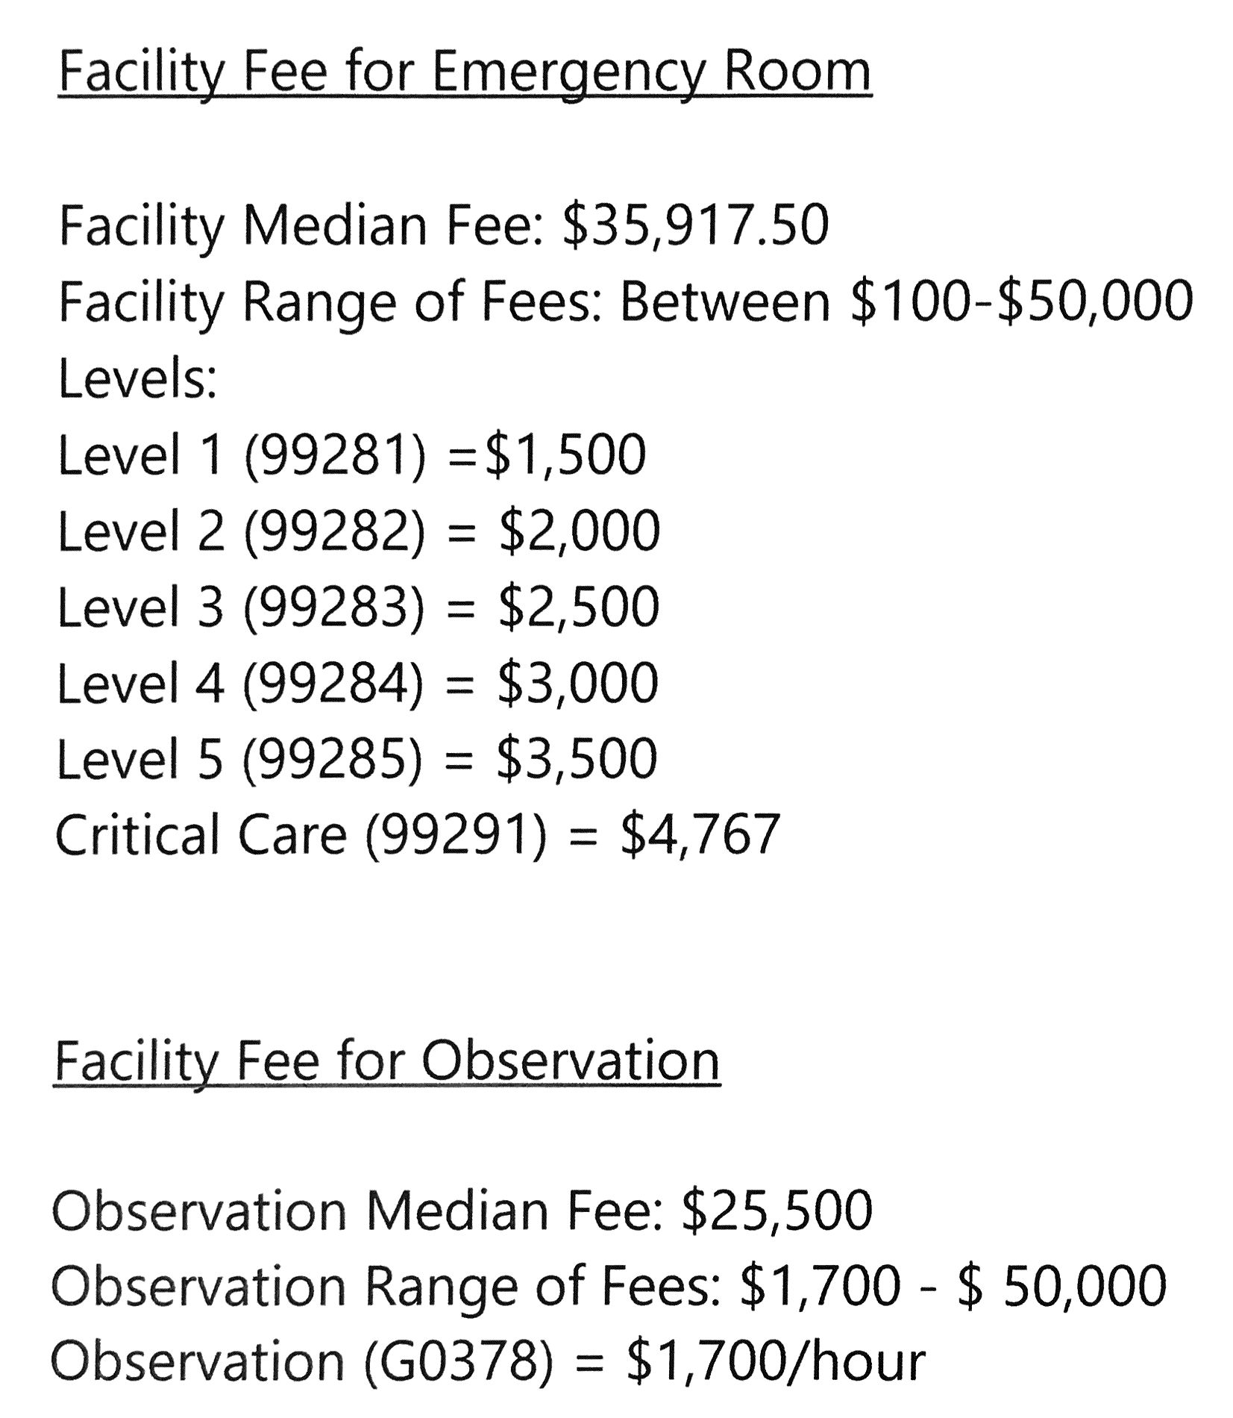
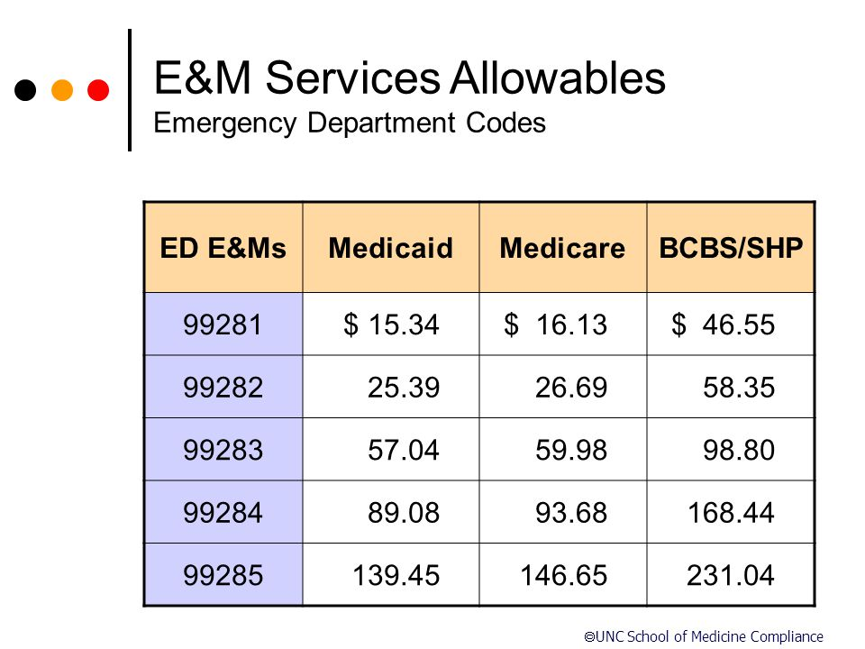
BUDGET (True service lines – Operations & Providers under 1 umbrella)

Slide 4
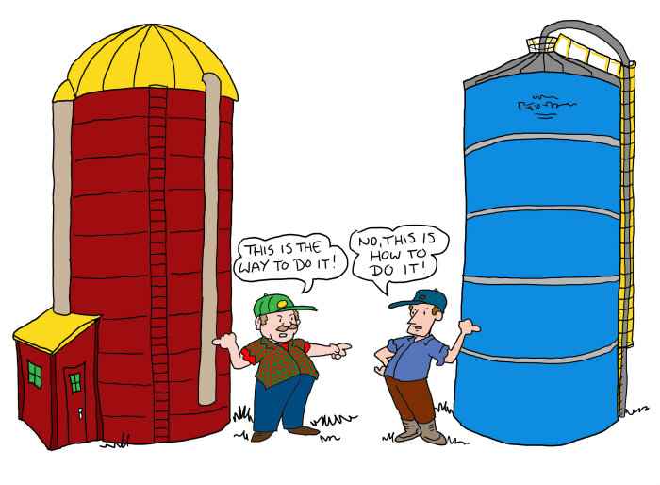

Slide 5
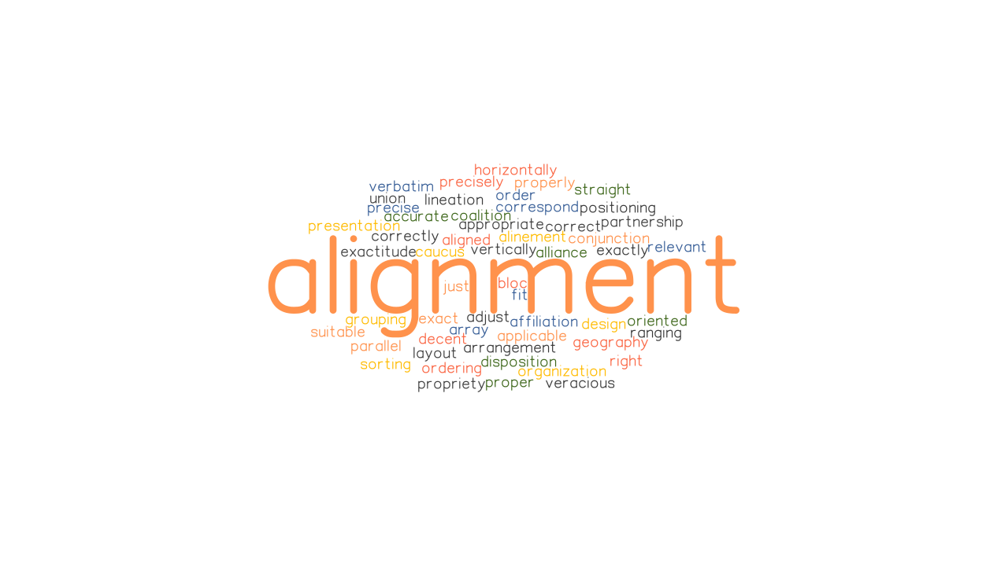
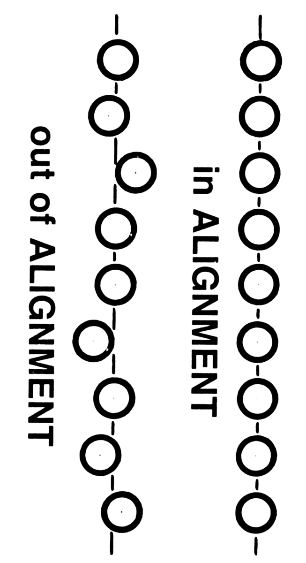
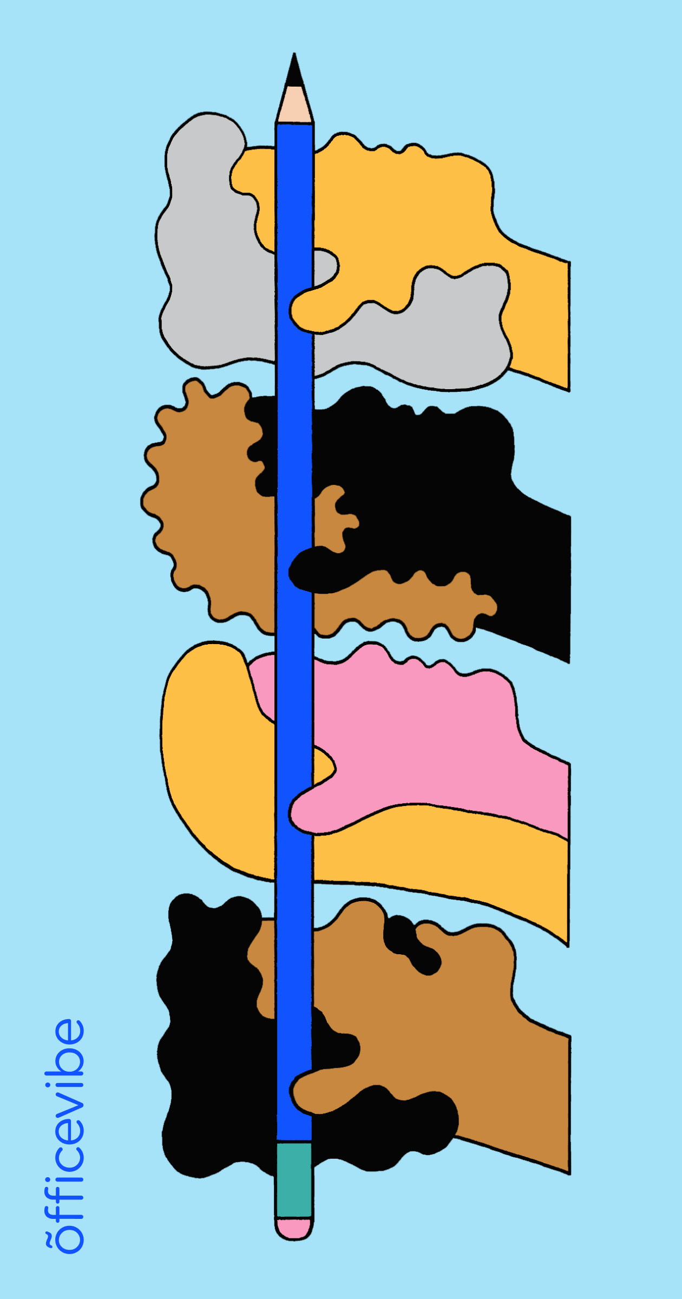
Culture eats strategy for breakfast.
Peter Drucker
Notes:
Structure
• How it formed or evolved
• Organizational resistance
• Challenges
• What works well and what doesn't
• Would you advocate for it or do it this way again?

Slide 6
University of Arkansas for Medical Sciences Service Line Models
A service line is a grouping of all products and services within a division to improve coordination of services for the patient.

Slide 7
How it formed or evolved
Clinical model: Starting in July 2014 UAMS to be redesigned its clinical enterprise around patient-centered service lines. From the beginning, 14 of the 16 lines were led by a physician and a triad of nursing, administration, and medical management. This shift to service lines was implemented to support an integrated, patient- and family-centered health care environment. The structure effectively and efficiently produced better health outcomes, enhanced the patient and family experience, supported clinical excellence, and is an outstanding way to promote interprofessional education and prepare UAMS students for team-based care. Since SL developed UAMS has made measurable improvements in quality of care, patient experiences, and fiscal efficiency. It stemmed from primary to specialty continuity of care, focusing on valued base care needs staying under one group.
Being outside of the operational c-suite, the service line leader can provide focused—albeit, agnostic—business planning and proforma exercises to review potential business additions to the hospital’s service offerings. The service line itself is not accountable for everything under the hospital roof like the CEO and therefore can be a great partner for smarter growth or divestment decisions.

Slide 8
Structure
Medical Specialties (Now Integrated Medicine)
Musculoskeletal
Myeloma
Neurosciences
Surgical Specialties Interventional
Emergency Medicine
Imaging
Lab/Pathology
Pharmacy and Therapeutics
Nursing
Primary Care
Behavioral Health
Cancer
Women’s Health
Ophthalmology
Transplant
Cardiovascular
InPatient
July 2014
July 2015
July 2019
October 2021
Future SL’s
UAMS has 19 SL’s, forming over the past 8 years

Slide 9
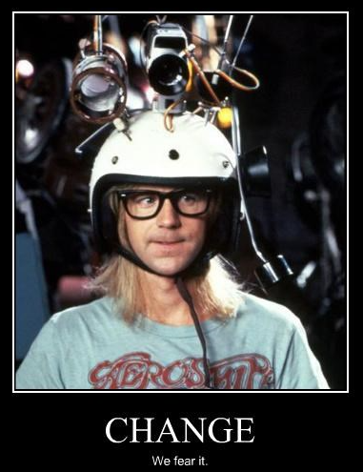
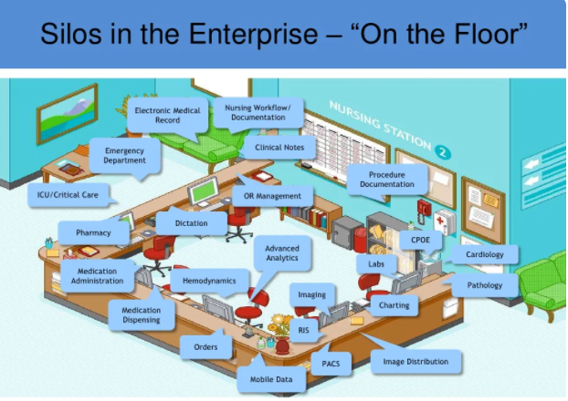
Organizational resistance
Some subspecialties felt they should be aligned w/ specific SL rather than the one they fell under. (i.e. GI fell under SURG SL, not IMSL)
Some support SL’s such as Nursing continued to manage some nursing subsets like IP but not OP.
CHANGE! We fear it!

Slide 10
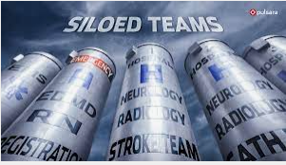
Challenges
Some SL approaches to value based care can be SILO’d
If the SL Director and the Chair don’t wear the same ‘hat’, same with the Administrator.
Supply Chain management system (i.e: for equipment purchases needs to funnel through an online approval that goes to compliance, legal, IT, leadership, space committee)
Some centralized services like HR lag time in hiring.
Payroll systems differ (KRONOS vs SAP which will soon transition to Workday)
Communication

Slide 11
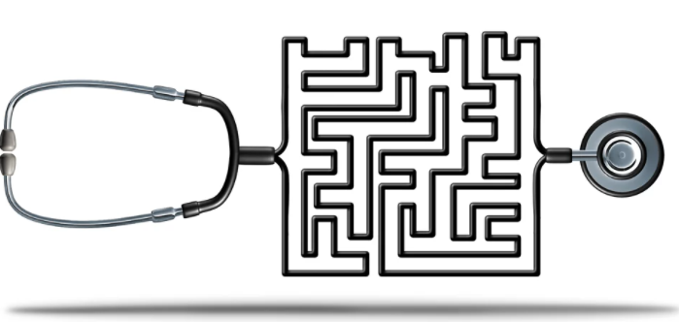
Challenges
EM is on it’s ‘island’, not the same as the other SL’s so working with SAEM benchmark data helps us w/our annual 30 sec elevator speech ☺.
Differing Scheduling systems used (i.e: KRONOS for nursing, PRNS docs, ShiftAdmin for Residents, APPs, Attendings and UAMS system transitioning to Qgenda).
Centralized Coding and Billing presents delays when a SL is trying to make positive revenue impacts w/in their SL.
Alignment of our regional programs are still a challenge due to slower system conversions (EPIC/Workday), various reporting structures, and geographic challenges.

Slide 12
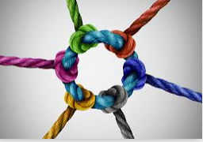
What works well and what doesn't
Works well if
SL alignment w/University mission, vision & values. (i.e. V2029 Plan)
Identifying current & planned patient pathways: analyzing existing pipelines in each SL and understanding how to best reach those pts. by also future forecasting shifting demographics and market conditions.
Data analysis to help benchmark for internal financial and operational performance.
Better ownership and increasing entrepreneur spirit
Supply tracking/controls working w/in SL

Slide 13
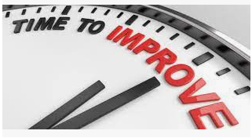
What works well and what doesn't
Needs improvement
More synergy between COM and ICE
Better succession planning
Better recruitment of ‘needs’ (i.e. clinical leaders vs. education ones)
Sharing doctors across SL’s (i.e. CC/EM doc split between two SL’s)
Denial reporting (i.e. infrequent mtgs, staff turnover, info lacking)
Space wars

Slide 14
Would you advocate for it or do it this way again?
ABSOLUTELY! Because….
Most patients don’t understand the health care system at all, much less think about it in terms of sophisticated organizational structures. SLs can address patient confusion or uncertainty by coordinating the efforts of medical professionals all along the continuum of care – from access to diagnosis to treatment to evaluating outcomes.
SL can overcome work flow waste and unexplained variations in clinical processes and operations.
SL’s provide an environment that informs and empower leaders, strategists and decision makers at every level: enterprise, hospital, service line, care setting, department.
SL’s help promote the intelligent and proactive use of existing and emerging information assets from diverse sources and aides in fostering new innovations.

