Slide 1
Emergency Medicine Community Survey: Helping Chairs and Administrators Connect
Robert Levine, MD
J. Jeremy Thomas MD, MBA
Michelle Aguirre, MPA
AACEM Community Workgroup Membership

Slide 2
Membership
Networking Committee - Community Workgroup
Lewis S. Nelson, MD, Chair Robert Levine, MD- Chair
Richard J. Hamilton, MD Adam Algren, MD
Robert L. Levine, MD Chad Cannon, MD
Susan A. Stern, MD Terry Kowalenko, MD
Stephen Traub, MD Nicole McCoin, MD
Richard E. Wolfe, MD Robert Neumar, MD, PhD
Kat Nagasawa, MBA - Staff Liaison Andrew Nugent, MD
Snizhana Kurylyuk - Staff Liaison J. Jeremy Thomas, MD, MBA
Michelle Aguirre, MPA- Staff Liaison

Slide 3
History
Goal: enhance member interaction, help new members acculturation into the organization
New member welcome
Chair Mentorship program (under-utilized)
Yearly meeting- opportunity to increase local and regional collaboration
Internal and external opportunities

Slide 4
History
Initial project identified by group:
Provide an easily searchable database
Enable chairs to identify those with similar practices and expertise that could serve as a resource to help new chairs to establish their own program(s)

Slide 5
Data Collection
Initial survey done at 2021 AACEM/AAAEM Joint Retreat
Data collected and scrubbed
122 chairs surveyed
67 responses
55% response rate

Slide 6
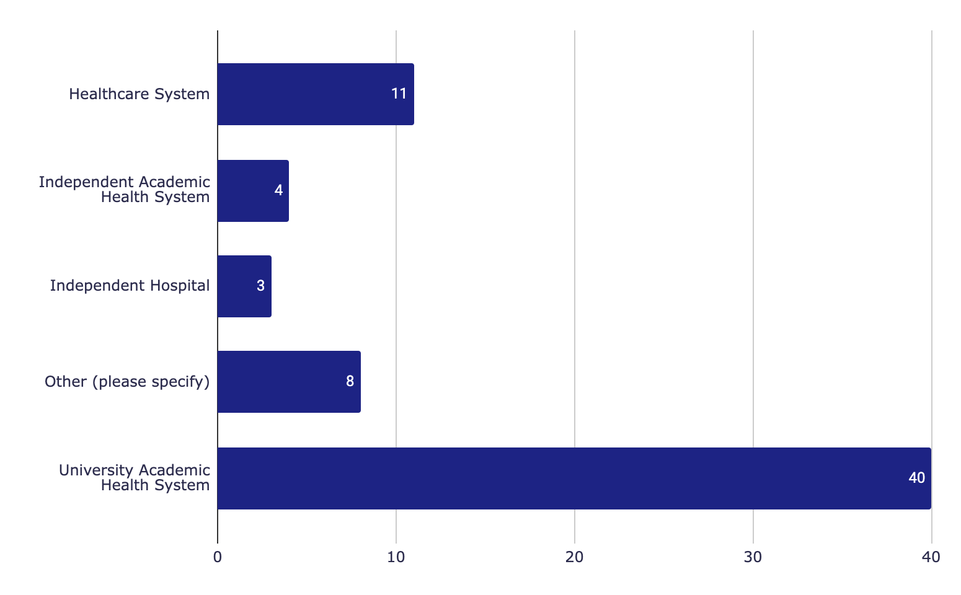
Which entity is your residency program based in?
Other (please specify)
County Affiliate of University AHS
Department of Defense university with a medical school but the Department of Military & Emergency Medicine does not administer EDs in the Military Health System (MHS)
Have 3 affiliated residency programs in different health systems
I have multiple programs affiliated with my department but not managed by my department
Los Angeles County
Medical School
Ochsner is affiliated with University of Queensland (clinical years are spent on our campus).
The Drexel Department of Emergency Medicine is the Academic Department for 7 regional campuses and affiliate sites. Three of those sites have Residency Programs and Fellowships run by the associated health system. The remainder of the survey will pertain to the Crozer Health Emergency Medicine program where I am the System Chair

Slide 7
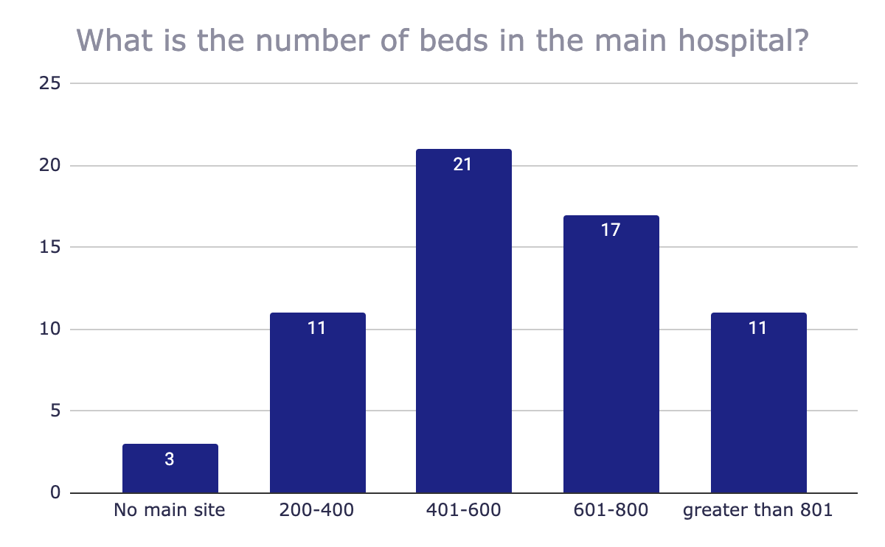
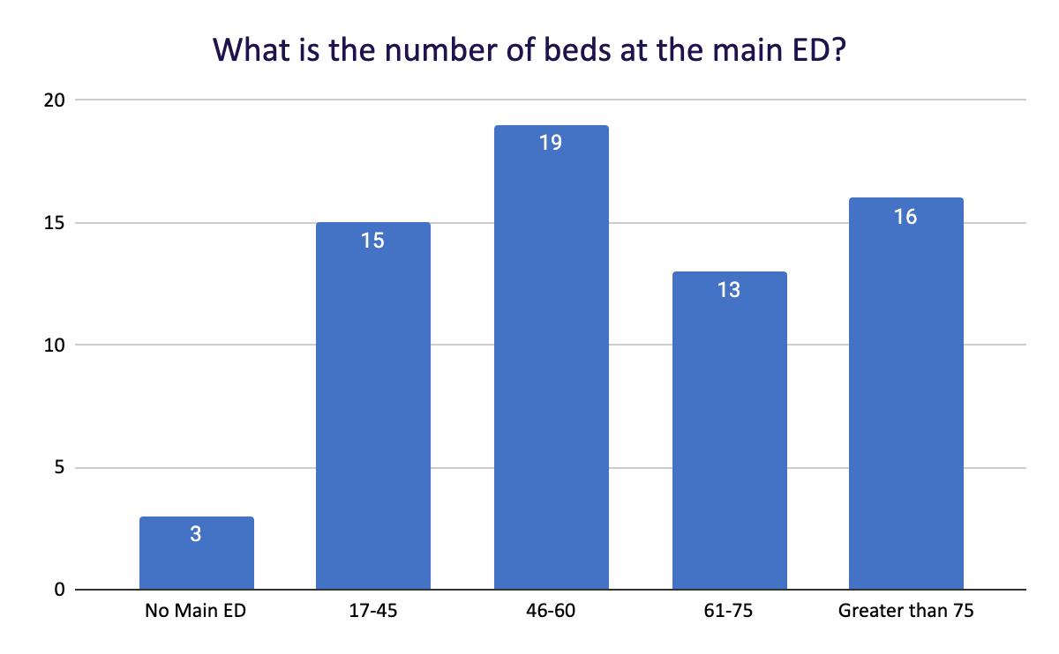
Bed and Patient Volume

Slide 8
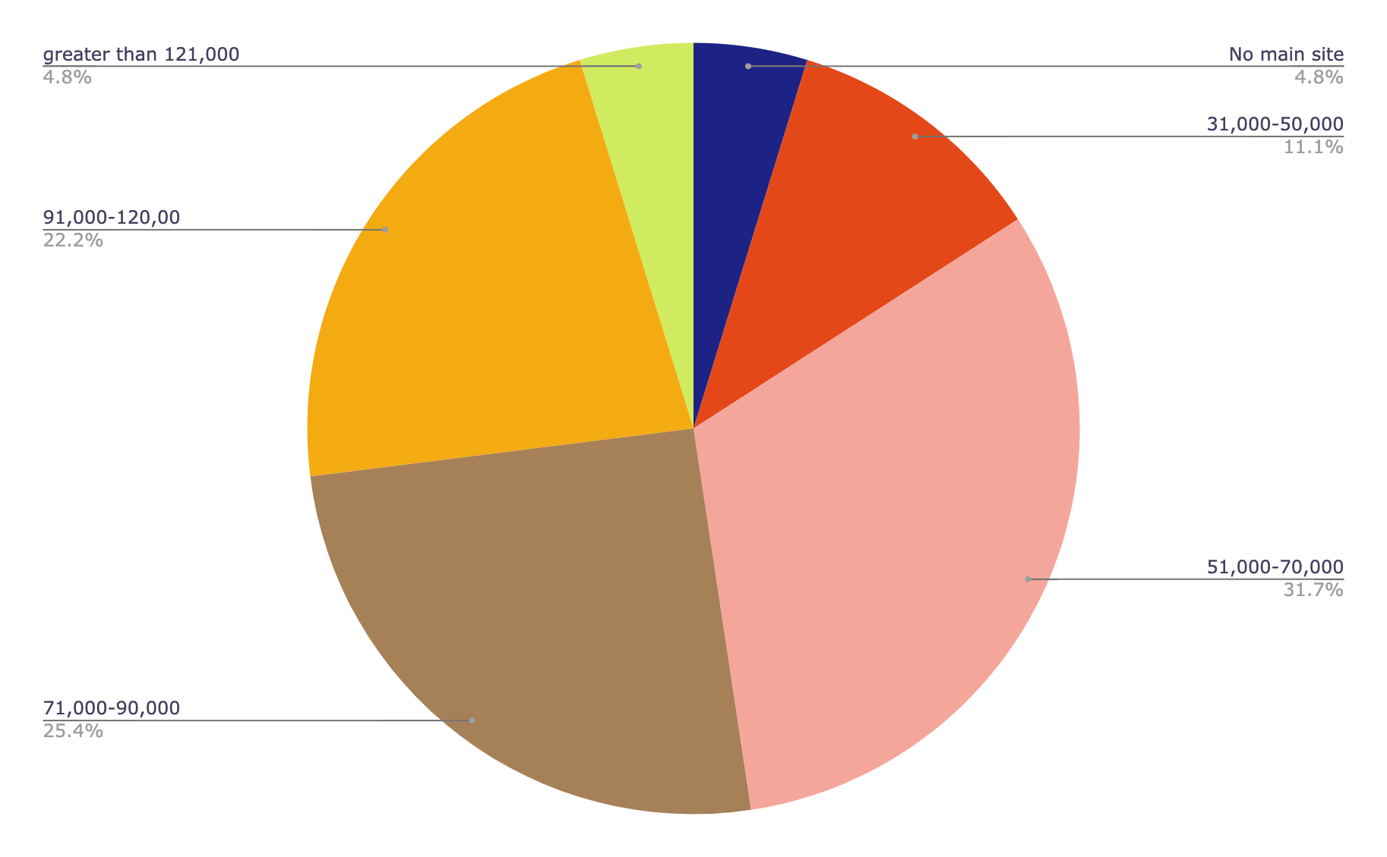
What is the number of patient visits at the main ED (per year)?

Slide 9
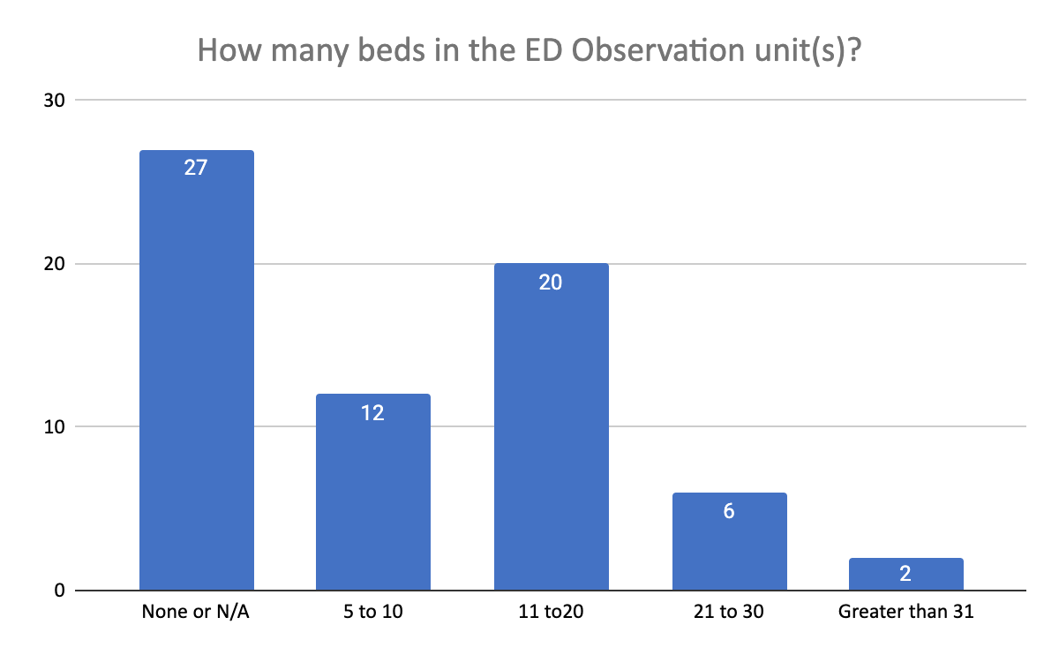
Observation Unit in ED
Does your emergency department/hospital have an Observation unit?
Yes | 64.2%%
No | 32.80%
N/A | 3%

Slide 10
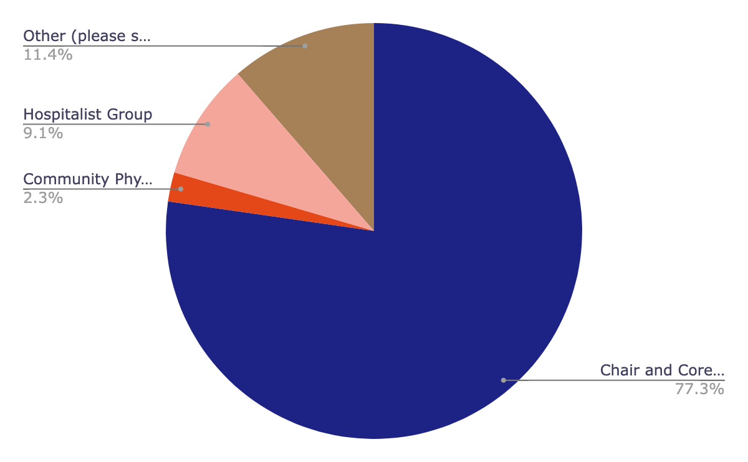
Who runs the ED Observation unit(s)?

Slide 11
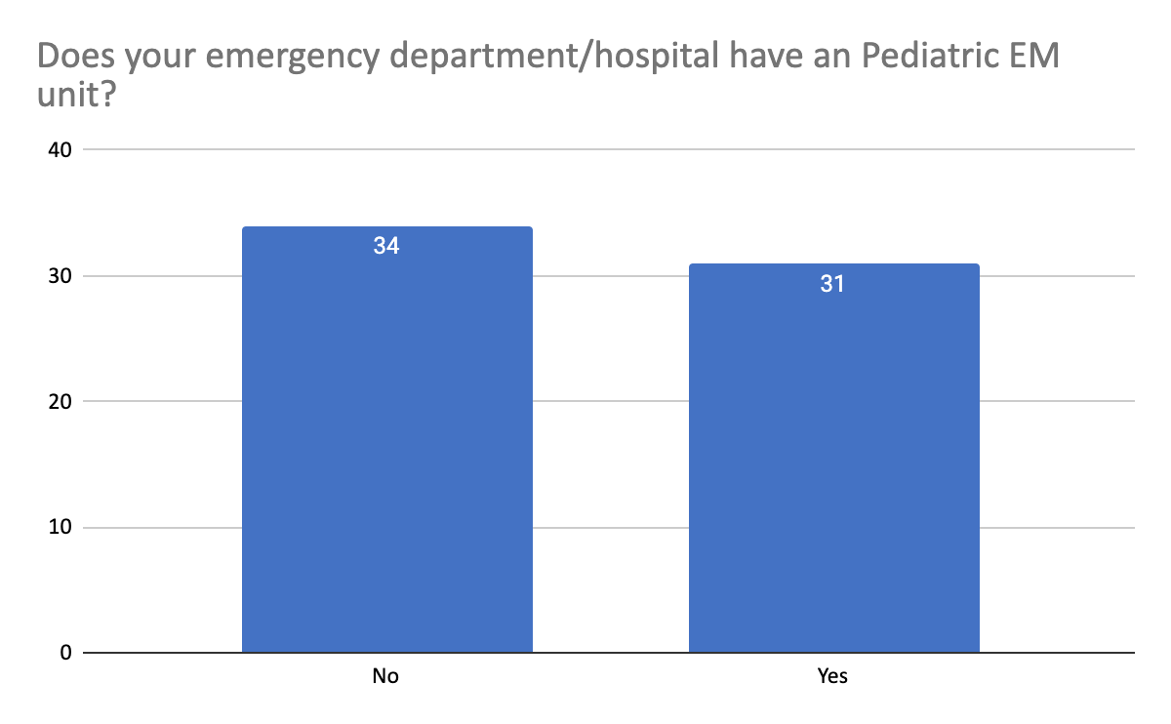
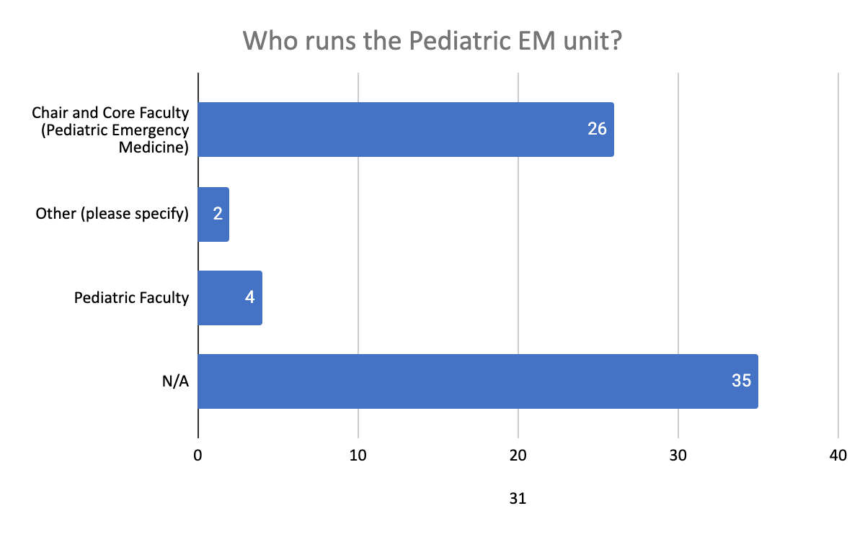
Pediatrics in the EM Unit

Slide 12
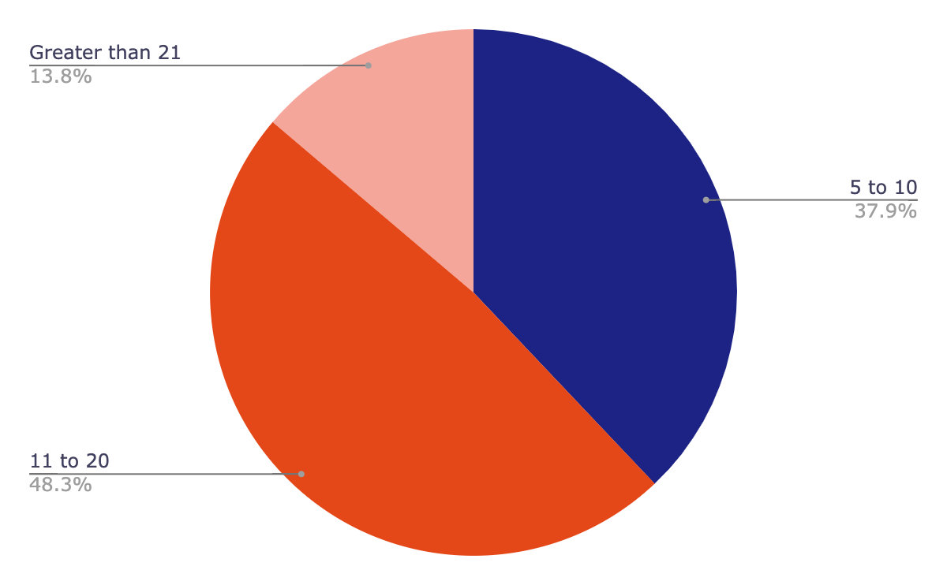
How Many Beds Pediatrics in the EM Unit ?

Slide 13
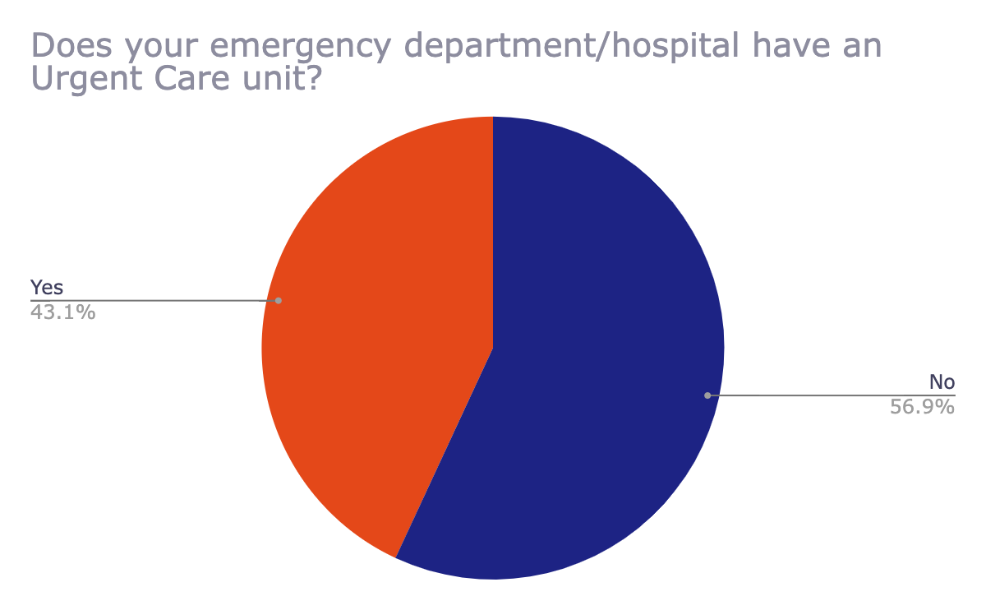
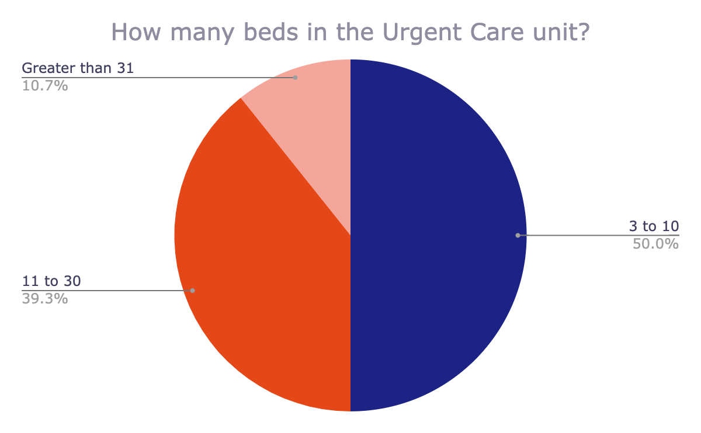
Urgent Care Units

Slide 14
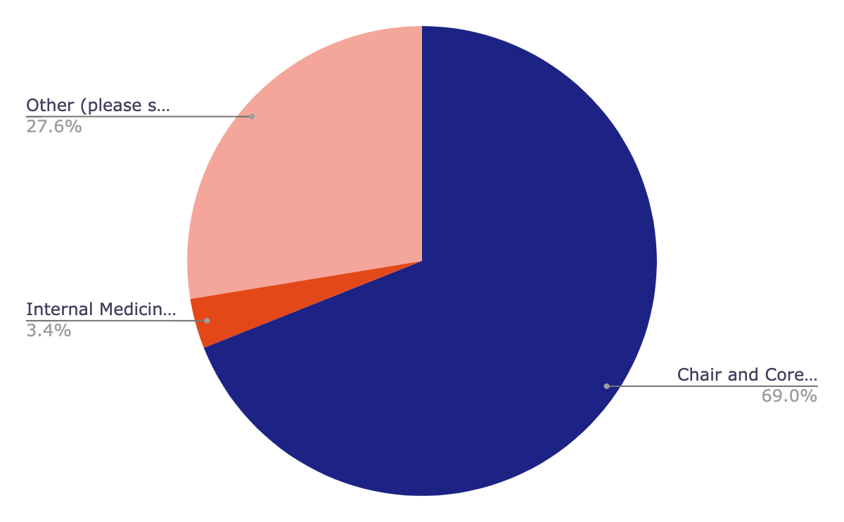
Who runs the Urgent Care unit?
Other:
Chair with community providers
Department does not run an ED
ED APP's
Emergency medicine faculty globally
Family Medicine
Family practice doc employed by health system; staffed by APPs
Hospital staffed physicians of varying specialties
Joint venture

Slide 15
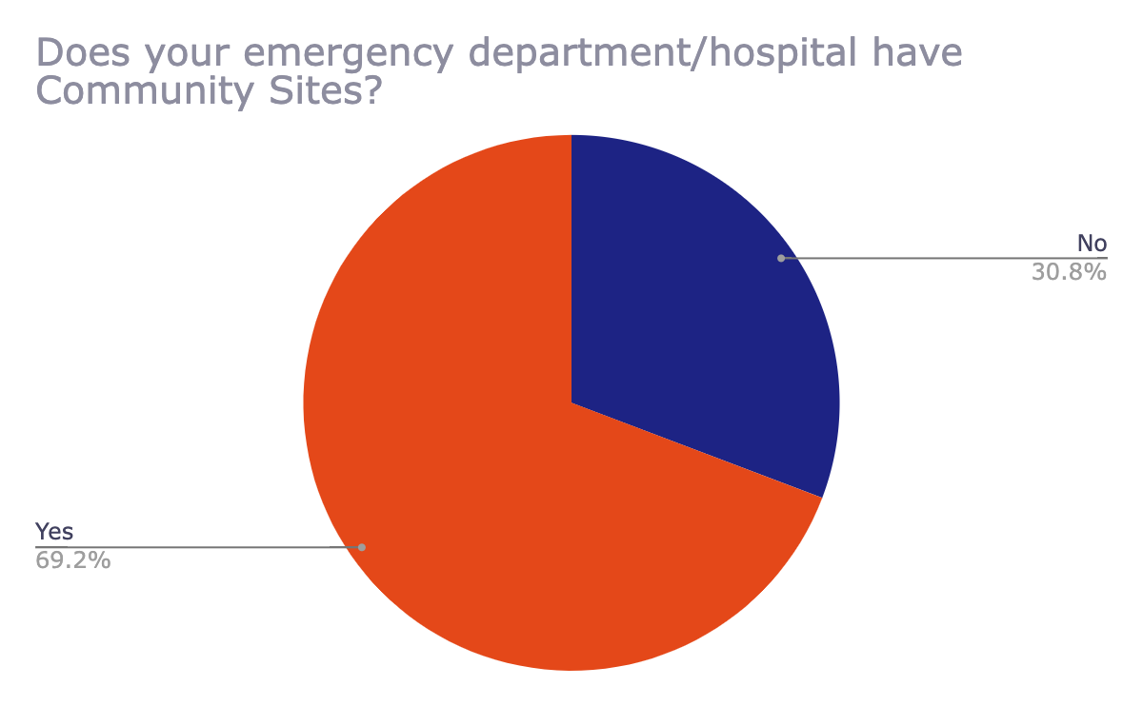
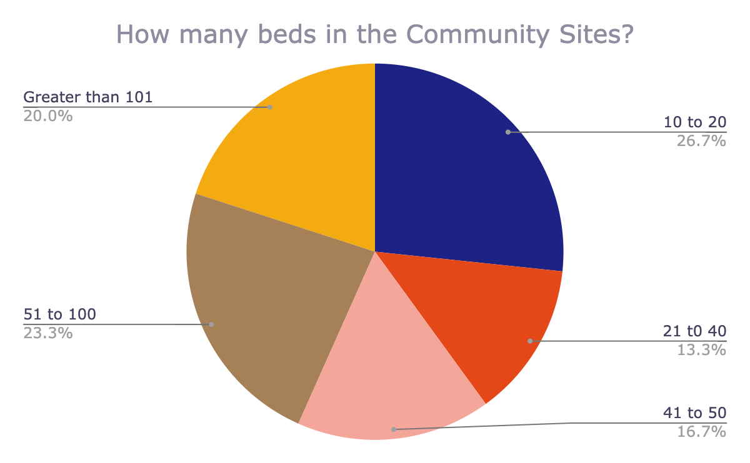
Community Sites

Slide 16
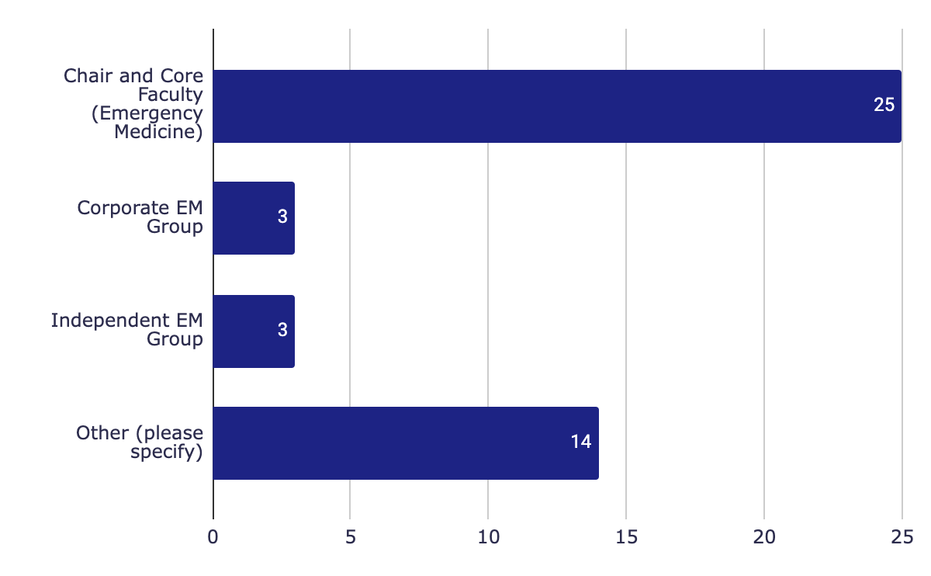
Who runs the Community Sites?
Various combinations of above

Slide 17
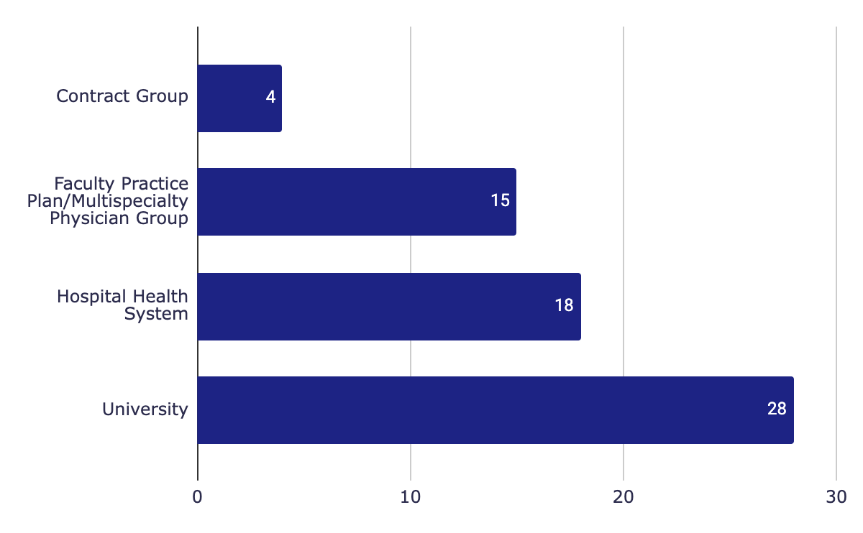
Who employs the Chair, Core Faculty, Clinical Faculty, and Non-core Clinical/Academic Faculty?
Other, please specify
An independent non-profit foundation that is a single specialty organization
Chair has a 20% FTE through University, 80% through hospital. All other faculty are 100% hospital employed.
For the main ED and the FSED, and one of the community sites, they are employed by the physicians practice plan (multispecialty). One of the sites employs the physicians by the hospital. We are working to bring those physicians under the practice plan so that we have some standardization at all sites.
Medical School
Mix of all above
Private practice group- all serve as volunteer faculty for the medical school
US Department of Defense

Slide 18
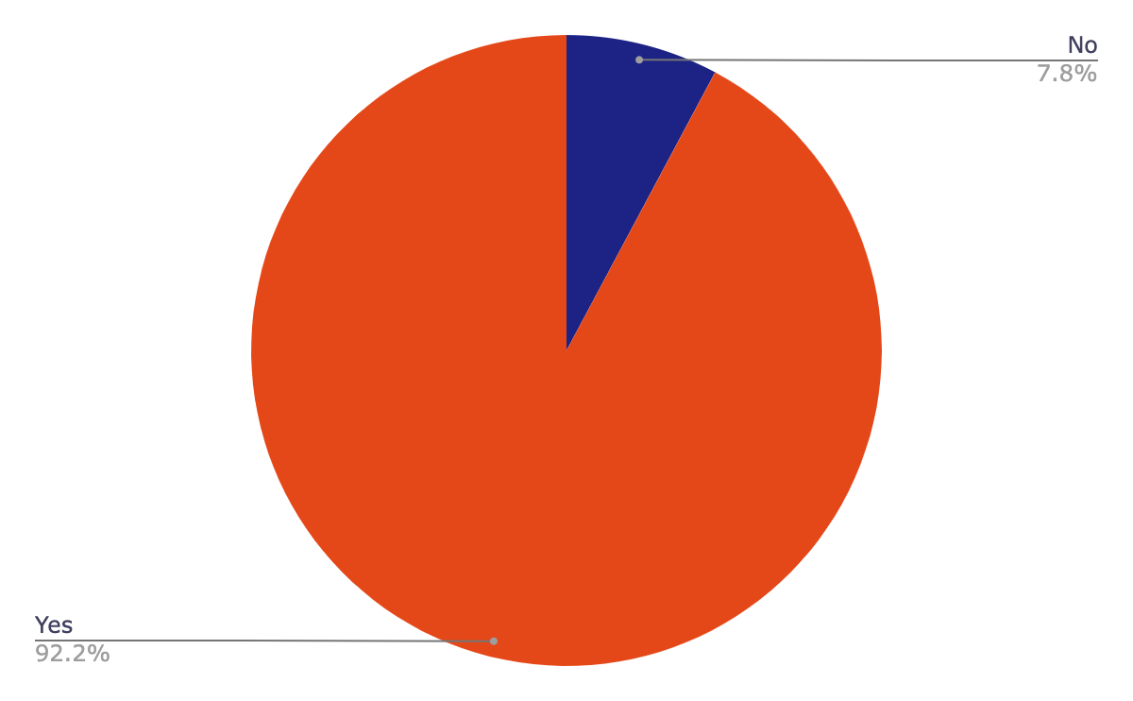
Are the Chair, Core Faculty, Clinical Faculty, and Non-Core Clinical/Academic Faulty employed by the same entity?

Slide 19
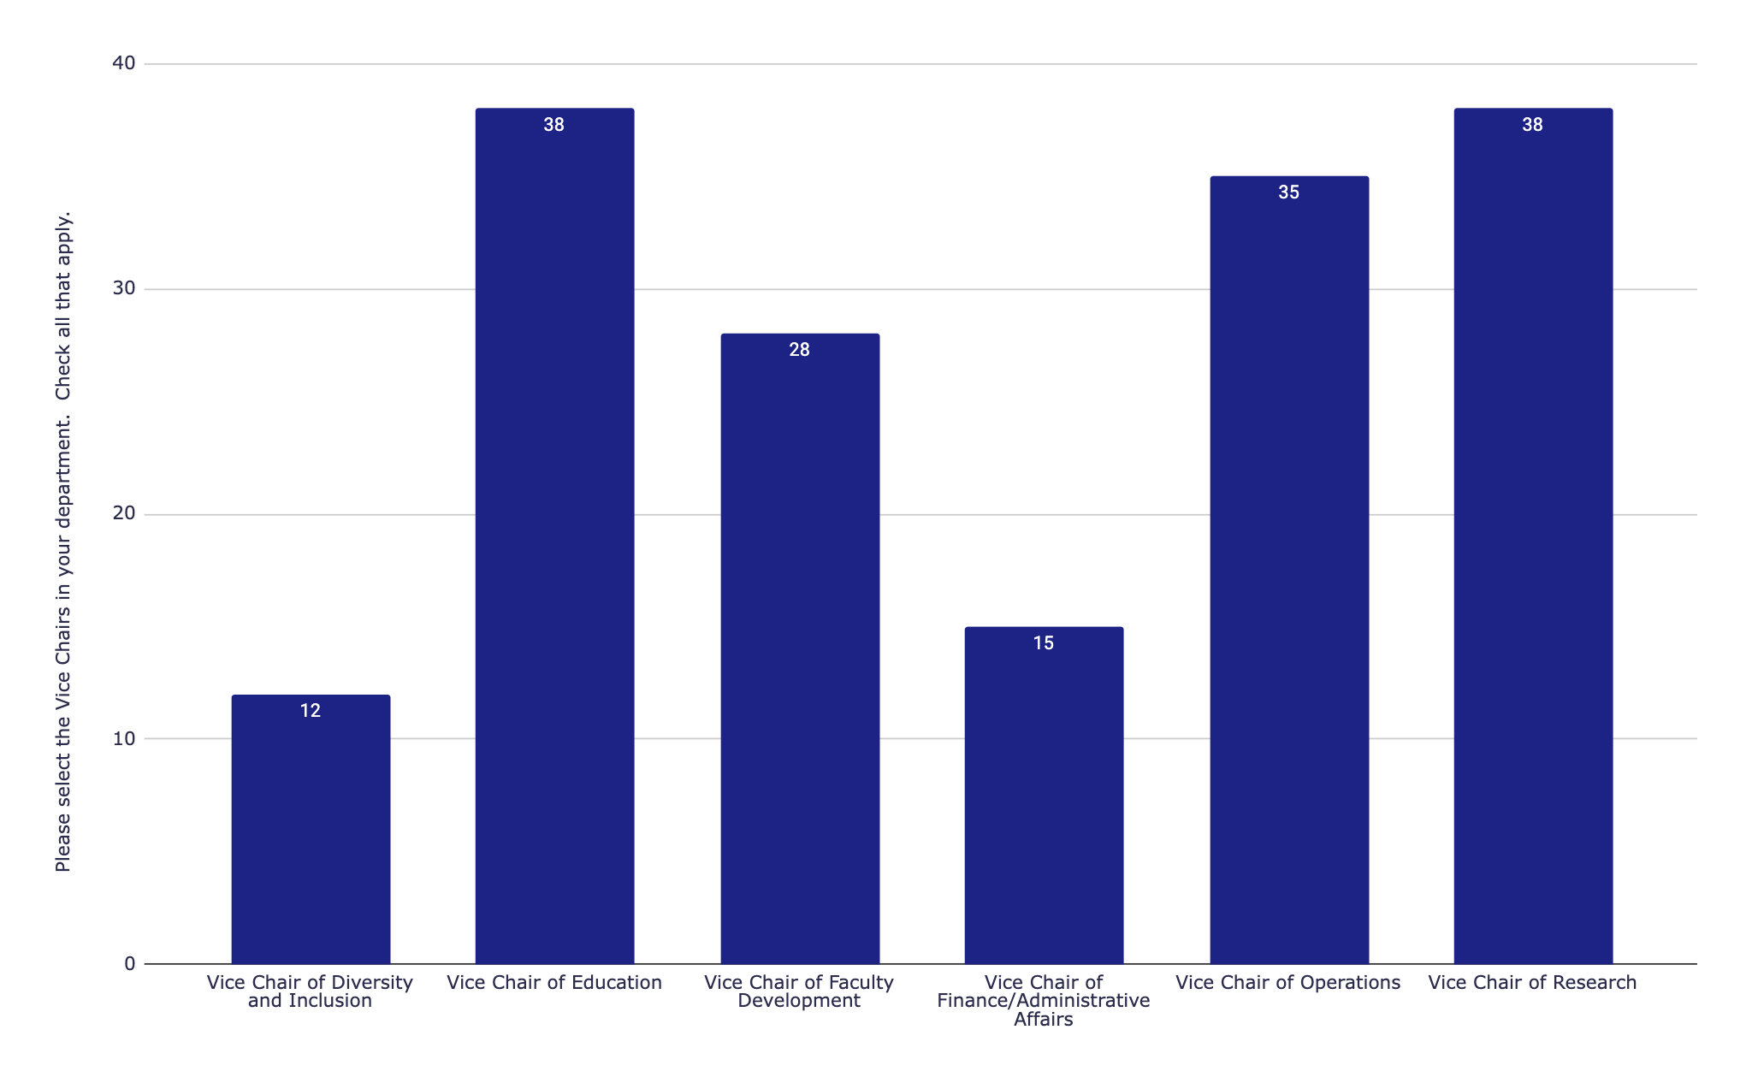
Please select the Vice Chairs in your department

Slide 20
Vice Chairs- Other
Vice Chair of Strategic Initiatives and Innovation
Executive Vice Chair
Vice Chair Pediatric EM
Quality and Safety/Performance Improvement/patient experience
Strategy and Growth
Vice Chair of Academic Affairs/Development
Vice Chair of EM
Vice Chair of Critical Care and Resuscitation
Vice Chair of Clinical and Faculty Affairs
Vice Chair of System Integration
Associate Vice Chairs with two year rotations

Slide 21
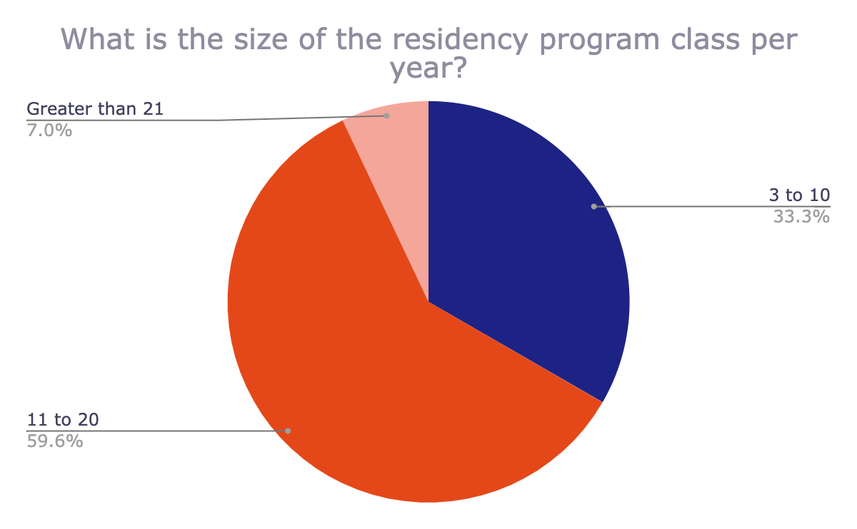
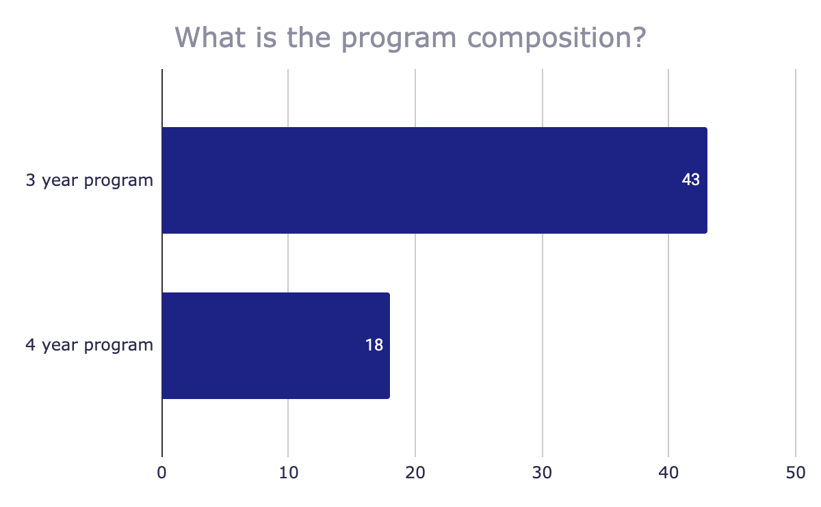
Residency class size and program composition

Slide 22
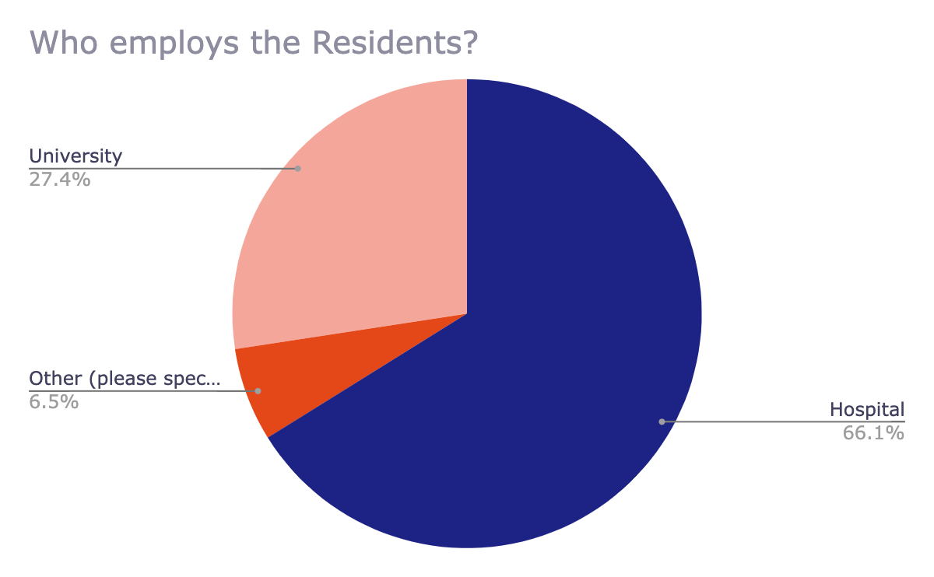
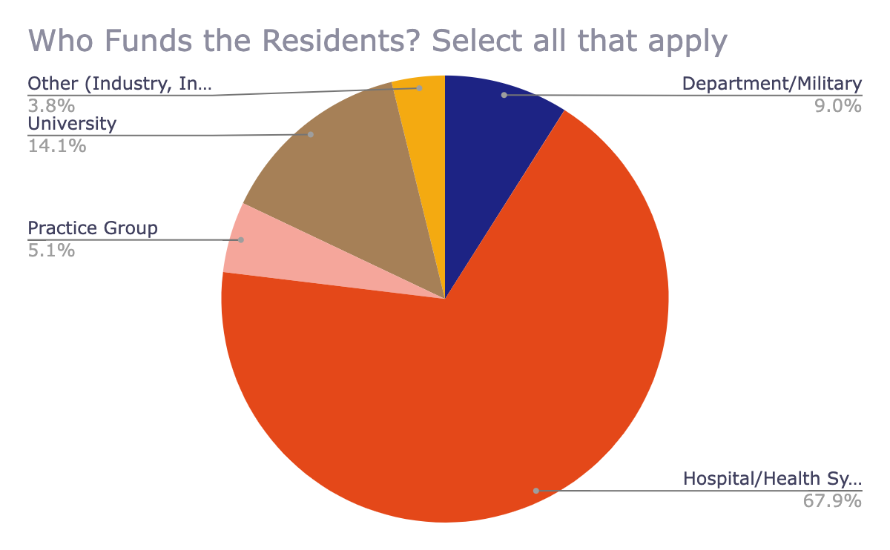
Resident Employment and Funding
Other:
Industry
International
Institution
State
VA
IHS

Slide 23
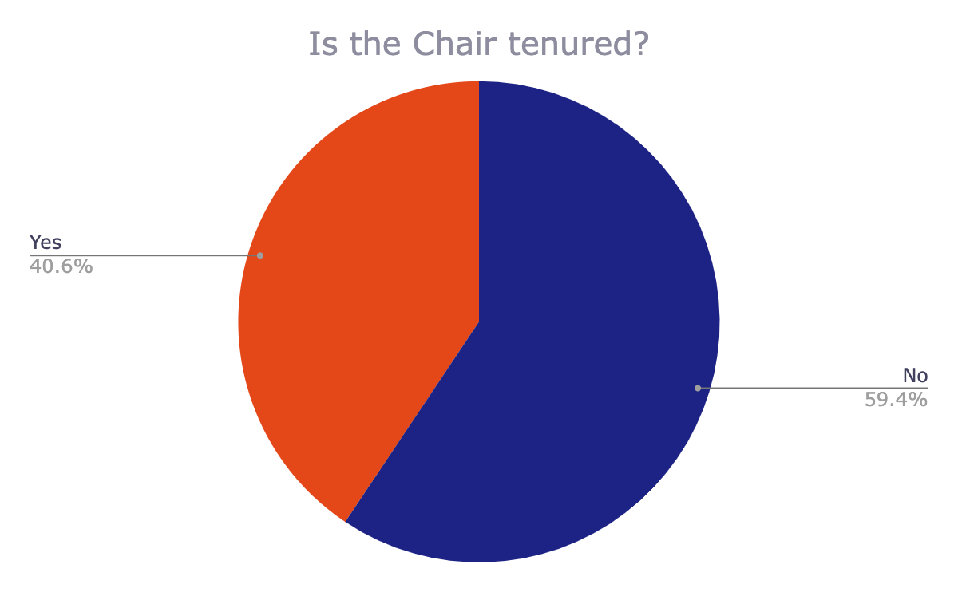
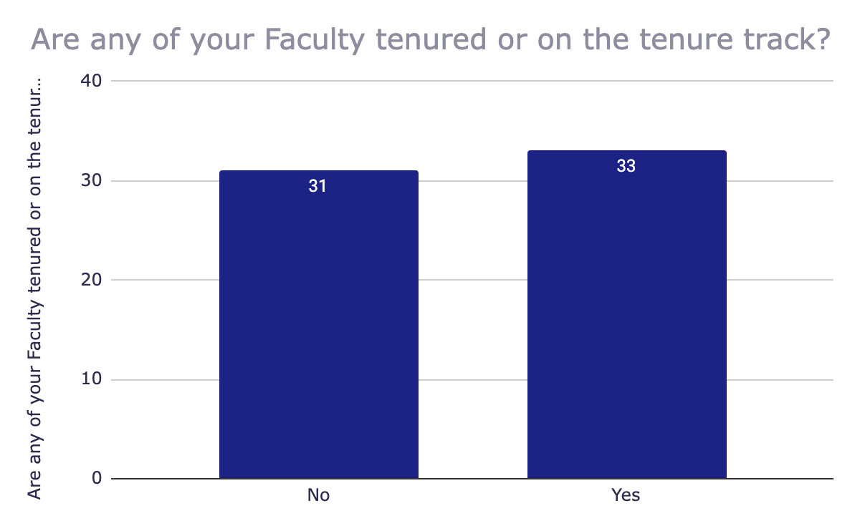
Chair and Faculty Tenure

Slide 24
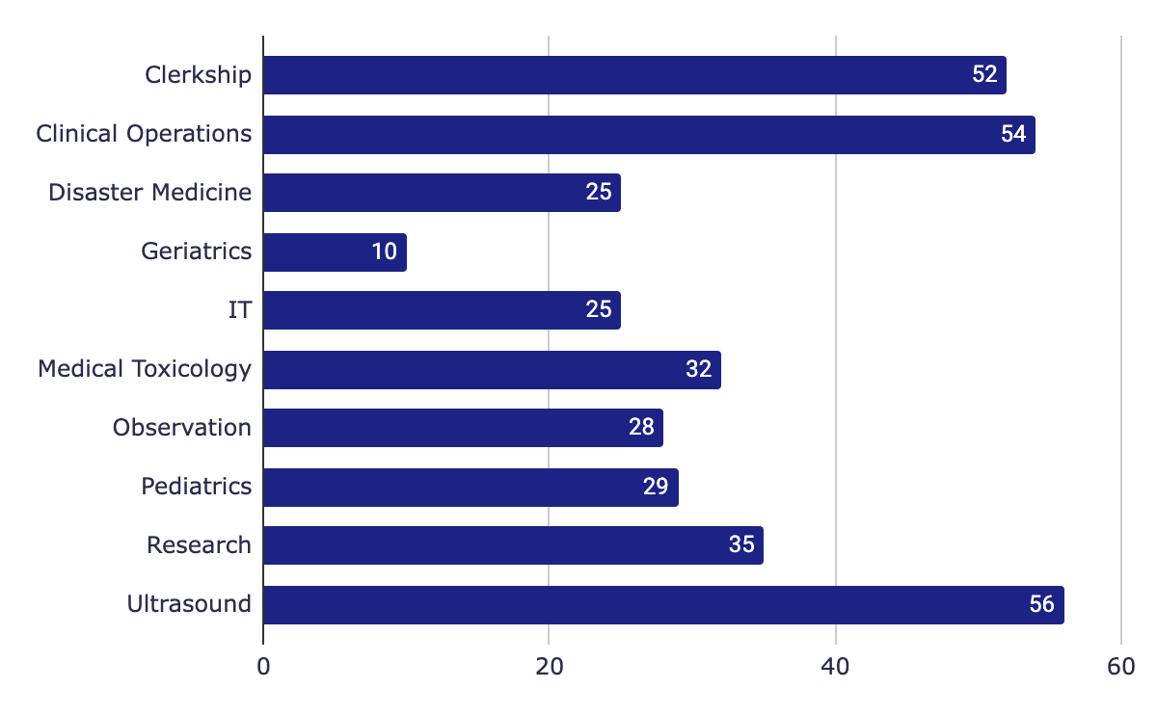
Medical Directorship(s) in ED

Slide 25
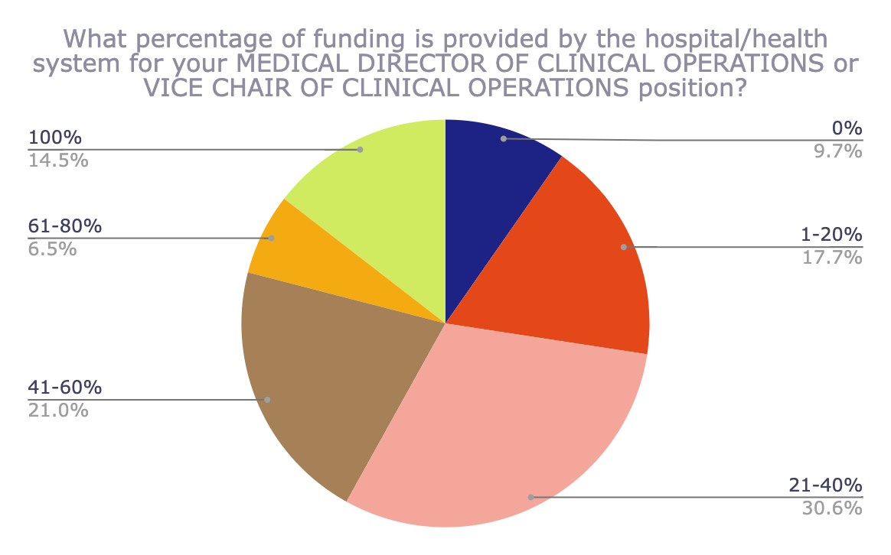
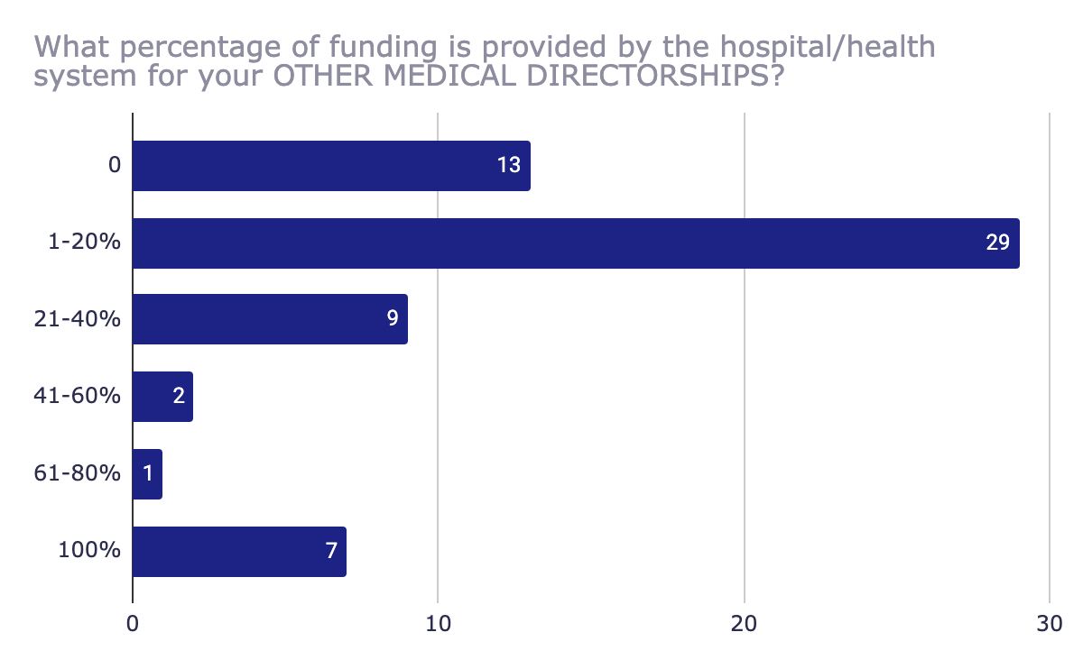
Percentage of funding provided by hospital/health system

Slide 26
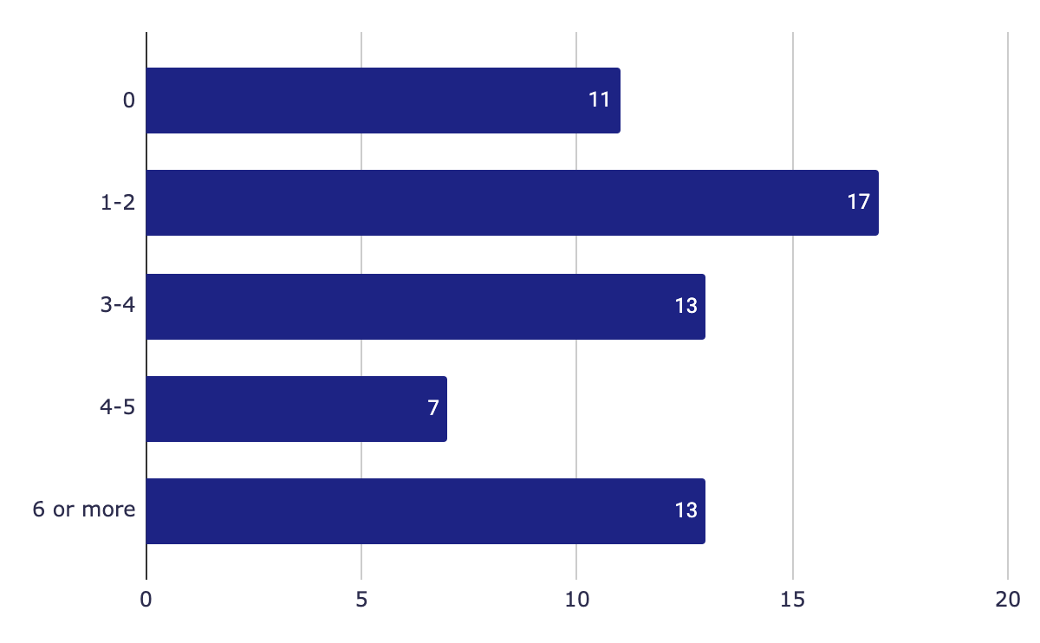
How many affiliate sites do you have?

Slide 27
Please list the primary areas of basic science/laboratory research program(s) in your department. If none, enter N/A.
Heart disease/ischemia reperfusion, limb ischemia: 8
Sepsis/inflammation/ID, mitochondrial dysfunction, Bio markers, Covid: 9
CPR, resuscitation: 7
Pain/addiction : 5
Burns, heat injury: 2 also hyperbaric medicine, wounds, blast injury
Hemostasis, sickle cell disease
Hypertension, preeclampsia
CVA/TBI
Health policy , EMS
Pulmonary endothelial disease:2, ARDS: 2, shock/critical care
Joint injury
Data science, computational med, AI
Device development/POC testing
Genomics, vivarium, toxicology

Slide 28
Please list the primary areas of clinical/health services research program(s) in your department. If none, enter N/A.
Research Categories/Frequency:
Heart disease/ischemia reperfusion, Limb ischemia: 8
Sepsis/inflammation/ID, Mitochondrial dysfunction: 7
CPR, Resuscitation: 6
Pain/addiction: 4
CVA/TBI, Hypertension, Preeclampsis, Burns, Heat injury,Hemostasis, Sickle Cell Disease: 2
Pulmonary endothelial elasticity, ARDS, Biomarkers for Sepsis and post cardiac arrest, Shock/Critical Care/ARDS/pulm endothelium, Covid Wounds, Blast injury, Opioid effect on brain, Health policy, EMS, Joint injury, Data science, computational med, AI, Device development/POC testing, Genomics, Vivarium tox, Hyperbaric medicine: 1

Slide 29
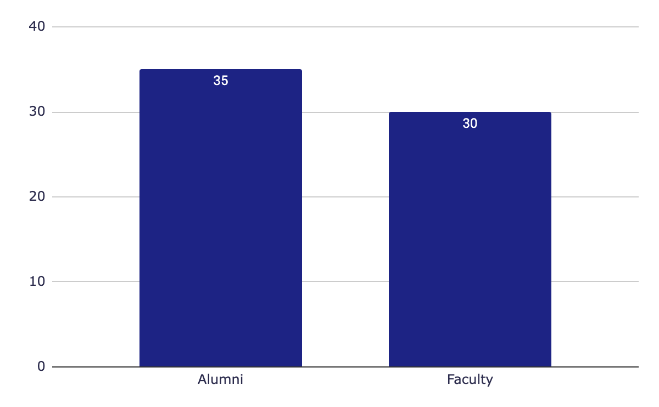
What are your sources of funding? Select all that apply
Summary of write in responses
No philanthropy/Self-funded:4
Community Donors:4
Foundation friends:2
Federal/state/local:2
Endowment Fund:2
Federal/state/local:2
Annual Philanthropy Fund: 1
Corporate Donors:1
Grants:1
Specific interest individuals:1

Slide 30
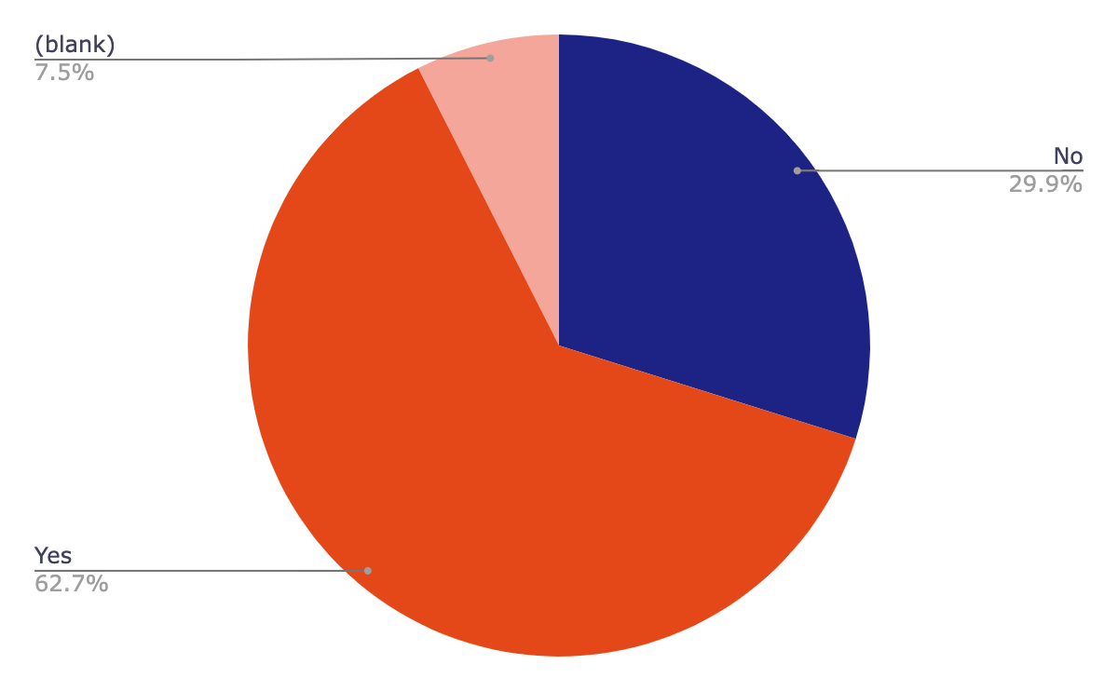
Does your department have access to a FT or partial FTE dedicated philanthropic officer?

Slide 31
Philanthropy
Limitations on the use of philanthropic monies:
Institution guidelines: 8
Award/Gift restrictions: 6
No limitations: 5
Government Regulations: 4
Funding flow between hospital and medical school: 2
Inadequate funding: 2
Philanthropic giving not allowed by institution:1

Slide 32
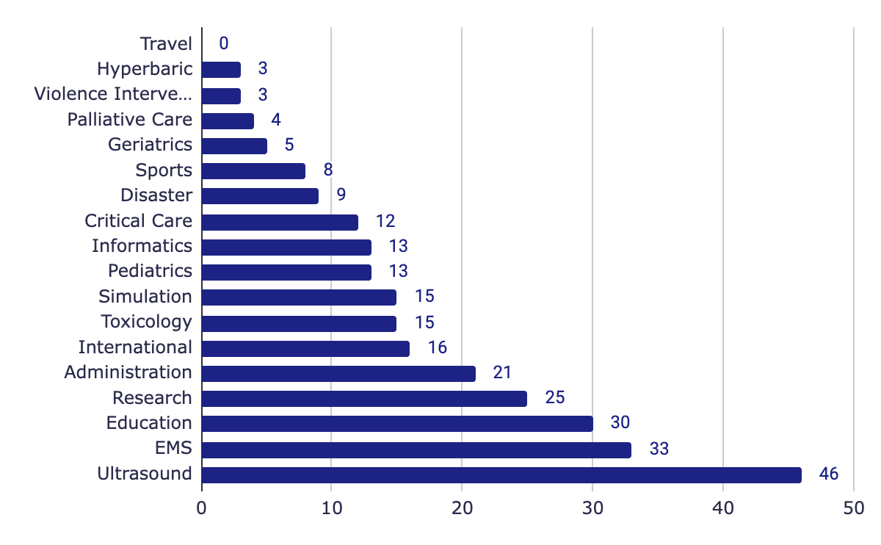
Select the Fellowship Program(s) available in your department.Check all that apply
Other:
Addiction Medicine
Advanced Airway
Global Health
Wilderness Medicine
Innovation
Health Equities
Public Policy
Advocacy Observation Medicine
Social Medicine
Telehealth
Health Care Policy

Slide 33
Discussion:
Residency Program variations
Tremendous number of unfilled positions this year
Most at HCA facilities
Implication?
Funding models
Employment models
Fellowships
Future directions / trends in Academic EM
Workforce issues and how we respond

Slide 34
Future Directives of the Group:
Archive of common lectures / presentations for AACEM members to access and pull from.
Regular (quarterly? biannual?) Regional Chair networking opportunities.
topical
virtual (Zoom)
optional

